Slide 1
Paper figures — editable
Every box, arrow and label is a PowerPoint object; photographs and renders are pictures

Slide 2




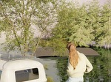



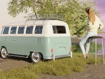

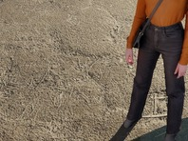
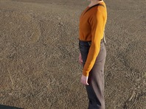
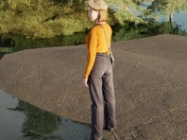
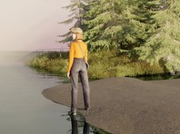
Fig. 2 — Method overview
a
Self-labelling data engine
b
World camera action model
p
tok
…
VLM expert
Qwen3-VL-8B · frozen
profile prompt
K,V
subject
joint attn · T‖ V‖ A
start o₂₆
ℰ
z⁰
Q,K,V
w₁
clean
World-action expert
ô_{s+4}, ô_{s+8}
w₂
o_{s}
o_{s+1:s+8}
trained
w₃
z^{1:2}_{τ}
W^{G}_{qkv}
v̂_{z}
end o_{g} (g=4)
τ
noisy
𝒟
ε~𝒩(0,I)
FFN^{G}
v̂_{a}
Δ t
W_{a}
×8
+ emb(τ)
R_{6D}
no reward, no human label:
from the mesh
a_{τ}∈ℝ^{8×10}
×36
shoot
every frame a flight reaches is a goal
label p(o_{g})
T
V
A
â: 8 tokens × 10-D
(o_{s}, p(o_{g})) ↦ (a_{s:s+8}, o_{s+1:s+8})
bearing 222°
6 moves, then shoot
12 orbits × 32 frames per placement
elevation −1°
attention mask
91 scenes × 102 subjects → 150k windows
occupancy 18%
no KV cache across chunks
ℒ=‖v̂_{z}-v_{z}‖²+‖v̂_{a}-v_{a}‖²
centre 895,351
rectified flow, shared τ
c
Deployment: intent → shot profile → closed-loop motion
the goal image is never shown to the policy
shot profile p
start o₀
after chunk 2
after chunk 3
chunk 4 · shoot
user intent
wide · back-left · eye level
â_{1:8}
“A wide shot from her
LLM / VLM
centred · full body
world camera
back-left, full body,
bearing 214°
action model
centred, eye level.”
off-the-shelf
elevation −7°
panel (b)
d 2.01
0.98
0.41
0.066
or a reference photo
occupancy 10%
shoot
centre 468,364
execute 6 steps, capture
re-render o_{t}, next chunk
Notes:
figures/overview/make_fig2.py. Rollout in (c): All-People-Are-Sisters p00 s31 g02, d 2.01 -> 0.066, shoot at step 7 of chunk 4. The user sentence in (c) is illustrative.

Slide 3






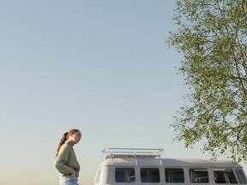


































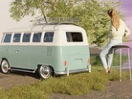

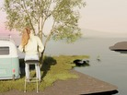









Data-generation pipeline
a
Assets
BlenderKit
b
VLM-guided placement
c
Camera trajectories
1
2
ellipse centred at O with C_far as its vertex; b is solved so it passes
through C_near. Endpoints: azimuth ~ U[0°, 360°), distance ~ logU[0.8, 8] m.
C_{near} (frame 31)
b
Δθ equal
O = centre
a=‖C_{far}-O‖
C_{far} = vertex
VLM marks where a
(look-at, 0.75 × height)
(frame 0)
91 indoor & outdoor scenes
person belongs
ray-cast floor cells
Gemini 2.5 Flash, per scene
slope ≤ 12°, flat, visible;
keep top-3, spread out
rejected (of 393k pairs)
kept 75k · 19 %
152k subject off frame
3
VLM judge
135k camera blocked
grounded · visible
17k arc midpoint blocked
scale · context
10k endpoints < 15° apart
keep if ≥ 7/10
5k degenerate look-at
102 human subjects · front calibrated on a 12-view turntable
place, render up to 6 orbit views; else move & retry
d
Render & hindsight label
e
Windows → action chunks
pick a goal frame g, then starts s with |g − s| ≤ 32; each walks 8 frames toward g
w₃
w₂
w₁
t = 0
t = 4
t = 8
t = 12
t = 16
t = 20
t = 24
t = 28
t = 31
goal
0
4
8
12
16
20
24
28
frame
31
occ 1%
occ 5%
occ 11%
occ 19%
occ 28%
occ 39%
occ 42%
occ 43%
occ 38%
w₃: 9 keyframes (clamped at g)
Δ t
too small
too small
goal-eligible
goal-eligible
goal-eligible
goal-eligible
goal-eligible
goal-eligible
goal-eligible
10
9
8
7
6
5
4
4
4
R_{6D}
Each frame is rendered (Cycles, 1024×768) and the subject mesh is projected into it,
a_{k}: pose change k→ k+1 in the camera frame,
shoot
so its box, bearing, elevation and occupancy are exact — no detector, no annotator. A frame can serve
(Δ t, R_{6D}) + shoot, latched once g is reached
8 × 10-D action chunk
as a goal if occupancy is 10–80 % and ≥ 35 % of the body is visible.
≤ 20 windows per trajectory (25 % near goal) · 8 view sectors balanced · 8 val scenes held out
9,889
scene × subject
7,885
placements
393k
sampled
75k
trajectories
2.4M
rendered
150k
training
runs
(91 scenes)
camera pairs
(19 % kept)
frames
windows
Notes:
figures/datagen/make_fig_datagen.py, panel (b) schematic. Counts taken from the data on 2026-10-14.

Slide 4
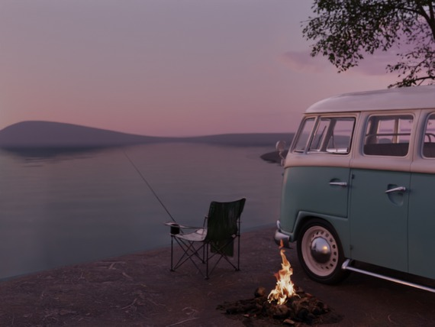



Data-generation pipeline — real floor grid
a
Assets
BlenderKit
b
VLM-guided placement
c
Camera trajectories
2
ray-cast floor cells,
ellipse centred at O with C_far as its vertex; b is solved so it passes
seen from the scene camera
through C_near. Endpoints: azimuth ~ U[0°, 360°), distance ~ logU[0.8, 8] m.
C_{near} (frame 31)
b
Δθ equal
O = centre
a=‖C_{far}-O‖
C_{far} = vertex
(look-at, 0.75 × height)
(frame 0)
91 indoor & outdoor scenes
rejected (of 393k pairs)
kept 75k · 19 %
152k subject off frame
2,054 flat & visible (green, darker = higher score); dropped: 21.6k outside the view,
135k camera blocked
2,083 hidden, 549 not flat · rings: top-3 kept (re-run without the VLM region)
17k arc midpoint blocked
3
VLM judge
10k endpoints < 15° apart
3
2
1
8
4
5k degenerate look-at
102 human subjects · front calibrated on a 12-view turntable
best 8 ≥ 7 → keep
d
Render & hindsight label
e
Windows → action chunks
pick a goal frame g, then starts s with |g − s| ≤ 32; each walks 8 frames toward g
w₃
w₂
w₁
t = 0
t = 4
t = 8
t = 12
t = 16
t = 20
t = 24
t = 28
t = 31
goal
0
4
8
12
16
20
24
28
frame
31
occ 1%
occ 5%
occ 11%
occ 19%
occ 28%
occ 39%
occ 42%
occ 43%
occ 38%
w₃: 9 keyframes (clamped at g)
Δ t
too small
too small
goal-eligible
goal-eligible
goal-eligible
goal-eligible
goal-eligible
goal-eligible
goal-eligible
10
9
8
7
6
5
4
4
4
R_{6D}
Each frame is rendered (Cycles, 1024×768) and the subject mesh is projected into it,
a_{k}: pose change k→ k+1 in the camera frame,
shoot
so its box, bearing, elevation and occupancy are exact — no detector, no annotator. A frame can serve
(Δ t, R_{6D}) + shoot, latched once g is reached
8 × 10-D action chunk
as a goal if occupancy is 10–80 % and ≥ 35 % of the body is visible.
≤ 20 windows per trajectory (25 % near goal) · 8 view sectors balanced · 8 val scenes held out
9,889
scene × subject
7,885
placements
393k
sampled
75k
trajectories
2.4M
rendered
150k
training
runs
(91 scenes)
camera pairs
(19 % kept)
frames
windows
Notes:
figures/datagen/make_fig_datagen.py --b real. Floor grid re-run without the Gemini interest region (sbatch_placement_grid.sh, job 192374); VLM view scores 3, 2, 1, 8, 4 are from the placement run.

Slide 5
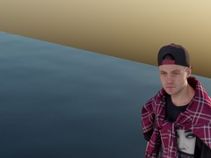
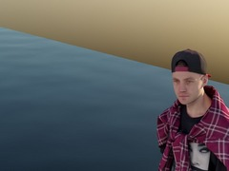
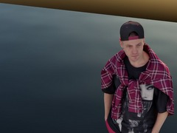
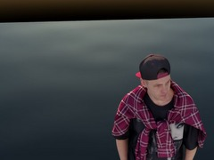
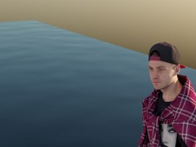
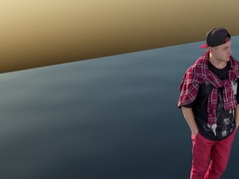
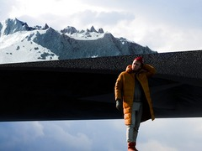
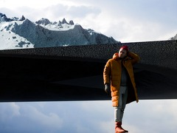
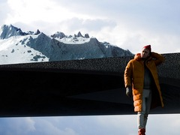
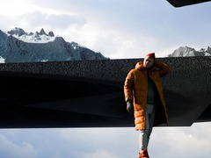
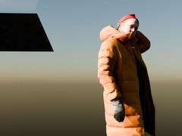
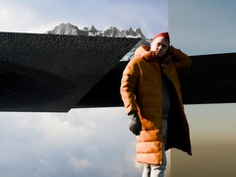
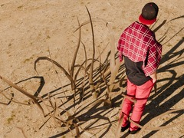
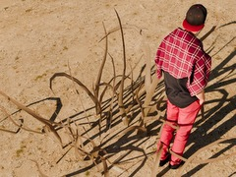
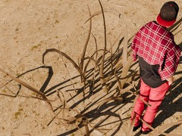
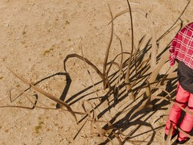
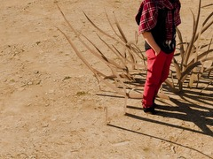
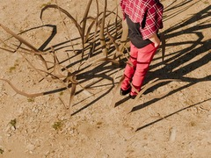
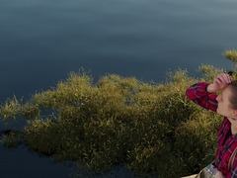
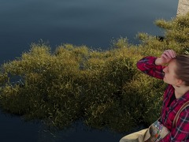
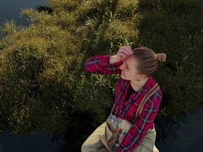
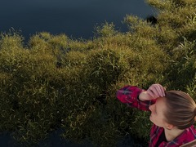
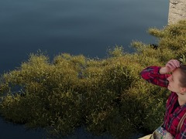
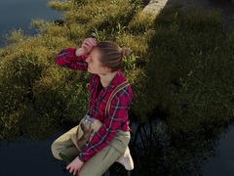
Qualitative rollouts (1/2)
lakeside camp
2 m
GT goal
Ours
π0.5
GR00T
Text→action
Diffusion policy
start d = 1.51
start
GT
d 0.09
d 0.34
d 0.61
d 0.25
d 1.07
snowy village
2 m
start d = 0.95
← subject
start
GT
d 0.07
d 0.11
d 0.16
d 0.95
d 0.48
desert roadside
2 m
start d = 1.28
start
d 0.02
d 0.11
d 0.24
d 1.08
d 0.23
GT
lakeside reeds
1 m
start d = 0.96
start
GT
d 0.08
d 0.38
d 0.32
d 0.12
d 0.30
Ours
π0.5
GR00T
Text→action
Diffusion policy
GT goal camera
d: distance to the GT goal (success d ≤ 0.10 + subject visible, green)
Notes:
figures/qualitative/make_fig_rollouts.py --rows 0,1,2,4. Selected examples: Ours succeeds, pi0.5 / GR00T / T2A / DP all miss; image-to-action left out (it is given the GT goal image).

Slide 6
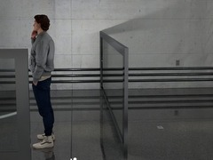
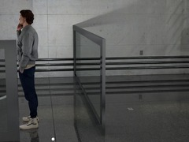
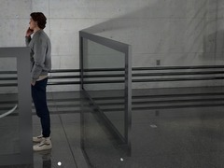
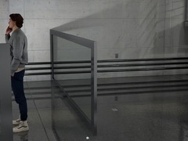
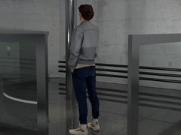
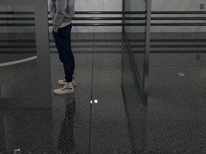
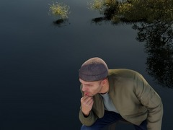
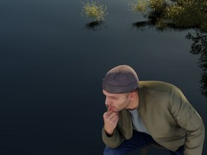
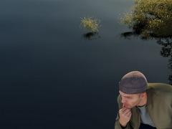
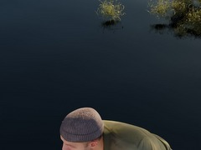
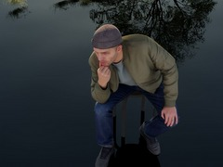
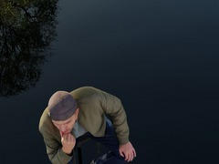
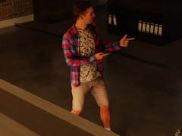
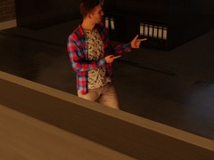
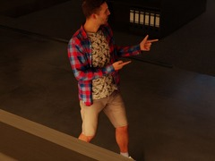
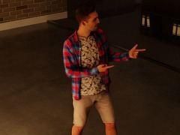








Qualitative rollouts (2/2)
office atrium
1 m
GT goal
Ours
π0.5
GR00T
Text→action
Diffusion policy
start d = 0.55
subject →
start
d 0.05
d 0.11
d 0.13
d 0.56
d 0.14
GT
lake shore
1 m
start d = 0.91
start
GT
d 0.05
d 0.13
d 0.28
d 0.24
d 0.40
modern office
start d = 0.96
2 m
subject →
start
d 0.07
d 0.14
d 0.14
d 0.19
d 0.24
GT
mountain terrace
2 m
start d = 0.72
← subject
start
GT
d 0.09
d 0.22
d 0.71
d 0.19
d 0.18
Ours
π0.5
GR00T
Text→action
Diffusion policy
GT goal camera
d: distance to the GT goal (success d ≤ 0.10 + subject visible, green)
Notes:
figures/qualitative/make_fig_rollouts.py --rows 3,5,6,7.

