Slide 1







$$λ_{j}(i,2)$$
$$P_{i(j,1)}$$
$$λ_{j}(i,3)$$
$$P_{i}$$
$$δ_{j}$$
$$λ_{j}(i,1)$$
$$P_{i(j,2)}$$

Slide 2












$$w_{i,k+1}$$
$$k+1$$
$$u_{j,k}^{∗}$$
$$v_{j,k}^{∗}$$
$$k$$
$$ρ_{i}$$
$$η_{i}$$
$$u_{j,k}^{∗}$$
$$S_{i}$$
$$h_{j}$$
$$T_{i}$$
$$k−1$$

Slide 3





$$x^{∗}$$
$$y$$
$$y^{∗}$$
$$θ$$
$$x$$

Slide 4




$$t^{n+1}$$
p$Δx$
$$t^{n}$$
i-n-1
i-a
i-n
i-1
i
u$Δt$

Slide 8
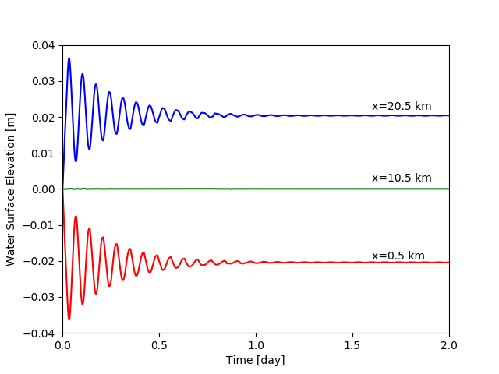

Slide 9
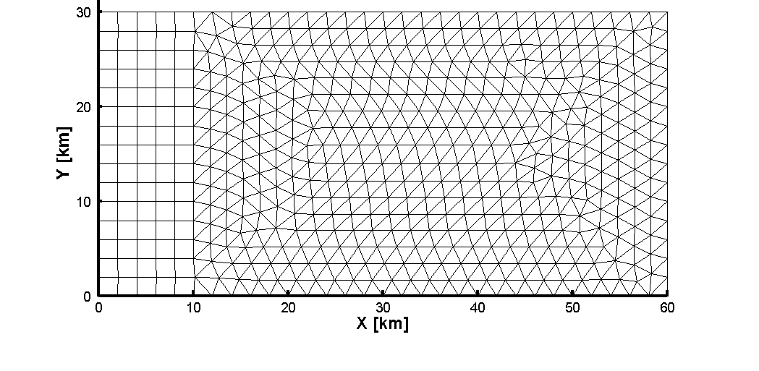
Closed Boundary, v=0
Closed Boundary, u=0
Open Boundary
Closed Boundary, v=0

Slide 10
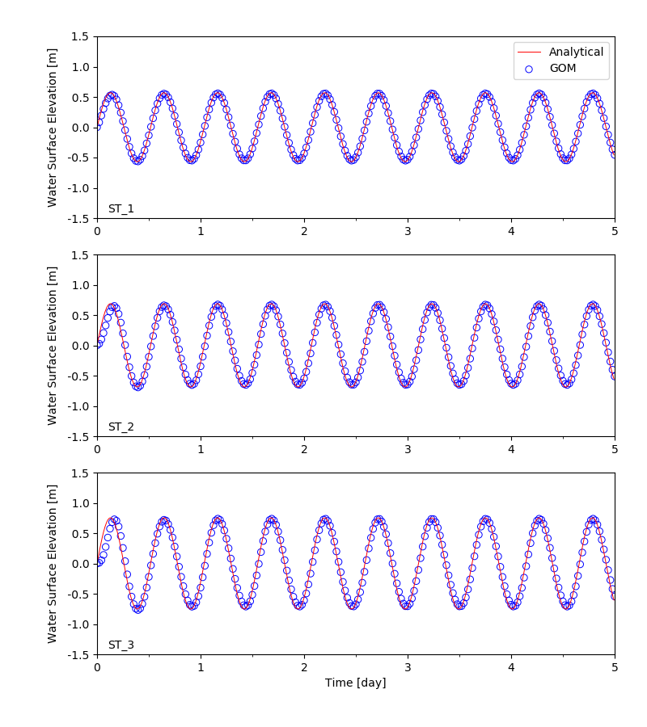

Slide 11
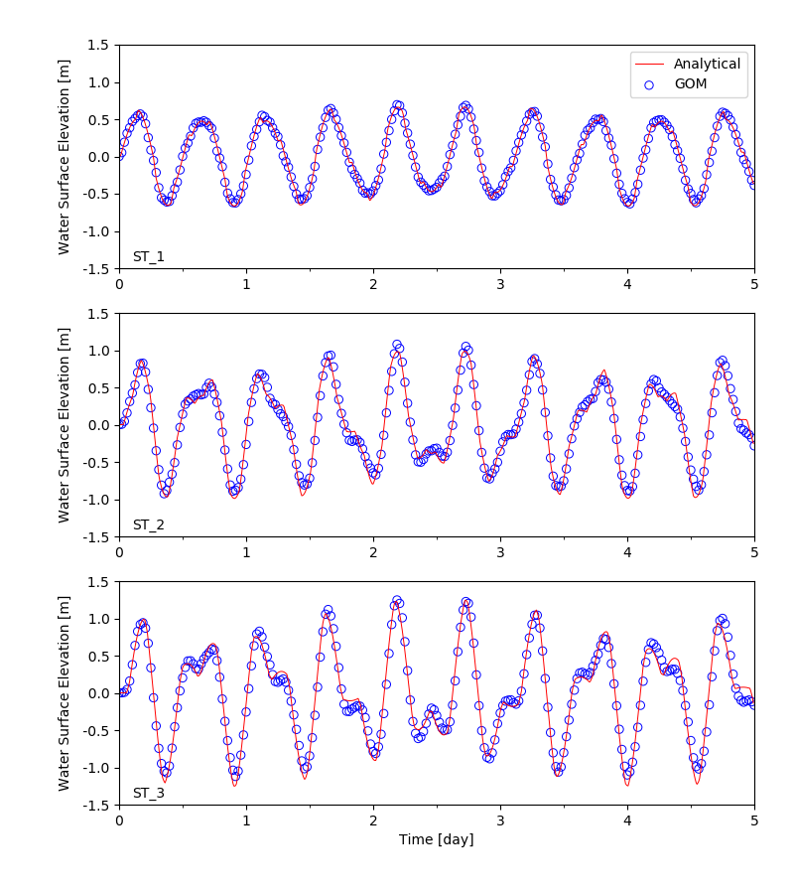

Slide 12


Slide 13
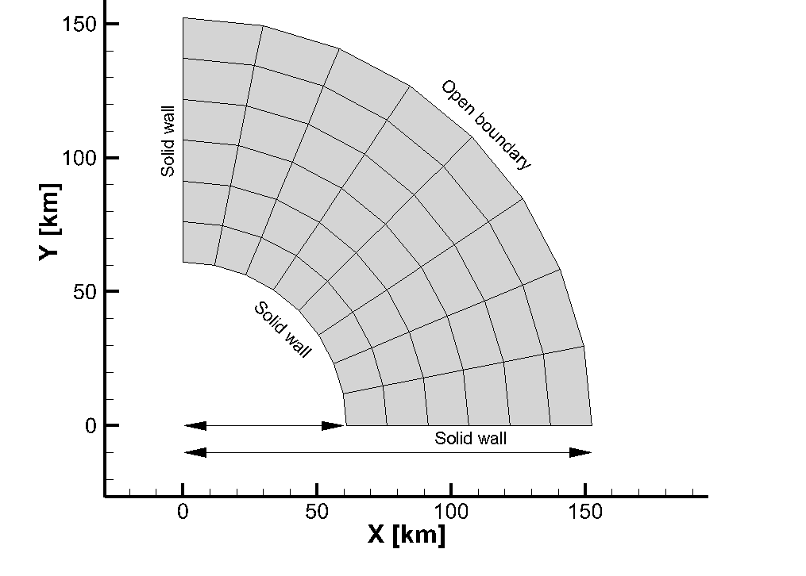
③
②
①
r₁ = 60,960 m
r₀ = 152,400 m
3.048 m
19.05 m
Solid wall
Open Boundary
Bottom
r₁
r₀

Slide 14
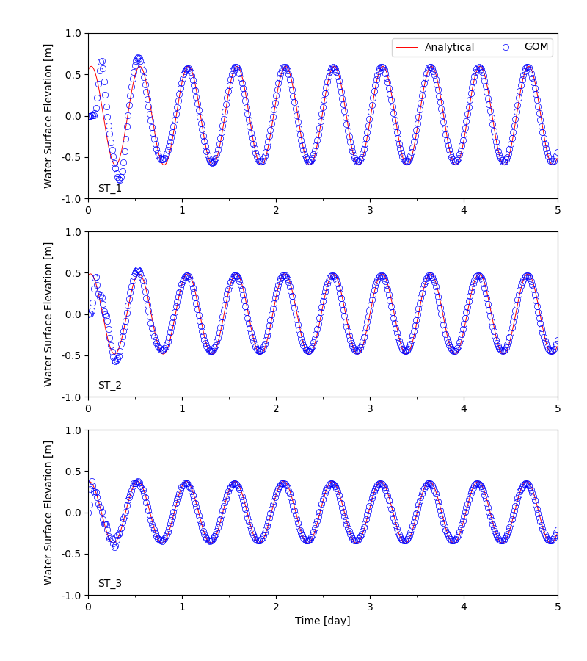

Slide 15


Initial shoreline
z
$$η(x,t)$$
Bottom line
MSL
$α$ = 1/1000
h(0)=50 m
L
x = 50 km

Slide 16
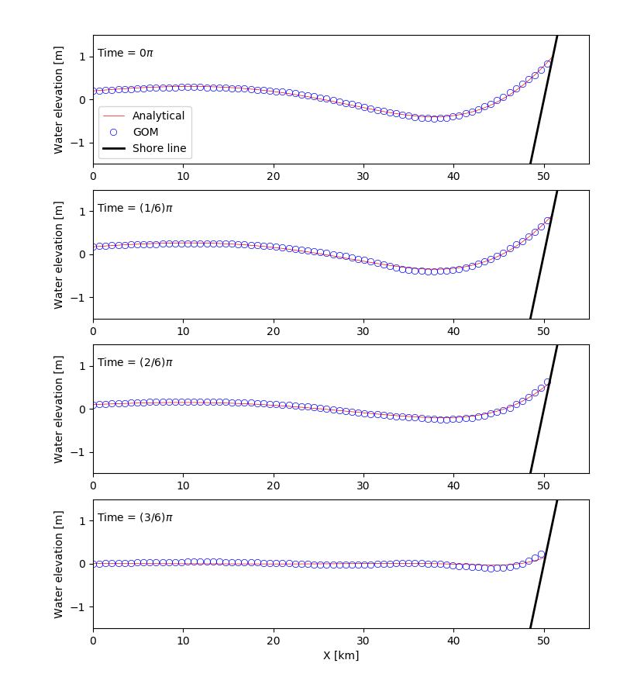

Slide 17
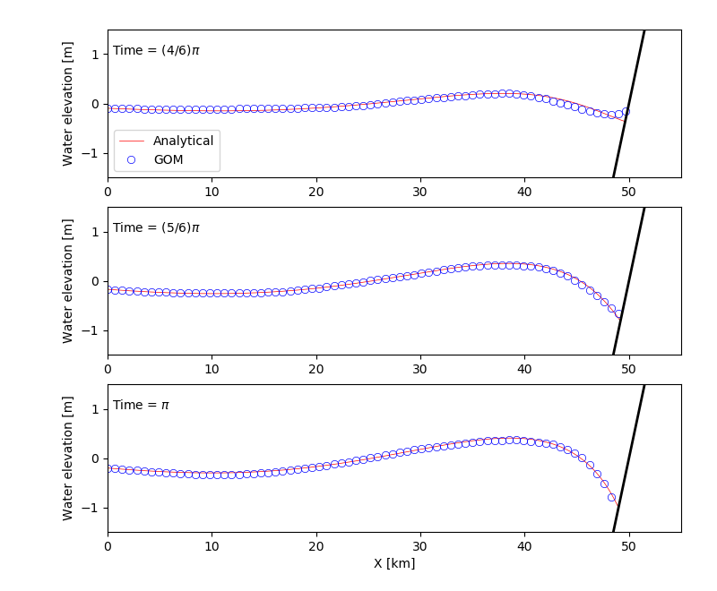

Slide 19
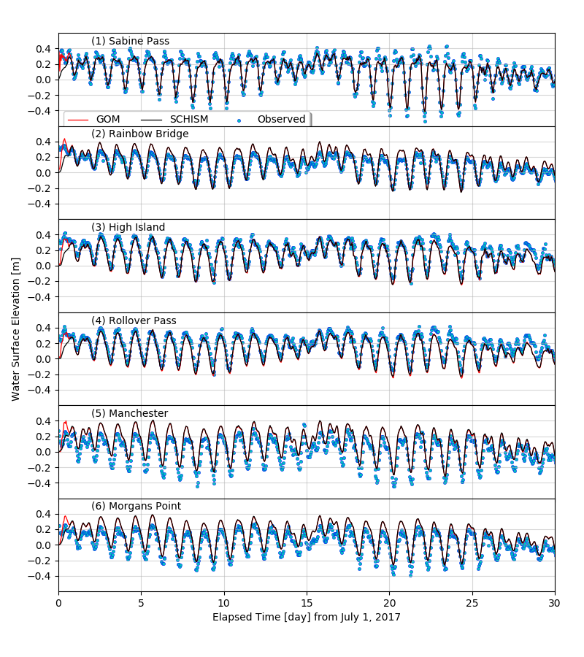

Slide 20
