Slide 1
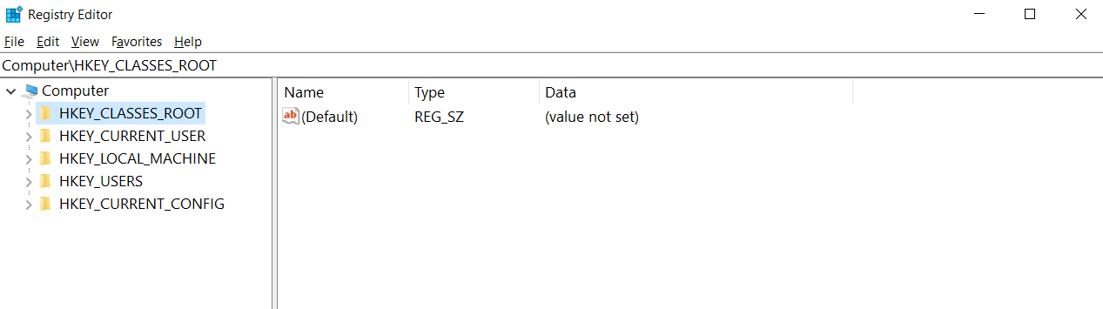
Figure 1. The structure of Windows Registry.

Slide 2




Figure 2. The overall framework of the proposed forensic analysis on Windows registry
Forensic Analysis
Extract
Data
Forensic Analysis
Extract
Transform Load
……
Data
HDFS

Slide 3
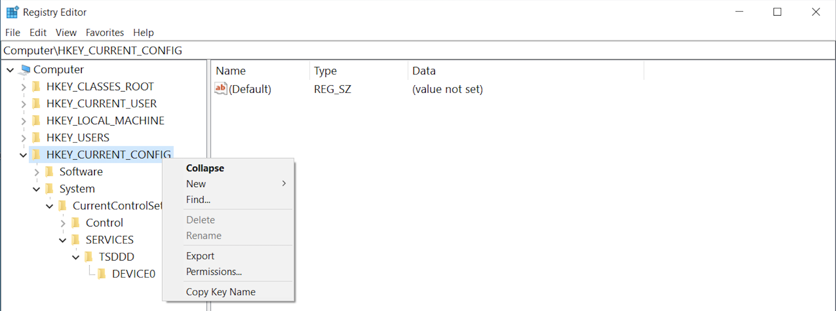
Figure 3. Registry keys and the corresponding values in a registry hive

Slide 4
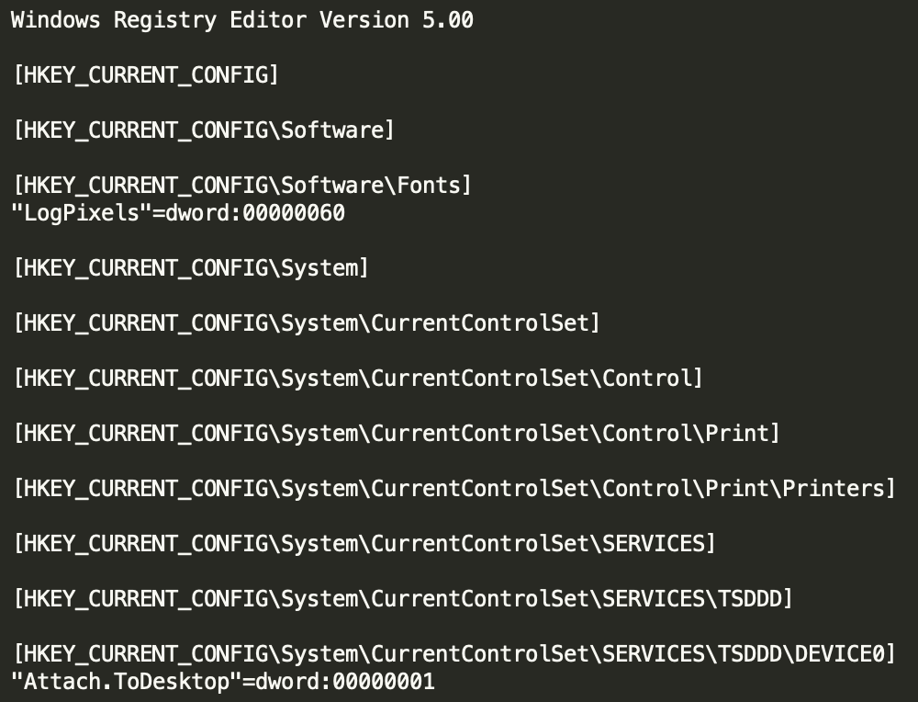
Figure 4. An example of the registry data exported by Regedit
Windows Registry Editor Version 5.00
[HKEY_CURRENT_CONFIG]
[HKEY_CURRENT_CONFIG\Software]
[HKEY_CURRENT_CONFIG\Software\Fonts]
"LogPixels"=dword:00000060
[HKEY_CURRENT_CONFIG\System]
[HKEY_CURRENT_CONFIG\System\CurrentControlSet]
[HKEY_CURRENT_CONFIG\System\CurrentControlSet\Control]
[HKEY_CURRENT_CONFIG\System\CurrentControlSet\Control\Print]
[HKEY_CURRENT_CONFIG\System\CurrentControlSet\Control\Print\Printers]
[HKEY_CURRENT_CONFIG\System\CurrentControlSet\SERVICES]
[HKEY_CURRENT_CONFIG\System\CurrentControlSet\SERVICES\TSDDD]
[HKEY_CURRENT_CONFIG\System\CurrentControlSet\SERVICES\TSDDD\DEVICE0]
"Attach.ToDesktop"=dword:00000001

Slide 5
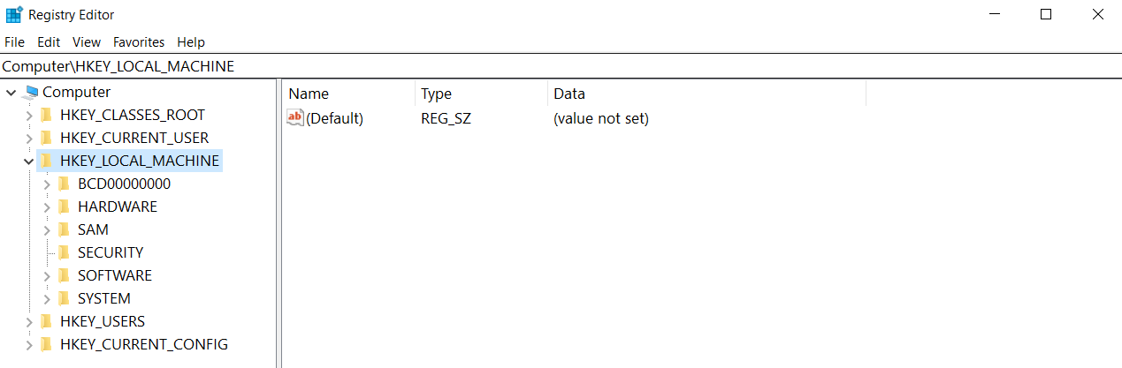
Figure 5. An example of registry manipulation using the MapReduce framework

Slide 6
MAP
Node1 – BCD00000000
Input
Output
HKLM \ BCD00000000 \ Objects \ Exploit
HKLM \ BCD00000000 \ Exploit
2
Node2 – HARDWARE
Input
Output
HKLM \ HARDWARE \ ACPI \ Exploit
HKLM \ HARDWARE \ Settings
1
Node3 – SAM
Input
Output
HKLM \ SAM \ Objects
0
Find ”Exploit” in
REDUCE
HKLM
7
Node4 – SECURITY
Input
Output
HKLM \ SECURITY \ Info \ Exploit
HKLM \ SECURITY \ User \ UID
1
Node5 – SOFTWARE
Input
Output
HKLM \ SOFTWARE \ Classes \ Exploit
HKLM \ SOFTWARE \ Microsoft
1
Node6 – SYSTEM
Input
Output
HKLM \ SYSTEM \ Plugins \ Exploit
HKLM \ SYSTEM \ Control \ Exploit
2

Slide 7
flatMap
filter
count
Figure 6. An example of registry manipulation using Apache Spark operations
Node1
Node1
Node1
HKLM \ BCD00000000 \ Objects \ Exploit
HKLM \ BCD00000000 \ Exploit
HKLM \ BCD00000000 \ Objects \ Exploit
HKLM \ BCD00000000 \ Exploit
2
Node2
Node2
Node2
HKLM \ HARDWARE \ ACPI \ Exploit
HKLM \ HARDWARE \ Settings
HKLM \ HARDWARE \ ACPI \ Exploit
1
Node3
Node3
Node3
HKLM \ SAM \ Objects
0
Node4
Node4
Node4
HKLM \ SECURITY \ Info \ Exploit
HKLM \ SECURITY \ User \ UID
HKLM \ SECURITY \ Info \ Exploit
1
Node5
Node5
Node5
HKLM \ SOFTWARE \ Classes \ Exploit
HKLM \ SOFTWARE \ Microsoft
HKLM \ SOFTWARE \ Classes \ Exploit
1
Node6
Node6
Node6
HKLM \ SYSTEM \ Plugins \ Exploit
HKLM \ SYSTEM \ Control \ Exploit
HKLM \ SYSTEM \ Plugins \ Exploit
HKLM \ SYSTEM \ Control \ Exploit
2

Slide 8
Figure 7. An example of the actual process of converting a registry entry into nested key-value data
ConvertRegEntryToNestedKeyValue
: key
: value
RegEntry = HKCC \ Software \ Fonts \ LogPixels = dword:00000060
reg = [ HKCC , Software , Fonts , LogPixels , dword:00000060 ]
reg = [ HKCC , Software , Fonts , { LogPixels : dword:00000060 } ]
reg = [ HKCC , Software , { Fonts : { LogPixels : dword:00000060 }} ]
reg = [ HKCC , { Software : { Fonts : { LogPixels : dword:00000060 }}}]
RegNestedKeyValue = { HKCC : { Software : { Fonts : { LogPixels : dword:00000060 }}}}

Slide 9
Figure 8. An example of the actual process of merging three registry entries based on the common registry path
Actual Registry Entries
RNE₁ : {HKU : {Control Panel : {Mouse : {MouseSpeed : 1}}}}
RNE₂ : {HKU : {Control Panel : {International : {Geo : {Name : KR}}}}}
RNE₃ : {HKU : {Control Panel : {Desktop : {Status : True}}}}
(b)
(c)

Slide 10
MergeRegNestedEntries
Value’s Key
: key
: value
RNE₁ = { HKU : { Control Panel : { Mouse : { MouseSpeed : 1 }}}}
RNE₂ = { HKU : { Control Panel : { International : { Geo : { Name : KR }}}}}
RNE₁ = { HKU : { Control Panel : { Mouse : { MouseSpeed : 1 }}}}
RNE₂ = { HKU : { Control Panel : { International : { Geo : { Name : KR }}}}
RNE₁₊₂ = { HKU : { Control Panel : { Mouse : { MouseSpeed : 1 } ,
International : { Geo : { Name : KR }}}}}
commonPath
ListRegEntries

Slide 11
MergeRegNestedEntries
Value’s Key
: key
: value
RNE₁₊₂ = { HKU : { Control Panel : { Mouse : { MouseSpeed : 1},
International : { Geo : { Name : KR }}}}}
RNE₃ = { HKU : { Control Panel : { Desktop : { Status : True }}}}
RNE₁₊₂ = { HKU : { Control Panel : { Mouse : { MouseSpeed : 1},
International : { Geo : { Name : KR }}}}}
RNE₃ = { HKU : { Control Panel : { Desktop : { Status : True }}}}
RNE₁₊₂₊₃ = { HKU : { Control Panel : { Mouse : { MouseSpeed : 1 },
International : { Geo : { Name : KR },
Desktop : { Status : True }}}}}
commonPath
ListRegEntries

Slide 12
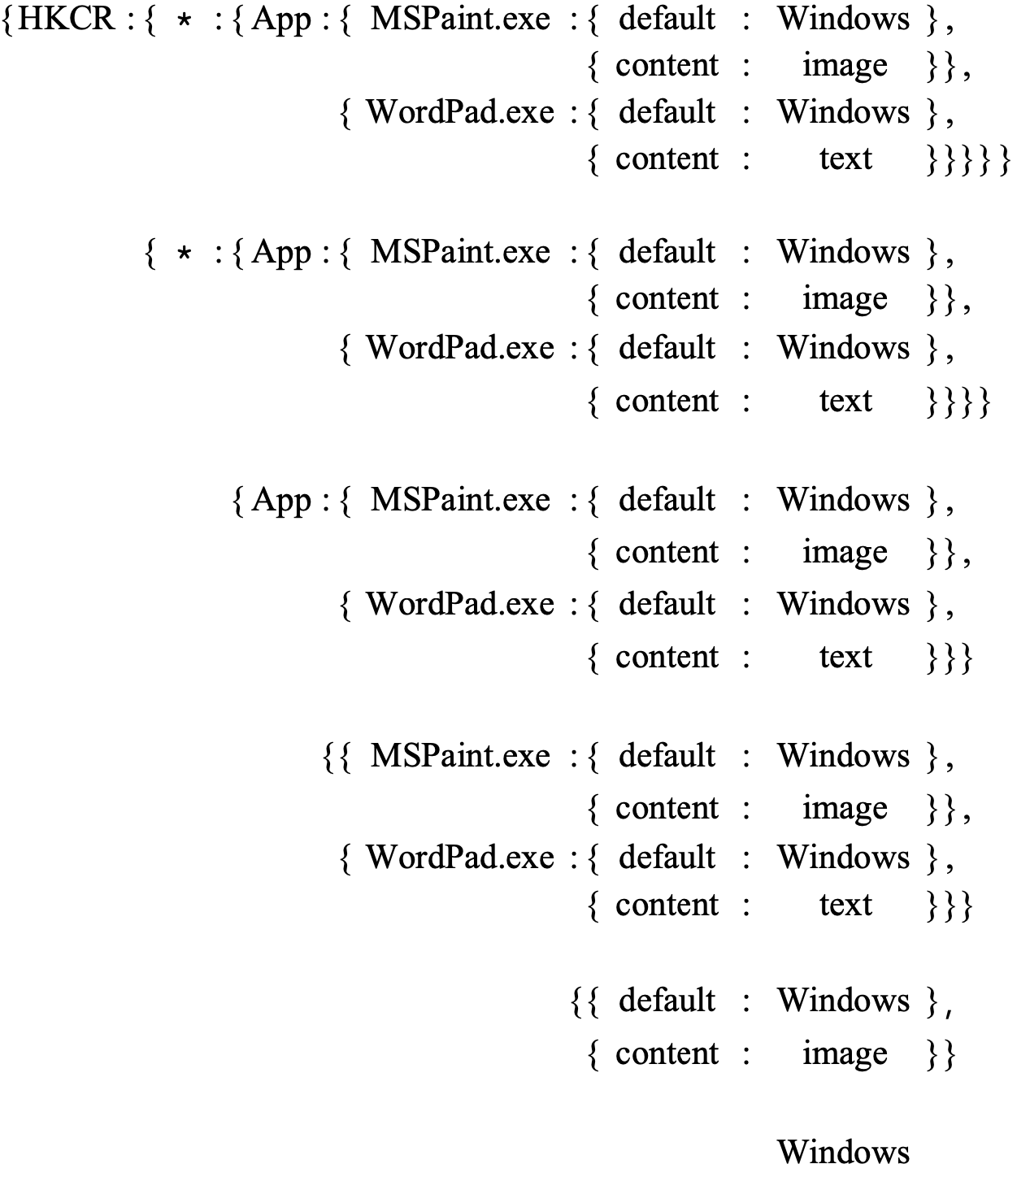
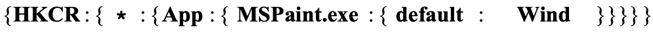
Figure 9. An example of the actual process of comparing two registry entries.
RegRepository
: key
: value
①
②
③
④
⑤
RegNestedEntry– regTemp
①
②
③
④
⑤

Slide 13
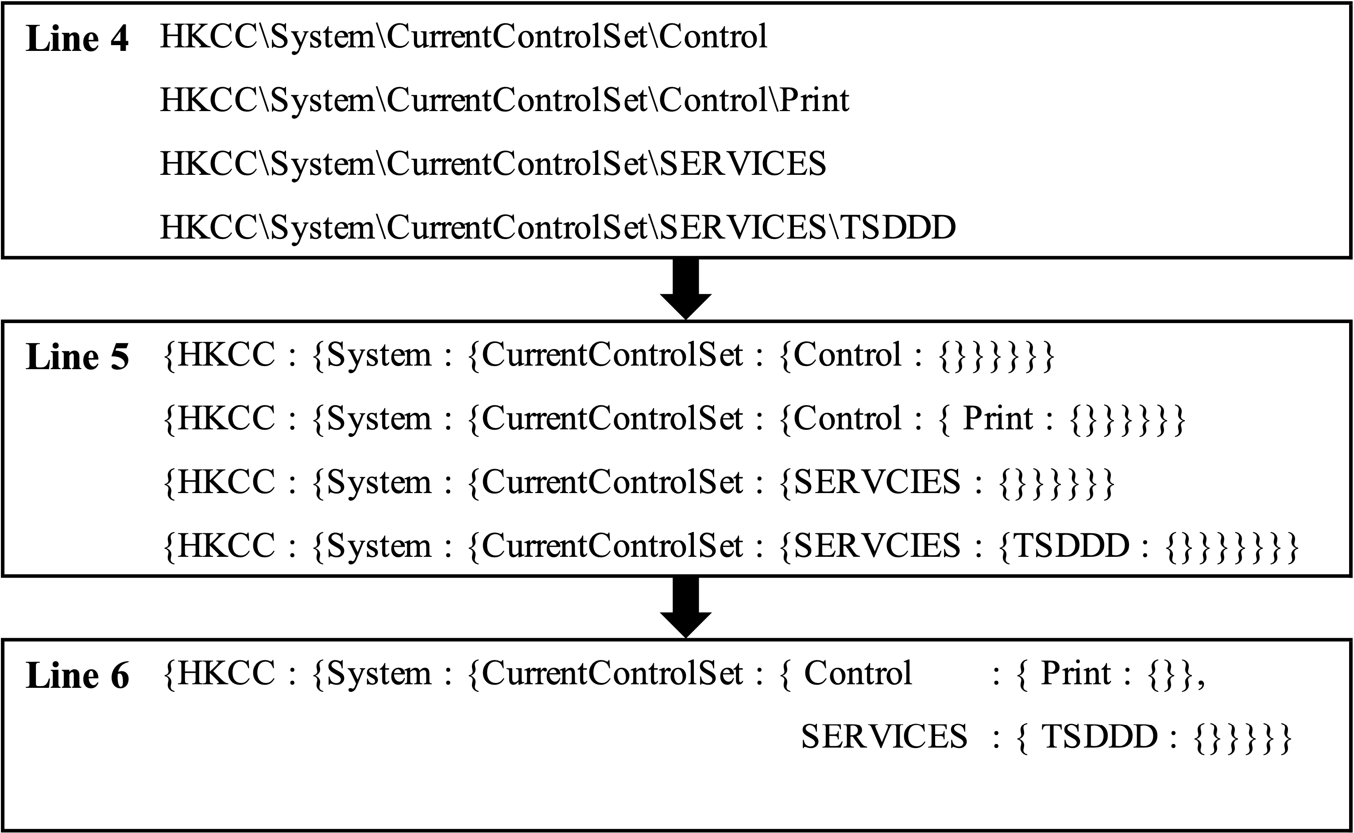
Common Path(Level 1)
Level 2
Level 3

Slide 14
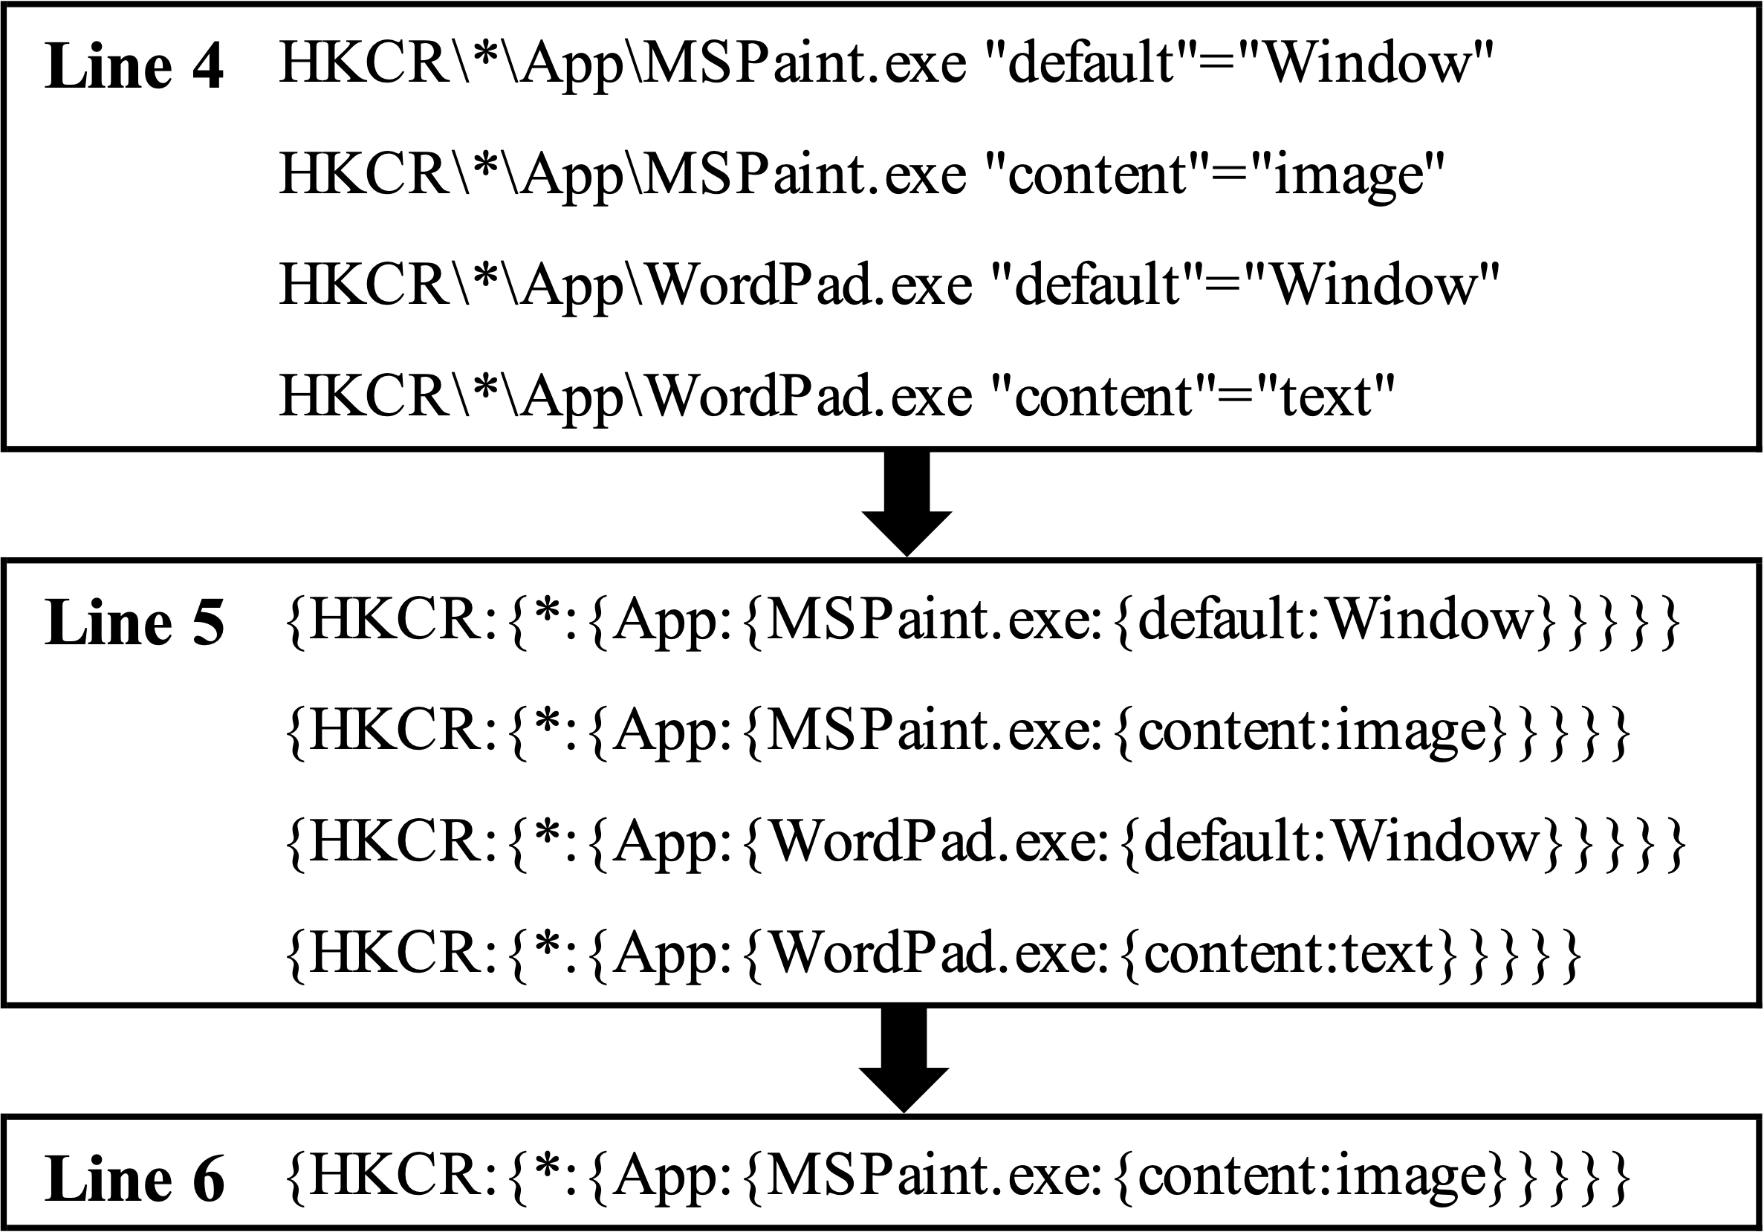
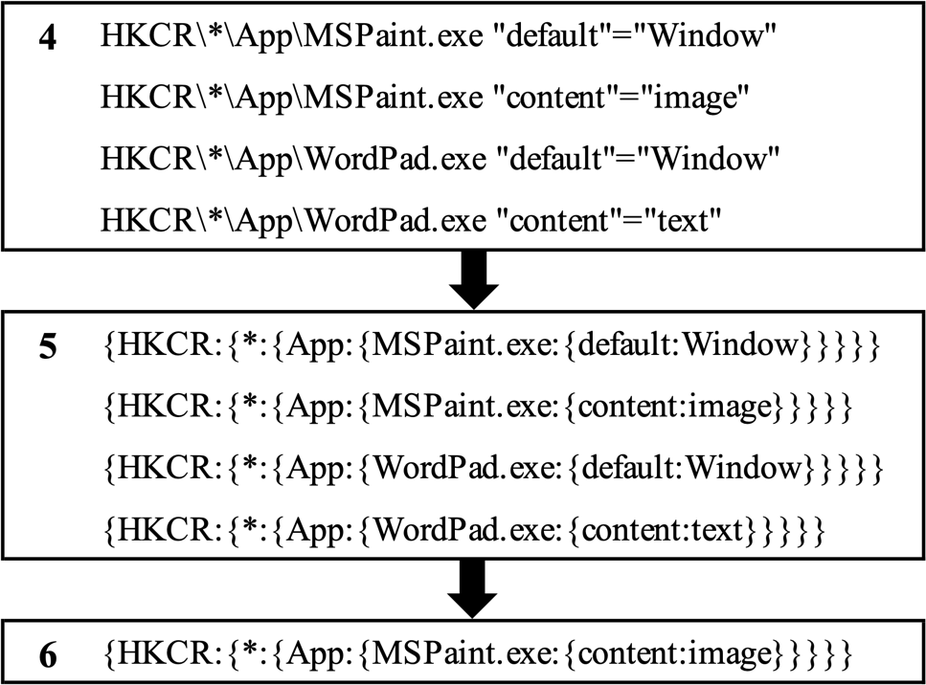

Slide 15
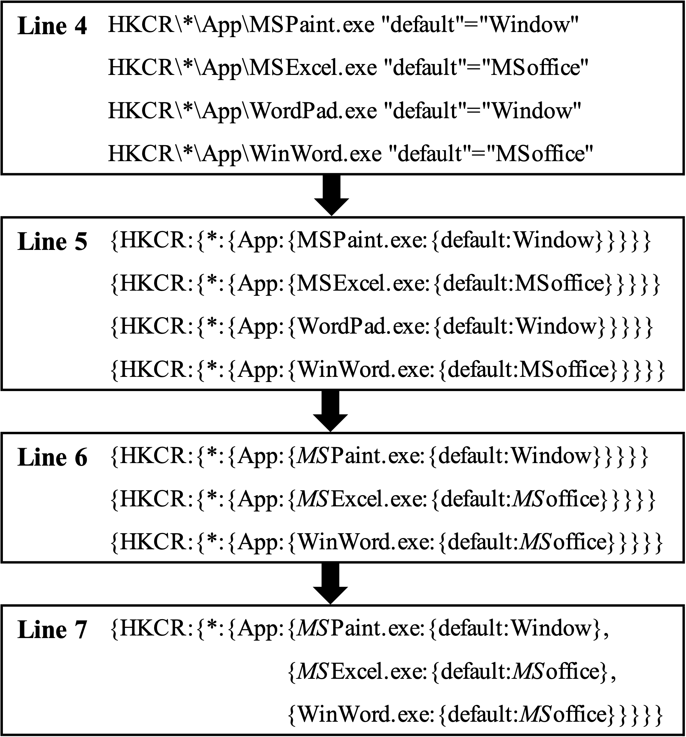
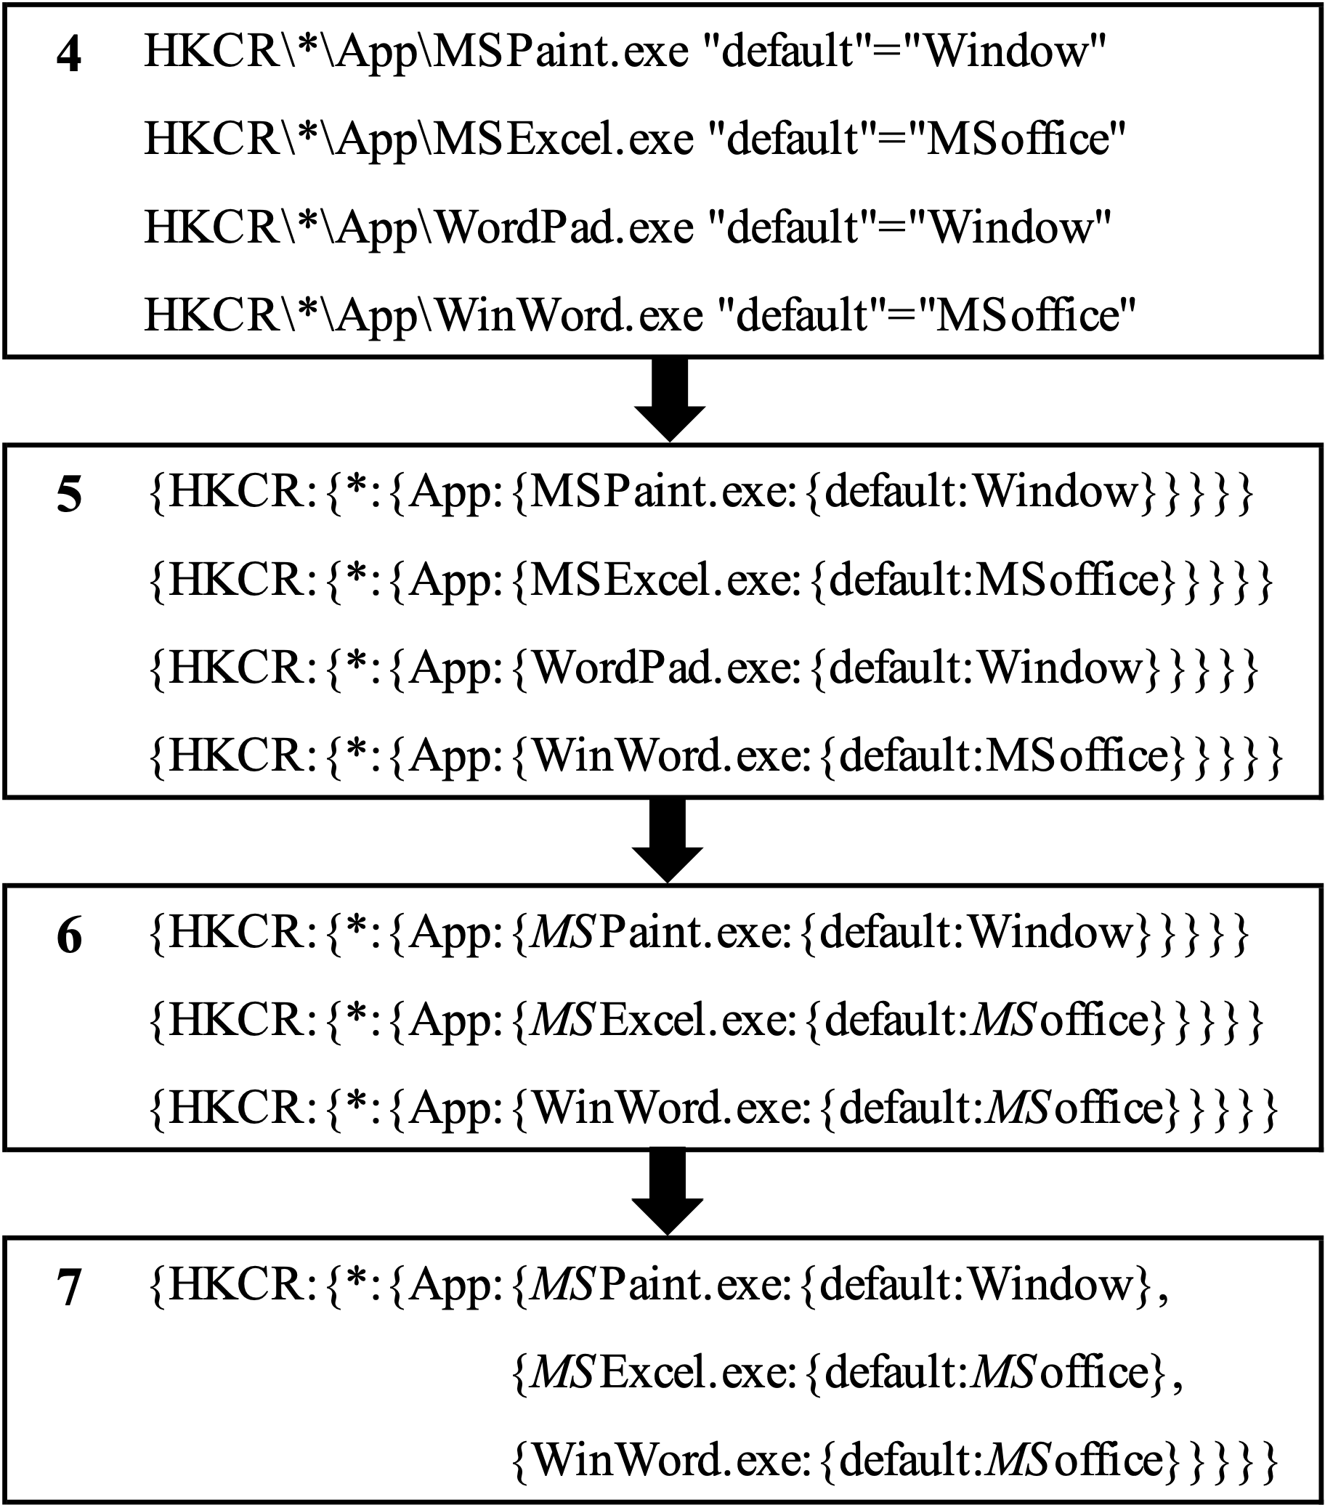

Slide 16
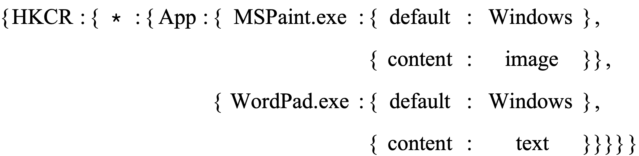
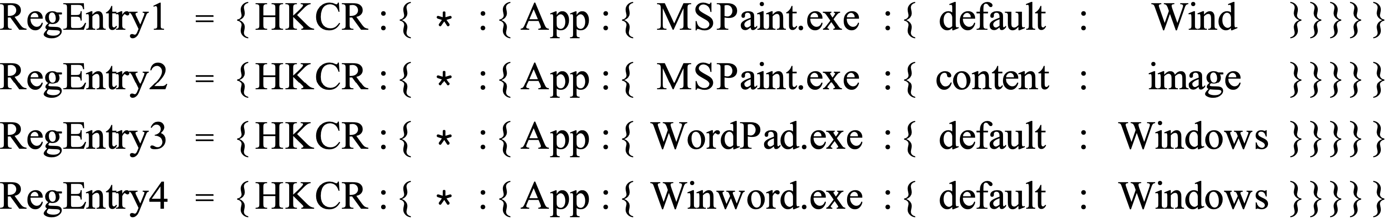
Lines 2~6 : RegRepo₁
Lines 7~10 : RegRepo₂
Line 11 : DifferentRegEntries

Slide 17
Figure 7. The comparison results of the Loading Windows Registry in HDFS

Slide 18
Figure 11. The comparison results of
Retrieving information based on a registry key
(a) The comparison results of Changes with number of node
(b) The comparison results of Changes with number of CPU

Slide 19
Figure 12. The comparison results of
Retrieving registry key and value based on a keyword
(a) The comparison results of Changes with number of node
(b) The comparison results of Changes with number of CPU

Slide 20
{HKLM : {SOFTWARE : {Classes : {.php3 : {PerceivedType : text}
{HKLM : {SOFTWARE …{default : Exploit Shield Brokeer},
{HKLM : {SOFTWARE …{default : Exploit Shield Class},
{HKLM : {SOFTWARE …{default : IExploitShield}}}}}}
{HKLM : {SOFTWARE … {default : FlashBroker},
{HKLM : {SOFTWARE … {default : Shockwave Flash Object}}}

Slide 21
Figure 12. The comparison results of
Comparing the entire registry repository
(a) The comparison results of Changes with number of node
(b) The comparison results of Changes with number of CPU

Slide 22
{HKU : {SOFTWARE … {ModuleInfo : {InstallDate : 2-25-2020},
{HKU : {SOFTWARE … {ModuleInfo : {SetupPath : D:\\SETUP\\}}}
Registry₁ : {HKLM … {BIOS : {BIOSVendor : American Megatrends Inc.},
Registry₁ : {HKLM … {BIOS : {BIOSVersion : 2.02(D)}}}}}}
Registry₄ : {HKLM … {BIOS : {BIOSVendor : Phoenix Technologies Ltd.},
Registry₄ : {HKLM … {BIOS : {BIOSVersion : W1ZD1210 X64}}}}}}

