Slide 1
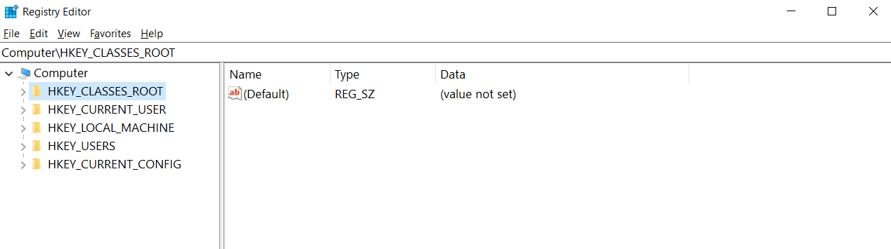
Figure 1. The structure of Windows Registry.

Slide 2
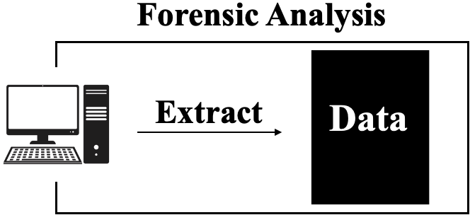
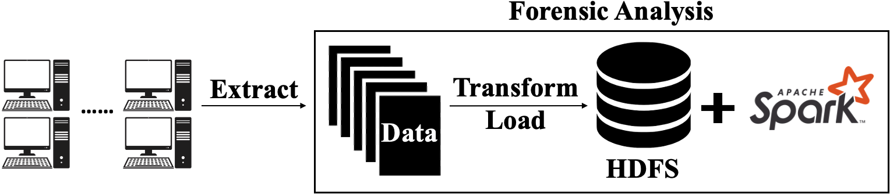
Figure 2. The overall framework of the proposed forensic analysis on Windows registry

Slide 3
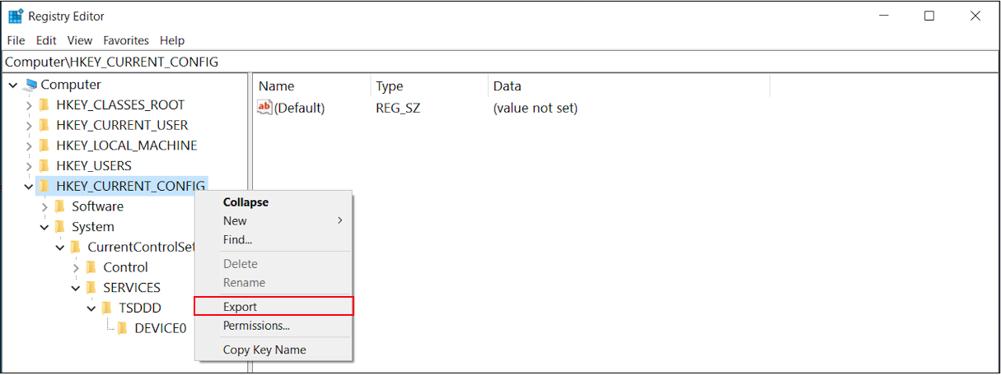
Figure 3. Registry keys and the corresponding values in a registry hive

Slide 4
Figure 4. An example of the registry data exported by Regedit
[HKEY_CURRENT_CONFIG]
[HKEY_CURRENT_CONFIG\Software]
[HKEY_CURRENT_CONFIG\Software\Fonts]
"LogPixels"=dword:00000060
[HKEY_CURRENT_CONFIG\System]
[HKEY_CURRENT_CONFIG\System\CurrentControlSet]
[HKEY_CURRENT_CONFIG\System\CurrentControlSet\Control]
[HKEY_CURRENT_CONFIG\System\CurrentControlSet\Control\Print]
[HKEY_CURRENT_CONFIG\System\CurrentControlSet\Control\Print\Printers]
[HKEY_CURRENT_CONFIG\System\CurrentControlSet\SERVICES]
[HKEY_CURRENT_CONFIG\System\CurrentControlSet\SERVICES\TSDDD]
[HKEY_CURRENT_CONFIG\System\CurrentControlSet\SERVICES\TSDDD\DEVICE0]
"Attach.ToDesktop"=dword:00000001

Slide 5
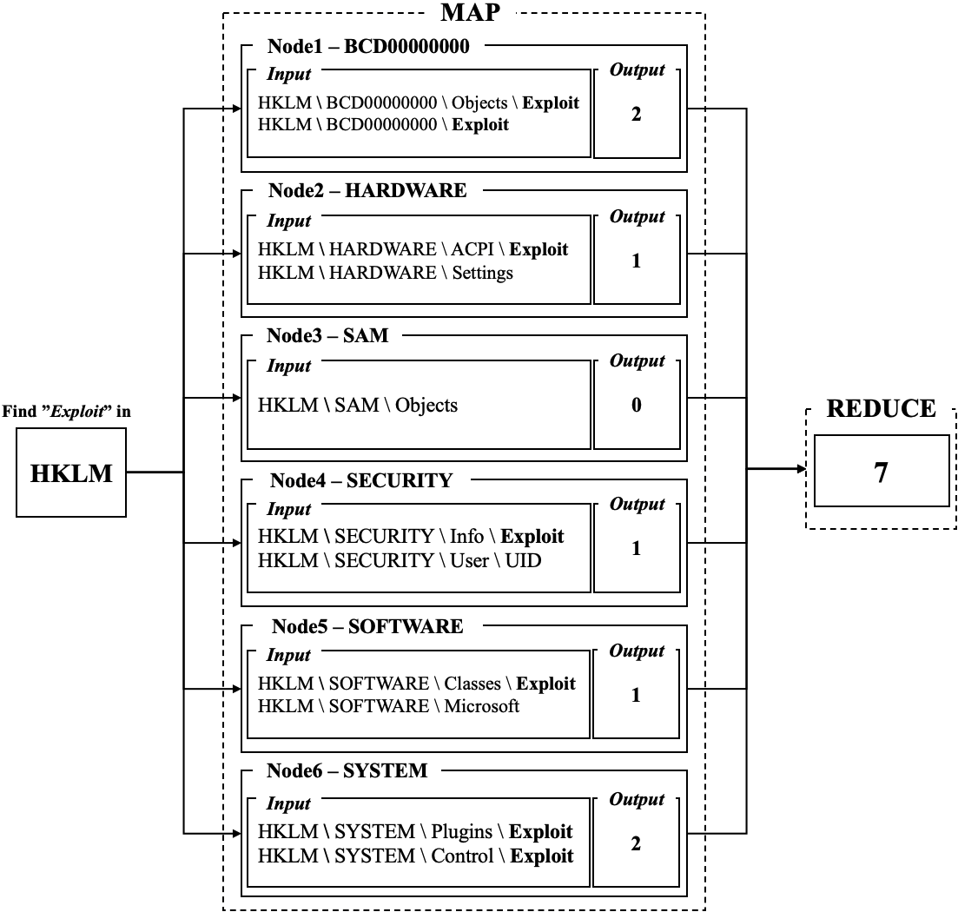
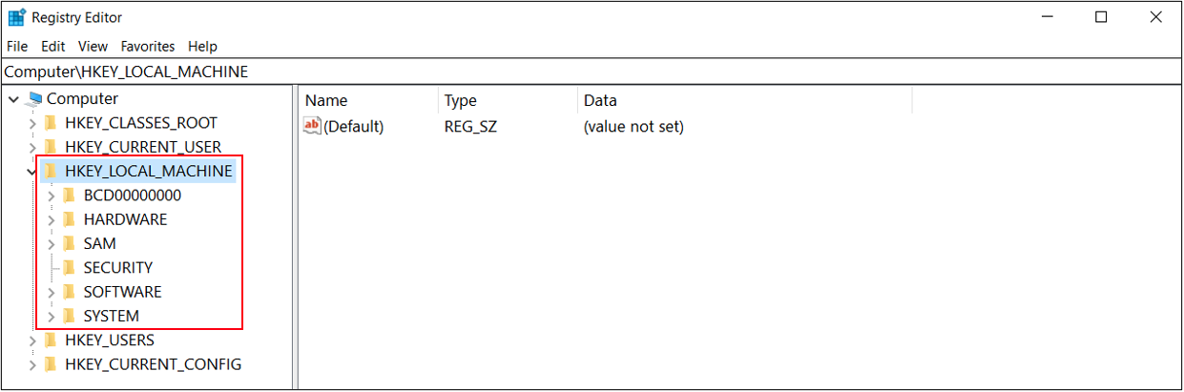
Figure 5. An example of registry manipulation using the MapReduce framework

Slide 6
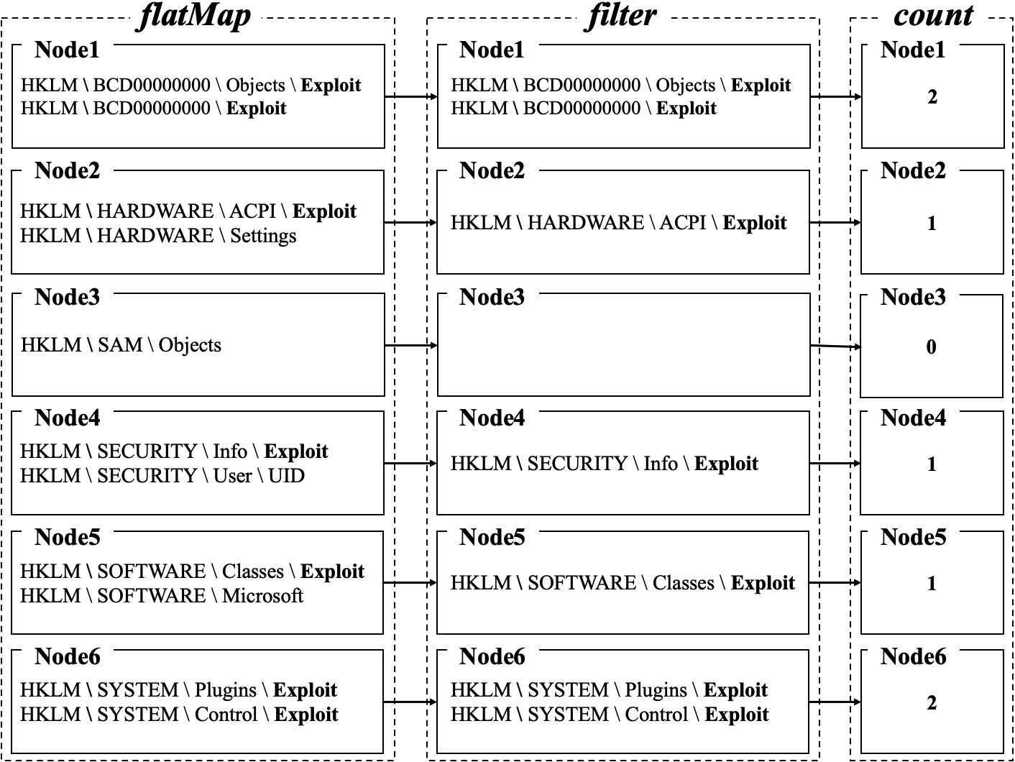
Figure 6. An example of registry manipulation using Apache Spark operations

Slide 7
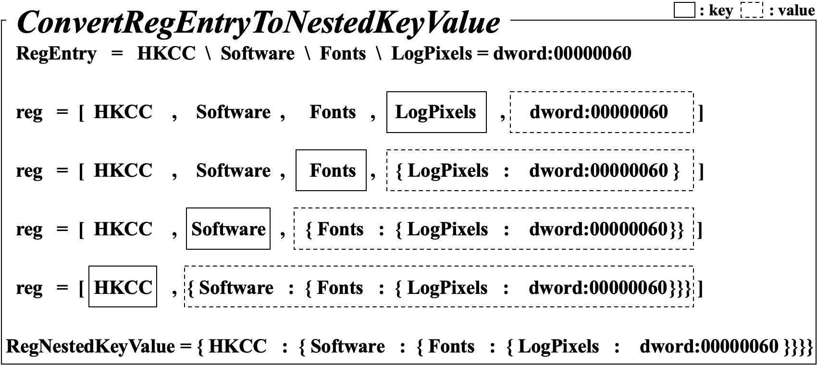
Figure 7. An example of the actual process of converting a registry entry into nested key-value data

Slide 8
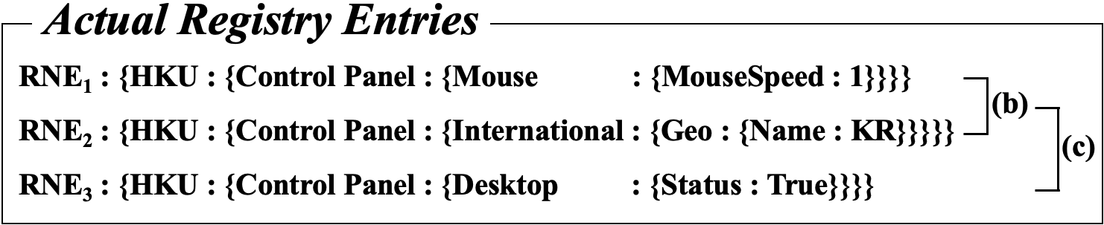
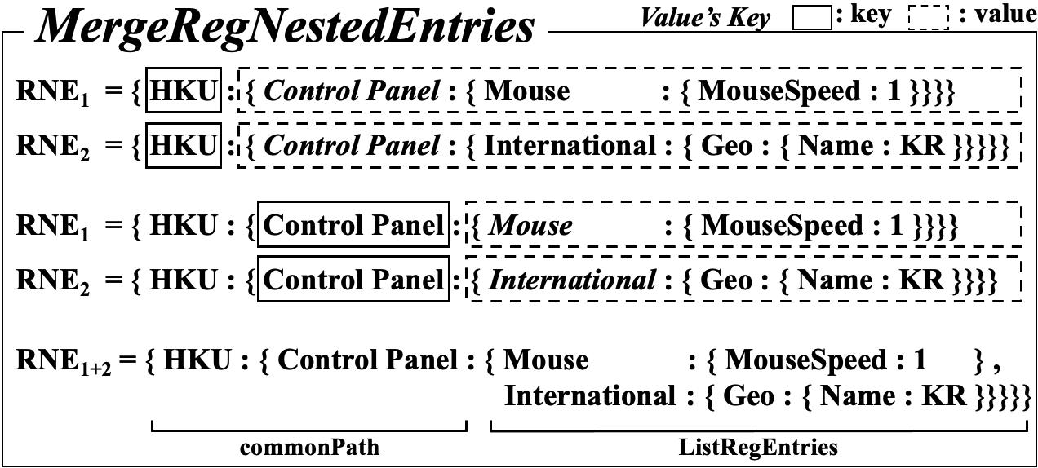
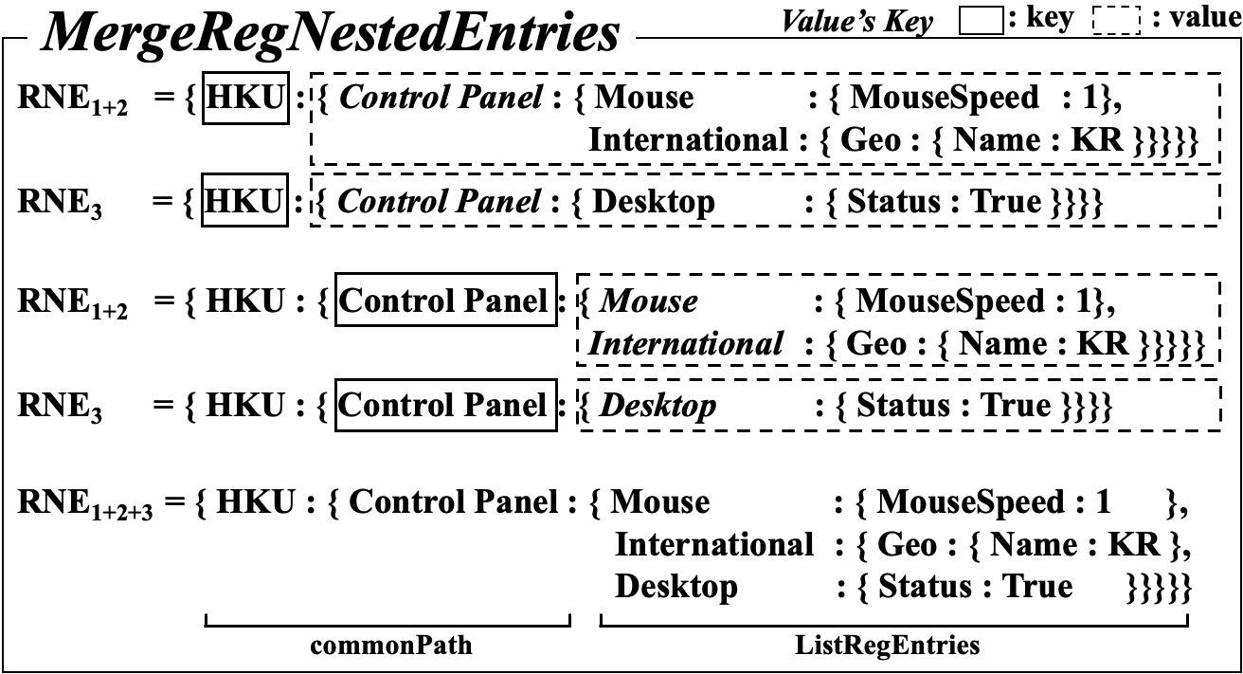
Figure 8. An example of the actual process of merging three registry entries based on the common registry path

Slide 9
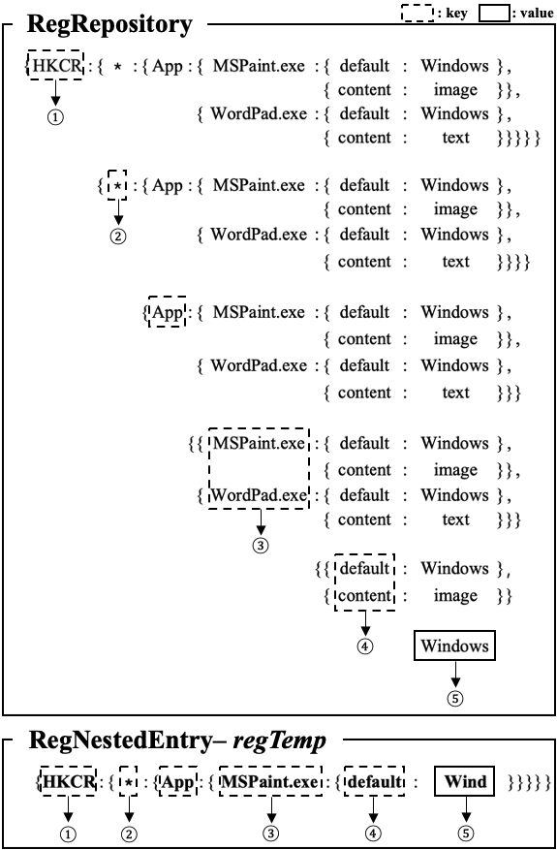
Figure 9. An example of the actual process of comparing two registry entries.

Slide 10
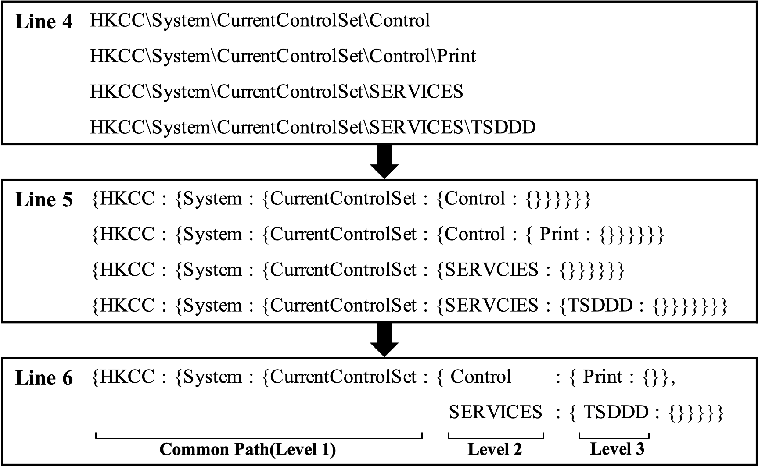
Figure10. An example of the actual process of loading Windows registry data into HDFS.

Slide 11
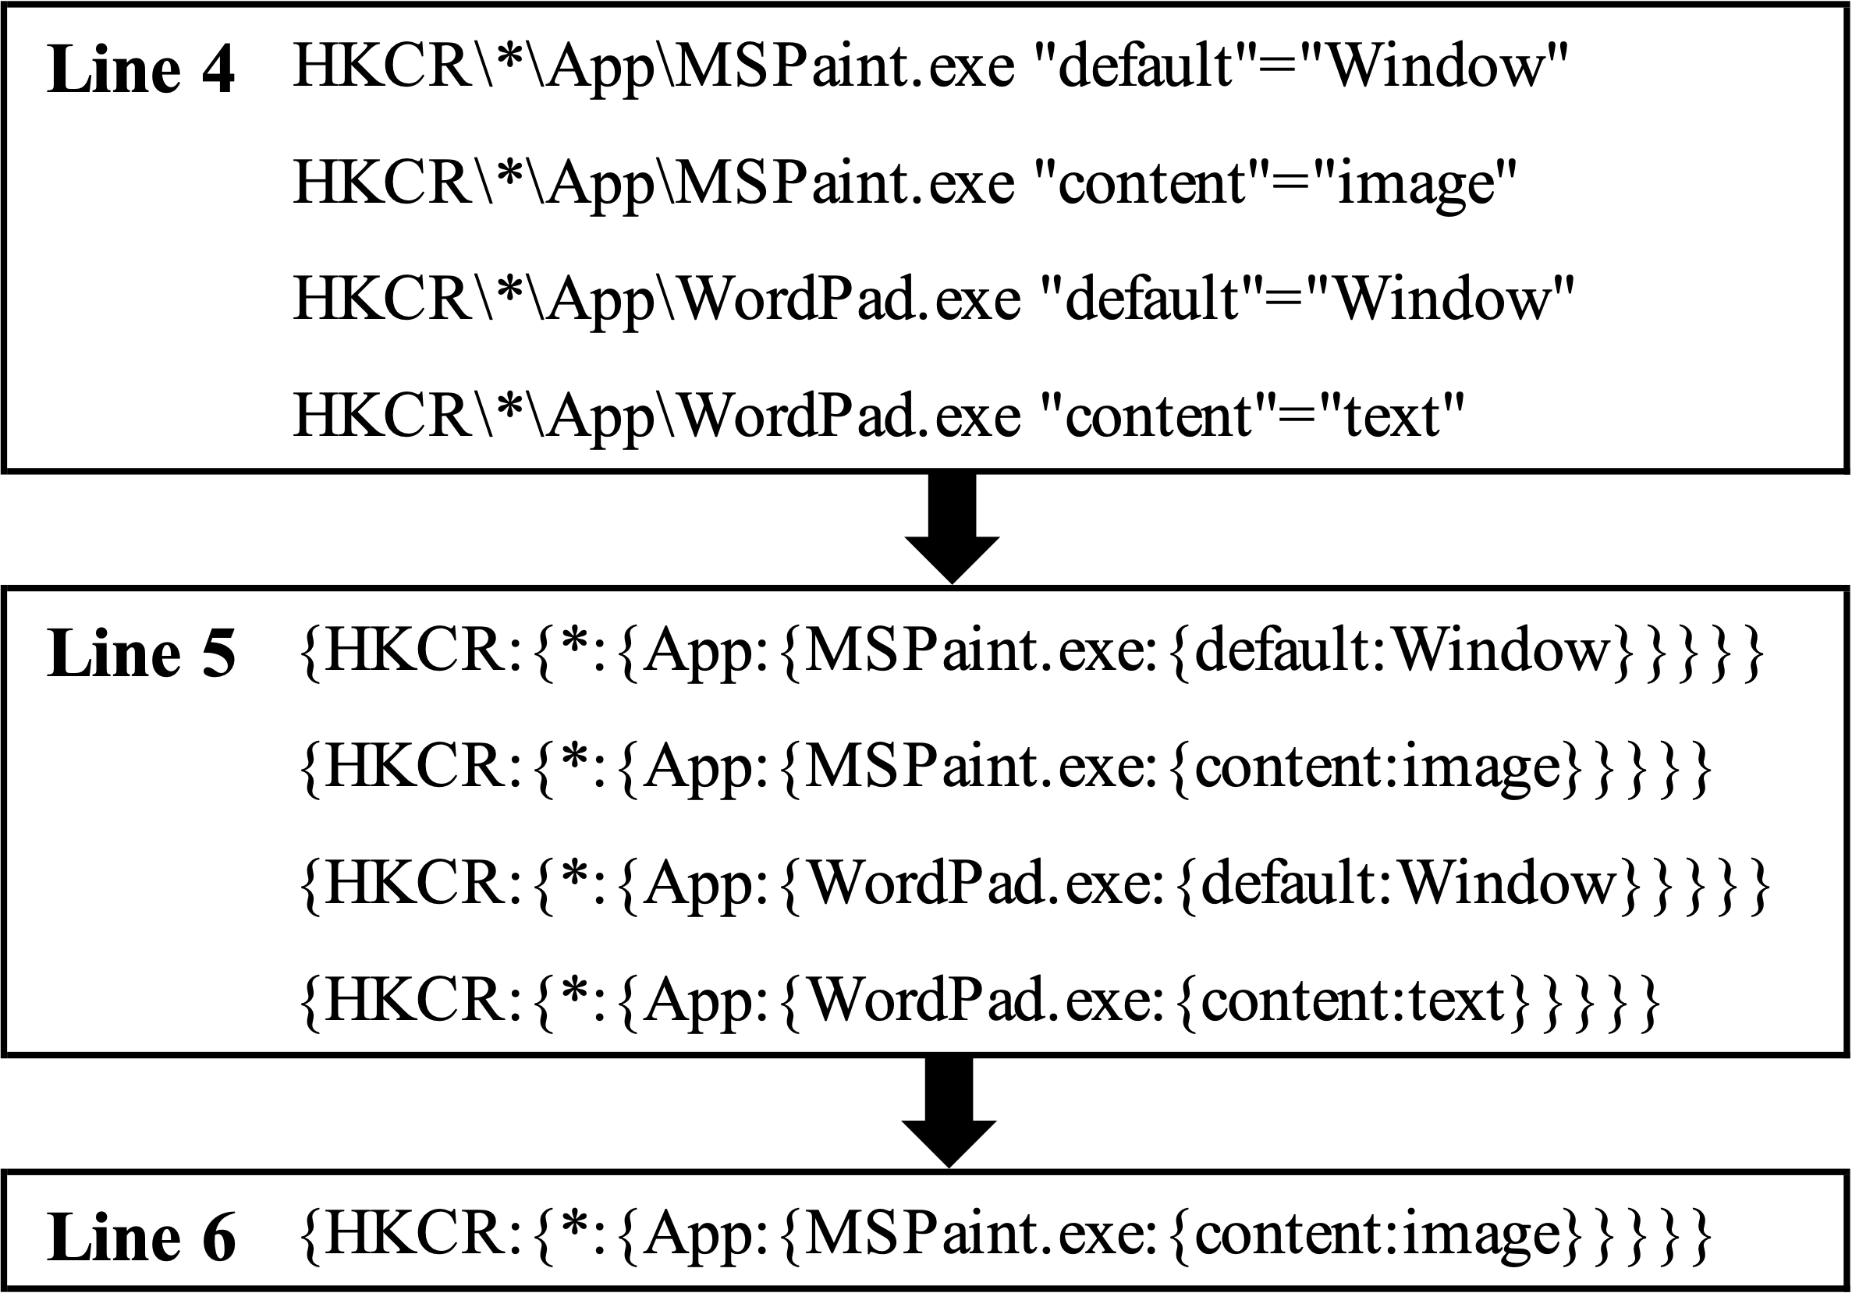
Figure 11. An example of the actual process of forensic for a target registry key.

Slide 12
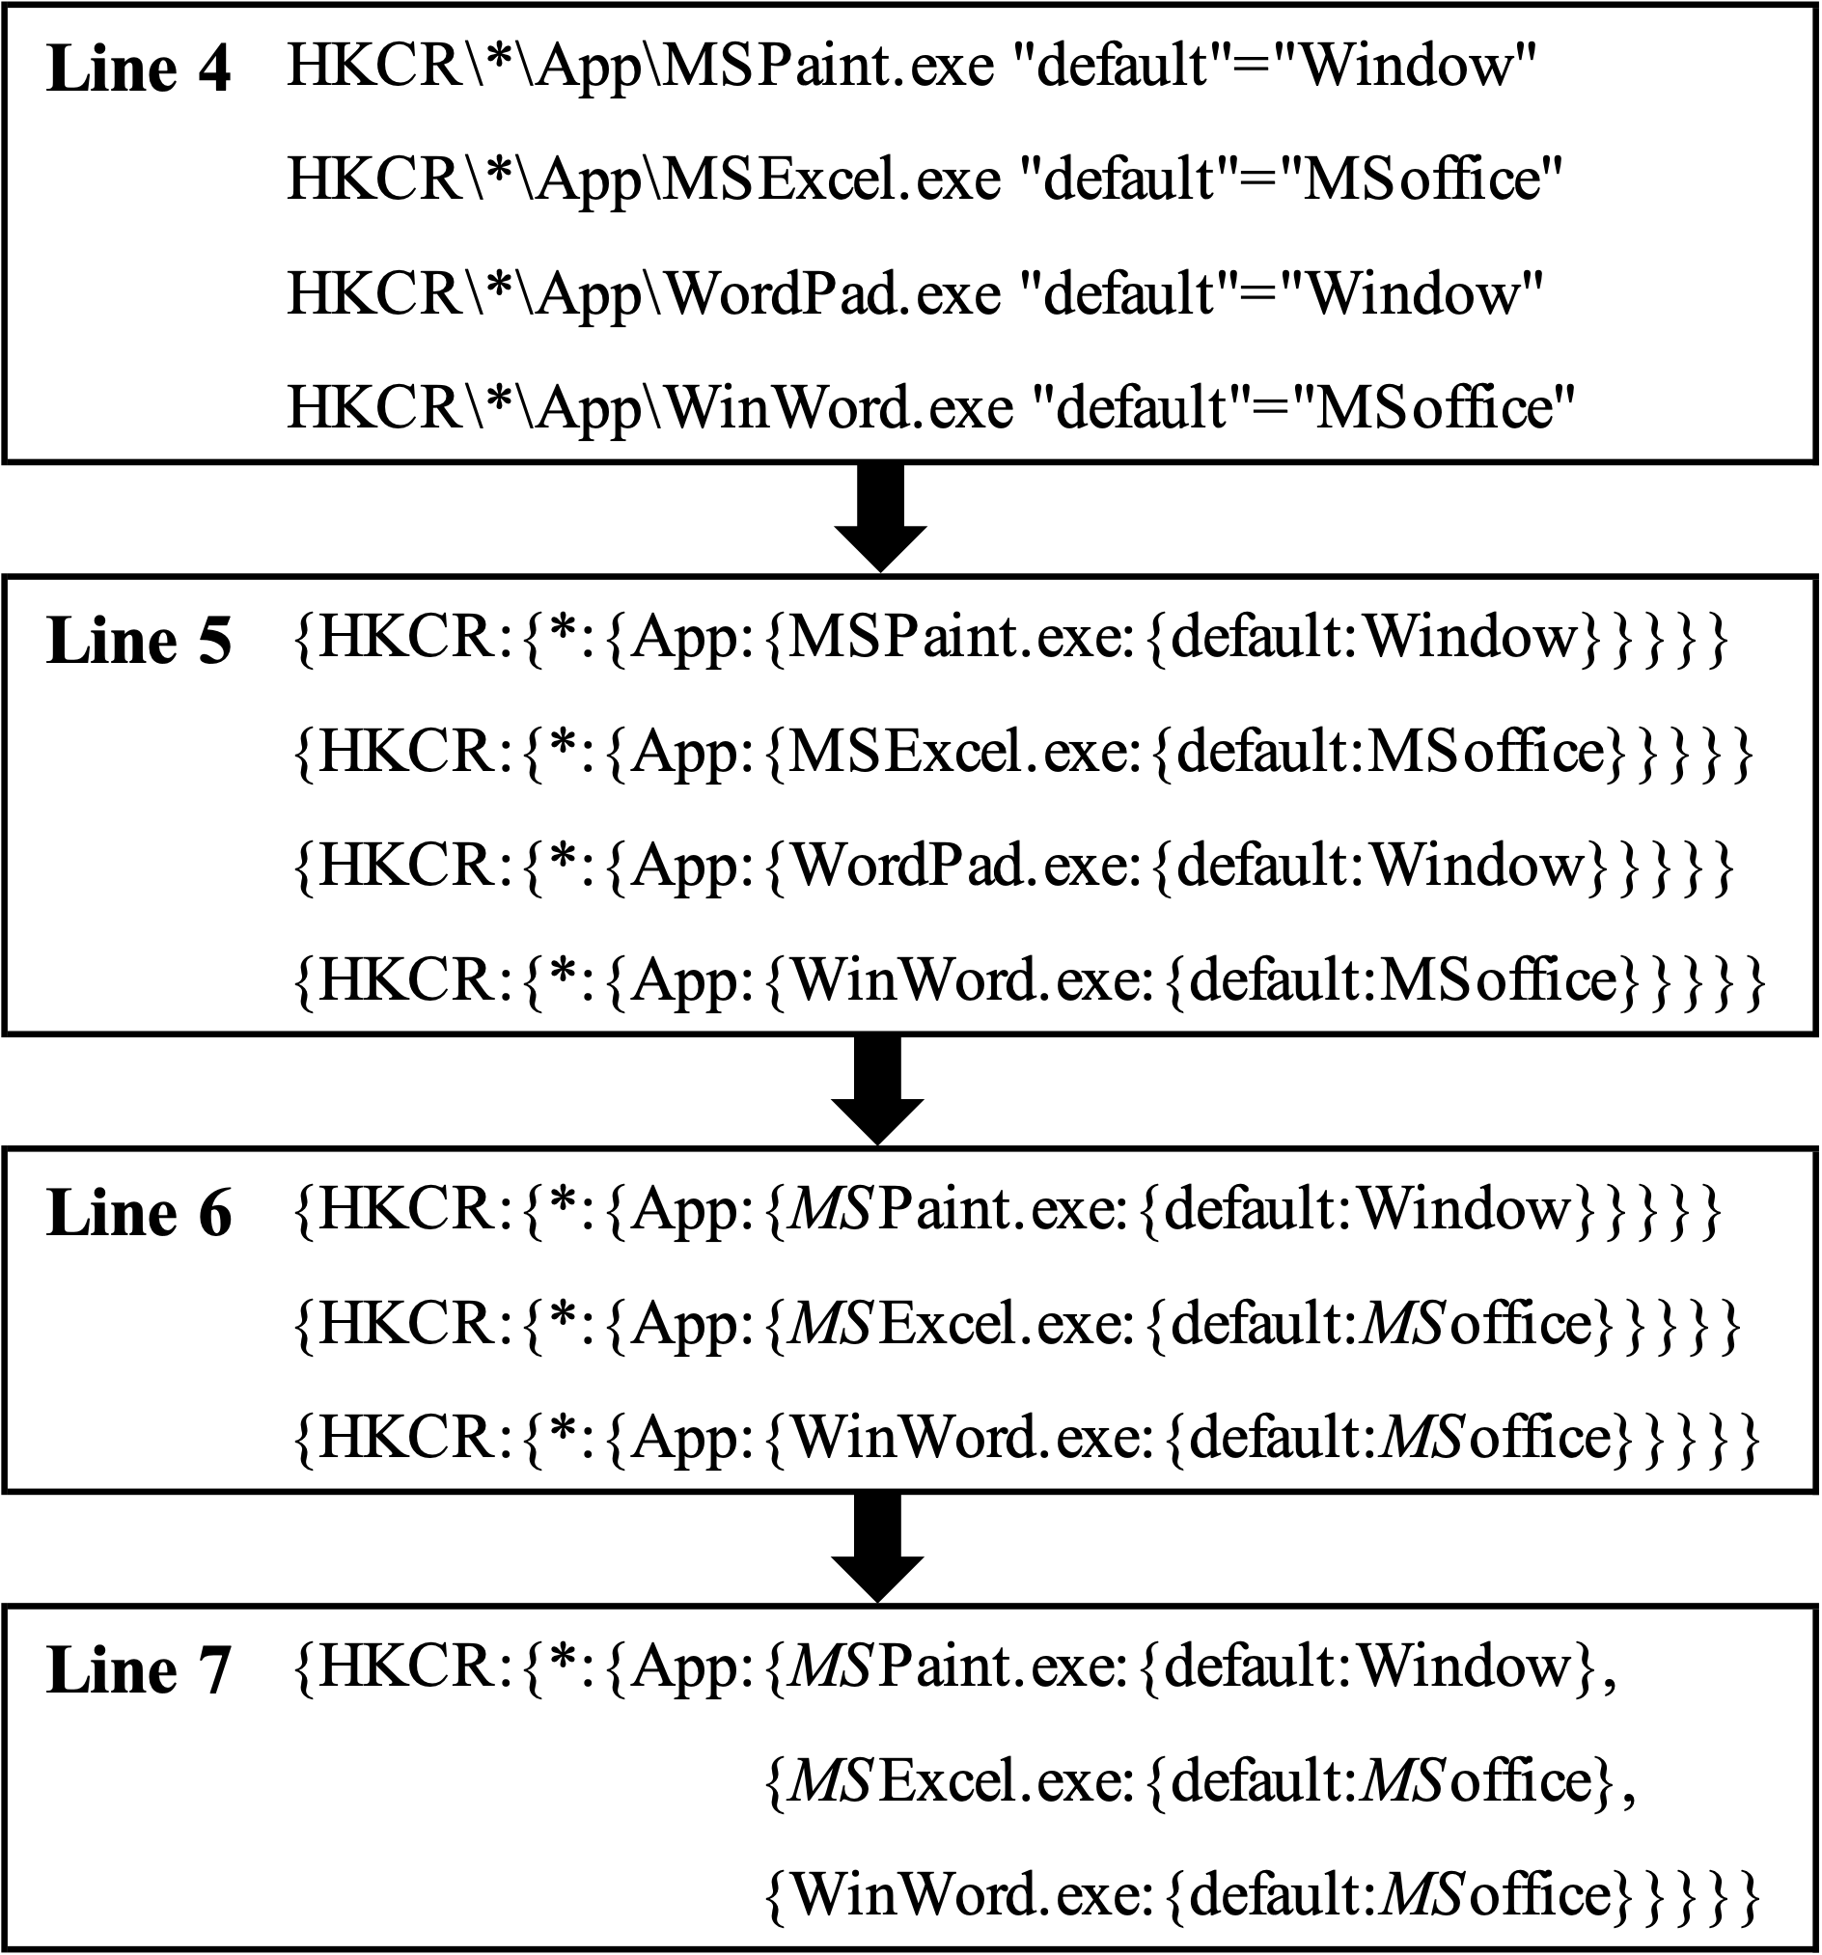
Figure 12. An example of the actual process of forensic on registry entries using keywords.

Slide 13
Figure 13. An example of the actual process of comparing the entire two registry repositories

Slide 14
Figure 14. The comparison results of the Loading Windows Registry in HDFS
(a) The comparison results of Changes with number of Nodes
(b) The comparison results of Changes with number of CPUs

Slide 15
Figure 15. The comparison results of the Retrieving information based on a registry key
(a) The comparison results of Changes with number of Nodes
(b) The comparison results of Changes with number of CPUs

Slide 16
Figure 16. The comparison results of the Retrieving registry key and value based on a keyword
(a) The comparison results of Changes with number of Nodes
(b) The comparison results of Changes with number of CPUs

Slide 17
Figure 17. The actual results obtained by the algorithm for Scenario 2.

Slide 18
Figure 18. The comparison results of the comparing the entire registry repository
(a) The comparison results of Changes with number of Nodes
(b) The comparison results of Changes with number of CPUs

Slide 19
Figure 19. The result of comparing the entire registry repositories.

