Slide 1
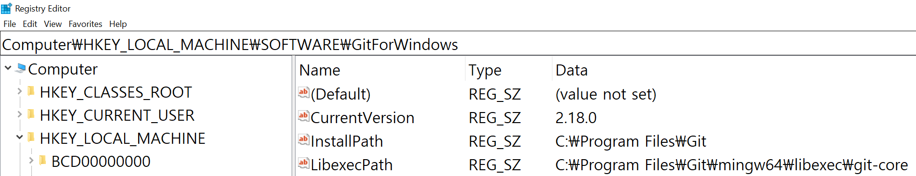
Fig. 1. The registry keys and values.

Slide 2


Fig. 2. A use case of the Windows registry.
(a) The value stored in a Windows registry key.
(b) The registry operations to access to a Windows registry key.

Slide 3
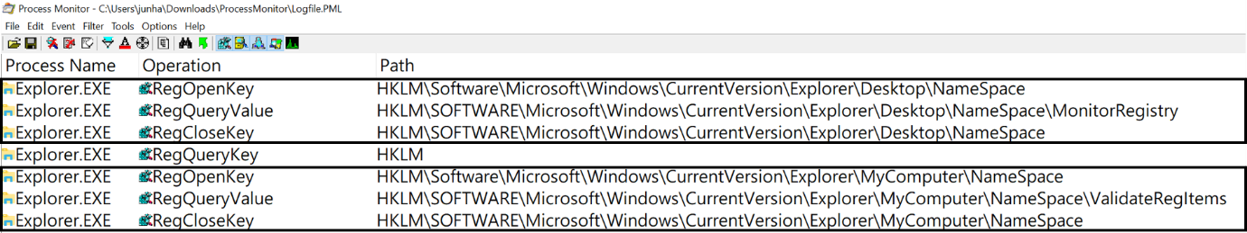
Fig 3. An example of inefficient access patterns to a registry.

Slide 4
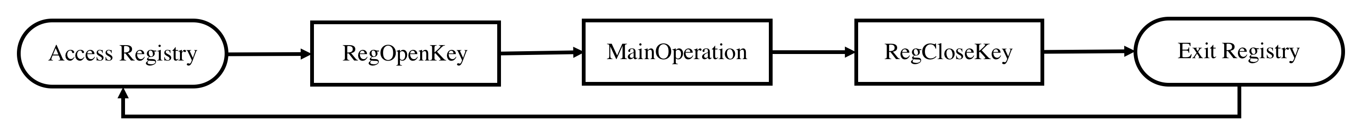
Fig 4. Comparison of original inefficient access patterns and the deduplication approach.
(a) Original access patterns to the registry.
(b) Deduplication of the access patterns to the registry

Slide 5

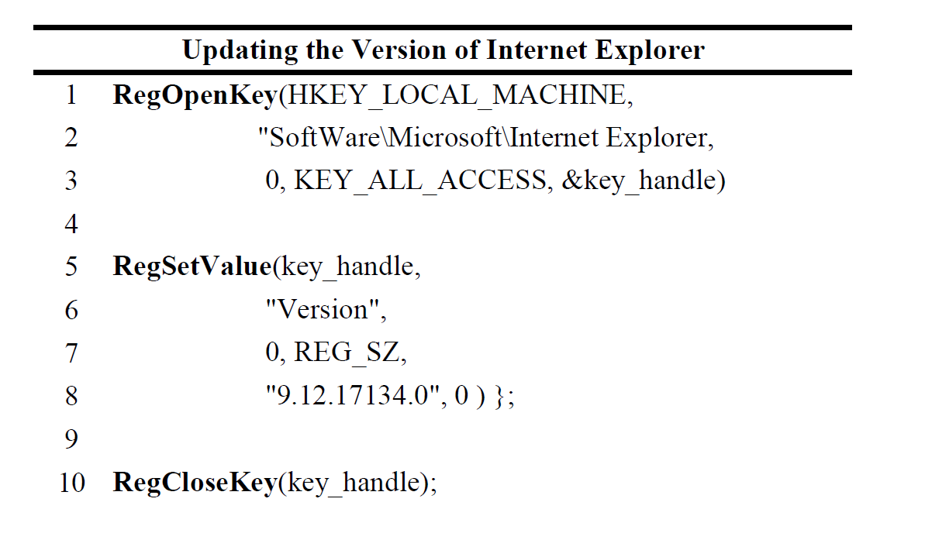
Fig 5. The registry and updating the registry.
(a) Version information of Internet Explorer stored in the registry.
(b) Source code of updating the registry value using registry operations.

Slide 6
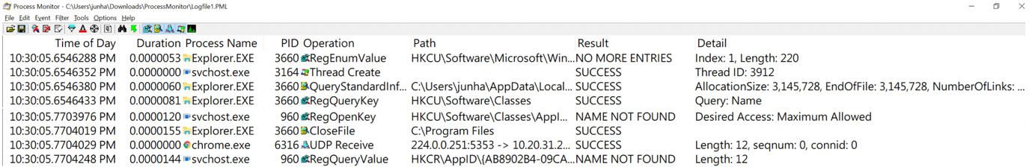
Fig 6. Windows I/O log data collected by Process Monitor.

Slide 7

Fig 7. Internal Duplication: Duplication of RegQueryKey

Slide 8
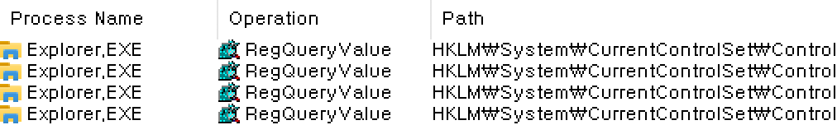
Fig 8. Internal Duplication: Duplication of RegQueryValue

Slide 9

Fig 9. Internal Duplication : Duplication of RegQuerykey

Slide 10

Fig 10. Outer Duplication : Duplication of RegOpenKey - RegCloseKey

Slide 11

Fig 11. Outer Duplication : Duplication of RegOpenKey – RegQueryValue - RegCloseKey

Slide 12
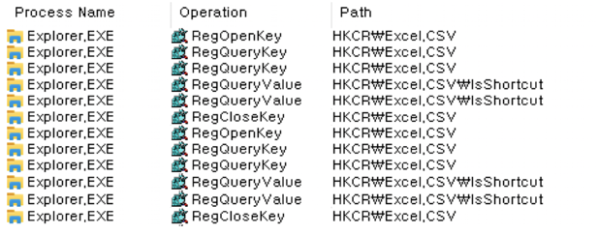
Fig 12. Outer Duplication : Duplication of
RegOpenKey – RegSetInfoKey - RegQueryValue - RegQueryValue - RegQueryValue - RegQueryValue - RegCloseKey

Slide 13
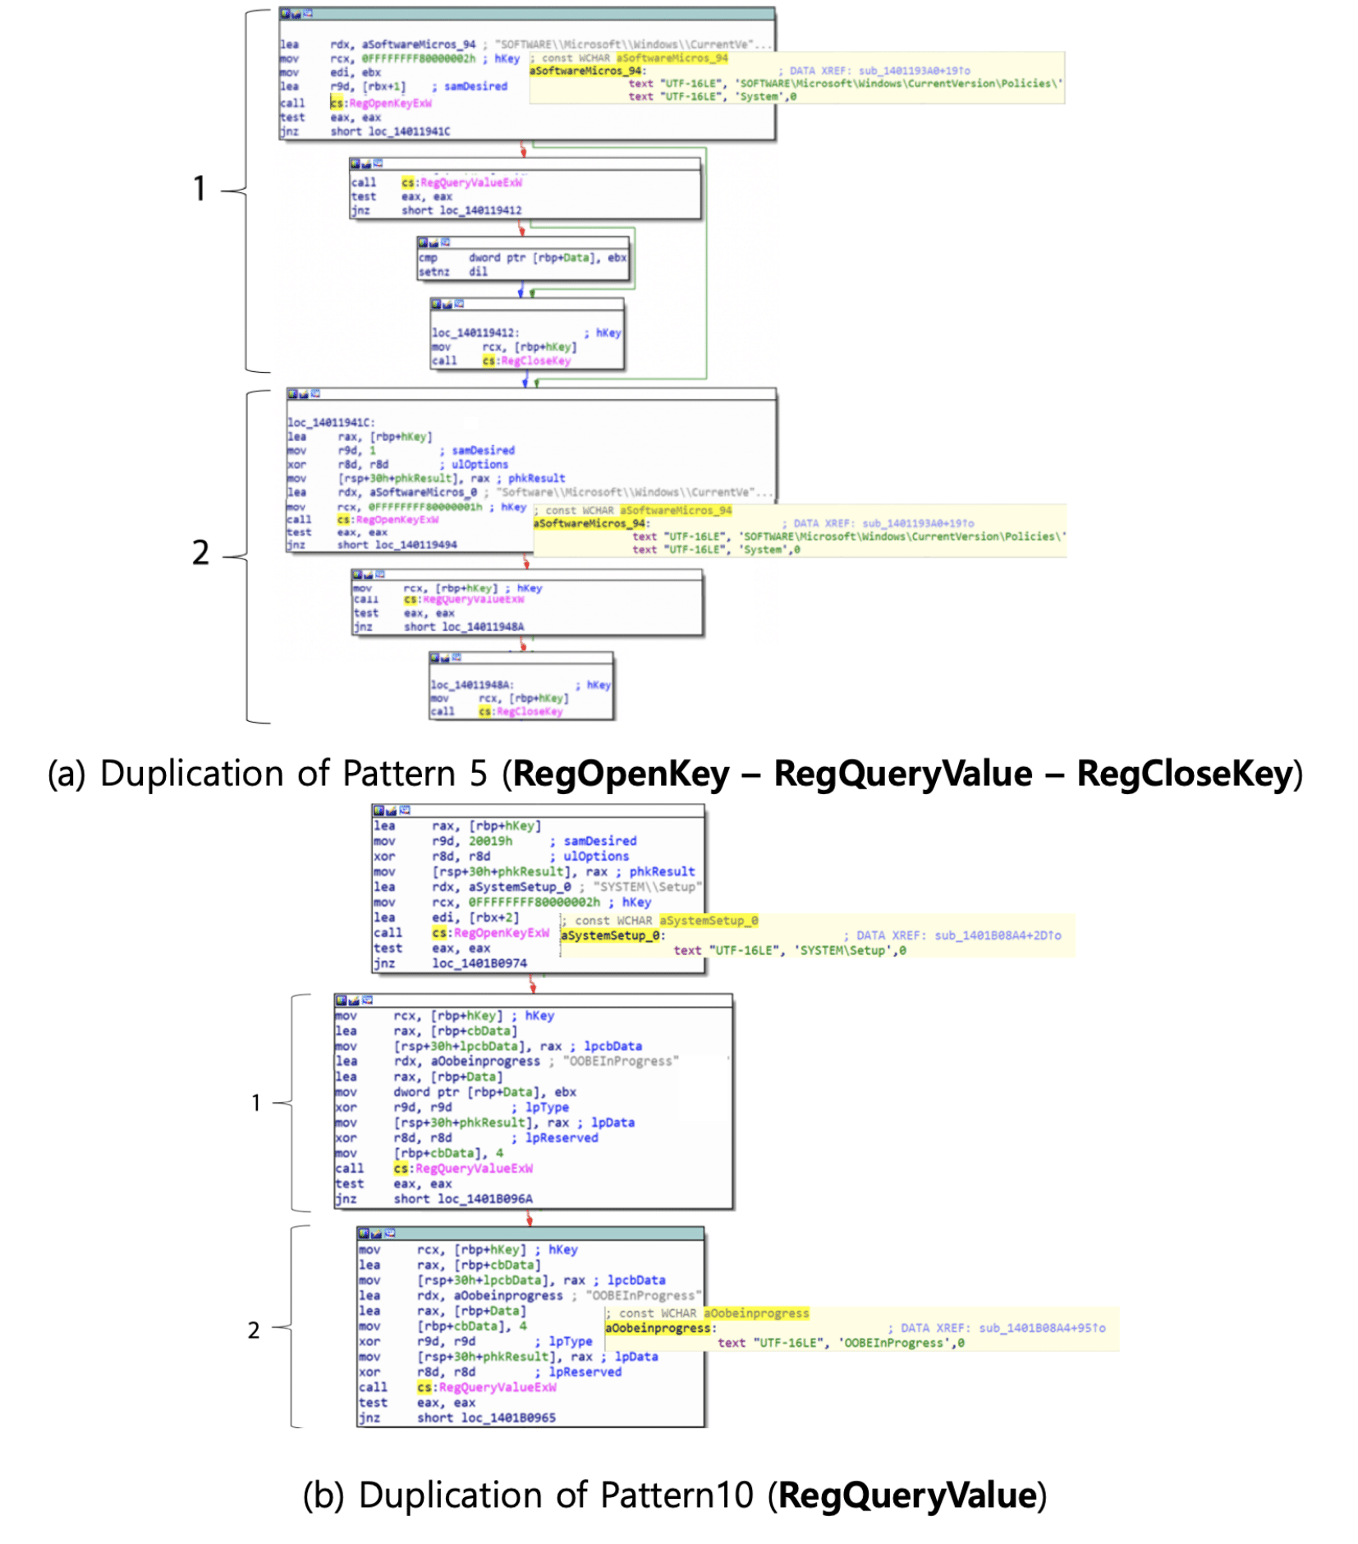
Fig 13. Verifying the existing duplicated access to the Registry by disassembling Explore.exe

Slide 14
Fig 14. Internal Duplication Algorithm

Slide 15
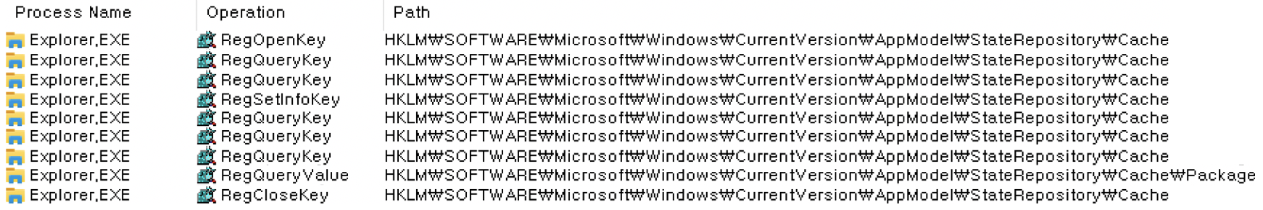
Fig 15.Side effect

Slide 16
Fig 16. outer duplication algorithm

Slide 17
Fig 17. The concept of two-level deduplication
RegOpenKey()
Reg_Operation₁()
Reg_Operation₁()
RegCloseKey()
RegOpenKey()
Reg_Operation₁()
Reg_Operation₂()
RegCloseKey()
RegOpenKey()
Reg_Operation₁()
Reg_Operation₂()
Reg_Operation₂()
RegCloseKey()
RegOpenKey()
Reg_Operation₁()
RegCloseKey()
RegOpenKey()
Reg_Operation₁()
Reg_Operation₂()
RegCloseKey()
RegOpenKey()
Reg_Operation₁()
Reg_Operation₂()
RegCloseKey()
RegOpenKey()
Reg_Operation₁()
RegCloseKey()
RegOpenKey()
Reg_Operation₁()
Reg_Operation₂()
Reg_Operation₁()
Reg_Operation₂()
RegCloseKey()
Internal
Redundancy Elimination
Outer
Redundancy Elimination

Slide 18

Fig 18. The example of the improved effect of applying the outer deduplication after the internal deduplication

Slide 19
Fig 19. The algorithm of the internal deduplication

Slide 20
Fig 20. The algorithm of the outer deduplication

Slide 21
Fig. 21. Evet-driven deduplicated access pattern for the internal duplication

Slide 22
Fig 18. Redundancy elimination based on redundancy analysis on access patterns.
I/O Log Data of Windows
Applications
Redundant Access Patterns
Redundancy Elimination Method
1) Redundancy
Detection
2) Redundancy
Elimination
(a) Redundancy analysis and its elimination method.
Windows
Applications (Binary Codes)
Source Codes
1) Decompilation [12], [13]
2)
Redundancy Eliminated
Windows
Applications
Redundancy Eliminated
Source Codes
3) Compilation
(b) Overall flow for applying the redundancy elimination to the Windows applications.

