Slide 1
Accident Detection System on the Road based on CCTV Images
Two Modules :
Car Fire Detection
Car Crash Detection

Slide 2
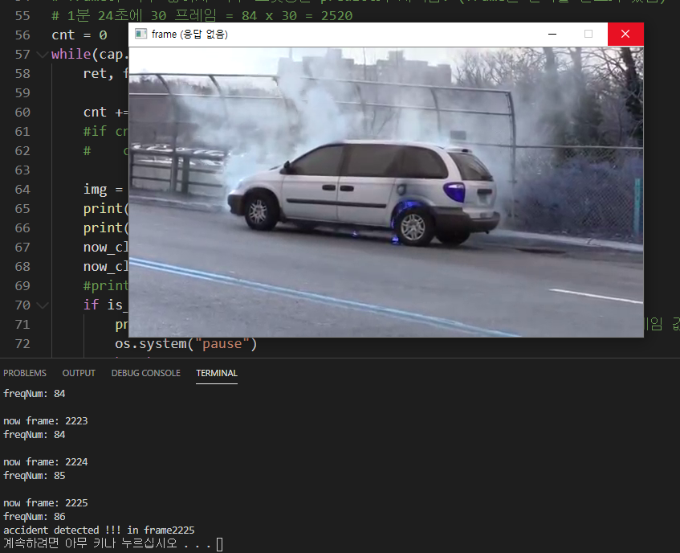
Car Fire Detection
Learn a new model to detect fires in cars
Train and validation set is 7:3, positive and negative set is 1:1, and the dataset image is about 2,000.
To fix overfitting, drop out is applied and the number of epochs is limited.
By configuring a buffer that stores 100 adjacent frames, it is judged to be a fire if it is true among 80 frames.

Slide 3
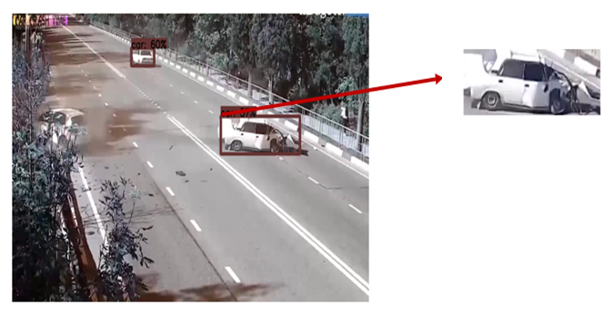
Car Crash Detection
Detect the car in the image and check if the car is stopped.
If it is stopped, crop the image separately and check the damage status of the car.
Validation accuracy is around 90~94%

