Slide 1
IMPROVING
FASHION MNIST MODEL

Slide 2
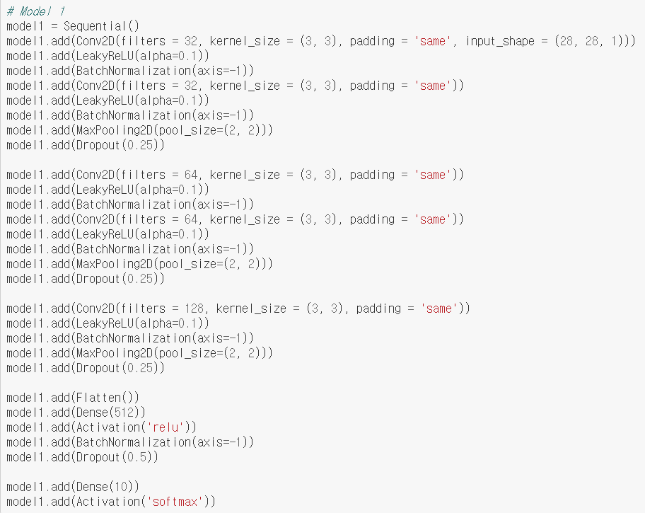

Slide 3
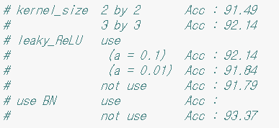

Slide 4




Slide 5
