Slide 1
Patcher Demo
Preventing XSS Attack

Slide 2
A Real XSS CASE

Slide 3
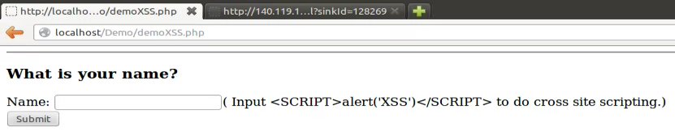
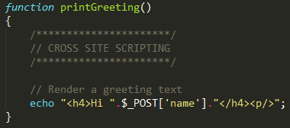
A Vulnerable PHP File
File Name: demoXSS.php

Slide 4
Input Attack String
<SCRIPT>alert('XSS')</SCRIPT>

Slide 5
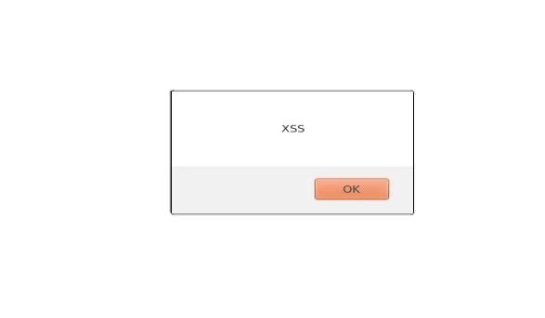
After Submitting Request
<SCRIPT>alert('XSS')</SCRIPT>
OOPS!

Slide 6
SCAN PHP CODE BY PATCHER

Slide 7
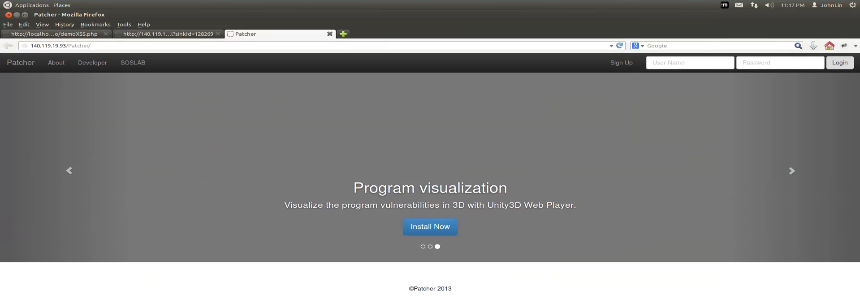
Link to Patcher
URL-
Http://140.119.19.93/Patcher/

Slide 8
Sign Up

Slide 9
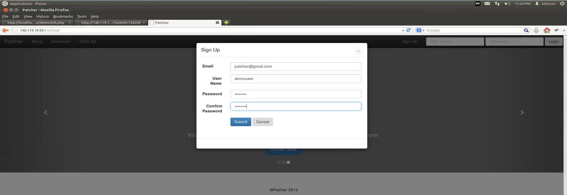
Sign Up

Slide 10
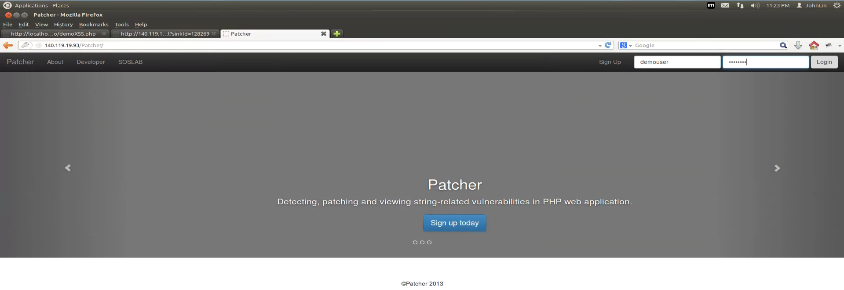
Login

Slide 11
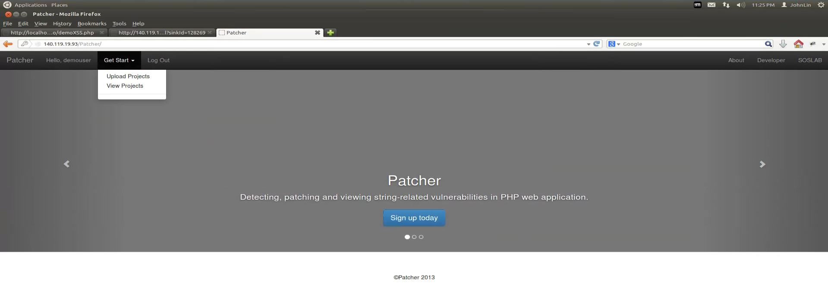
Visit Workspace

Slide 12
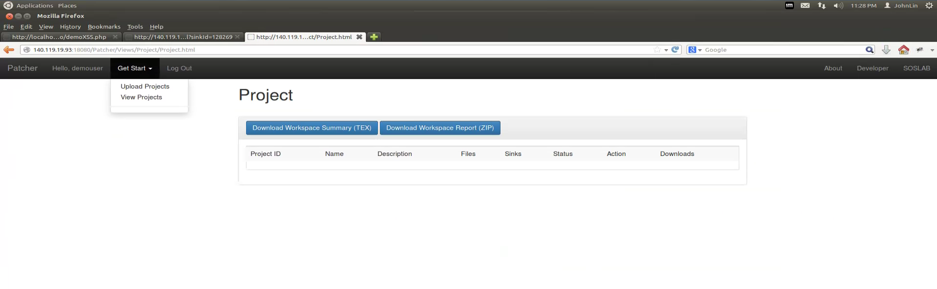
Upload PHP Code

Slide 13
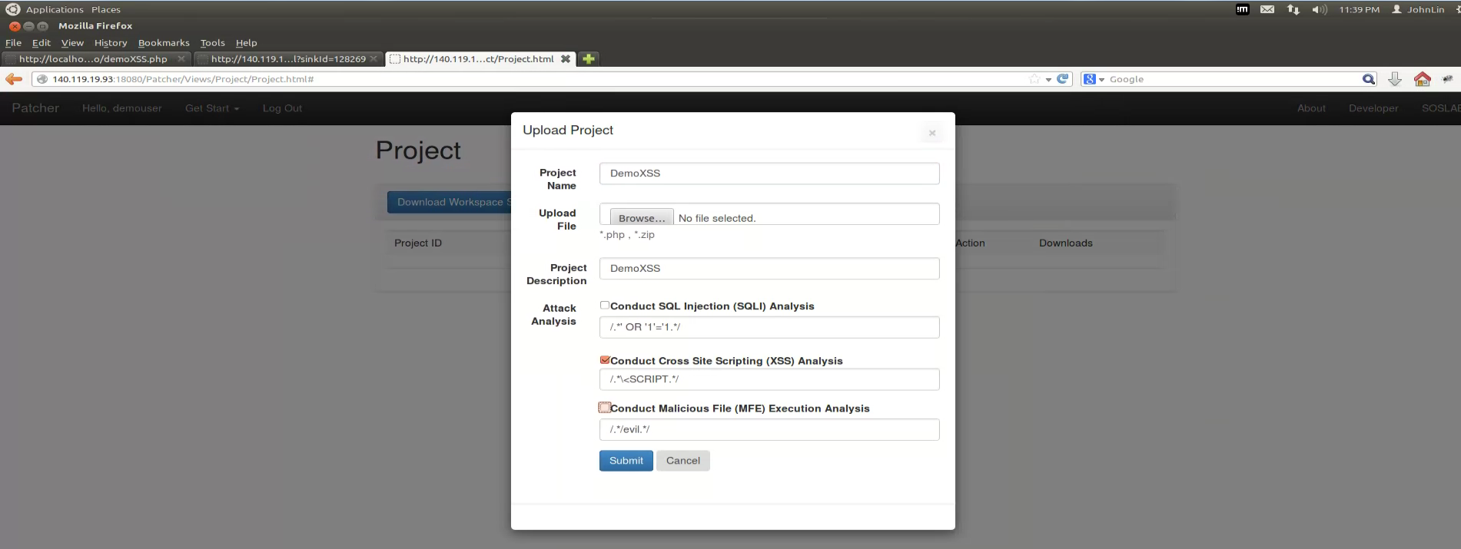
Upload PHP Code

Slide 14
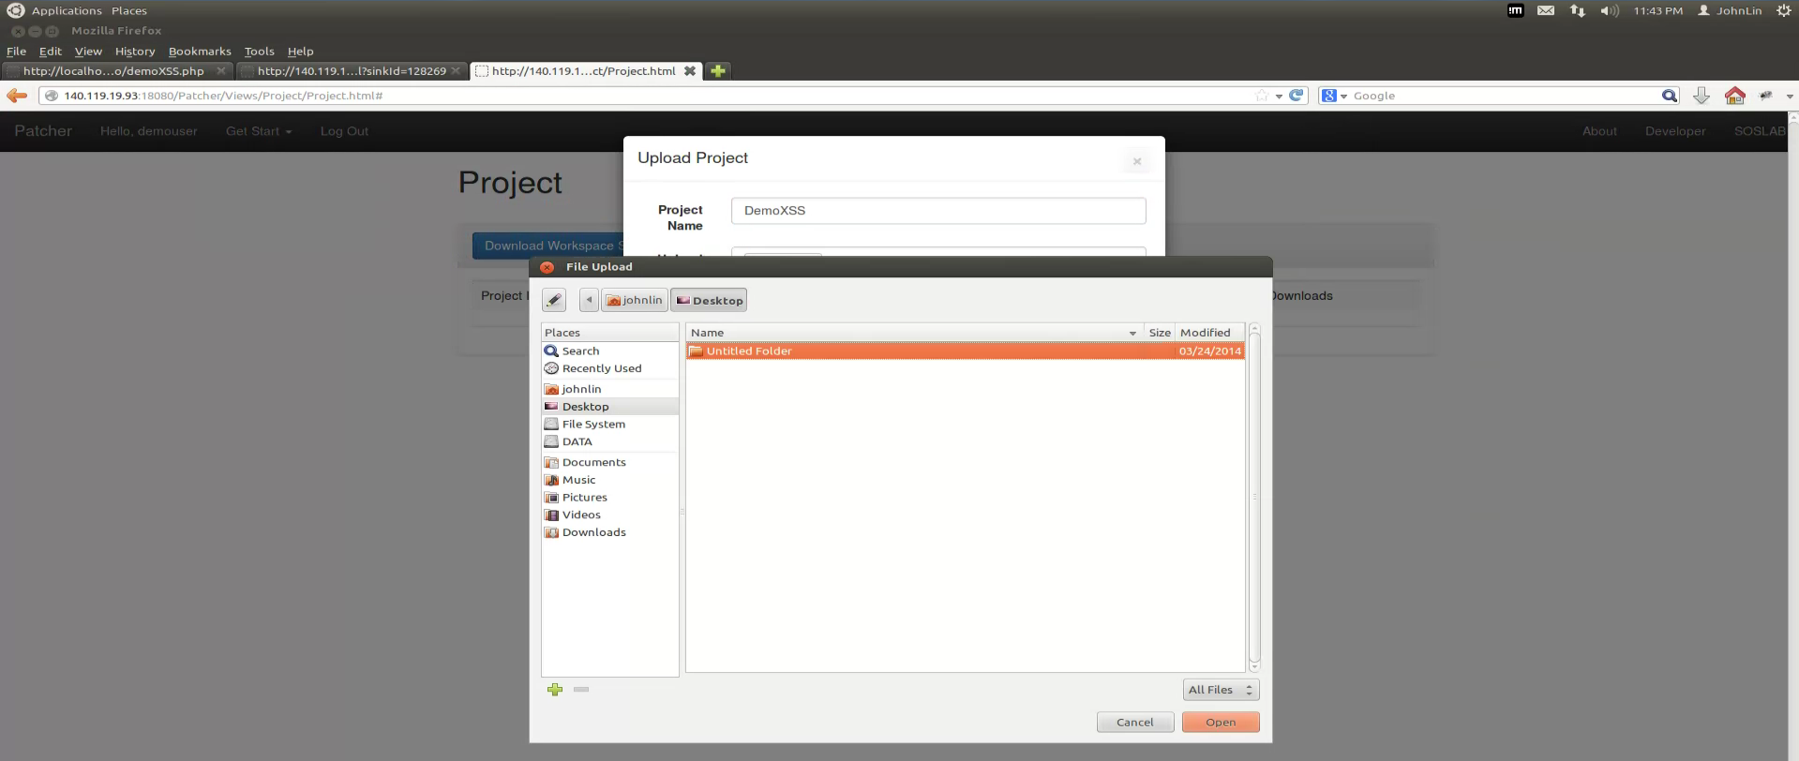
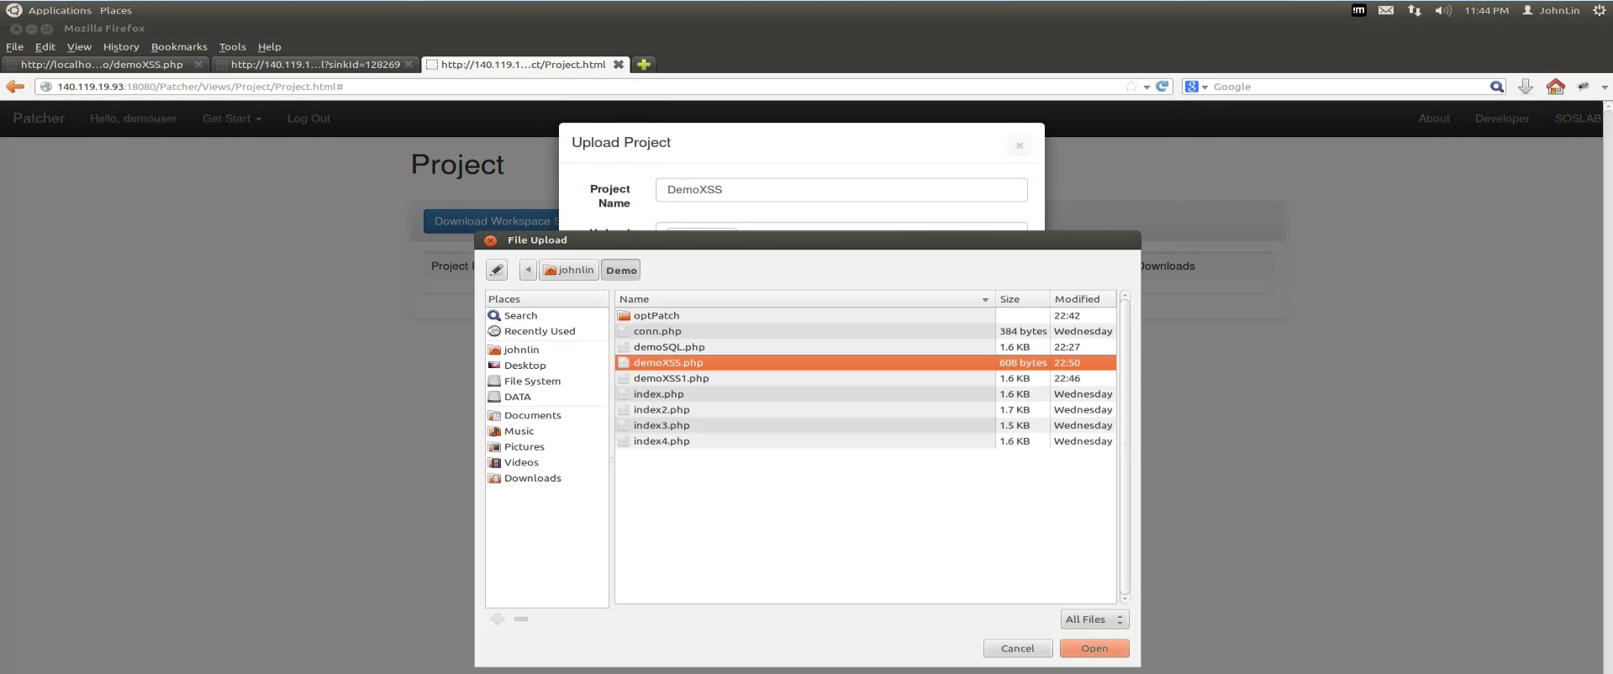
Upload PHP Code

Slide 15
Upload PHP Code

Slide 16
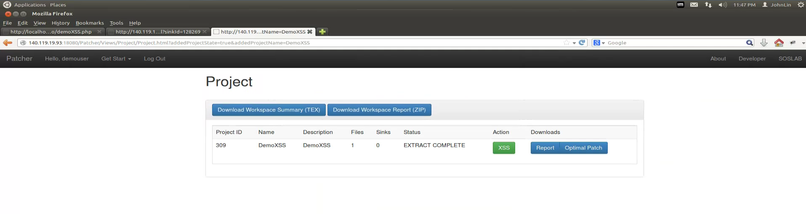
Upload Complete
The uploaded file is ready in the list.

Slide 17
View Analysis Result

Slide 18
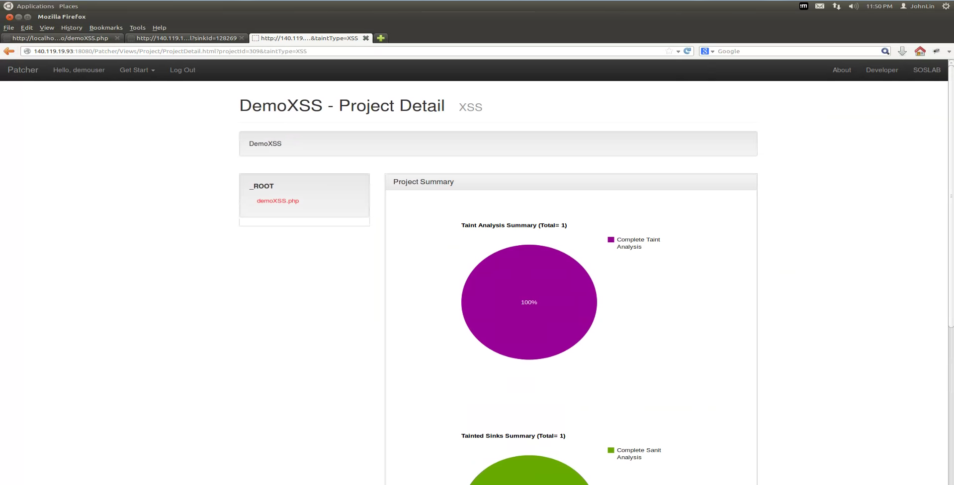
View Analysis Result
File Tree (Vulnerable files will be marked as red color)
Monitor analysis progress instantly

Slide 19
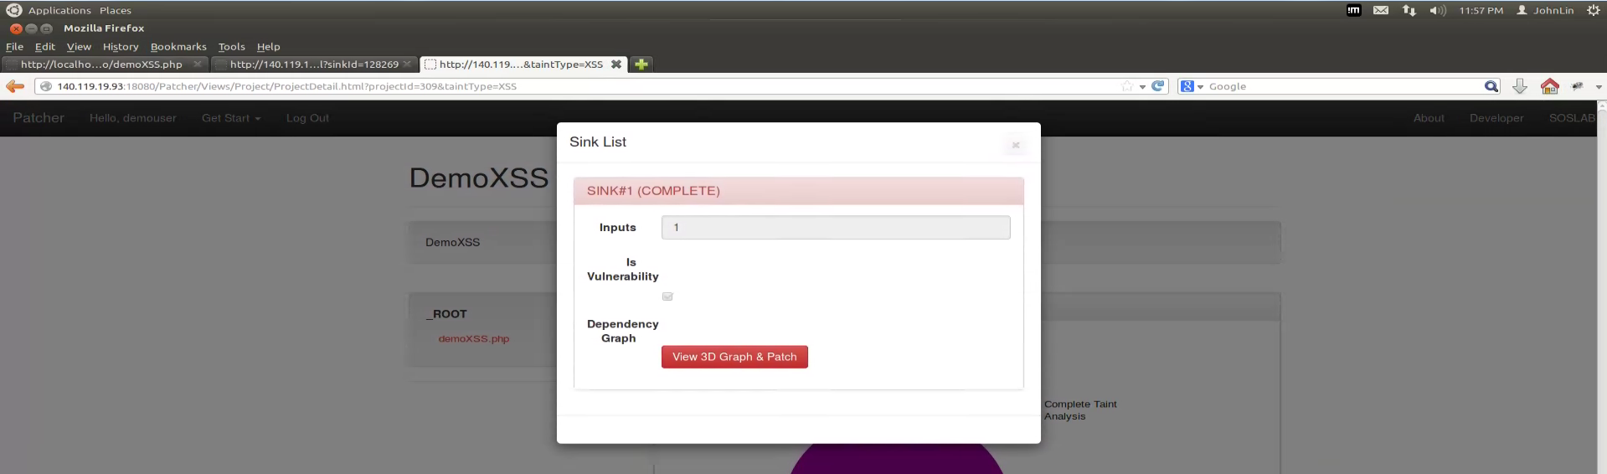
View Analysis Result

Slide 20
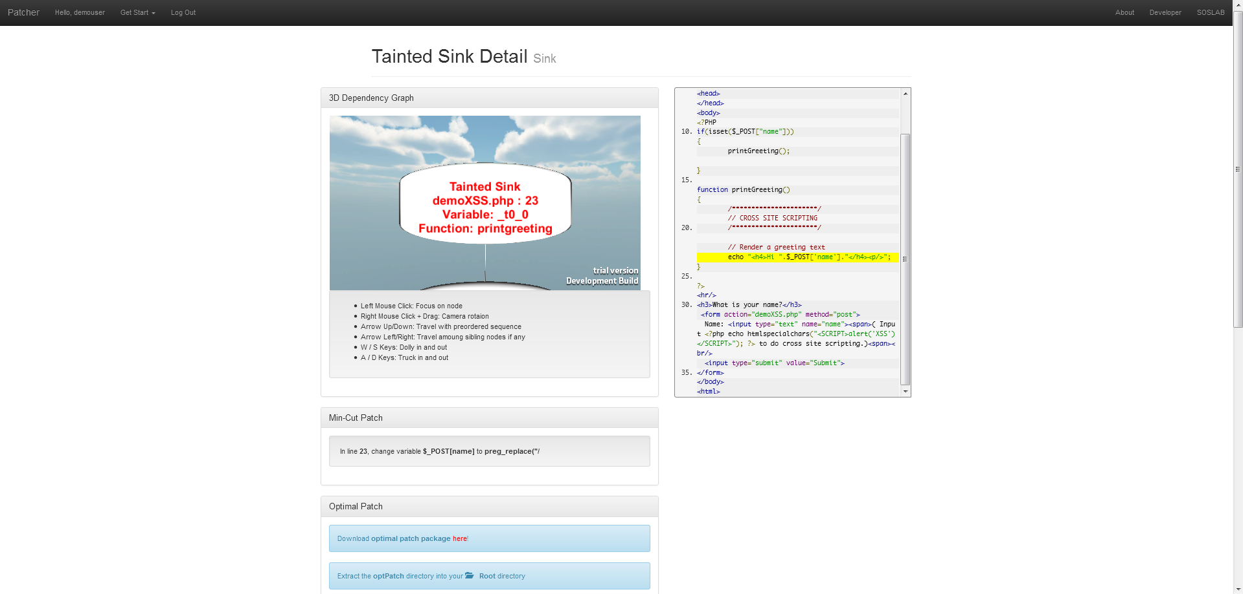
View Analysis Result
3D Dependency Graph
PHP Source Code
Optimal Patch Package

Slide 21
Patch Vulnerabilities

Slide 22
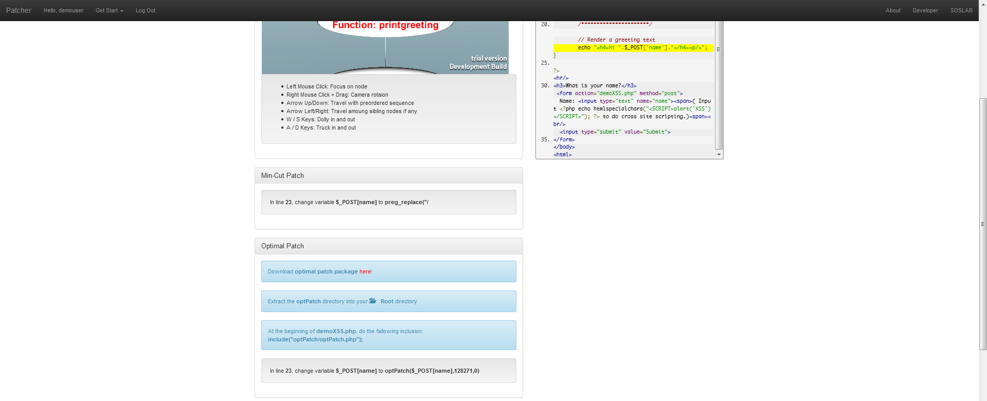
Download Patch Package
Click to start downloading

Slide 23
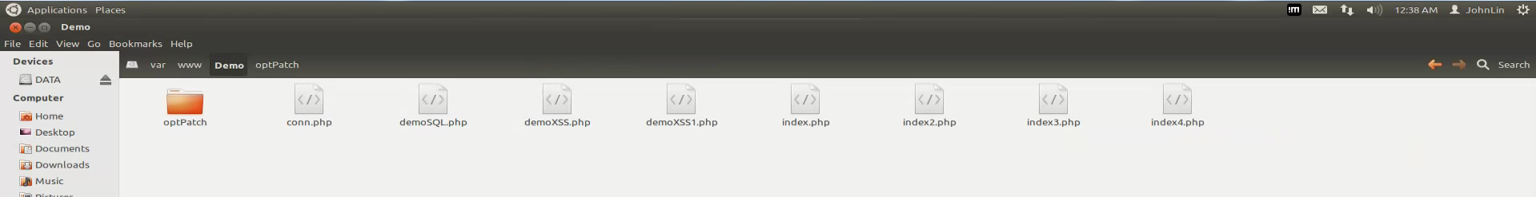
Put the Package Into Root Folder
Decompress the patch package and put it into your root folder of PHP project.
Optional:
In some operating system,
you might need to grant the reading permission of this folder to PHP
In order to prevent “Permission Denied” error.

Slide 24
Patch the code by Patcher’s Instruction
In line 23, change variable $_POST[‘name’] to optPatch($_POST[‘name’],128271,0)

Slide 25
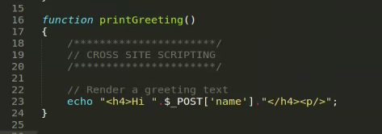
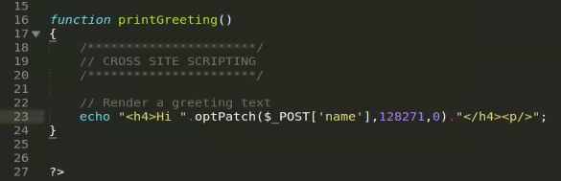
Patch the code by Patcher’s Instruction

Slide 26
Include Patch Package
include("optPatch/optPatch.php");

Slide 27
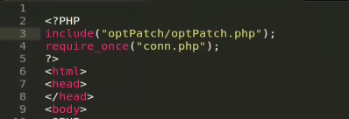
Include Patch Package

Slide 28
TRY ATTACKING AGAIN

Slide 29
Input Attack String
<SCRIPT>alert('XSS')</SCRIPT>

Slide 30
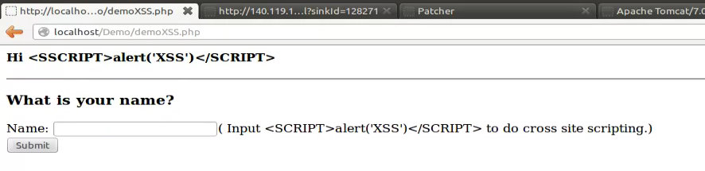
After Submitting Request
Instead of pop out an alert box,
we escape the attack string

