Slide 1
Variables and decisions
A variable names a value.
A comparison returns True or False.
An if / else statement selects one branch.
score = 72
if score >= 60:
print("Practice passed")
else:
print("Try again")
Introduction to Programming | Synthetic CourseDock demo lesson

Slide 2
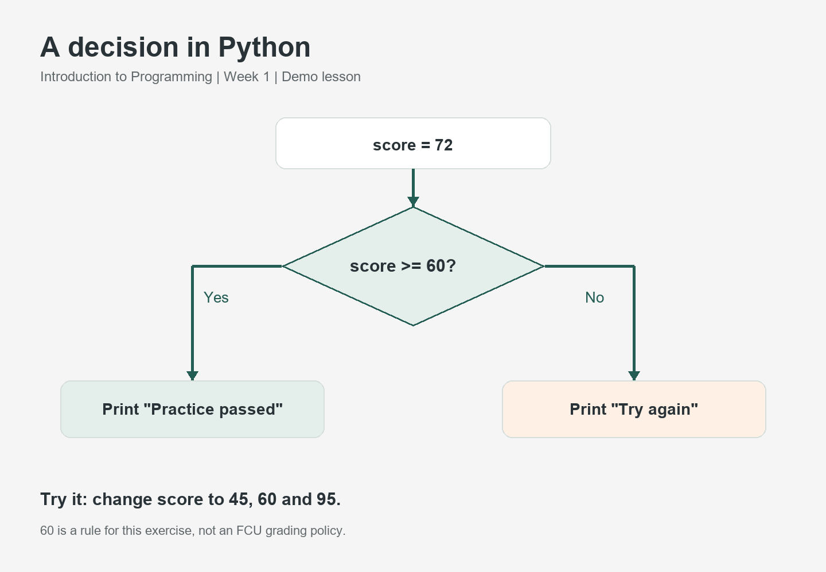
Trace the program
Introduction to Programming | Synthetic CourseDock demo lesson

Slide 3
Test the boundary
45 takes the else branch.
60 takes the if branch.
95 takes the if branch.
Practice: write a new comparison and two test cases.
The threshold is an exercise rule, not an FCU grading policy.
Introduction to Programming | Synthetic CourseDock demo lesson

