Slide 1
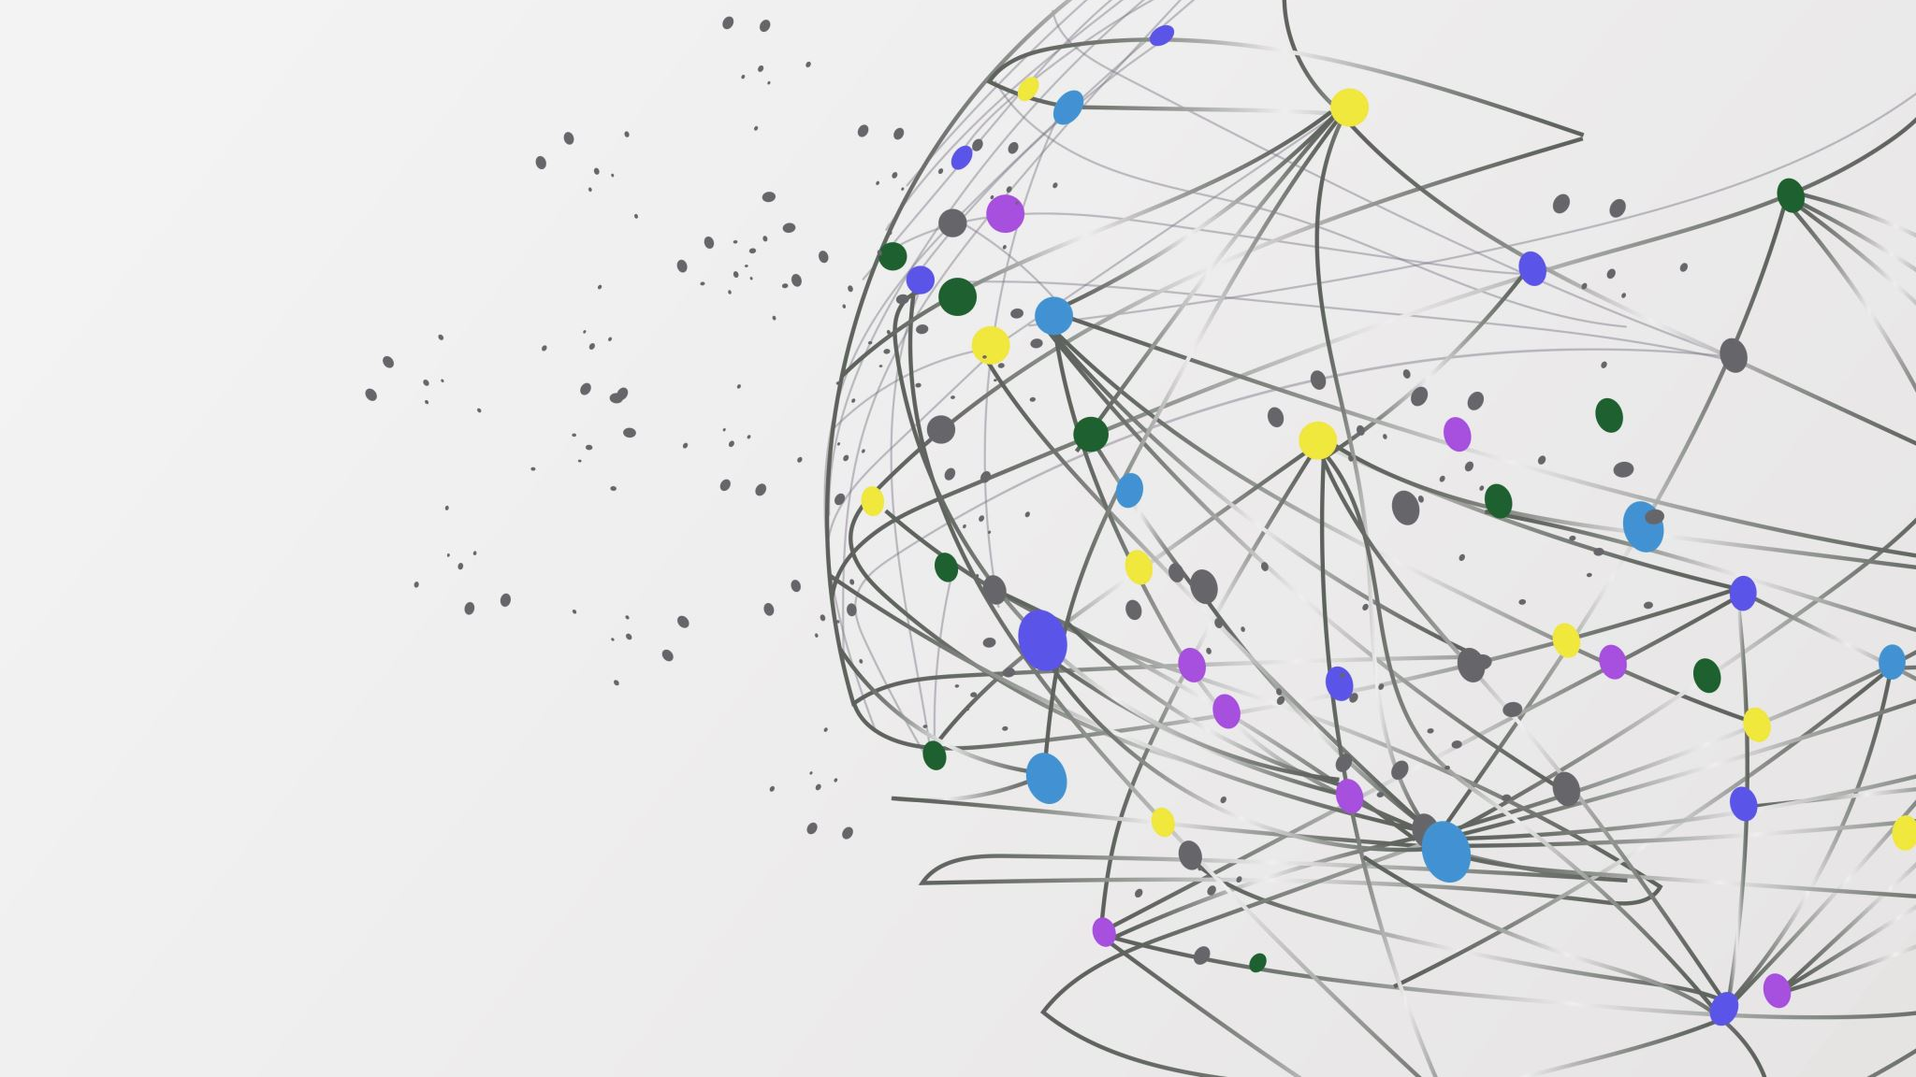
The Refugee Research Project
An Overview

Slide 2
Contents
The Goals of the Project
2) How the manual looks like
3) How I am doing the research and what I hope to do in the future
4) For Further Discussion

Slide 3

The Goals of the Project
As there is no definite resource for the Community College of Aurora (CCA) to assist the refugees in their life on and off campus, I am hoping that this collection of useful and up to date information on their countries of origin would be used by the college towards helping the refugees feel more comfortable and included while they attend CCA.
Through this project, I hope to learn more about the history, culture, and the background of these countries and their people myself.
The information on the manual encourages those who are a part of CCA to have an inclusive and understanding mindset towards refugees and treat them appropriately based on their background and experiences.

Slide 4
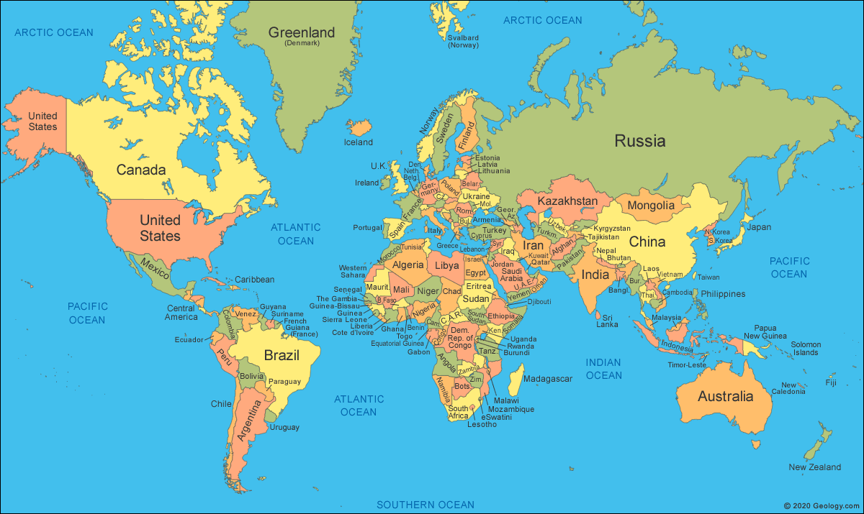
How the manual looks like
The Format for each country:
-Introduction: Geographical location, demonym(s).
- Culture: Attitudes and norms, religion and beliefs, food, music, language, and holidays.
- Background of the Country: Brief history, political situation, economical situation, push factors.

Slide 5

How I am doing the research
Mostly through the internet
Through online communities
Through learning the experiences of refugees and immigrants in person
Clubs at the school
Friends, classmates
What I hope to do in the future
To possibly met refugees in person at CCA and Project Worthmore (Aurora).
To make sure that the manual is proofread and accurate

Slide 6
For Further Discussion:
Is there anything that you are wondering about?
Do you have any suggestions for this project?

Slide 7
Thank You!

