Slide 1


CS145 Discussion
Week 1
Junheng, Shengming, Yunsheng
10/05/2018

Slide 2
Roadmap
Class logistics & Reminders
Math review: Basics of
Probability
Linear Algebra
Optimization
Matrix Calculus
Linear Regression

Slide 3
Announcement
Course Website:
http://web.cs.ucla.edu/~yzsun/classes/2018Fall_CS145/index.html
Dates:
Project introduction on next Monday (10/08)
Homework 1 out on next Wednesday (10/10)
In-class midterm on Nov. 14 (12-2pm)
Final exam schedules on Dec 13 (11:30am-2:30pm)
Update: TA office hours
Yizhou Sun (yzsun@cs.ucla.edu), office hours: 3-5pm Wednesdays @BH 3531E
Yunsheng Bai (yba@cs.ucla.edu), office hours: 1-3pm Thursdays @BH 3256S
Junheng Hao (haojh.ucla@gmail.com), office hours: 1-3pm Tuesdays @BH 3256S
Shengming Zhang (michaelzhang@cs.ucla.edu), office hours: 3-5pm Mondays @BH 3256S

Slide 4
Math Review
Probability
Linear Algebra
Optimization
Matrix Calculus

Slide 5
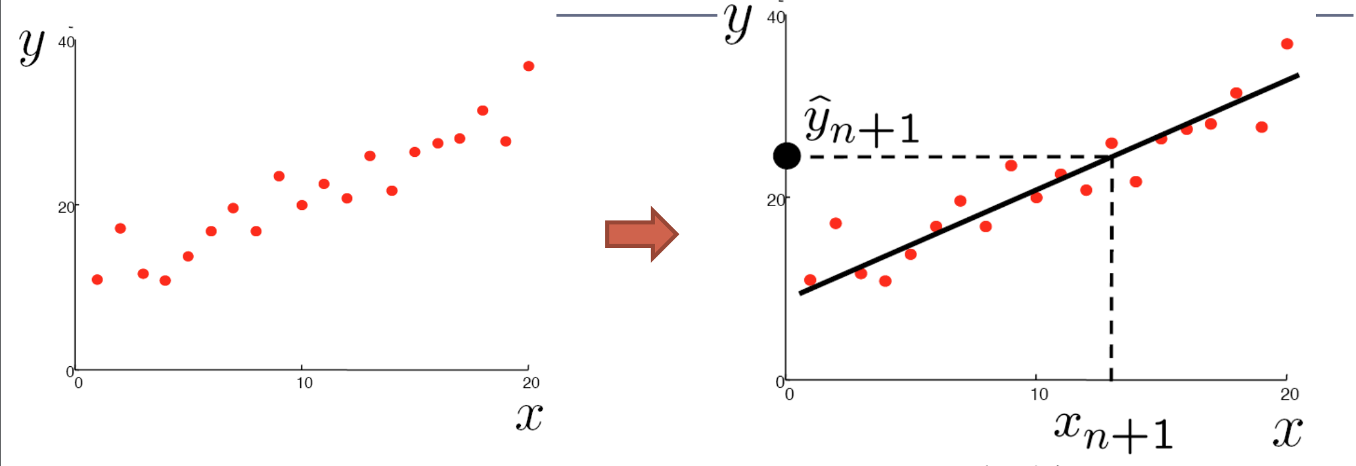
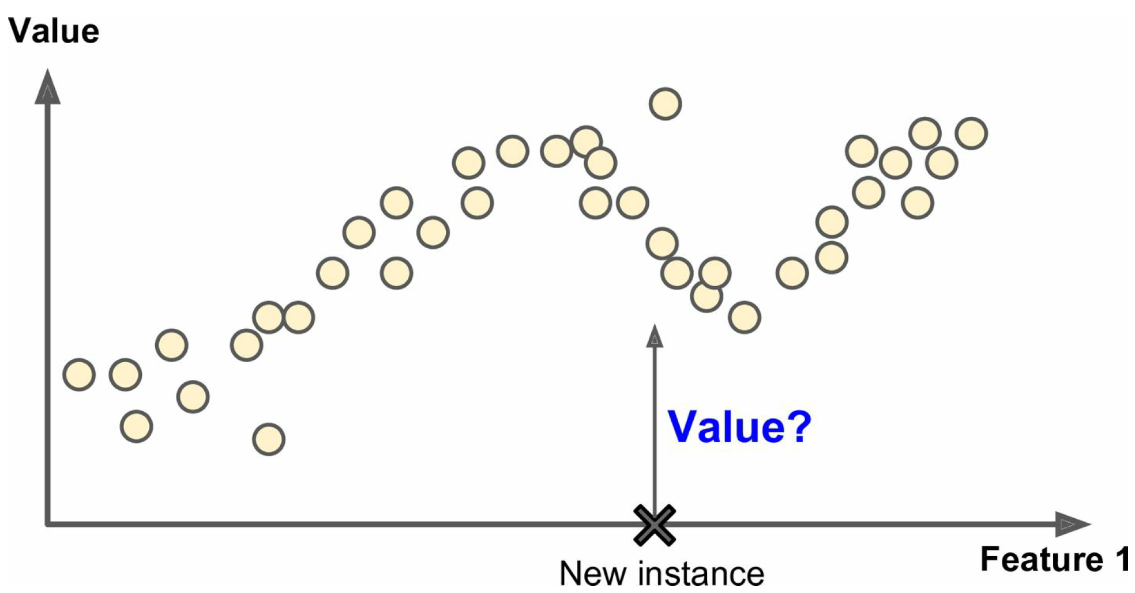
Linear Regression
Can this be fitted using a straight line?
No!
If not, can we still use the idea of linear regression?
Yes! (sometimes called Polynomial Regression)

Slide 6
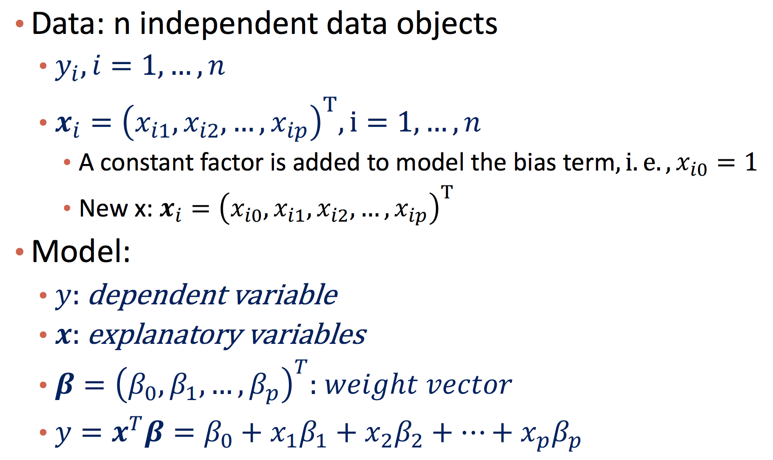
Linear Regression → Polynomial Regression
(𝑥, 𝑥², 𝑥³, …)^{T}
𝛽₀+𝑥𝛽₁+𝑥²𝛽₂+...

Slide 7

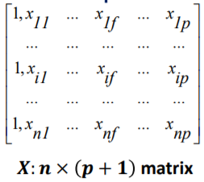


Matrix form of Least Square Estimation
𝜷₀
𝜷₁
⋮
𝜷_{p}
y₁
y₂
⋮
y_{n}
X₁ 𝜷 - y₁
X₂ 𝜷 - y₂
⋮
X_{n} 𝜷 - y_{n}
𝜷: (p + 1) x 1 matrix
y: n x 1 matrix
X𝜷 - y: n x 1 matrix
Notes:
J (beta) is half of (X.beta - y) transpose times (X.beta - y) according to the first equation. Here, we are trying to prove that J (beta) can also be calculated using the bottom equation.
Now, let’s see what’s the size of (X.beta - y).
X is n by (p+1) matrix. Beta is (p+1) by 1. Multiplying the two matrices will result in (n by 1) matrix. Subtracting that from ‘Y’ which is (n by 1) too would result in (n by 1) matrix, which implies that (X.beta - y) is a vector.
According to first equation, multiplying (X.beta - y) transpose with (X.beta - y) would thus be a dot product of (X.beta - y). This means that the product can also be calculated by the square of magnitude of (X.beta - y), that is ||X.beta - y||^2
Thus, J (beta) can also be calculated using the bottom equation.

Slide 8
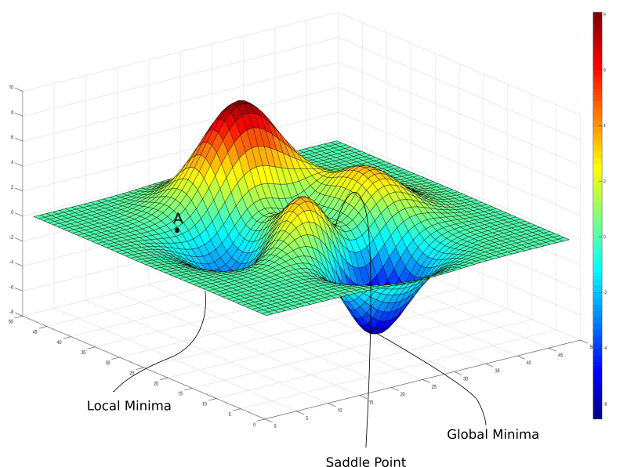
Gradient Descent
https://blog.paperspace.com/intro-to-optimization-in-deep-learning-gradient-descent/

Slide 9
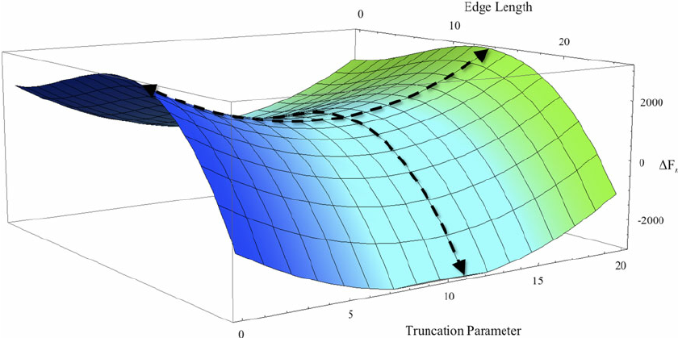
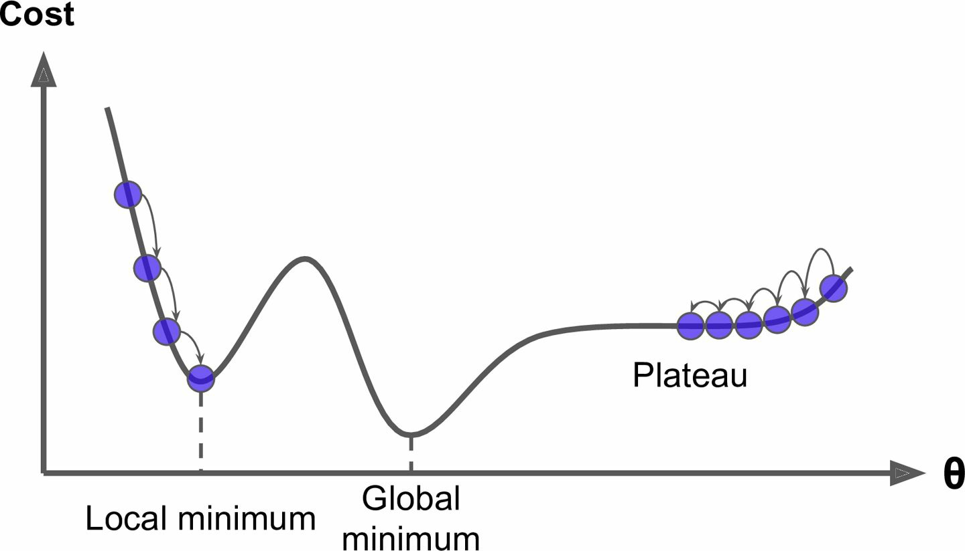
Batch vs Stochastic Gradient Descent
Why do we need Stochastic GD besides the efficiency/scalability reason?
Think about saddle points and local minima.
https://blog.paperspace.com/intro-to-optimization-in-deep-learning-gradient-descent/
Géron, Aurélien. Hands-on machine learning with Scikit-Learn and TensorFlow: concepts, tools, and techniques to build intelligent systems. " O'Reilly Media, Inc.", 2017.

Slide 10
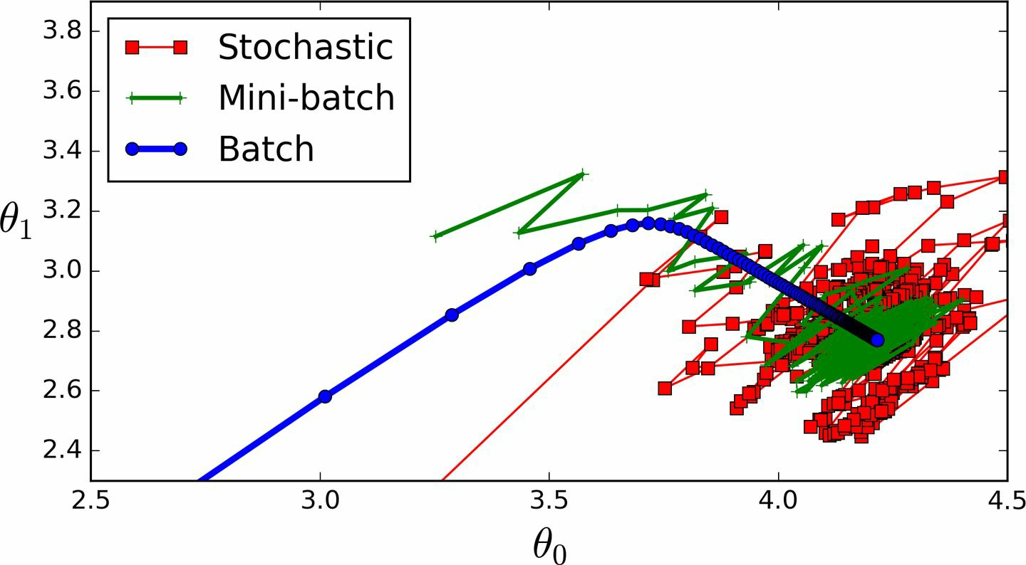
Comparison
Géron, Aurélien. Hands-on machine learning with Scikit-Learn and TensorFlow: concepts, tools, and techniques to build intelligent systems. " O'Reilly Media, Inc.", 2017.

Slide 11
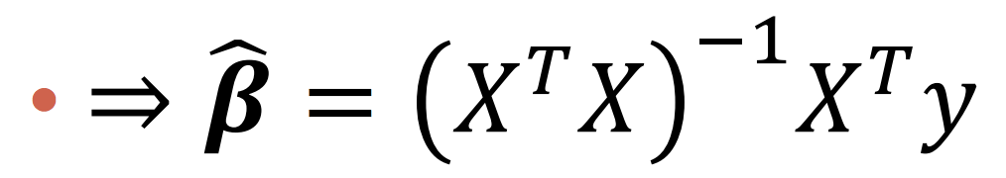
Linear Regression: When to use...
Closed form solution?
Gradient descent
Batch GD?
Stochastic GD?
Mini-batch GD?
https://stats.stackexchange.com/questions/49528/batch-gradient-descent-versus-stochastic-gradient-descent

Slide 12
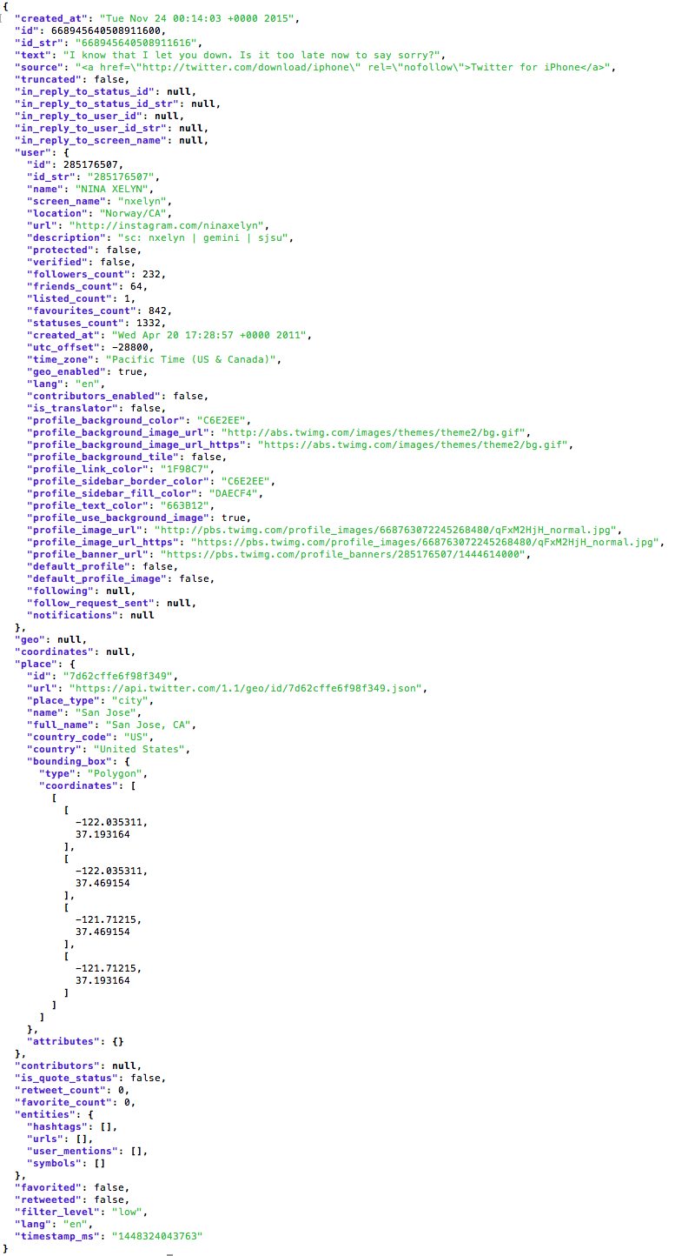
Feature Extraction from Real Data
Types of Features
Numerical
Categorical
Nominal, Binary, Ordinal
Real data may be messy for extracting features
Unorganized structure
Hidden and deep information
Example of a tweet data

Slide 13
Numerical Features
Numerical attributes
Raw data with numerical formats
E.g., numbers of friends and followers, timestamps
Numerical statistics
Numerical statistics towards a characteristic
E.g., the length of text, the average daily number of tweets for the user
Numerical hidden representations
Represent data in optimized hidden spaces
E.g, pLSA and LDA for text (Week 10)

Slide 14
Categorical Features
Categorical attributes
Raw data which originally have a set of discrete categories
E.g., cities of users, languages of text,
Discretization for numerical attributes
Transform numerical features into categorical features
E.g., Morning/Afternoon/Night, Long/Short Text (more than k words?)
Categorical statistics
Categorical statistics towards a characteristic
E.g., If the user posts more than k tweets in a week, Few/Usual/Many tweets posted in near regions

Slide 15
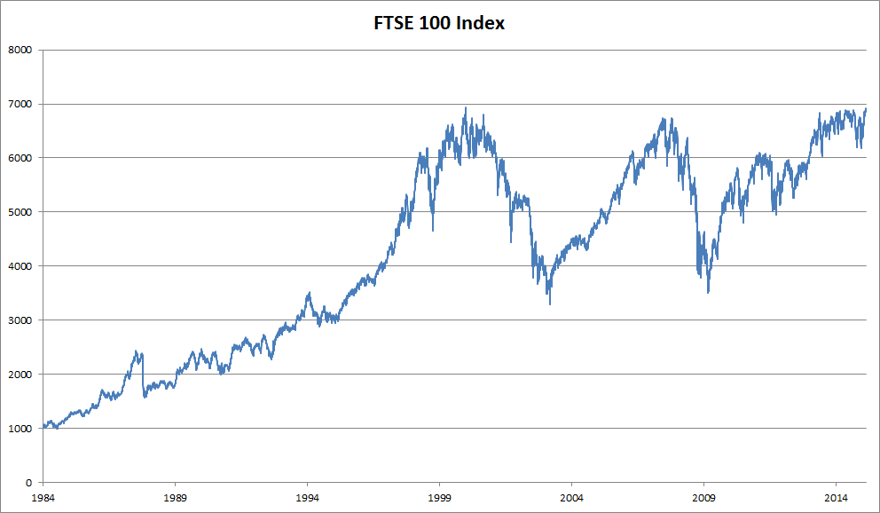
An application of linear regression: Stock Prices
Notes:
Want to get linear regression of stock price data points (here shown as graph but actually a set of points)

Slide 16
An application of linear regression: Stock Prices
Notes:
Using same techniques we can determine and draw lines for 1 standard deviation above and below linear regression line

Slide 17
An application of linear regression: Stock Prices
Notes:
When stock is at or below 1 standard deviation BUY BUY BUY (2014 close FTSE 100 Index 6520, now 7516 ~ 15% increase)

Slide 18
Appendix: Unbiased Estimator
Sample variance vs Variance
Proof & Explanation:https://en.wikipedia.org/wiki/Bessel%27s_correction

Slide 19
Thank you!
Q & A

