Slide 1


CS145 Discussion
Week 3
Junheng, Shengming, Yunsheng
10/19/2018

Slide 2
Roadmap
Announcements
HW1 due Oct 19, 2018 (Friday, tonight)
Package your Report AND codes,README together and submit it through CCLE
Review:
Decision Tree
Information Gain
Gain Ratio
Gini Index
SVM
Linear SVM
Soft Margin SVM
Non-linear SVM

Slide 3
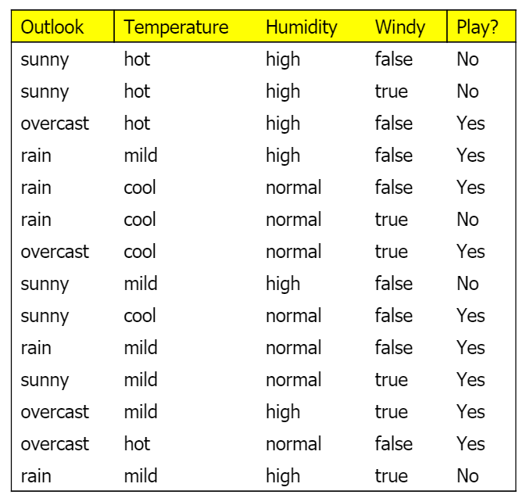
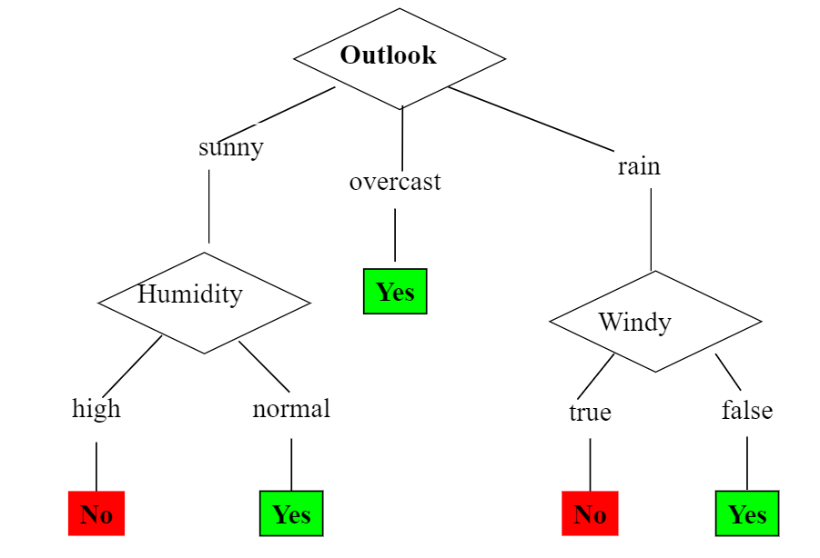
Decision Tree
Decision Tree Classification
Example: Play or Not?
-->

Slide 4
Decision Tree
Choosing the Splitting Attribute
At each node, available attributes are evaluated on the basis of separating the classes of the training examples.
A Goodness function is used for this purpose:
Information Gain
Gain Ratio
Gini Index

Slide 5
A criterion for attribute selection
Which is the best attribute?
The one which will result in the smallest tree
Heuristic: choose the attribute that produces the “purest” nodes
Popular impurity criterion: information gain
Information gain increases with the average purity of the subsets that an attribute produces
Strategy: choose attribute that results in greatest information gain

Slide 6
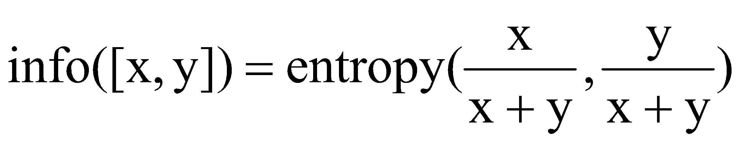
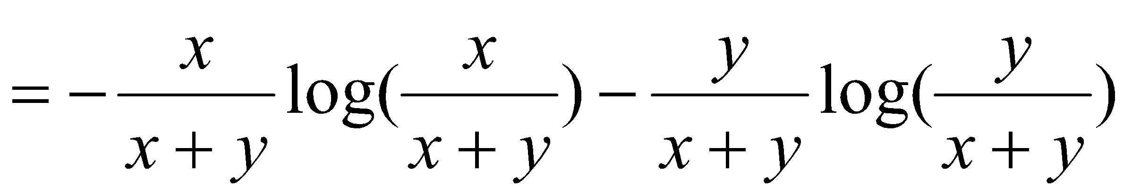
Entropy of a split
Information in a split with x items of one class, y items of the second class

Slide 7
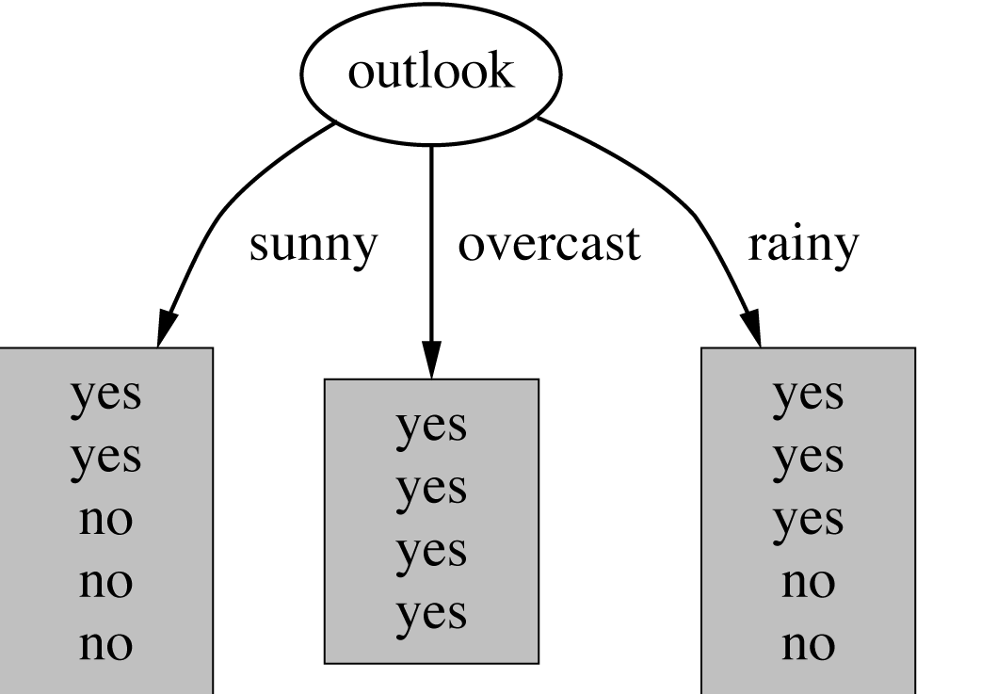
Example: attribute “Outlook”
“Outlook” = “Sunny”: 2 and 3 split

Slide 8
Outlook = Overcast
“Outlook” = “Overcast”: 4/0 split
Note: log(0) is not defined, but we evaluate 0*log(0) as zero

Slide 9
Outlook = Rainy
“Outlook” = “Rainy”:

Slide 10
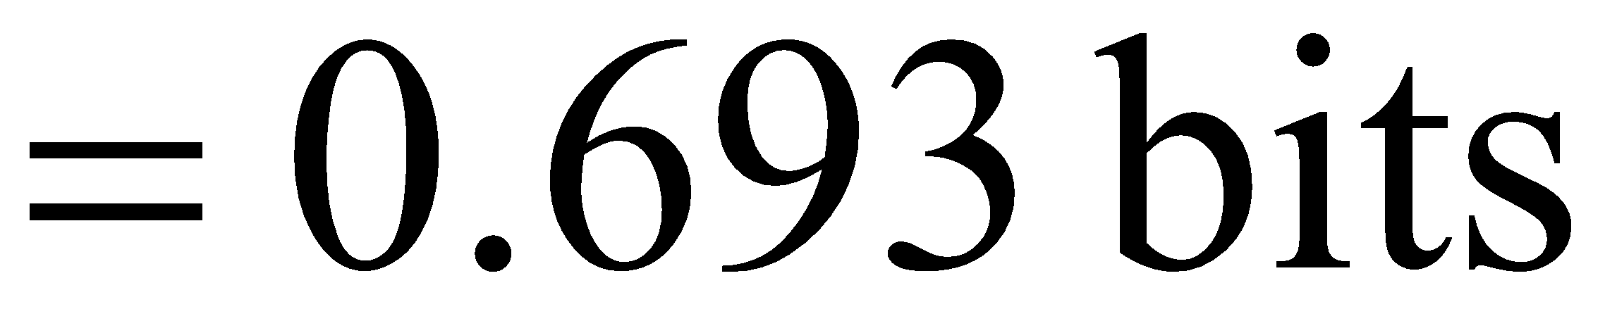
Expected Information
Expected information for attribute:

Slide 11
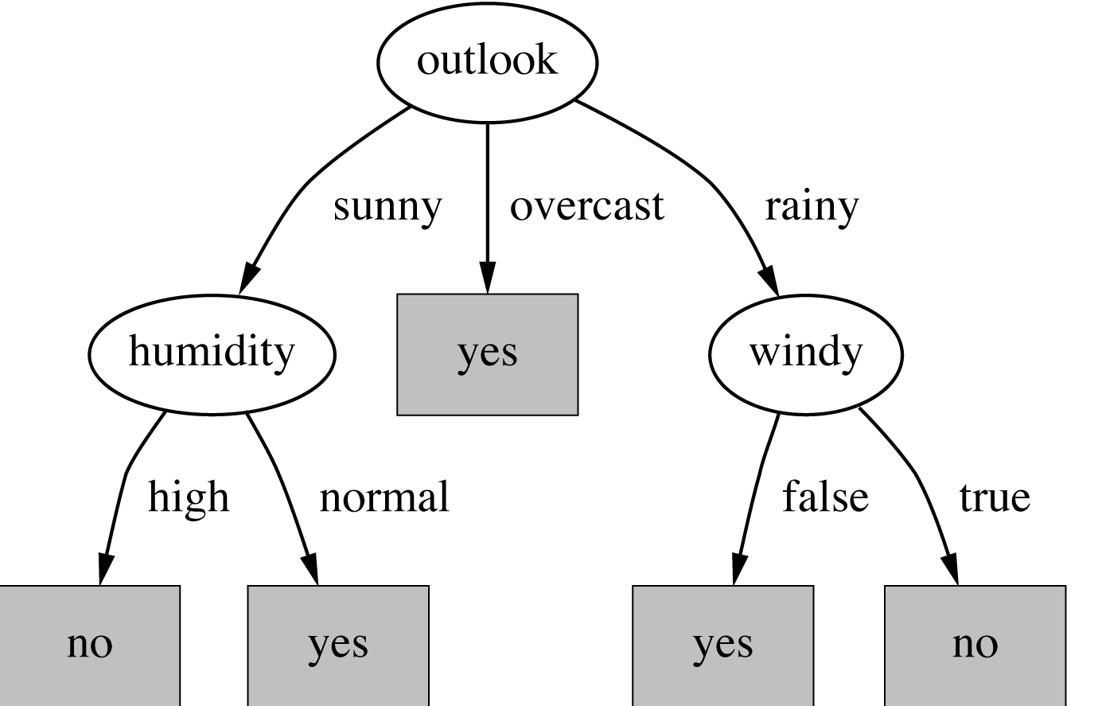
The final decision tree
Note: not all leaves need to be pure; sometimes identical instances have different classes
⇒ Splitting stops when data can’t be split any further

Slide 12
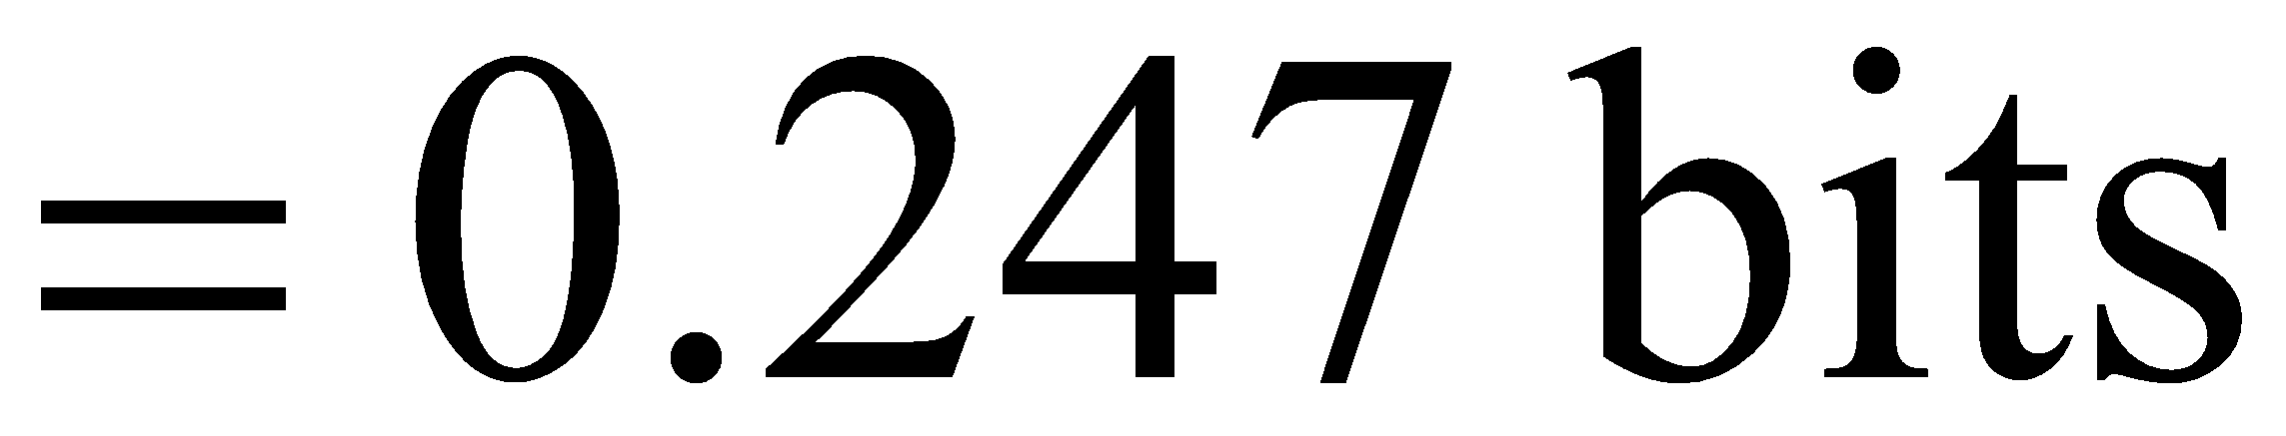
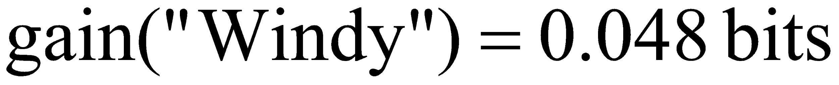
Computing the information gain
Information gain:
(information before split) – (information after split)
Information gain for attributes from weather data:

Slide 13
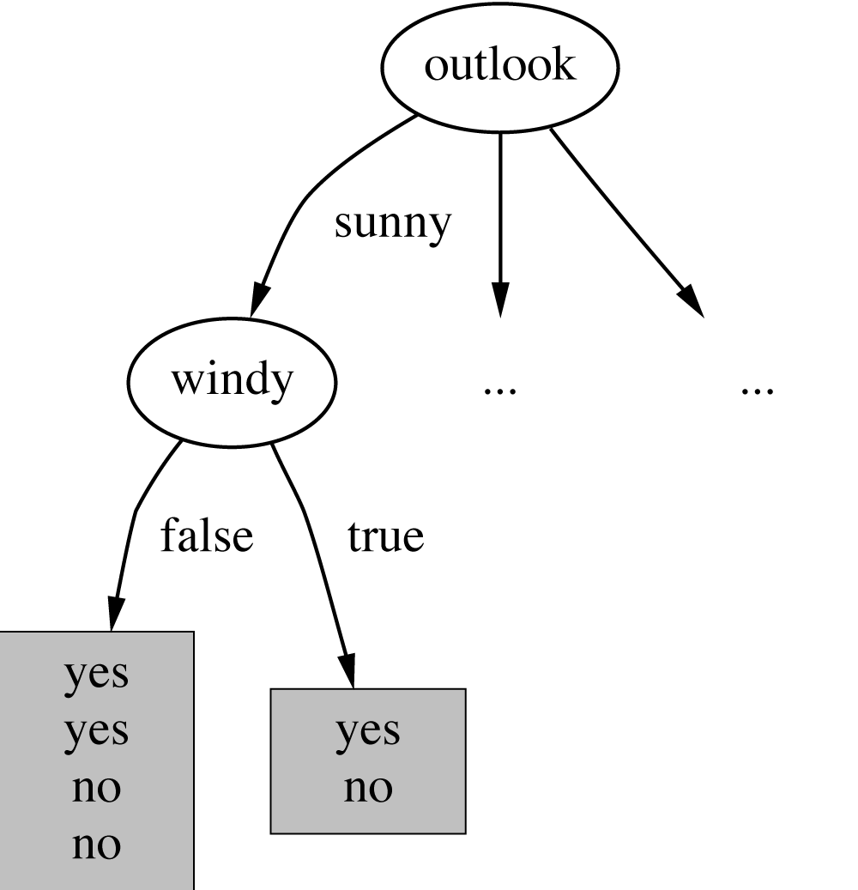
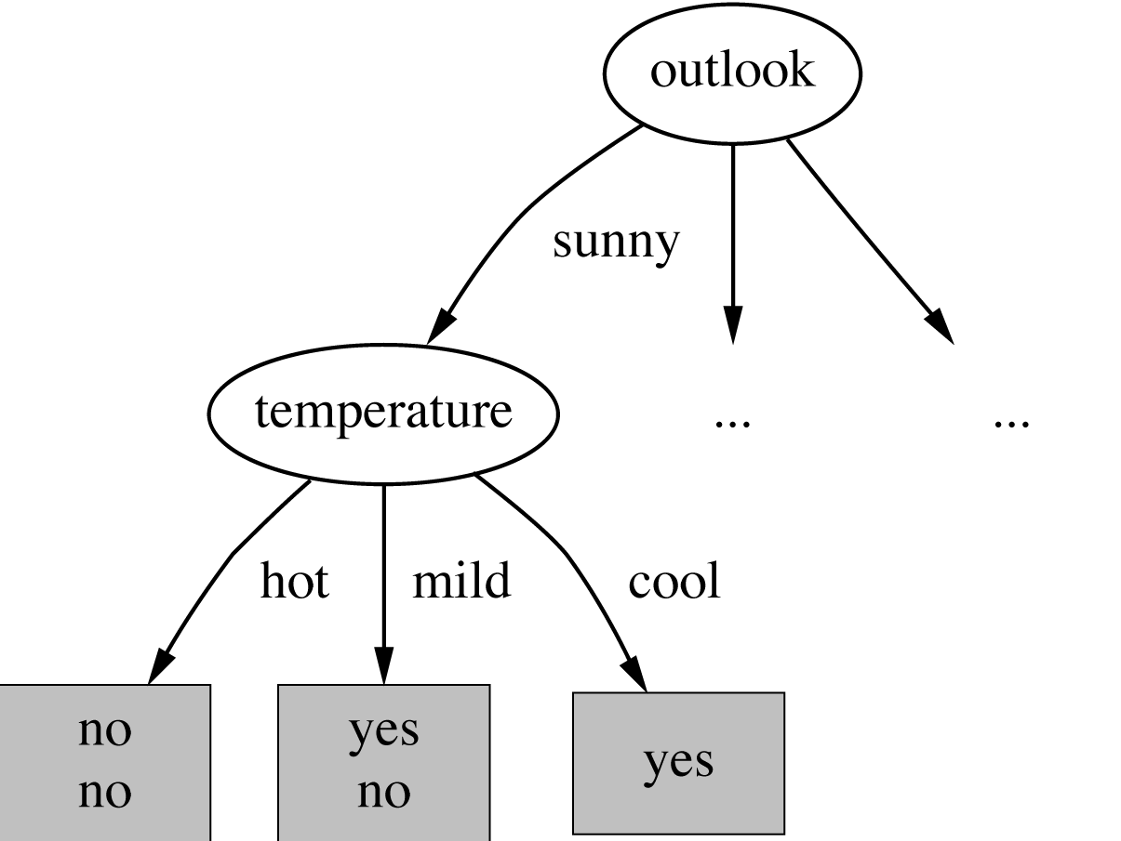
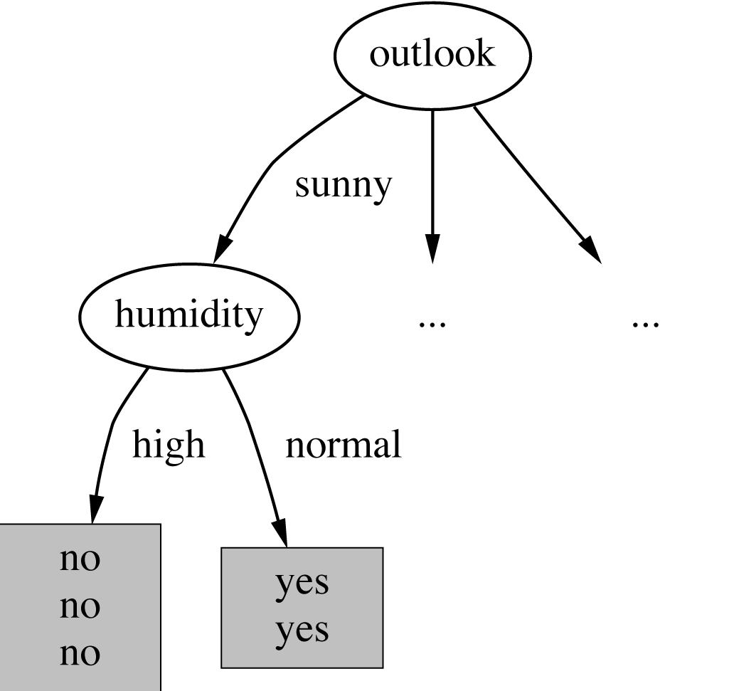
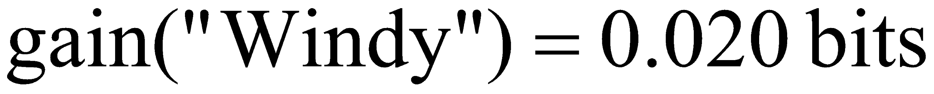
Continuing to split

Slide 14
The final decision tree
Note: not all leaves need to be pure; sometimes identical instances have different classes
⇒ Splitting stops when data can’t be split any further

Slide 15
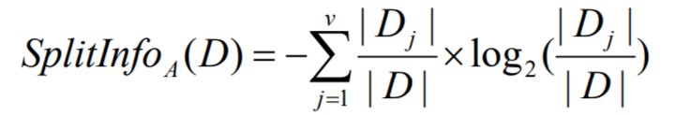
Decision Tree
Gain Ratio
Gain Ratio = Gain_A(D) / SplitInfo_A(D)
Why Gain Ratio?
Unbiased compared with Information Gain
Why? (https://stats.stackexchange.com/questions/306456/how-is-information-gain-biased)

Slide 16
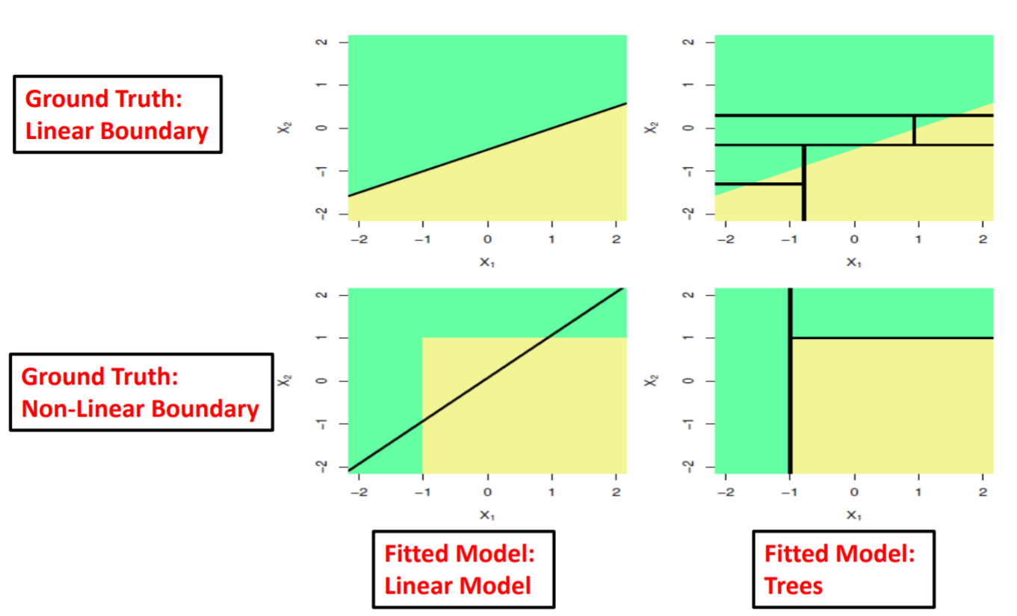
Decision Tree
•Is the decision boundary for decision tree linear? No

Slide 17
Visual Tutorials of Decision Trees
https://algobeans.com/2016/07/27/decision-trees-tutorial/

Slide 18



Support Vector Machine
Hyperplane separating the data points
Maximize margin
Solution

Slide 19

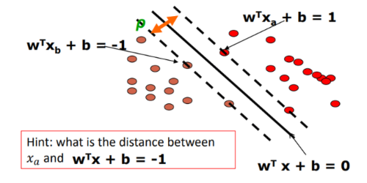


Margin Formula
Margin Lines
Distance between parallel lines
Margin

Slide 20
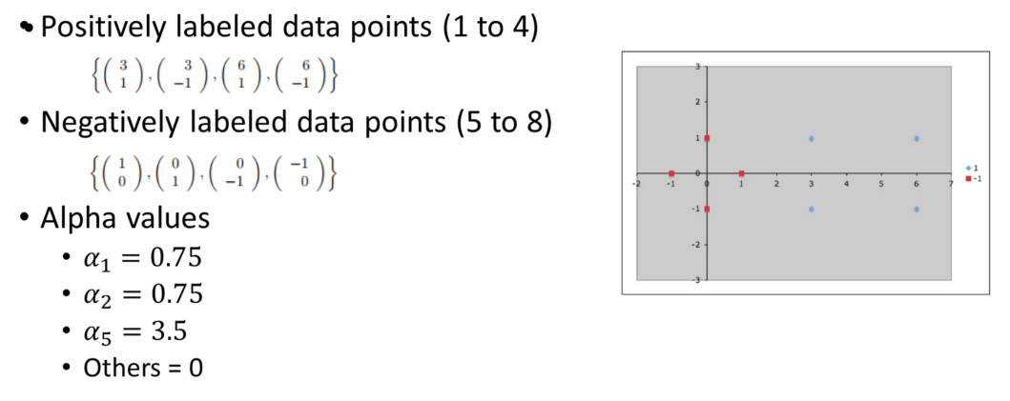
Linear SVM Example

Slide 21
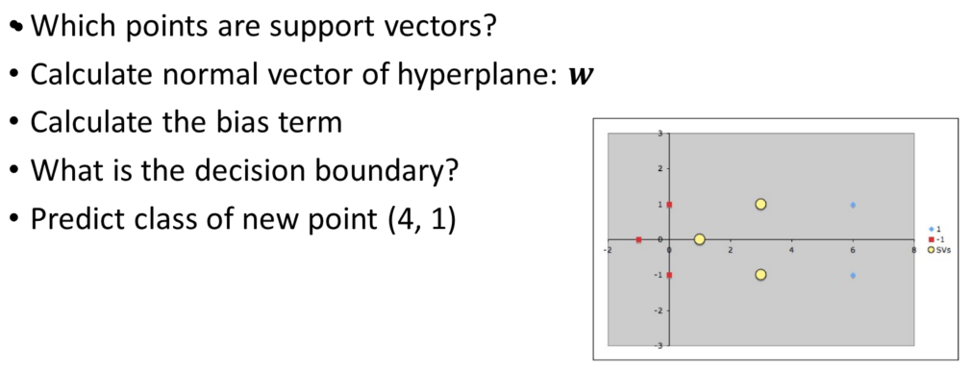
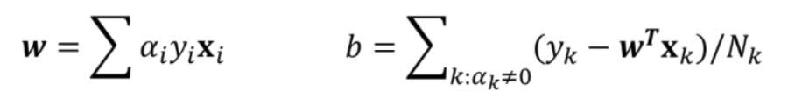
Linear SVM Example

Slide 22
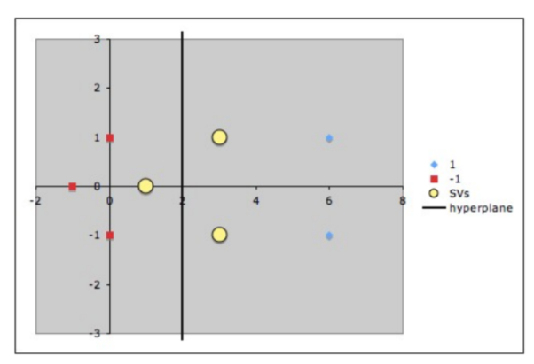
Plot

Slide 23
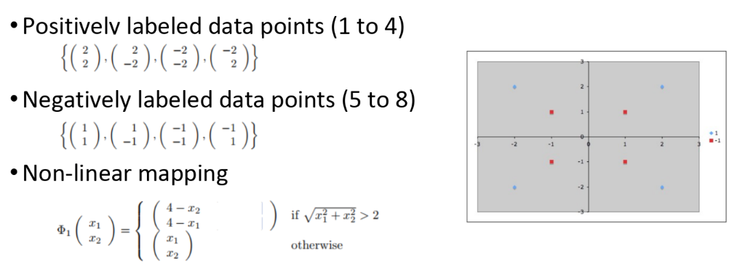
Non-linear SVM Example

Slide 24
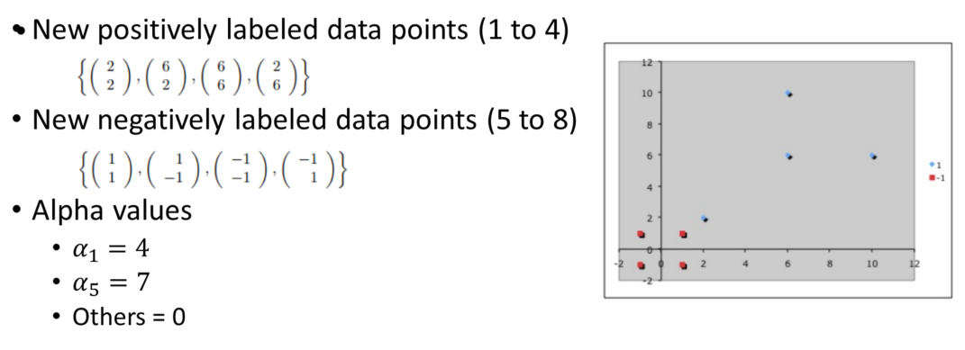
Non-linear SVM Example

Slide 25
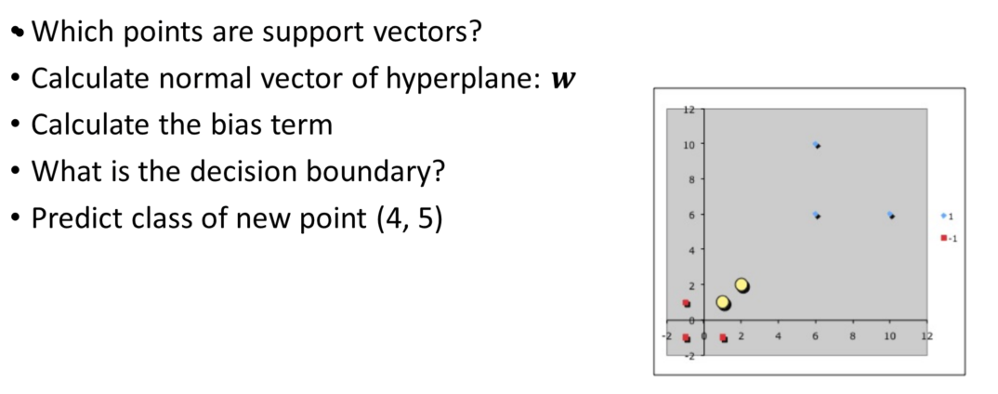
Non-linear SVM Example

Slide 26
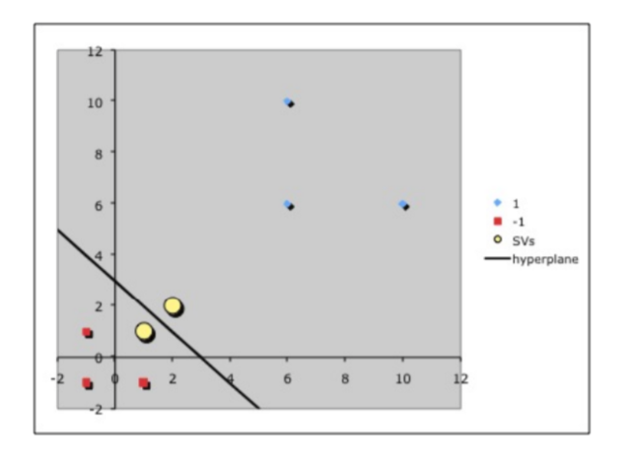
Plot

Slide 27
Visualize Tutorials of Decision Trees
http://www.r2d3.us/visual-intro-to-machine-learning-part-1/
http://explained.ai/decision-tree-viz/

Slide 28
Visual Tutorials of SVM
https://cs.stanford.edu/people/karpathy/svmjs/demo/

Slide 29
Thank you!
Q & A

Slide 30
Blank

Slide 31
Double-row title
Subtitle

Slide 32
Single-row title

Slide 33
Figure Page

