Slide 1


CS145 Discussion
Week 5
Junheng, Shengming, Yunsheng
11/2/2018

Slide 2
Roadmap
Announcement
K-NN
Similarity Metrics
ROC
K-Means
Homework 3
Course Project Midterm Report

Slide 3
Announcement
Homework 3 out
Deadline: 11/09 Friday 11:59 pm
KNN(30%) and Neural Network(70%)
Environment Requirement: Jupyter + Python 3
Course Project Midterm Report (about to) out
Deadline: 11/12 Monday 11:59 pm
According to the guildline file
Midterm date out
11/14 Wednesday 12:00-1:50 pm(in class)
Remember to carry: one-page reference paper(letter size), simple calculator

Slide 4
KNN

Slide 5
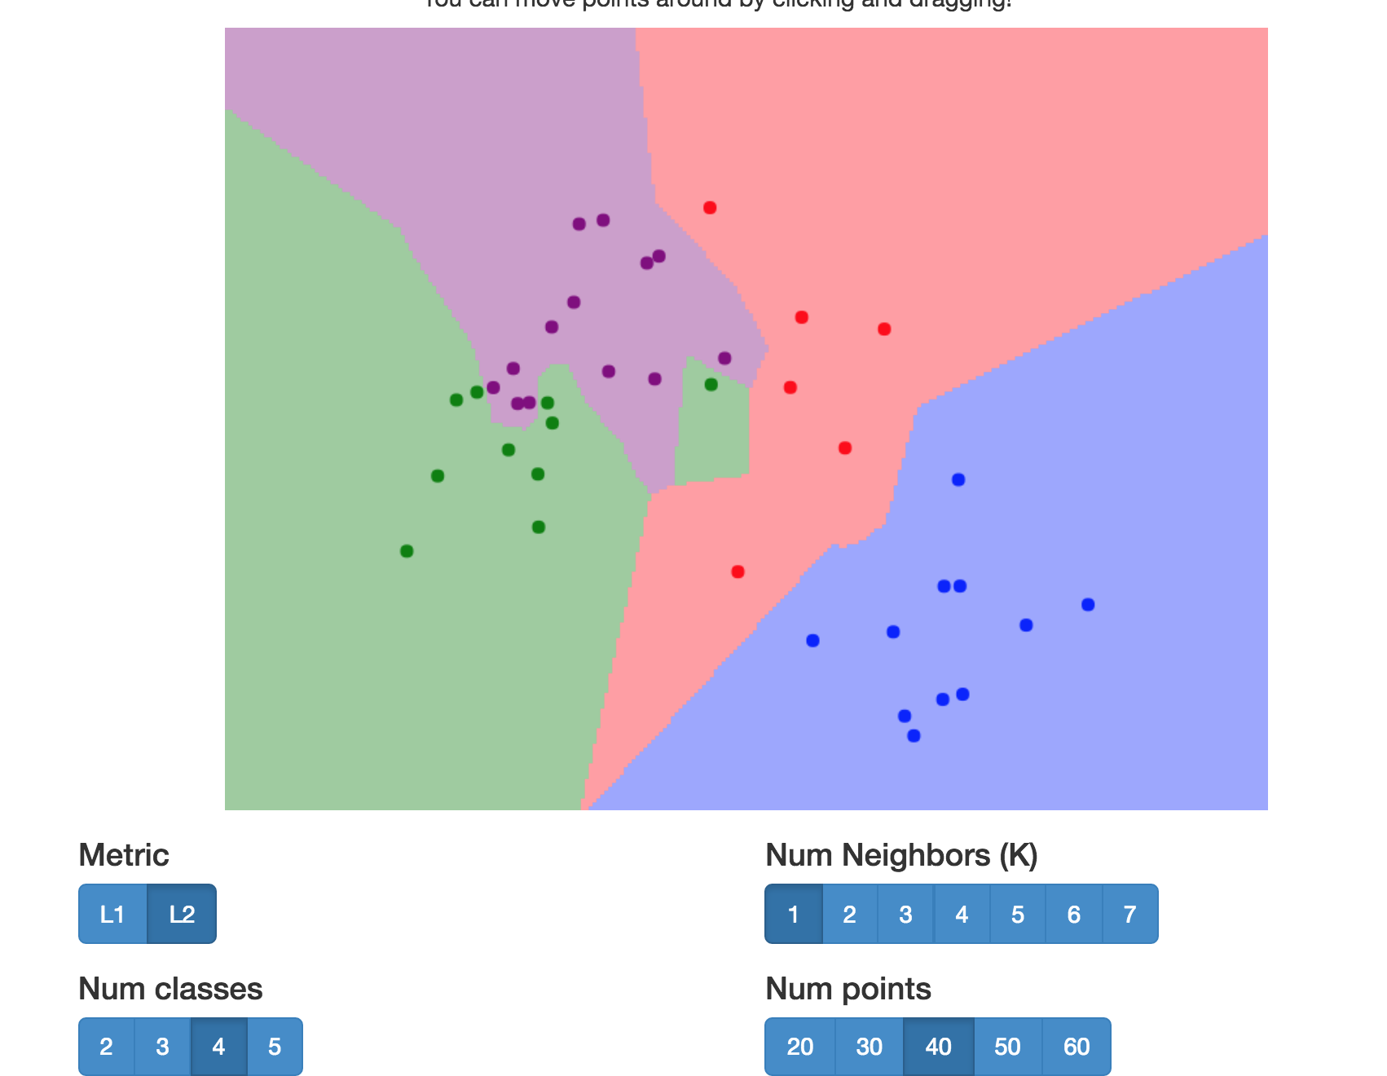
KNN
Demo: http://vision.stanford.edu/teaching/cs231n-demos/knn/

Slide 6
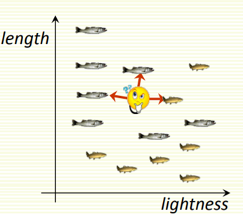
KNN
Classify an unknown example with the most common class among K nearest examples
“Tell me who your neighbors are, and I’ll tell you who you are”
Example
K = 3
2 sea bass, 1 salmon
Classify as sea bass

Slide 7
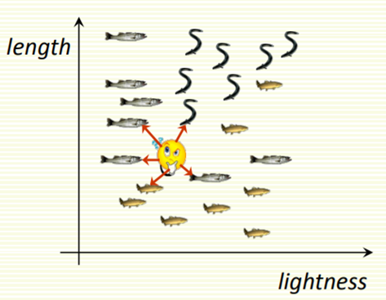
KNN: Multiple Classes
Easy to implement for multiple classes
Example for K = 5
3 fish species: salmon, sea bass, eel
3 sea bass, 1 eel, 1 salmon → classify as sea bass

Slide 8
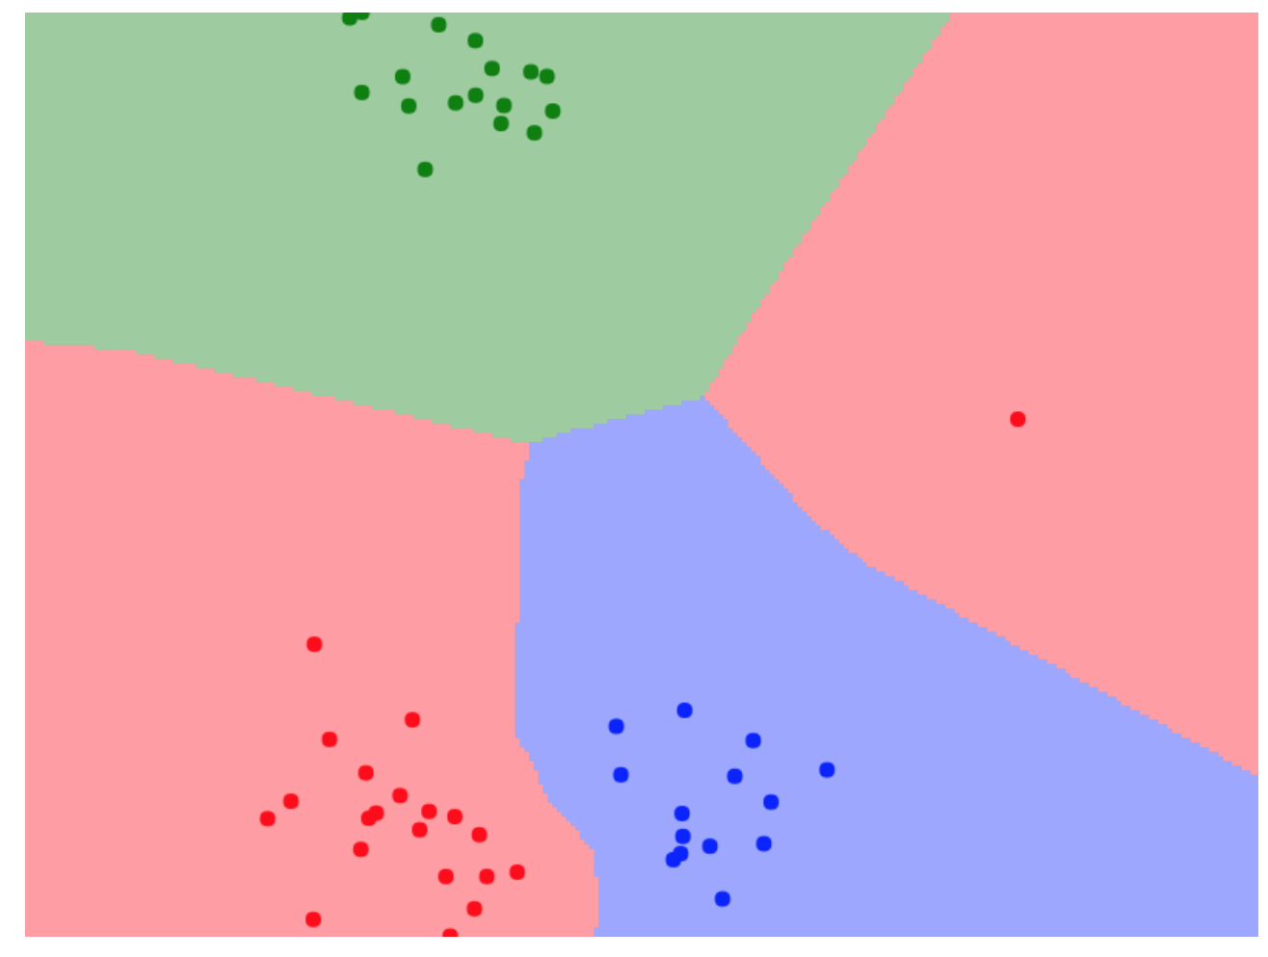
KNN: How to Choose K?
In theory, if infinite number of samples available, the larger k, the better classification result you’ll get.
Caveat: all K neighbors have to be close
Possible when infinite # samples available
Impossible in practice since # samples if finite
Should we “tune” K on training data?
Overfitting
K = 1 → sensitive to “noise” (e.g. see right)
noise
K=1 :)

Slide 9
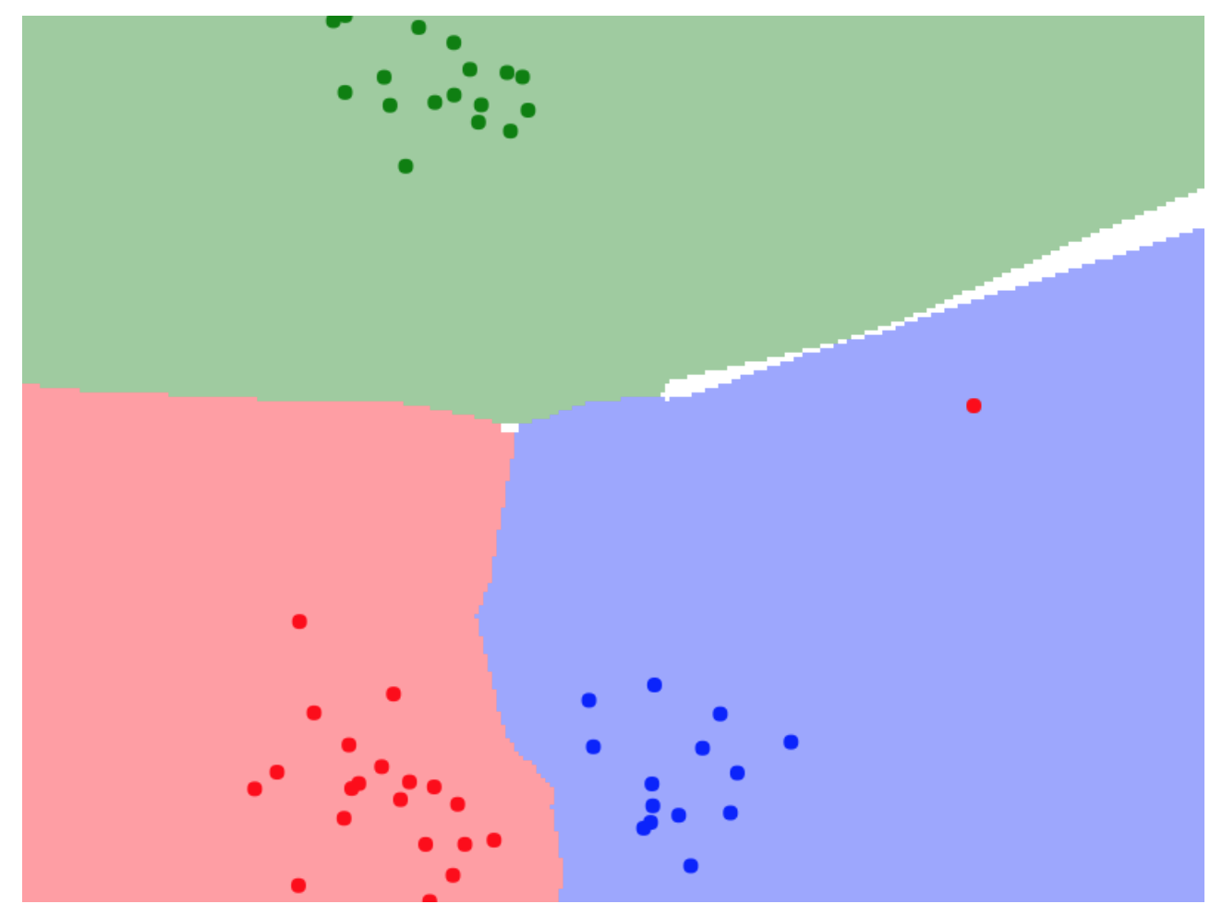
KNN: How to Choose K?
In theory, if infinite number of samples available, the larger k, the better classification result you’ll get.
Caveat: all K neighbors have to be close
Possible when infinite # samples available
Impossible in practice since # samples if finite
Should we “tune” K on training data?
Overfitting
K = 1 → sensitive to “noise” (e.g. see right)
noise
K=3 :)

Slide 10
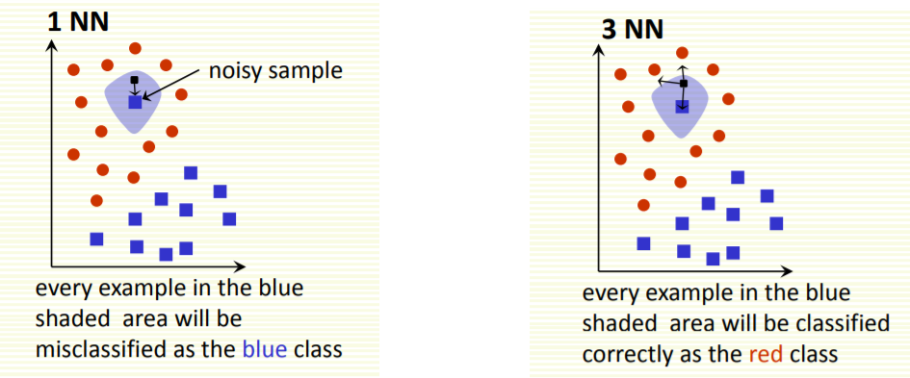
KNN: How to Choose K?

Slide 11
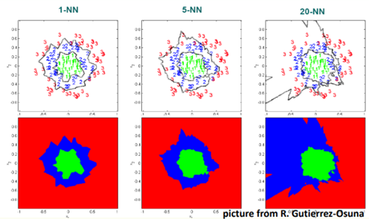
KNN: How to Choose K?
Larger K gives smoother boundaries, better for generalization
Only if locality is preserved
K too large → looking at samples too far away that are not from the same class
Can choose K through cross-validation

Slide 12
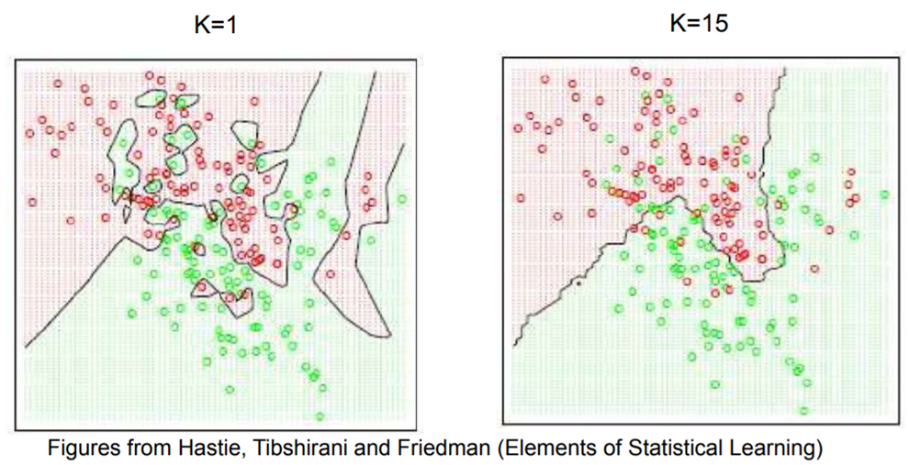
KNN: How to Choose K?

Slide 13
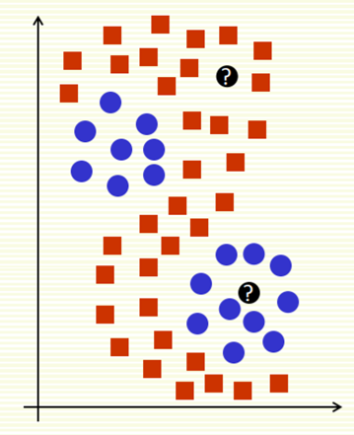
KNN: Multi-Model Distributions
Many classification models would not work for this 2-class classification problem
Linear-R
Logistic-R
Decision-Tree
SVM
Nearest neighbors will do reasonably well

Slide 14
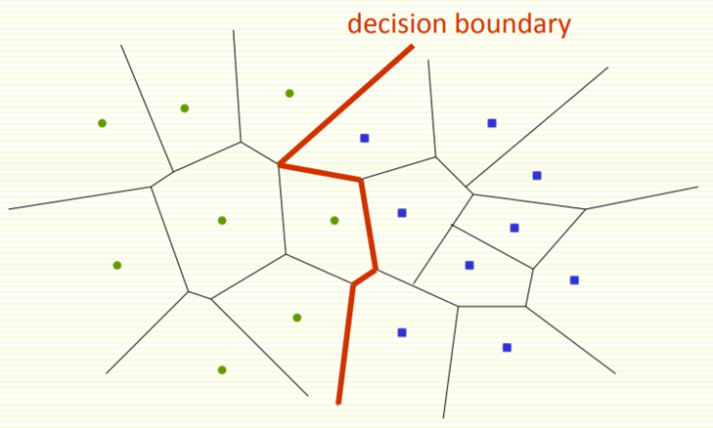
Decision Boundaries
Voronoi diagram is useful for visualization

Slide 15
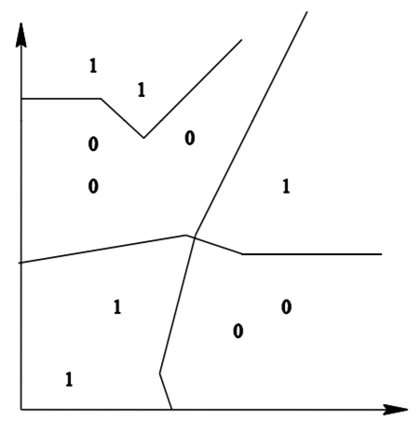
Decision Boundaries
Decision boundaries are formed by a subset of the Voronoi Diagram of the training data
Each line segment is equidistant between two points of opposite class
The more examples that are stored, the more fragmented and complex the decision boundaries can be.

Slide 16
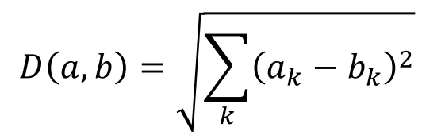
KNN: Selection of Distance
We use Euclidean Distance to find the nearest neighbor:
Euclidean distance treats each feature as equally important
Sometimes, some features (or dimensions) may be much more discriminative than other features

Slide 17
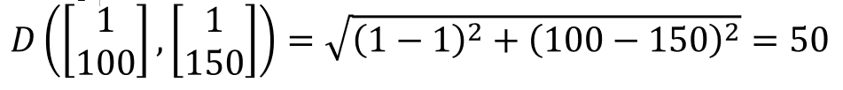
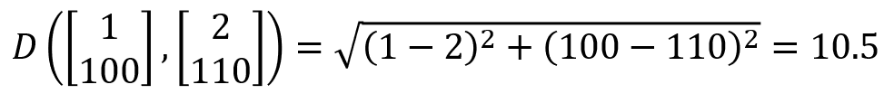
KNN Distance Selection: Extreme Example
Feature 1 gives the correct class: 1 or 2
Feature 2 gives irrelevant number from 100 to 200
Dataset: [1, 150], [2, 110]
Classify [1, 100]
Use Euclidean distance can result in wrong classification
Dense Example can help solve this problem

Slide 18
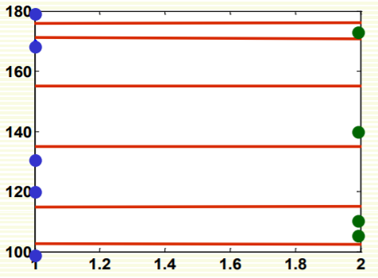
KNN Distance Selection: Extreme Example
Decision boundary is in red, and is really wrong because:
Feature 1 is discriminative, but its scale is small
Feature gives no class information but its scale is large, which dominates distance calculation

Slide 19
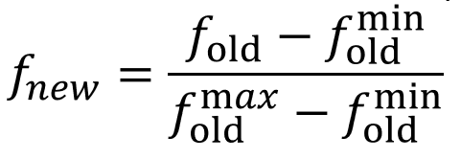
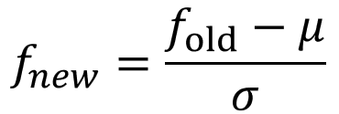
KNN: Feature Normalization
Normalize features that makes them be in the same scale
Different normalization approaches may reflect the result
Linear scale the feature in range [0,1]:
Linear scale to 0 mean variance 1(Z-score):

Slide 20
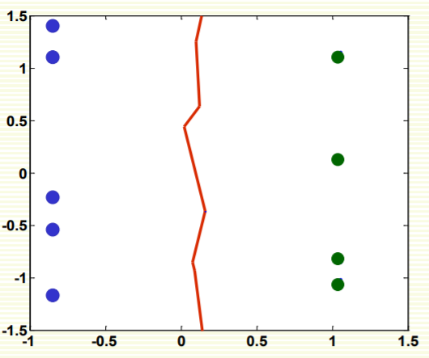
KNN: Feature Normalization
Result comparison non-normalized vs normalized

Slide 21
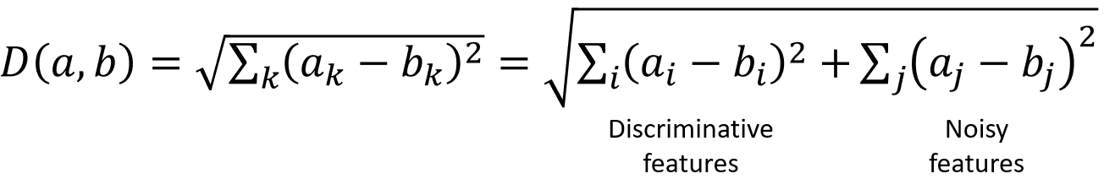
KNN: Selection of Distance
Feature normalization does not help in high dimensional spaces if most features are irrelevant
If the number of useful feature is smaller than the number of noisy features, Euclidean distance is dominated by noise.

Slide 22
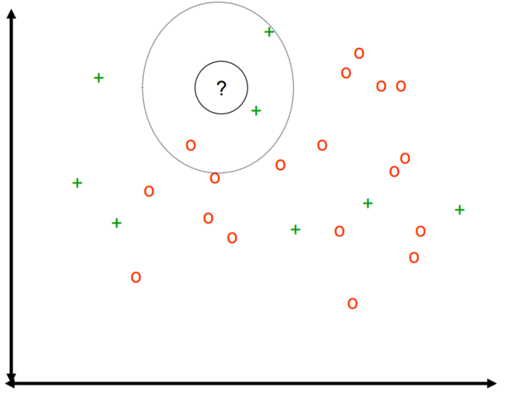
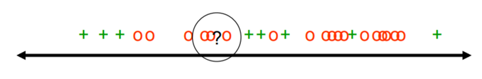
KNN: Example of Noise Domination Problem

Slide 23
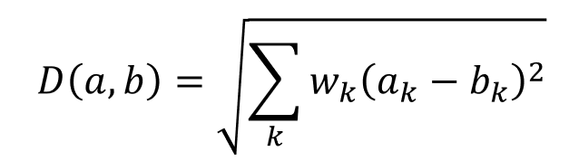
KNN: Feature Weighting
Scale each feature by its importance for classification
Use prior/domain knowledge to set the weight w
Use cross-validation to learn the weight w

Slide 24
KNN: Computational Complexity
Suppose n examples with dimension d
For each point to be classified:
O(d) to compute distance to one example
O(nd) to compute distances to all examples
O(nk) time to find k closest examples
Total time: O(nk + nd)
Very expensive for a large number of queries

Slide 25
KNN: Reduce Complexity
Reduce the dimensionality of the data:
Find a projection from high dimensional space to a lower dimensional space so that the distance between samples are approximately the same
Use Principal Component Analysis(PCA)
Apply smart data structure, e.v. k-d trees

Slide 26
KNN: Summary
Advantages:
Can be applied to the data from any distribution
The decision boundary is not necessarily to be linear
Simple and Intuitive
Good Classification with large number of samples
Disadvantages:
Chossing k may be tricky
Test stage is computationally expensive
No training stage, time-consuming test stage
Usually we can afford long training step but fast testing speed
Need large number of examples for accuracy

Slide 27
Reference
•http://www.csd.uwo.ca/courses/CS9840a/Lecture2_knn.pdf
•http://classes.engr.oregonstate.edu/eecs/spring2012/cs534/notes/knn.pdf
•http://people.csail.mit.edu/dsontag/courses/ml12/slides/lecture10.pdf

Slide 28
Similarity Metrics

Slide 29
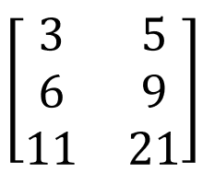
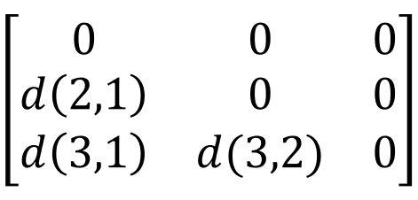
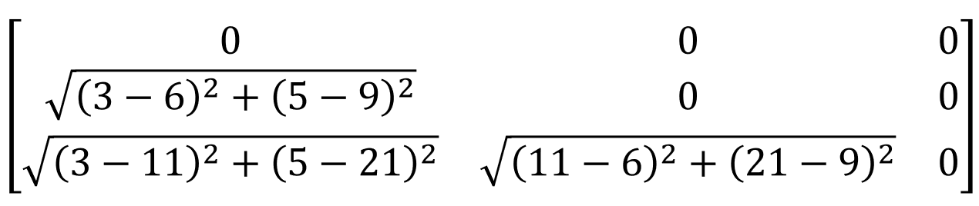
Similarity Metrics
Dissimilarity
3 2-d input, x1,x2,x3
The dissimilarity matrix is a 3*3 lower-triangular matrix:

Slide 30
Dissimilarity: Nominal Atributes
Student 1: likes Jazz, eats pizza, roots for the cubs, wears socks
Student 2: likes Rock, eats pizza, roots for the cubs, goes barefoot
d(Student 1, Student 2):
m: # of matches → 2
p: total # of variables → 4
d(Student 1, Student 2) = (4-2)/4 = 0.5

Slide 31
Binary Attributes
Symmetric binary attributes:
Gender
Asymmetric attributes:
Preference, Character, etc.
Can be manually defined

Slide 32
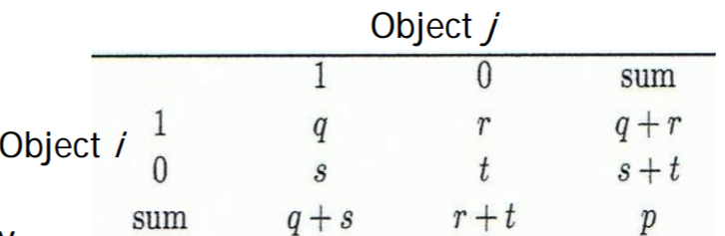

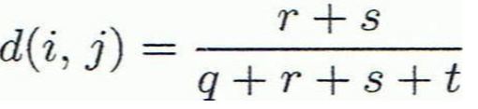
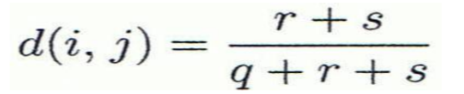
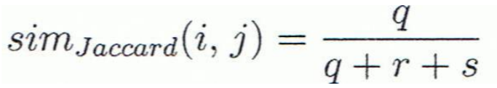
Binary Attributes
Dissimilarity of Binary Attributes:
Define 0 and 1
calculate q,s,r,t,p
Distance measure for symmetric binary variables:
Distance measure for asymmetric binary variables:
Jaccard coefficient (similarity measure for asymmetric binary variables):

Slide 33
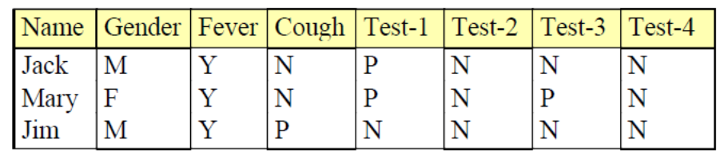
Binary Attributes: Example
i = Jack, j = Mary
Define M,Y,P as 1; Define F,N as 0
Assume symmetric attributes for all:
r = 0, s = 1, q = 2
Assume symetric for Gender, asymetric for other attributes
For Gender: r = 1, s = 0, q = 0, t = 0
For others: r = 0, s = 1, q = 2

Slide 34
Ordinal Attributes
Order is important
Transfer rank into value
Freshman, Sophomore, Junior, Senior
1,2,3,4

Slide 35
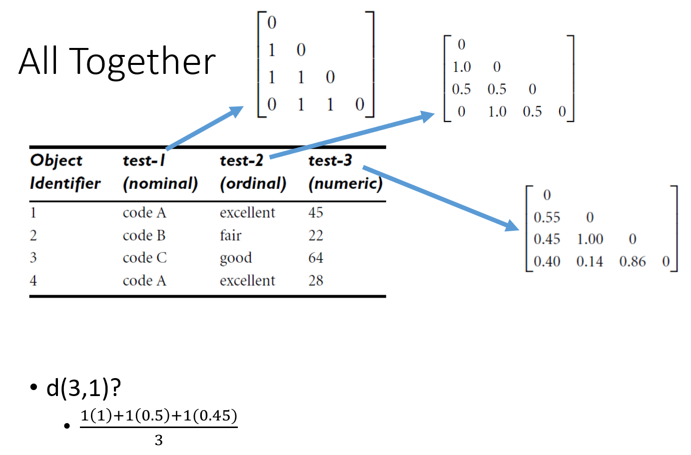
Mixed Attributes

Slide 36

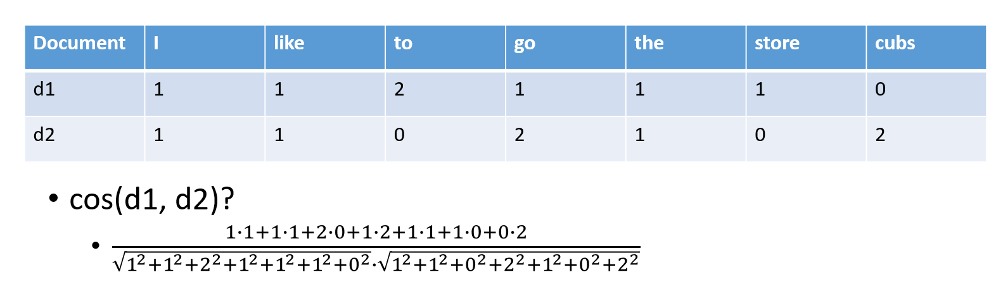
Cosine Similarity
For vector data
d1: I like to go to the store
d2: I like the cubs, go cubs go

Slide 37
ROC
http://mlwiki.org/index.php/ROC_Analysis

Slide 38
K-Means
Demo 1: http://stanford.edu/class/ee103/visualizations/kmeans/kmeans.html
Demo 2: https://www.naftaliharris.com/blog/visualizing-k-means-clustering/

Slide 39
About Homework 3
Due Date: Next Friday
Be prepared (Refer to the doc for hw3)
Install Jupyter with Python 3.x(3.6 is preferred)
Download the cifar-10 dataset via get_datasets.sh
For windows user, there might be problems downloading the dataset
Live demonstration for installation
Hints on k-fold cross-validation and matrix-level operations involved in NN

Slide 40
Course Project Midterm Report
https://docs.google.com/document/d/1xLeBU-n8nuMT6zhLyLL1NIGuu25SJU1OWl9eybdgjXg/edit?usp=sharing

