Slide 1


CS145 Discussion
Week 6
Junheng, Shengming, Yunsheng
11/09/2018

Slide 2
Today’s Discussion
Announcement
Roadmap
Clustering: K-means, DB-SCAN
Midterm Review
Q & A
Notes:
Add neural networks

Slide 3
Announcement
Homework 3 due on 23:59pm, Nov 9, 2018
Submitted on CCLE and click “Submit for grading”
Must include: (1) Two python files: knn.py + neural_net.py (2) Two workbooks ipynb files with converted PDF files
Midterm project report due on 23:59pm, Nov 12, 2018
Submit guidelines: https://docs.google.com/document/d/1xLeBU-n8nuMT6zhLyLL1NIGuu25SJU1OWl9eybdgjXg/edit?usp=sharing
Midterm exam
Nov 14, In class (12:00-13:45)
Closed-book, one letter-size cheatsheet, one simple calculator
Keep every digital copy for convenience of grading → Clear and readable handwriting!
No lecture on Nov 12 (Veteran Day)

Slide 4
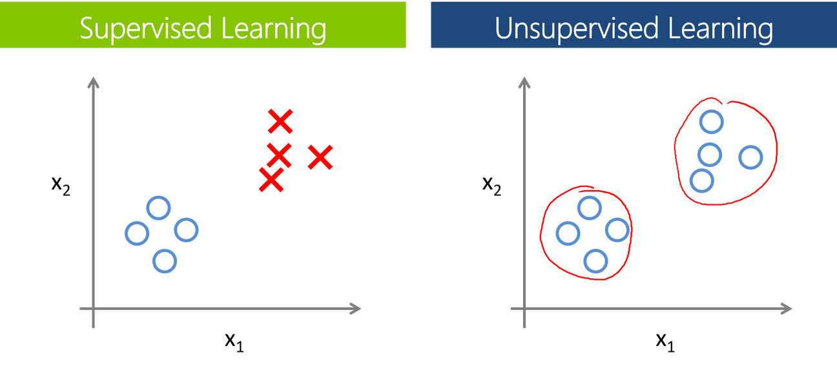
Clustering
Input / Output / Goal of clustering analysis
Large amount of unlabeled data in real life
Difference between supervised learning and unsupervised learning
Semi-supervised learning
Typical clustering algorithm examples:
K-means
Hierarchical clustering
DB-SCAN
Mixture models

Slide 5
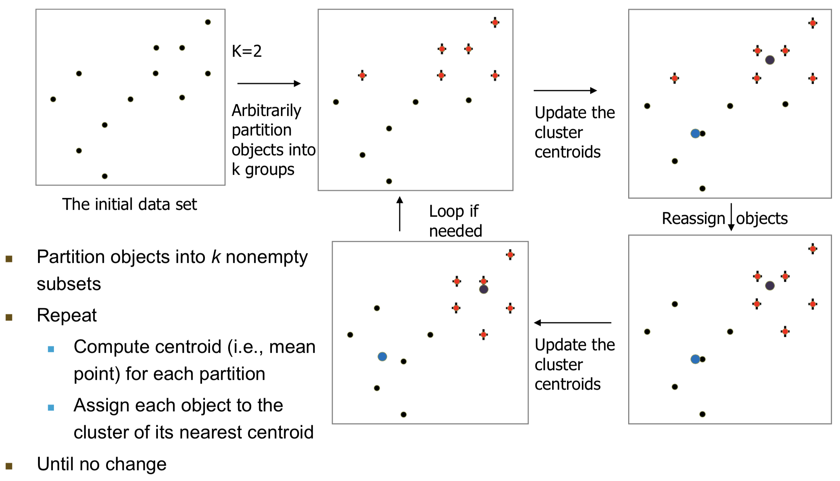
K-means

Slide 6
K-means
Demo 1: http://stanford.edu/class/ee103/visualizations/kmeans/kmeans.html
Demo 2: https://www.naftaliharris.com/blog/visualizing-k-means-clustering/
Key idea of K-means algorithms:
Step 1: Partition into k non-empty subsets (select K points as initial centroids)
Step 2: Iteration: Update mean point and assign object to cluster again
Step 3: Stop when converge
Partition-based clustering methods
Can be considered as a special case of GMM

Slide 7
K-means
Q1: Will K-means converge?
Q2: Will different initialization of K-means generate different clustering results?

Slide 8
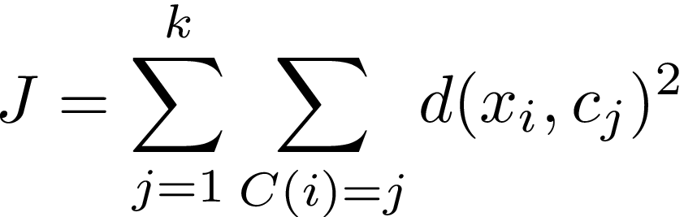
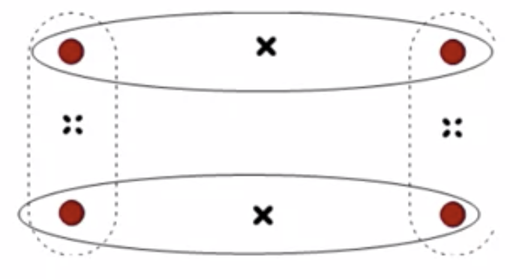
K-means
Q1: Will K-means converge?
A1: Yes.
Q2: Will different initialization of K-means generate different clustering results?
A2: Yes. Initialization matters!

Slide 9
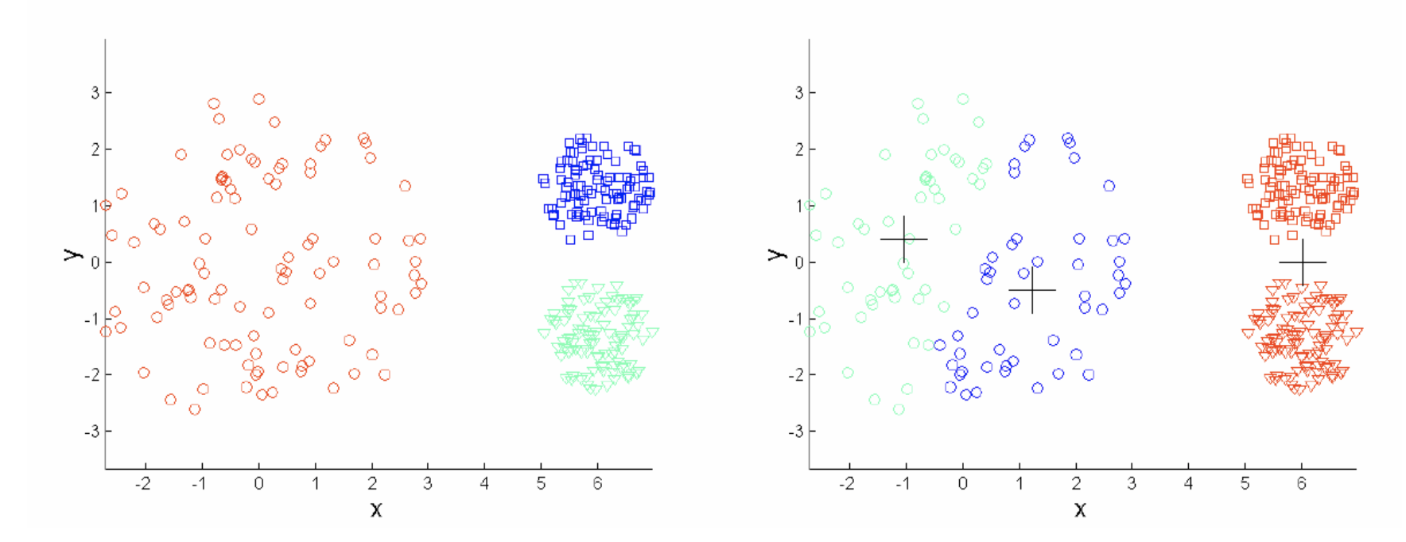
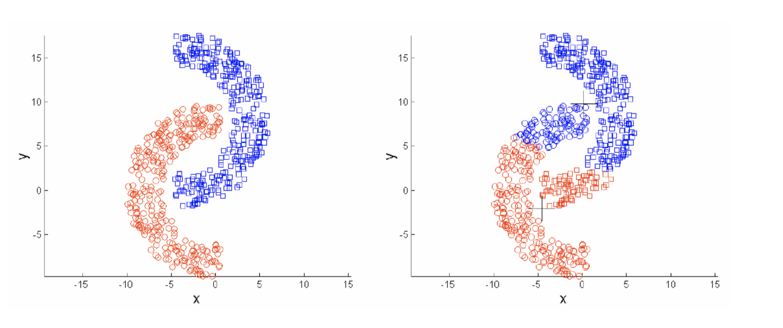
K-means: Discussion
Efficiency: O(tkn) normally k,t are much smaller than n → efficient
Can terminate at a local optima
Need to specify k (or take time to find best k)
Sensitive to noisy data and outliers
Different sizes and variances
Not suitable to discover clusters with non-convex shapes
Can K-medoids help?
Many variants of K-means:
K-means++, Genetics K-means, etc.

Slide 10
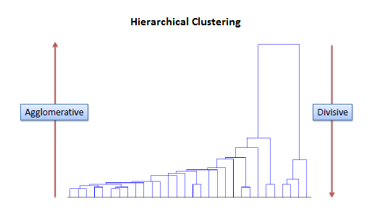
Hierarchical Clustering
Method
Divisive (Top-down)
Agglomerative (Bottom-up)
Distance metrics
Single linkage
Complete linkage
Average linkage
Centroid
Medroid

Slide 11
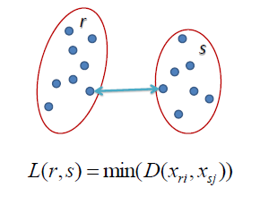
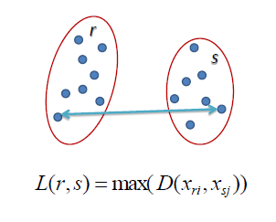
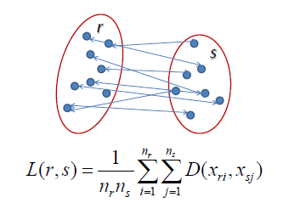
Hierarchical Clustering
Single Linkage
Complete Linkage
Average Linkage

Slide 12
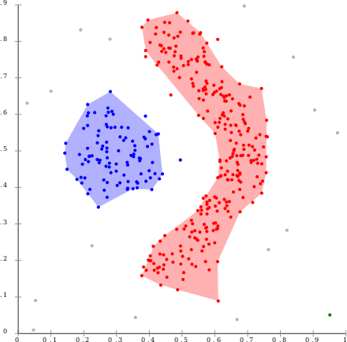
DB-SCAN
Density-based clustering method
Demo
Pros and Cons
has a notion of noise, and is robust to outliers
does not require one to specify the number of clusters in the data a priori, as opposed to k-means
can find arbitrarily shaped clusters
not entirely deterministic, depending on the order
cannot cluster data sets well with large differences in densities
Complexity analysis

Slide 13
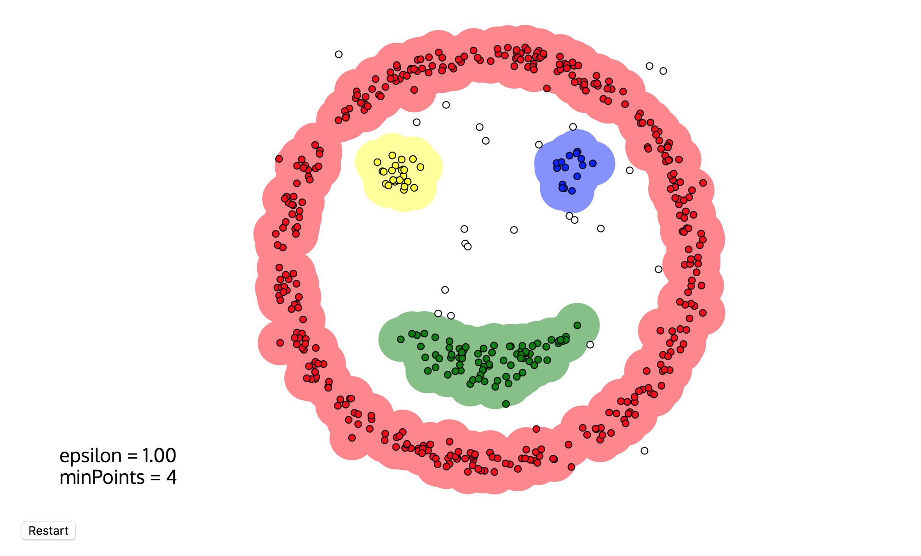

Slide 14
Gaussian Mixture Model
Generative model vs Discriminative model
EM algorithm
More details on GMM

Slide 15
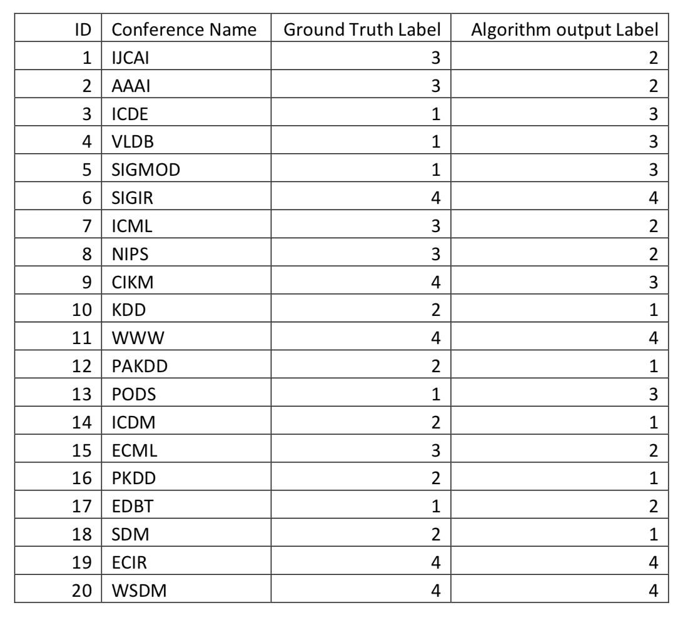
Example: Clustering Evaluation
Calculate:
Purity, precision, recall, F-measure, and normalized mutual information

Slide 16
Midterm Reminder
Time: 12:00-13:45, Nov 14
Place: In Class
Questions: True/False, Conceptual questions, Computation questions
Policy:
Honor code (No discussion during exam).
Closed book exam, but you can take a “reference sheet” of letter size.
You can bring a simple calculator.
Make sure your handwriting readable and clear enough and write down your answer in the “correct” area. → We will use the digital copy for grading.
Keep your answer concise.

Slide 17
Midterm Topics
Task | Vector data
Classification | Logistic Regression; Decision Tree; KNN; SVM; Neural Networks
Clustering | K-means; Hierarchical clustering; DBSCAN; Mixture Models
Prediction | Linear Regression

Slide 18
True or False
Sample Questions
You are only required to write down “T” or “F” before each statement. No need to justify (subject to change).
Insights and details about learned algorithms and techniques.

Slide 19
Examples: True or False
Sample Questions
[ ? ] Logistic regression is a linear classifier.
[ ? ] Normalization of the features (e.g., z-score) in linear regression will affect the weights learned from closed-form solution.
[ ? ] Decision tree can handle both numerical and categorical features.
[ ? ] In K Nearest Neighbor classifier, a bigger K will more likely cause overfitting in the training dataset.
[ ? ] Linear regression is a supervised learning model while hierarchical clustering is unsupervised learning model.

Slide 20
Conceptual Questions
Sample Questions
Give your conclusion or results and also need to justify (in most cases).
Example 1: What is the time complexity of DBSCAN? Why?
Example 2: What are the conditions of stopping partitioning the training examples when constructing a decision tree?

Slide 21
Computation Questions
Sample Questions
For example,
Information gain computation in decision tree
SVM problem in HW2
Neural network forward computation
Classification evaluation

Slide 22
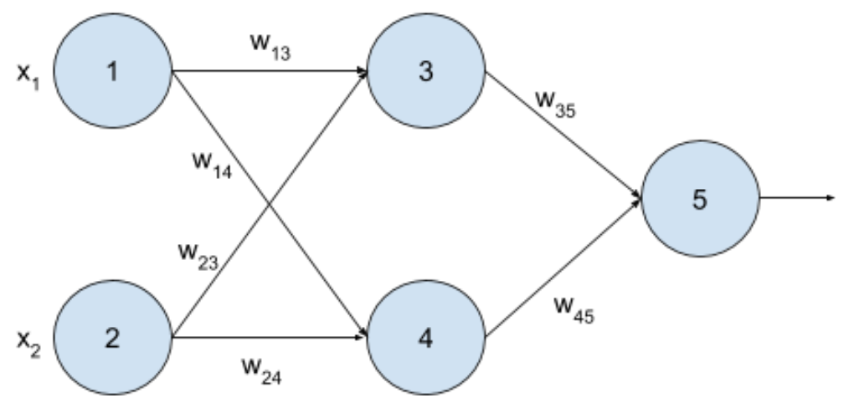
Example: Computation Questions
Sample Questions
Given the following multilayer neural network, a training data point x = (x₁=0, x₂=1), and the target value T=1, please calculate weights and bias after 1 iteration of backpropagation algorithm (show your calculations and fill out the empty tables given below). The learning rate =0.8. The initial weights and bias are in the following table.
w₁₃ | w₁₄ | w₂₃ | w₂₄ | w₃₅ | w₄₅ | 3 | 4 | 5
-0.3 | 0.2 | 0.4 | -0.1 | -0.2 | -0.3 | 0.2 | -0.4 | 0.1

Slide 23
Examples
Given the following multilayer neural network, a training data point x=(x₁=0,x₂=1), and the target value T=1, please calculate weights and bias after 1 iteration of backpropagation algorithm (show your calculations and fill out the empty tables given below). The learning rate =0.8. The initial weights and bias are in the following table.
w₁₃ | w₁₄ | w₂₃ | w₂₄ | w₃₅ | w₄₅ | 3 | 4 | 5
-0.3 | 0.2 | 0.4 | -0.1 | -0.2 | -0.3 | 0.2 | -0.4 | 0.1

Slide 24
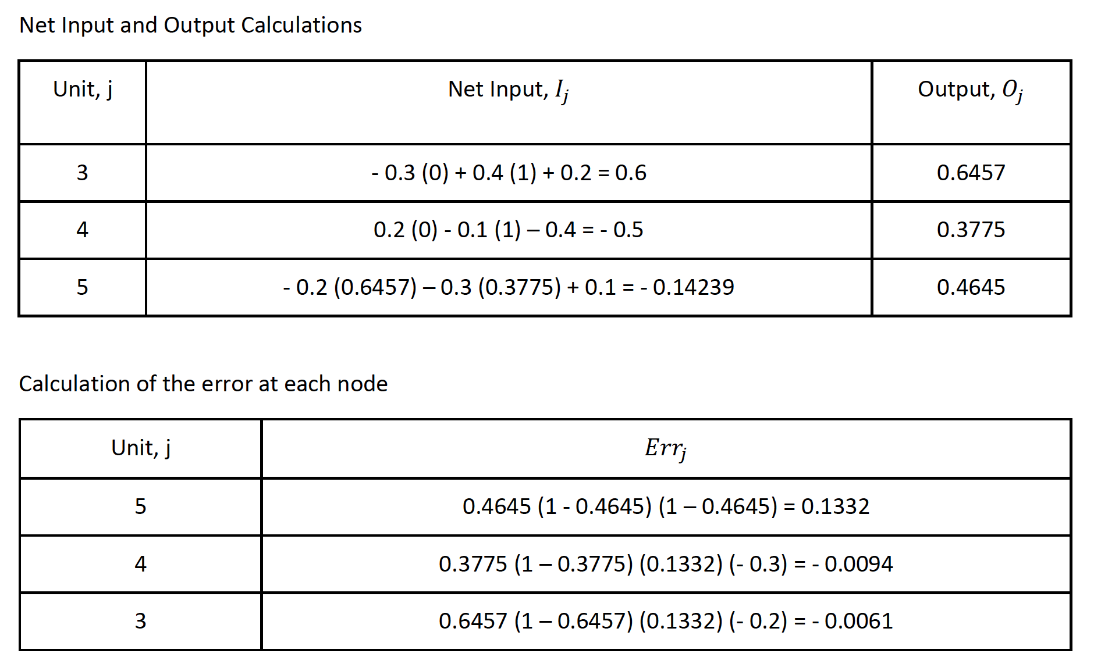
Pay attention to whether it is err or derivative.

Slide 25
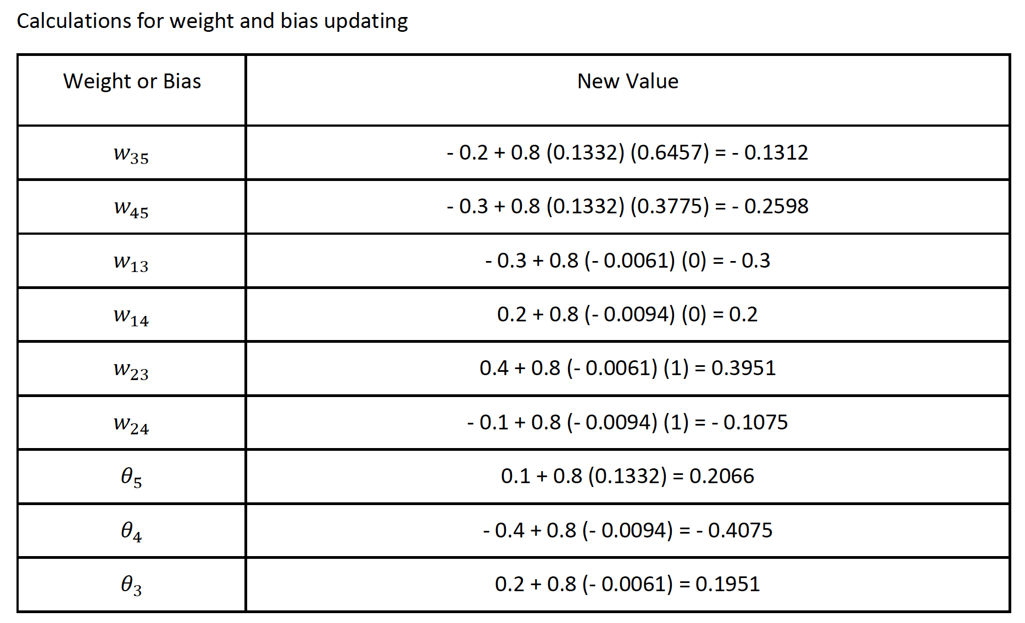
Pay attention to the sign here! If err, +; If derivative, - (~SGD).

Slide 26
Thank you!
Q & A

