Slide 1
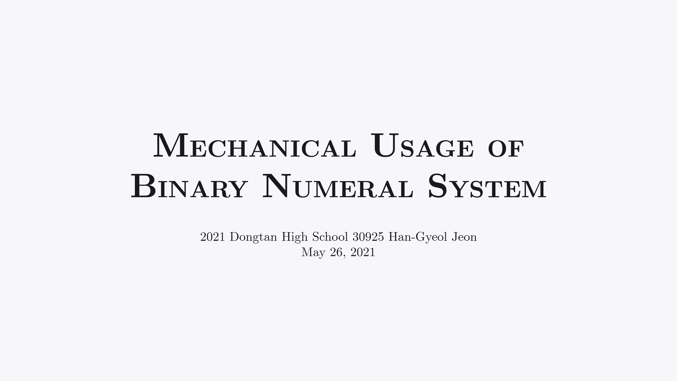

Slide 2
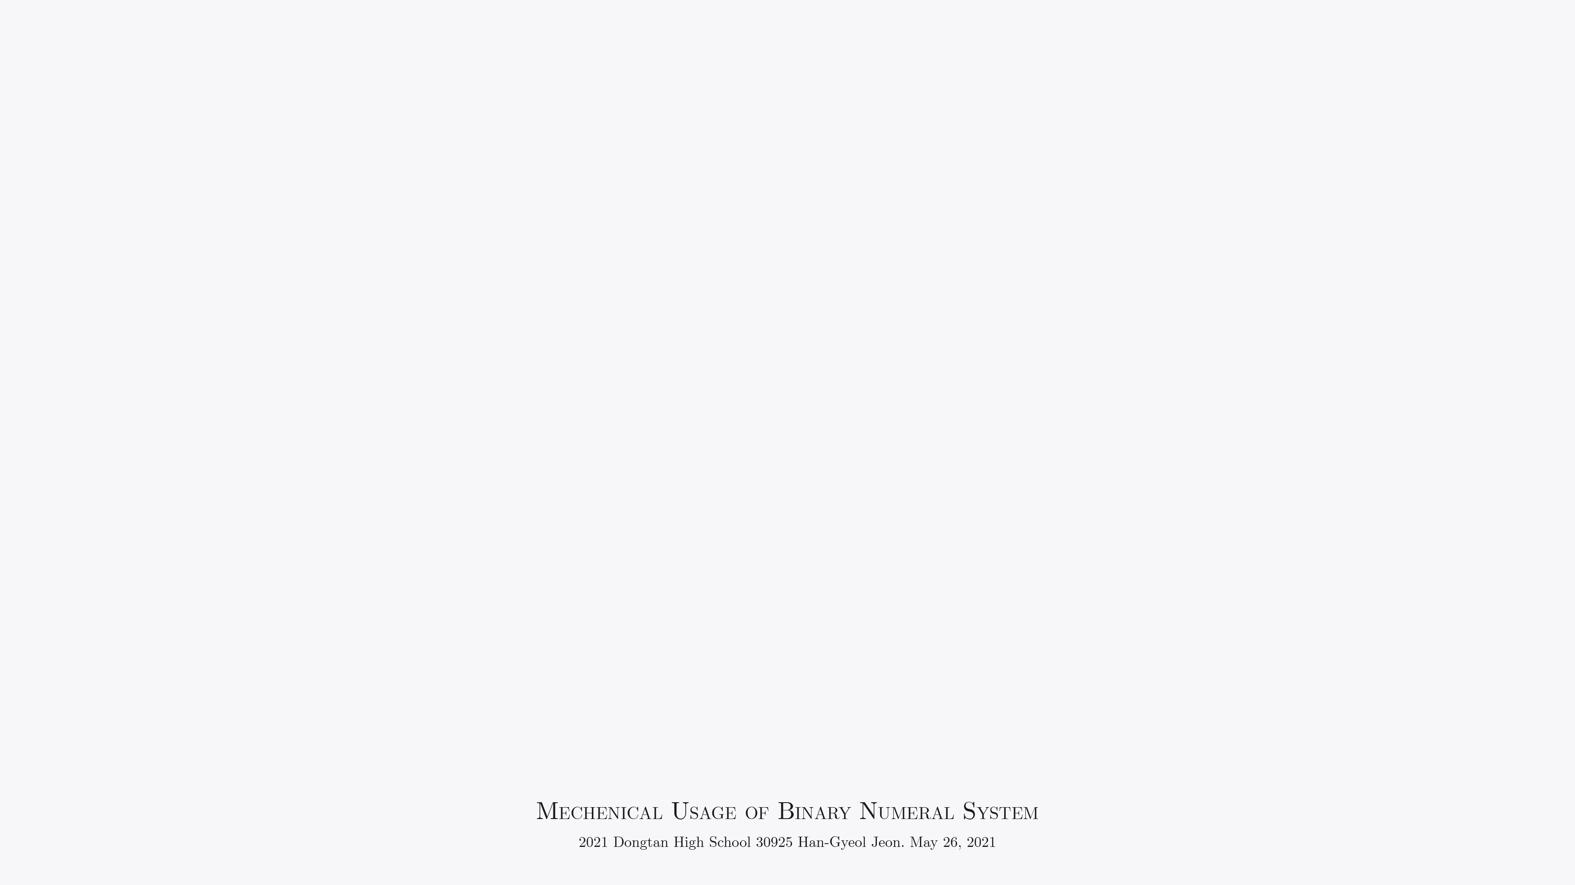
I. Why This Topic was Chosen

Slide 3
I. Why This Topic was Chosen
Computers work only within 0's and 1's.

Slide 4
II. Numeral Systems

Slide 5
II.1. Binary Numeral System
21 = 1,0101₂

Slide 6
II.1. Binary Numeral System
1,000 = 11,1110,1000₂

Slide 7
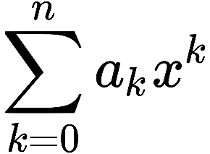
II.1. Binary Numeral System
The Value of Polynomial
Where the Variable is a Natural Number

Slide 8
II.2. Hexadecimal Numeral System
0 1 2 3 4 5 6 7
8 9 A B C D E F

Slide 9
II.2. Hexadecimal Numeral System
F₁₆ = 15 = 1111₂

Slide 10
III. Binary Data Representation

Slide 11
III.1. Representation of Integer
15 = 1111₂

Slide 12
III.1. Representation of Integer
-15 = 1000,1111₂

Slide 13
III.2. Representation of String
‘‘Hello.”

Slide 14
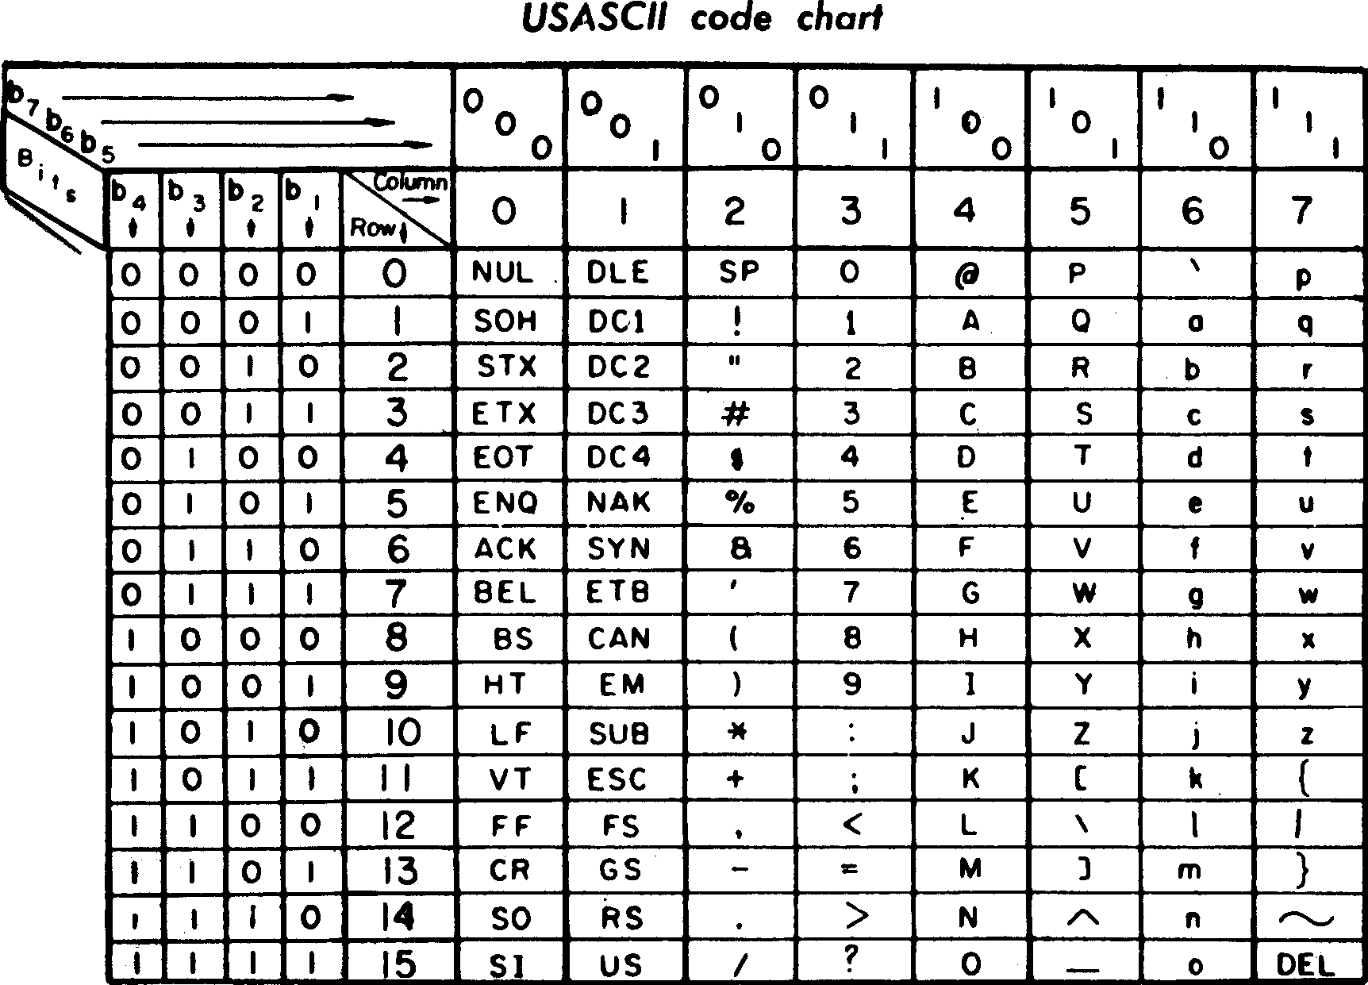
III.2. Representation of Strings
Declare
a Standard!

Slide 15
III.2. Representation of String
Hello. = 48,65,6C,6C,6F,2E_{RoS}

Slide 16
III.2. Representation of String
The UnicodeTM

Slide 17
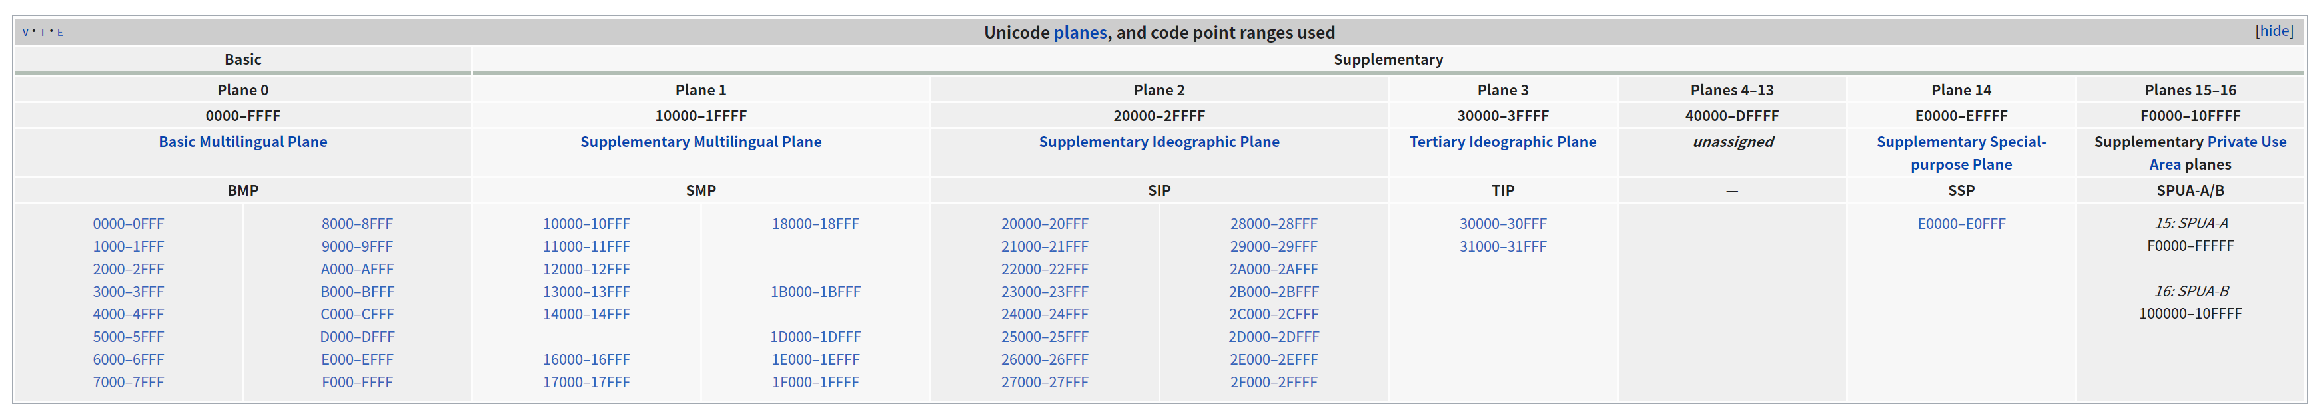
III.2. Representation of String

Slide 18
III.3. Representation of Image
Pixels

Slide 19
III.4. Representation of Audio
Wave Phase

Slide 20
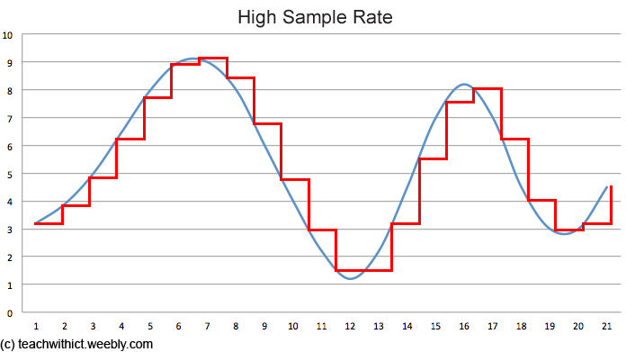
III.4. Representation of Audio

Slide 21
IV. Thoughts

Slide 22
IV. Thoughts
Structured Thinking

Slide 23
IV. Thoughts
Ethical Issues

