Slide 1
Machine Learning
백준호
bemodesty306@naver.com

Slide 2
Machine Learning (기계학습)
ML is the scientific study of algorithms and statistical models that computer systems use to perform a specific task without using explicit instructions, relying on patterns and inference instead.

Slide 3
Machine Learning (기계학습)
Supervised learning
Unsupervised learning
Reinforcement learning
Evolutionary learning

Slide 4
Supervised learning
Supervised learning algorithms build a mathematical model of a set of data that contains both the inputs and the desired outputs.
Feature Data
Target data
-Classification
-Regression
Train data set

Slide 5
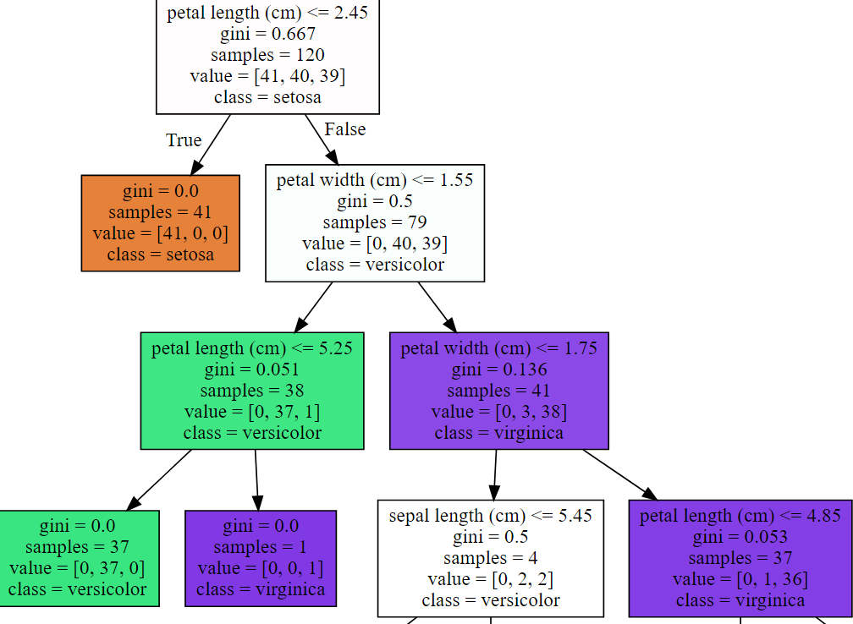
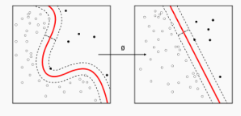
Classification
Classification algorithms are used when the outputs are restricted to a limited set of values.

Slide 6
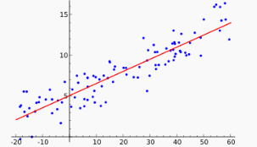
Regression
Regression algorithms are used when the outputs may have any numerical value within a range.

Slide 7
Progress
data mining
Preprocessing etc..
Training
Tuning
Optimization
Generalization
Predict
Evaluation

Slide 8
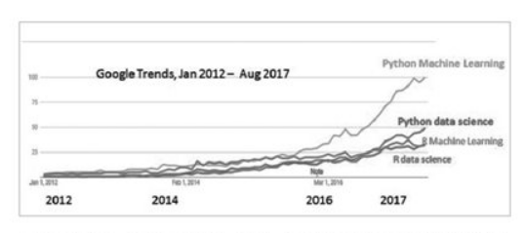
R VS PYTHON

Slide 9
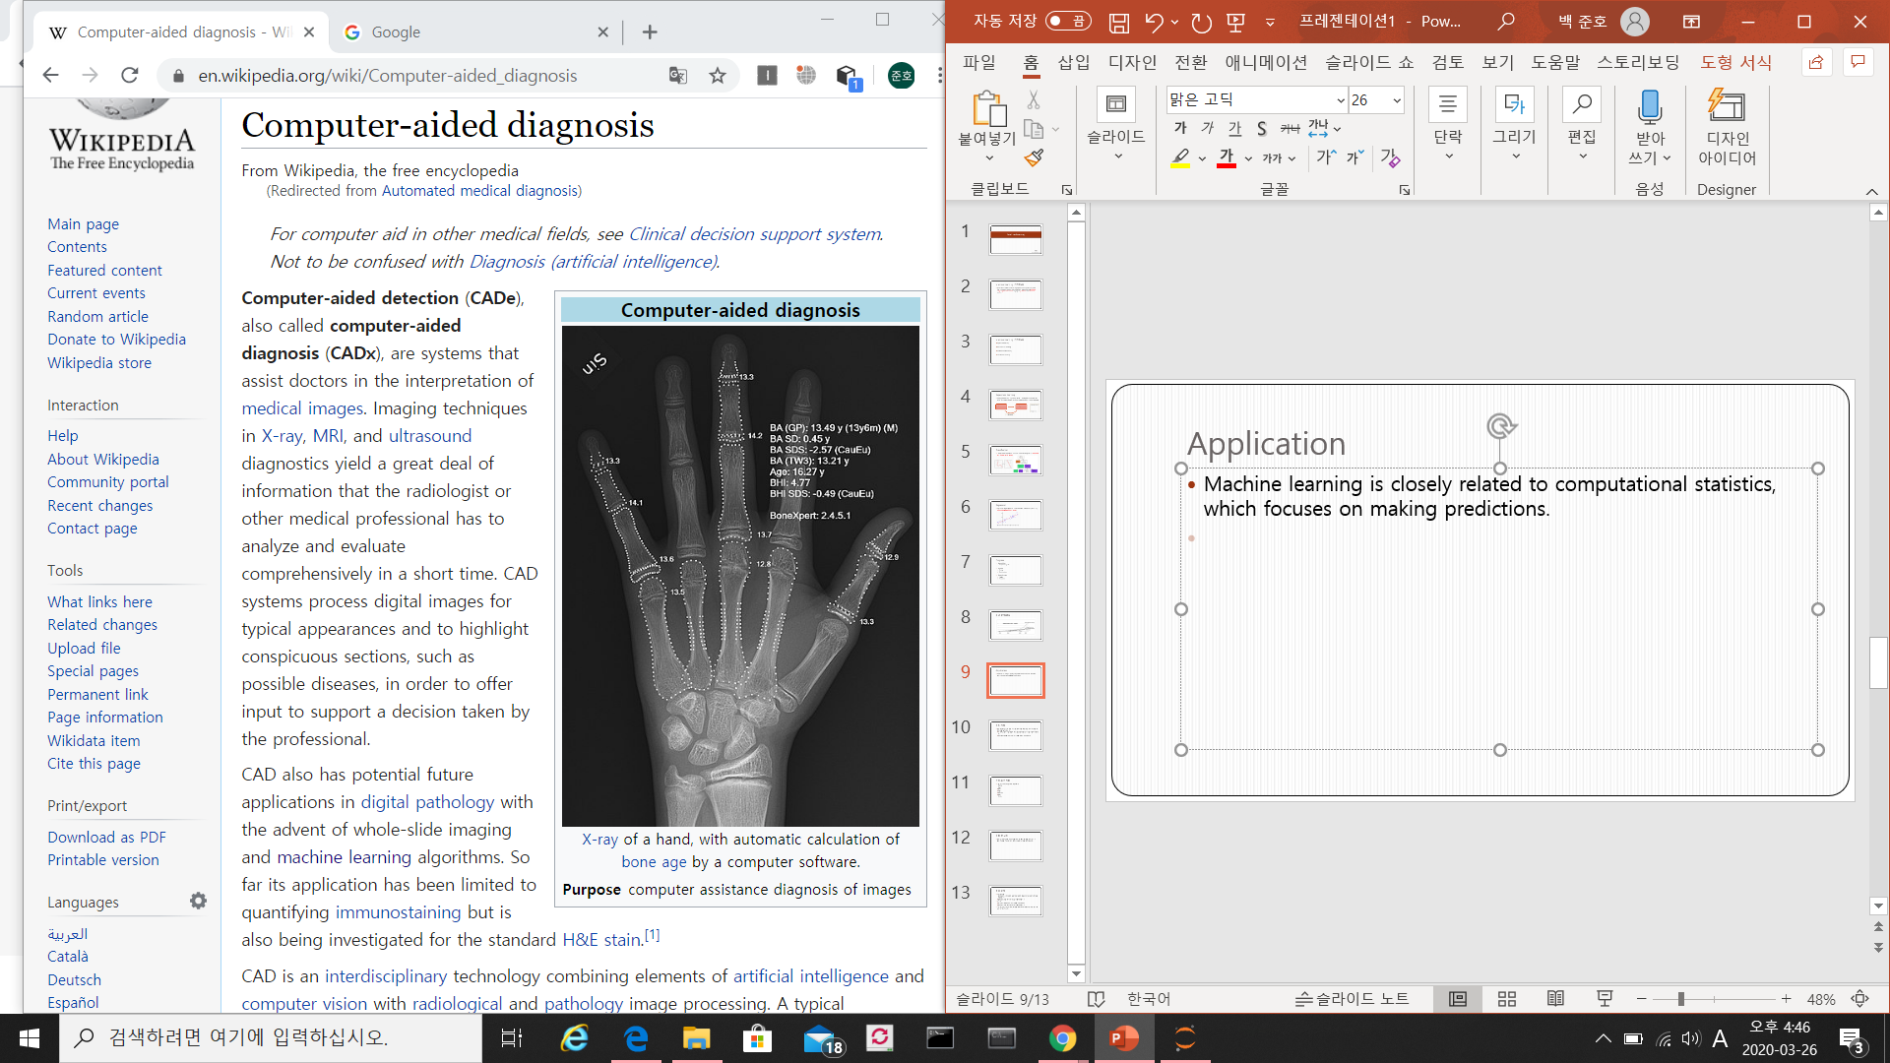
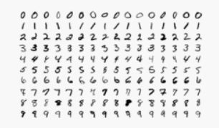
Application
Machine learning is closely related to computational statistics, which focuses on making predictions.
Handwriting recognition
Computer aided diagnosis

