Slide 1
System Design

Slide 2
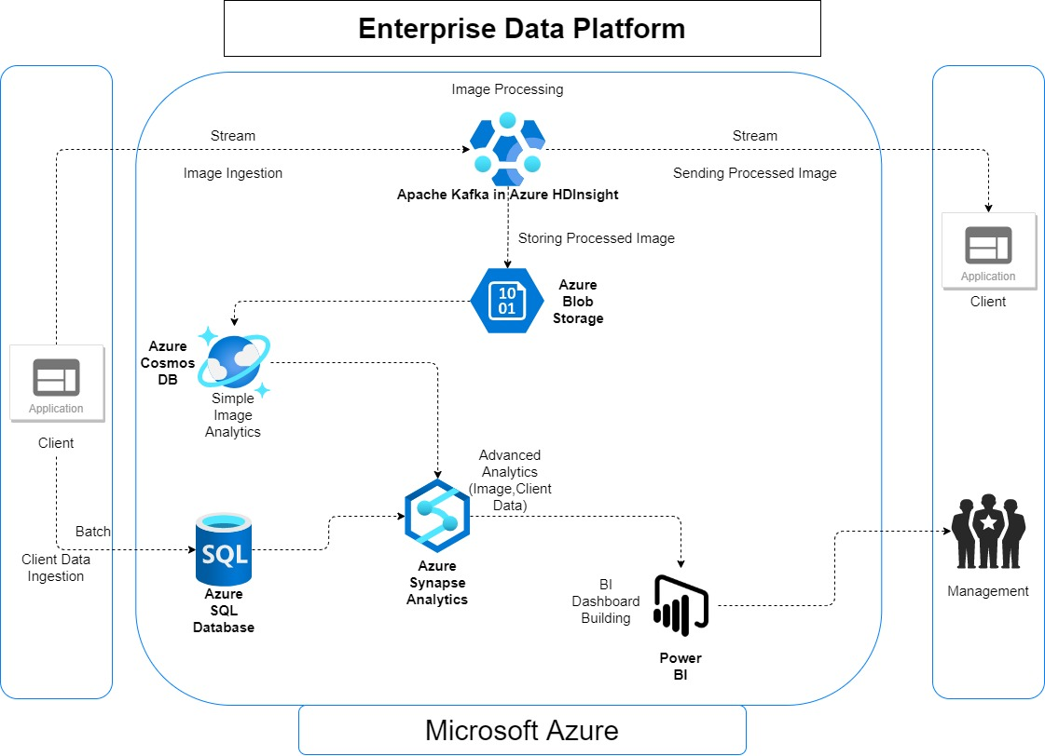
EDP Architecture

Slide 3

Apache Kafka in Azure HDInsight
Efficient for Stream Data Pipeline
Big data processing frameworks available
Efficient for unstructured data
Available for pre-written scripts saved to process data

Slide 4

Azure blob storage
Cheap for binary data storage
Data stored is ready for further analytics by other Azure services
Can set active storage period

Slide 5

Azure cosmos db
Low latency, high throughput
Simple query analytics on No-SQL data

Slide 6

Azure sql database
Efficient in storing SQL data
Simple query analytics on structured data like customer profile data

Slide 7

Azure synapse analytics
Powerful Azure service for advanced analytics
Applicable to both SQL & No-SQL data

Slide 8

Power bi
Powerful business intelligence dashboards building platform
Can be used to create interactive, immersive dashboards and reports that provide actionable insights and drive business results.

