Slide 1
EasyPreviewer Demo Deck
Complex PPTX sample with layout, images, tables, and bilingual content.

Slide 2
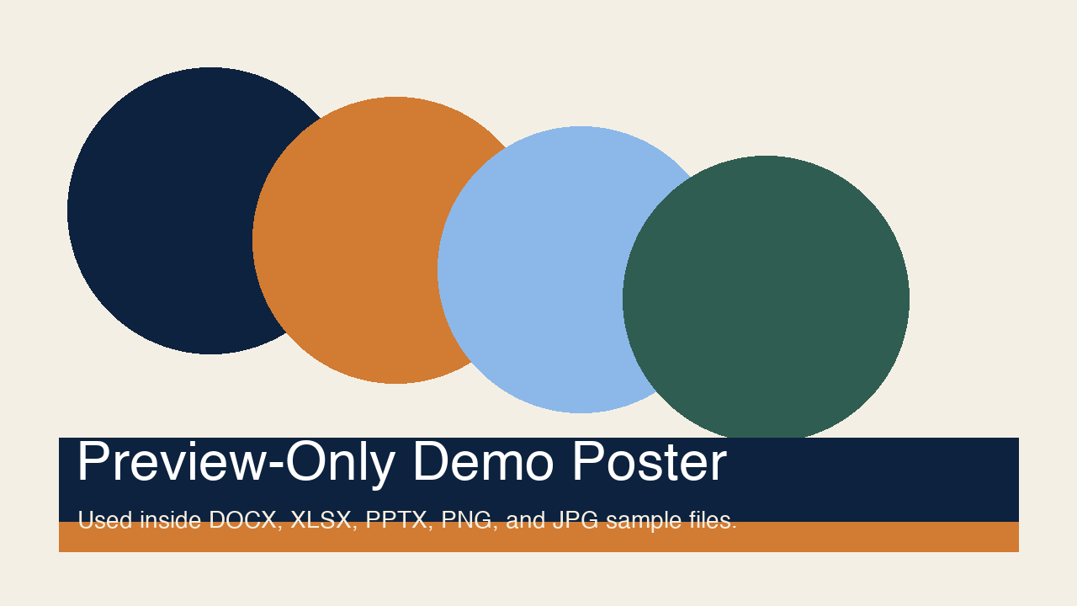
Agenda
1. Product rules
2. Supported file types
3. Unsupported-by-policy list
4. Bilingual rollout

Slide 3
Support Matrix
Capability | Status | Notes
Office | Supported | LibreOffice conversion
PDF / Text / Images | Supported | Read-only rendering
CAD / Media / TIFF | Unsupported | Removed by policy

Slide 4
Bilingual UX
English: Preview only means no editing, no export, and no save-back.
中文：仅预览意味着不提供编辑、导出与保存回源文件。

