Slide 1
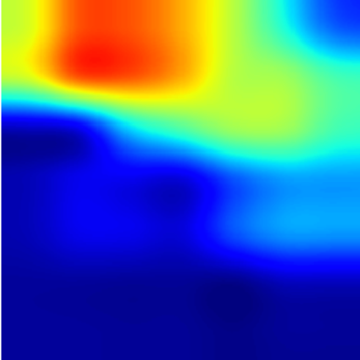


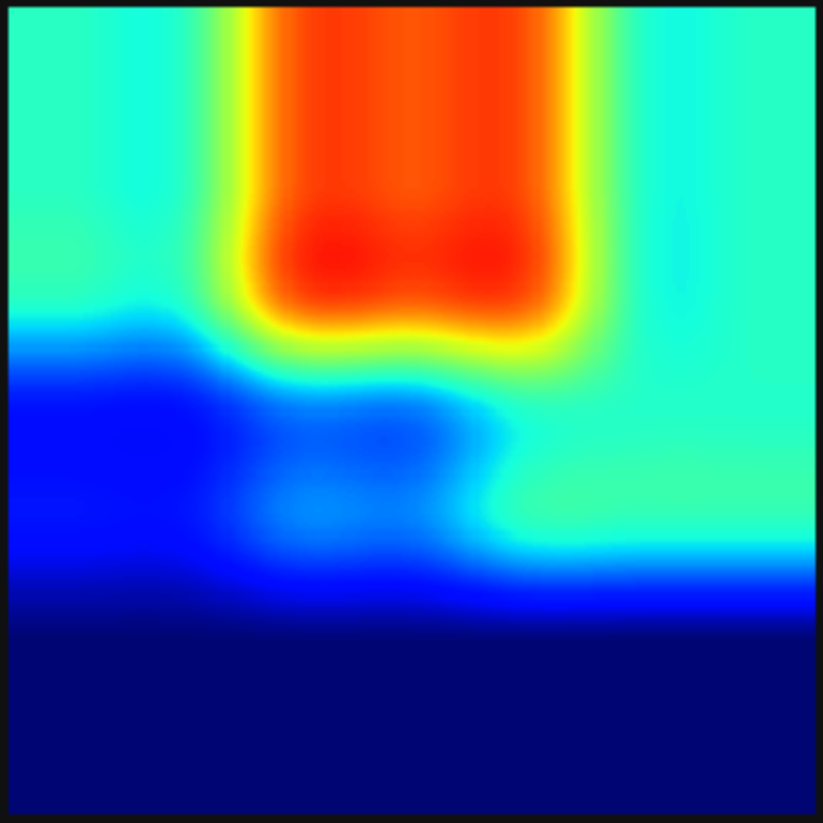

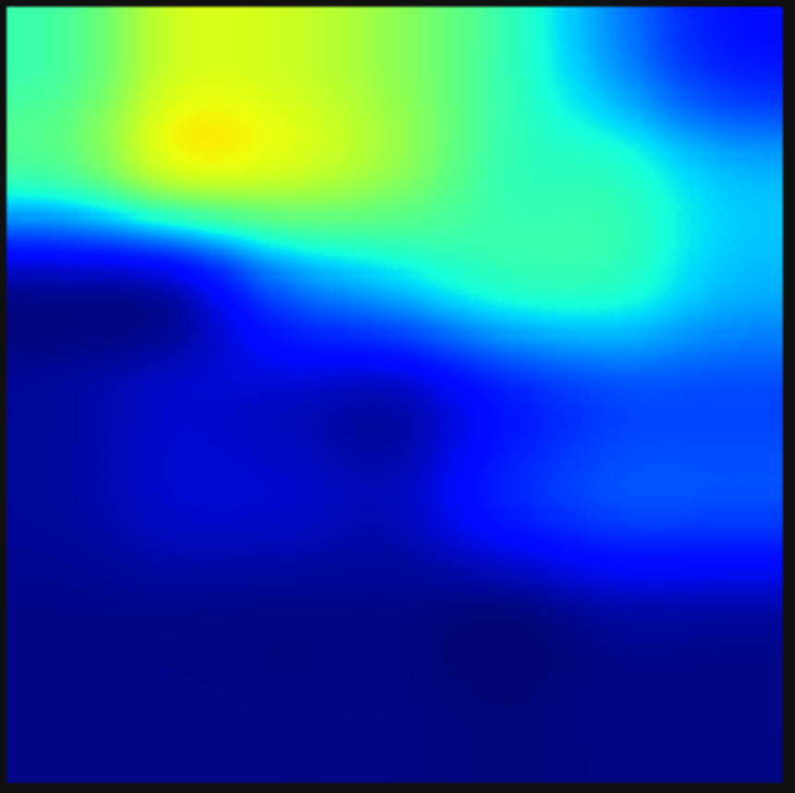
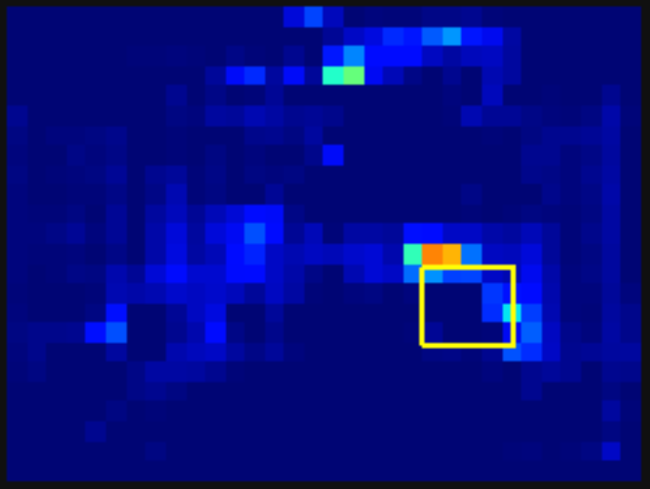
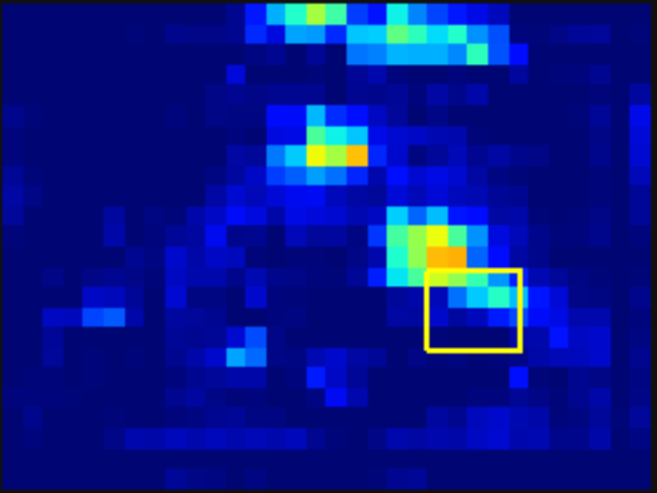
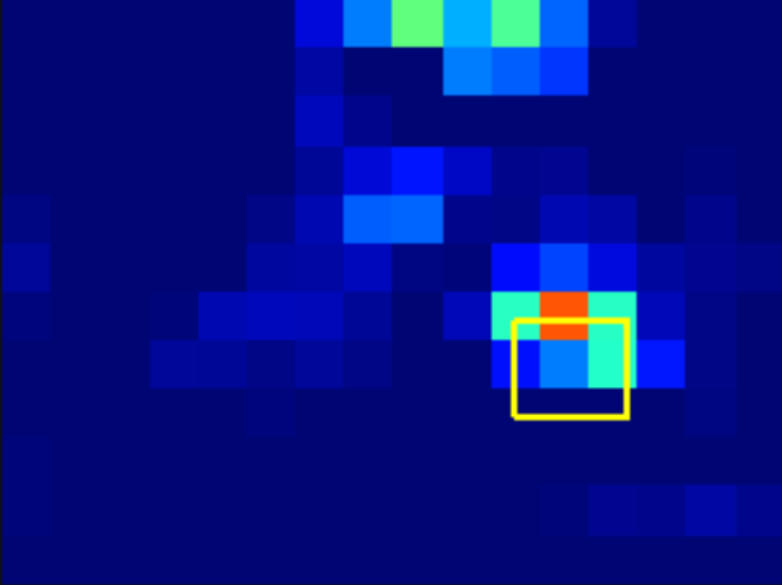



SR Feature
Generator
Better SR target to follow?
SR feature
LR
feature
Naïve
SR target
Our
SR target
Feature Extractor
Feature Extractor
SR Target
Extractor
$$I_{}^{0.5}$$
$$I_{}^{1.0}$$
$$I_{}^{1.0}$$
Receptive field

