Slide 1
Interrupt
Embedded System

Slide 2
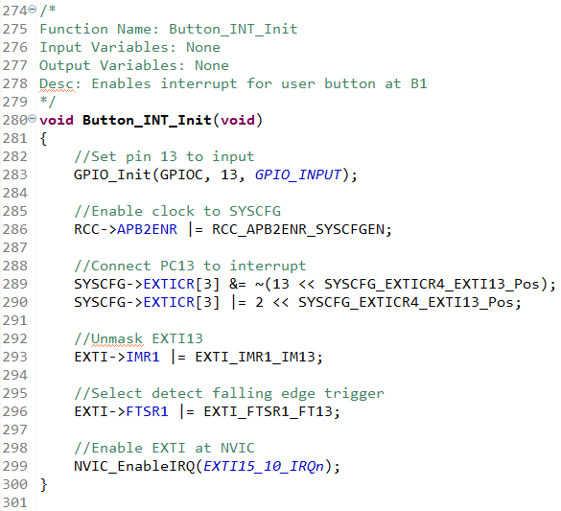
Interrupt – Function

Slide 3
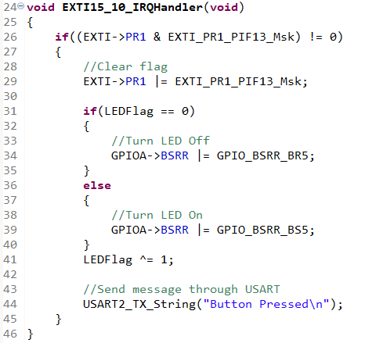
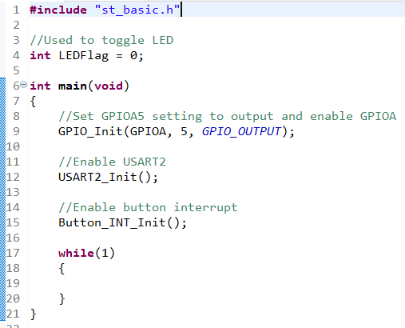
Interrupt – Main Function

Slide 4
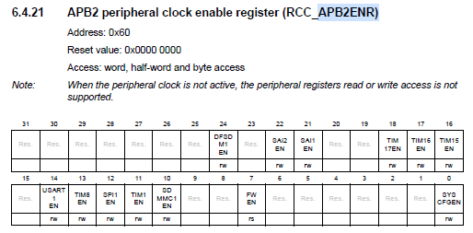

Interrupt - Registers
Reference Material(page 258, 259)
Used to enable interrupt for button input(GPIO).

Slide 5
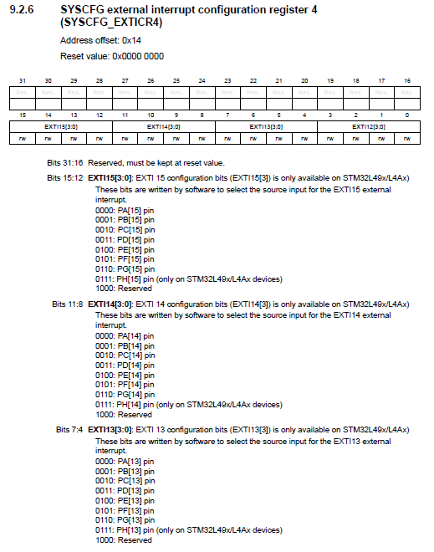
Interrupt - Registers
Reference Material(page 321)
All interrupts from same pin numbers are connected.
Can’t have 2 interrupts in same pin number.
EXTI used to set which pin will have the interrupt enabled(default A).
Set EXTI13 to pin C13(0010).

Slide 6
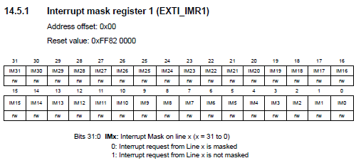
Interrupt - Registers
Reference Material(page 405)
Used to enable masks for certain lines.
IM13 is changed to 1 to unmask GPIO button interrupt request.

Slide 7
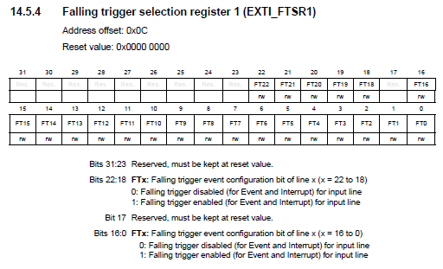
Interrupt - Registers
Reference Material(page 406)
FTSR register is used to enable falling edge trigger interrupt.
RTSR register is used to enable rising edge trigger interrupt.
FTSR2 and RTSR2 to enable interrupts from GPIO with pin number higher than 32.
Interrupt can’t differentiate rising or falling edges.

Slide 8
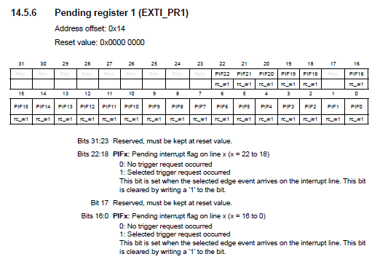
Interrupt - Registers
Reference Material(page 408)
PR1 keeps the status of pending interrupt.
After interrupt, the pending flag is set to 1, disabling the next interrupt from happening.
PIF needs to be set to 1 to reset the pending flag.

Slide 9
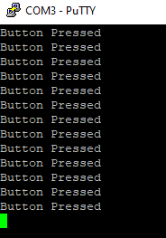
Interrupt – Result

Slide 10
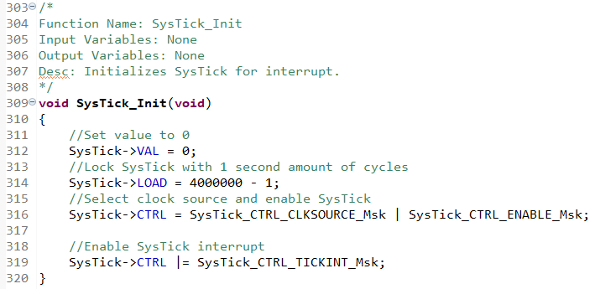
Interrupt – Function

Slide 11
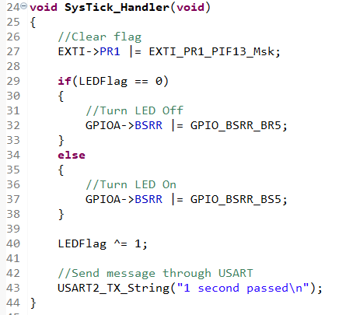
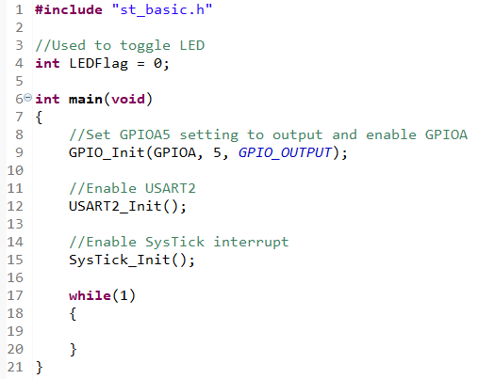
Interrupt – Main Function

Slide 12
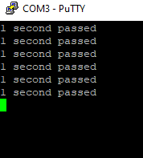
Interrupt – Result

Slide 13
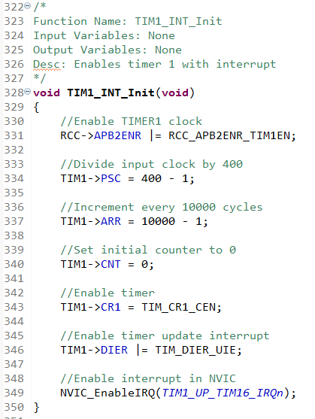
Interrupt – Function

Slide 14
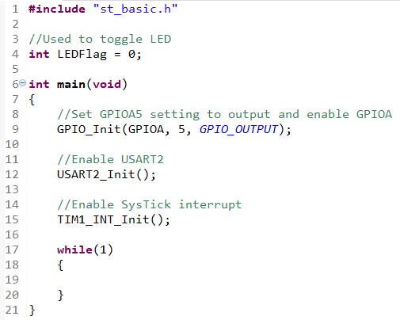
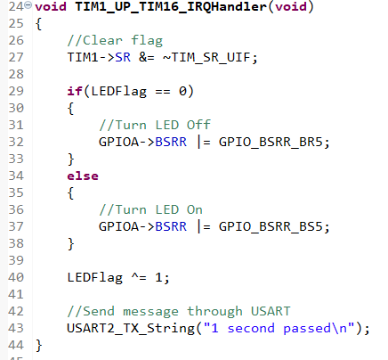
Interrupt – Main Function

Slide 15
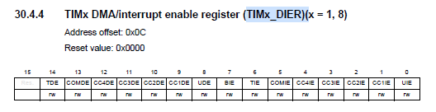

Interrupt - Registers
Reference Material(page 975, 977)
DMA -> UIE used to enable interrupt of timer 1, 8.
Other resistors needed to get other TIMERs enabled.

Slide 16
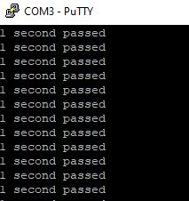
Interrupt – Result

Slide 17
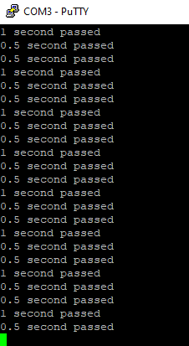
Task 1
Change SysTick to get a 0.5s time for each interrupt.
Change timer1 to get a 1s time for each interrupt.
Send different output to USART for each interrupt
SysTick = “0.5s passed”
Timer1 = “1s passed”

Slide 18
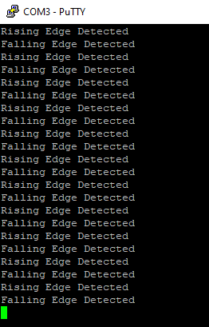
Task 2
Change button interrupt to detect falling and rising edges.
Every falling and rising edge is printed using USART.
Falling edge = “Falling edge detected”
Rising edge = “Rising edge detected”
LED toggle on falling edge and rising edge detection.

