Slide 1
USART
Embedded System

Slide 2
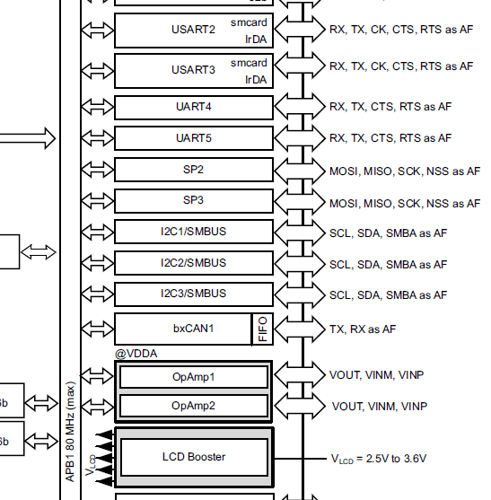
USART - Registers
Datasheet(page 17)
USART2 connected to APB1
Order:
Setup GPIO for USART2 output and input
Enable clock APB1 for USART2 use
Configure the USART

Slide 3
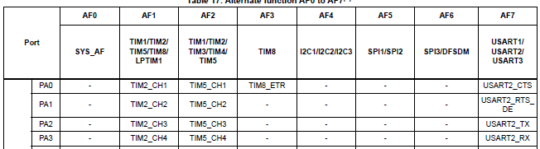
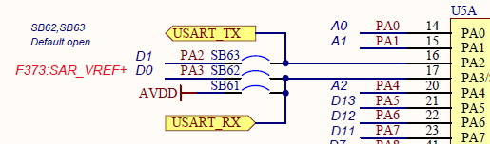
USART - Registers
Datasheet(page 92), MB(page 2)
PA2, PA3 used for USART2_TX and USART2_RX
PA2 and PA3 need to be set to AF7 mode

Slide 4

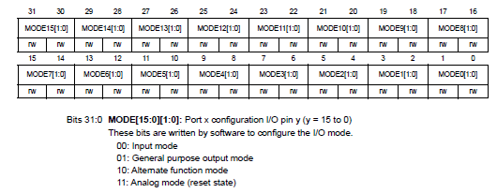
USART - Registers
Reference manual(page 303, 304)
To set the GPIO, change the MODEn[1:0] to [1, 1] for alternate function mode

Slide 5
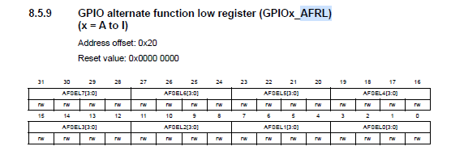
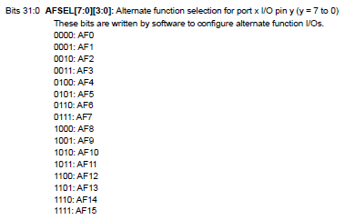
USART - Registers
Reference manual(page 308, 309)
Change GPIOx mode when using alternate functions
AF7 = 0111
A2, A3 need to be changed for USART output and input

Slide 6
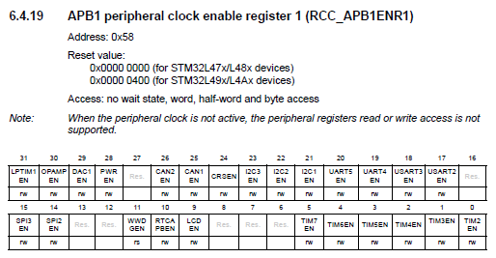

USART - Registers
Reference manual(page 254, 255)
To enable USART2 clock, change bit 17 to ‘1’

Slide 7
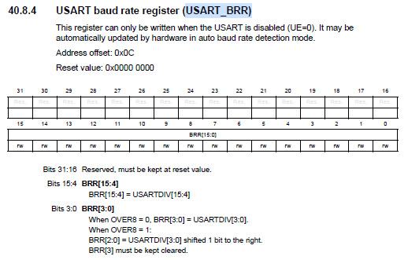
USART - Registers
Reference manual(page 1395)
Used to setup baud rate

Slide 8
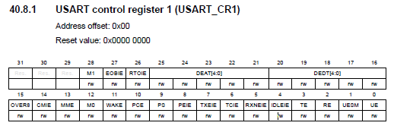
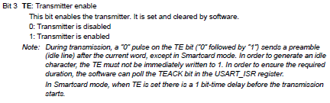
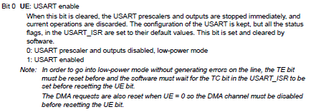

USART - Registers
Reference manual(page 1384)
Used to enable, transfer, receive from USART
Bit 0 : Enable USART
Bit 2 : Enable receive from USART
Bit 3 : Enable transfer from USART

Slide 9
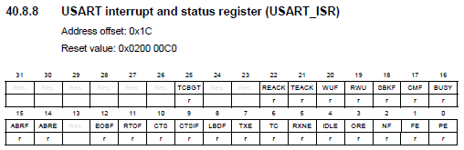
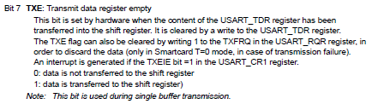

USART - Registers
Reference manual(page 1399, 1402)
Used to check if USART can send output or take input
‘1’ means that the USART can send / output

Slide 10
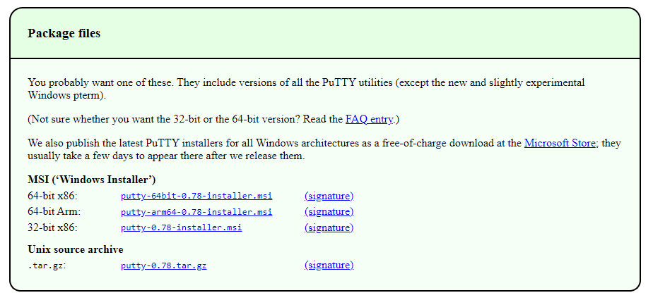
PuTTY – Install
URL: https://www.chiark.greenend.org.uk/~sgtatham/putty/latest.html
Press ‘Next’ to every step and ‘Install’

Slide 11
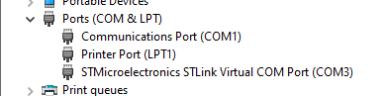
PuTTY – Configure
Search and open ‘device manager’
Check ‘Ports’
Remember the number after ‘COM’ for STM~
The port is ‘COM3’ here

Slide 12
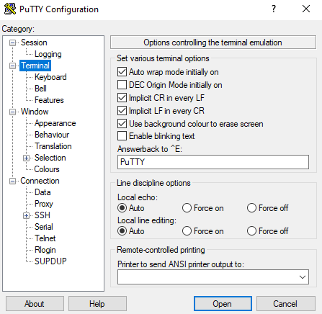
PuTTY – Configure
Open PuTTY
Open ‘Terminal’
Check both ‘Implicit~’ options

Slide 13
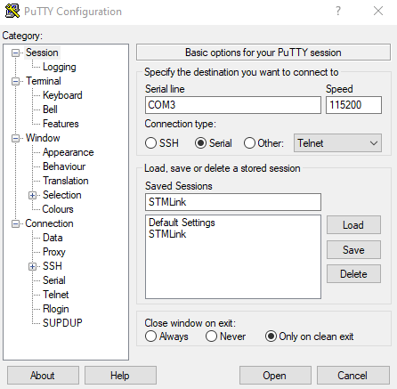
PuTTY – Configure
Go back to ‘Session’
Change ‘Connection type’ to ‘Serial’
Set ‘Serial line’ to ‘COMn’(n is the number found in the above step)
Set ‘Speed’ to ‘115200’
Save the settings by
Write name to ‘Saved Sessions’
Press ‘Save’
Next time, when you open PuTTY double click the name to open it.

Slide 14
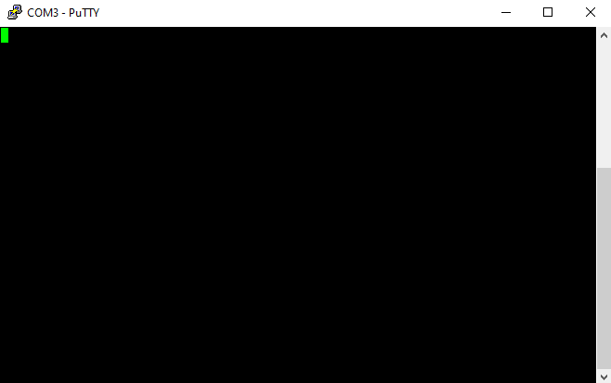
PuTTY – Configure
When you opened a blank terminal will open
Click the terminal to make the name show up at the top

Slide 15
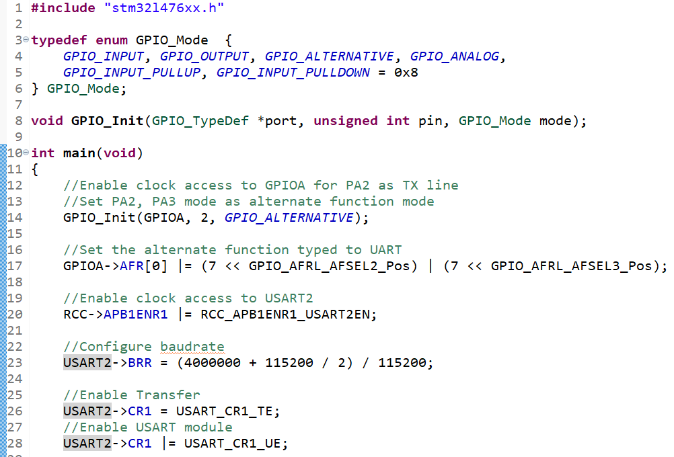
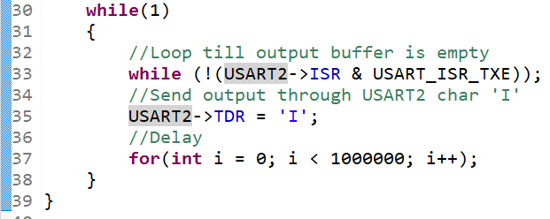
USART - Output
GPIO_Init function needed.
Will print ‘I’ on the screen constantly

Slide 16
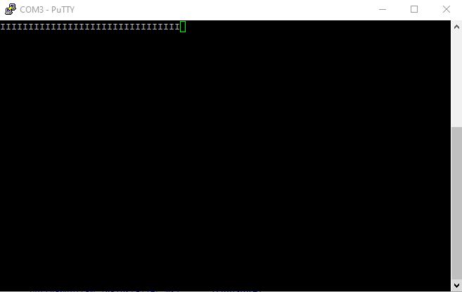
USART - Output

Slide 17
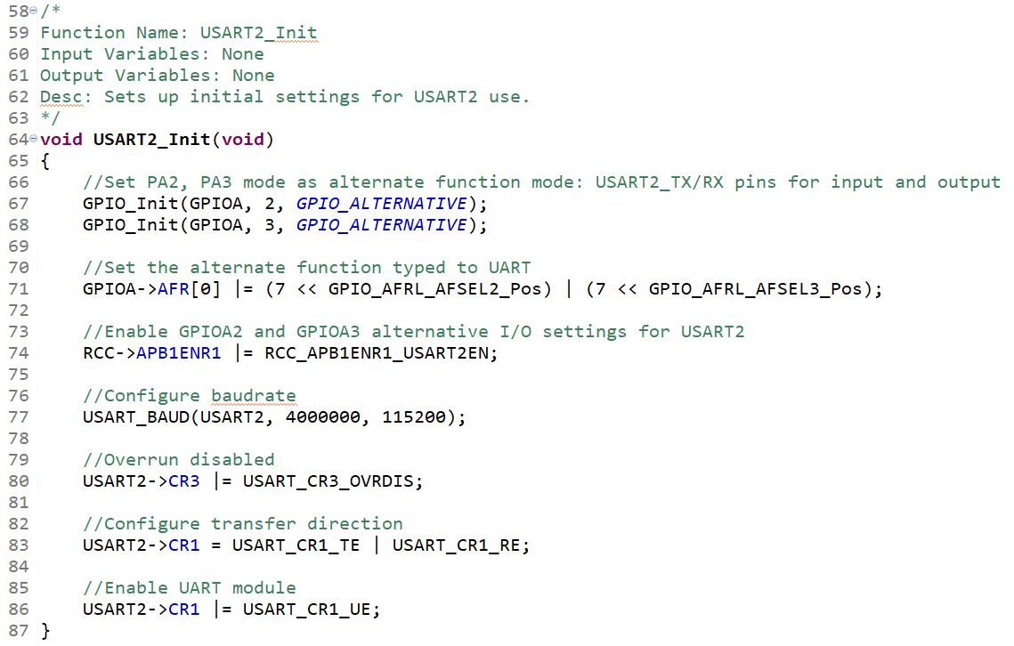
USART – Output functions
Change the code to readable functions

Slide 18
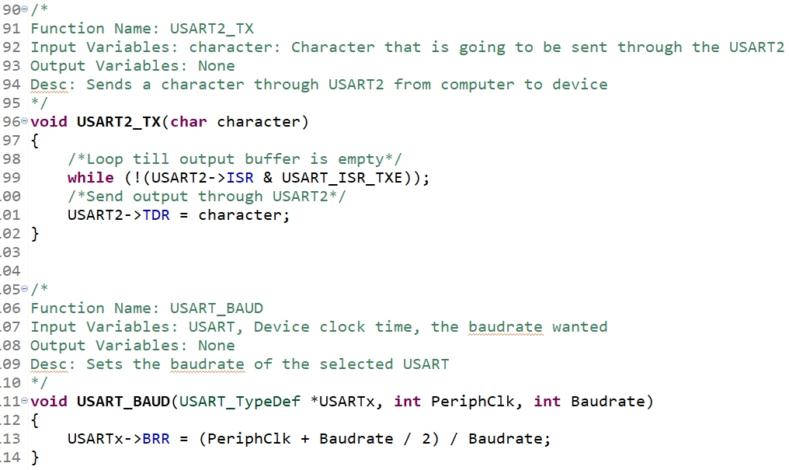
USART – Output functions
Change the code to readable functions

Slide 19
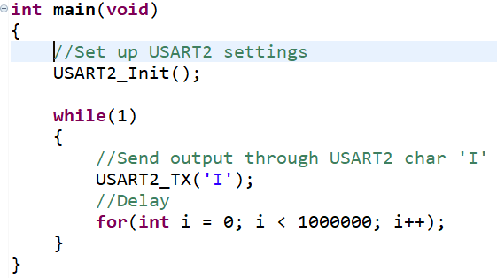
USART – Output functions
Makes main function more readable and shorter

Slide 20
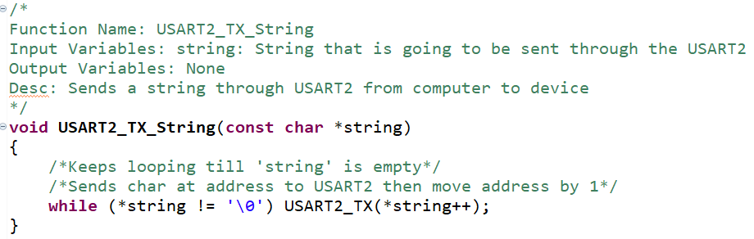
USART – Output string
Takes a string and prints it to the terminal

Slide 21
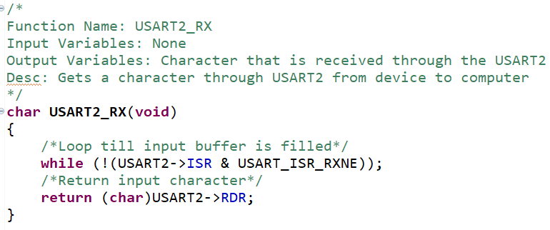
USART – Input
Takes an input from the terminal and returns it

Slide 22
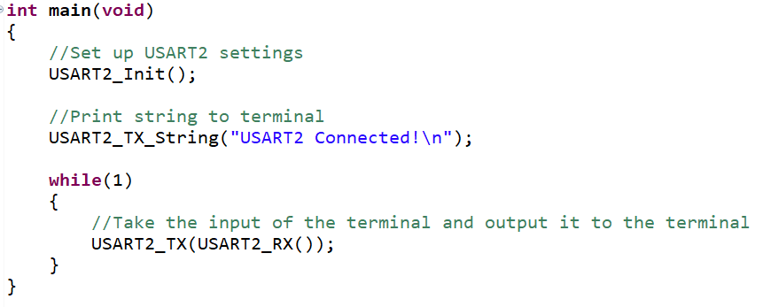
USART – Input
After printing the string ‘USART2 Connected!’
Takes input from the terminal and sends it back right away

Slide 23
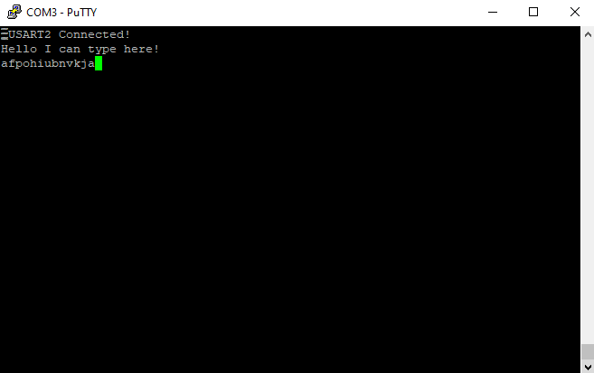
USART – Input

Slide 24

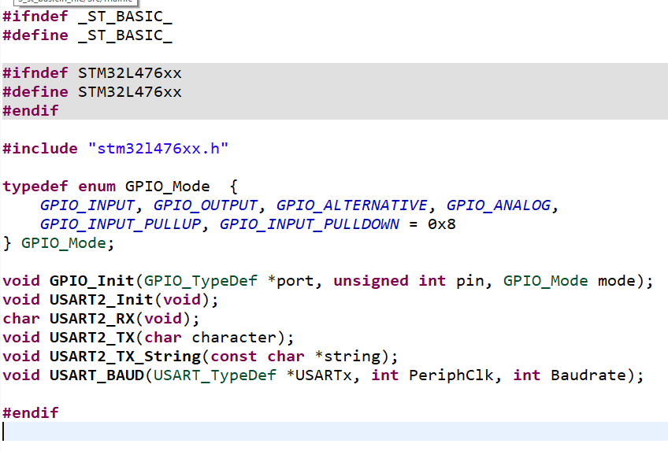
Use header file to save functions
Make a ‘st_basic.h’ and ‘st_basic.c’ file at the ‘src’ file
Write the following code to ‘st_basic.h’ file

Slide 25
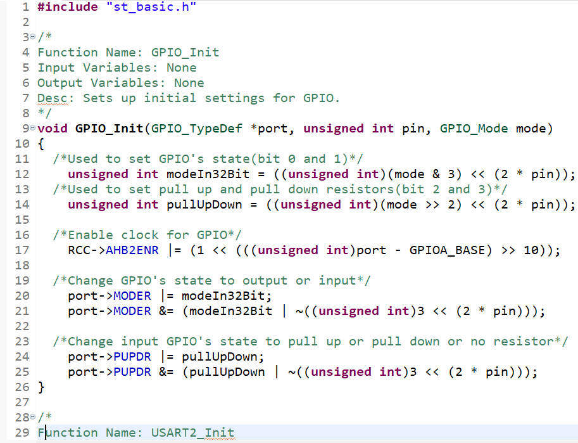
Use header file to save functions
Put all the functions into the ‘st_basic.c’ file
Make sure to add the ‘#include “st_basic.h”’ line.

Slide 26
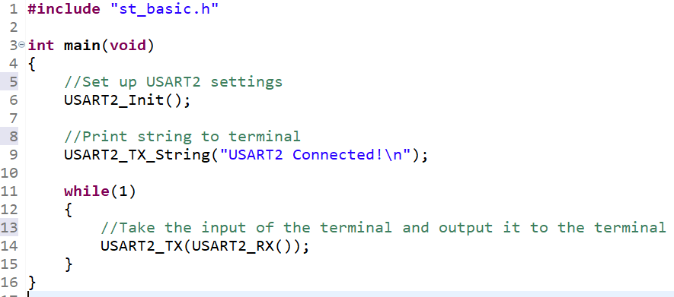
Use header file to save functions
Change the ‘main.c’ file “stm32l476xx.h” to “st_basic.h”
Build and run code to check if it works

Slide 27
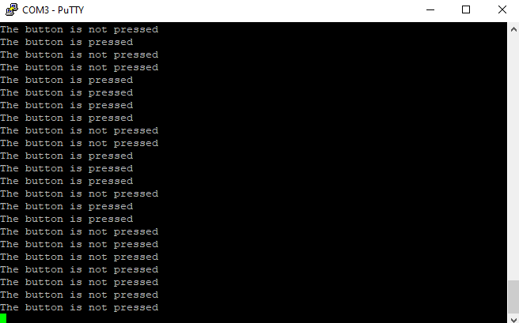
Task 1
Make the board output a string “The button is pressed” / “The button is not pressed” if the button is pressed / not pressed accordingly
Add delay to prevent rapid output.

Slide 28
Task 2
Make the LED LD2 change according to the input terminal
If the y key is inputted on the terminal turn the LED on
Else if the n key is inputted on the terminal turn the LED off

