Slide 1
GPIO
Embedded System

Slide 2
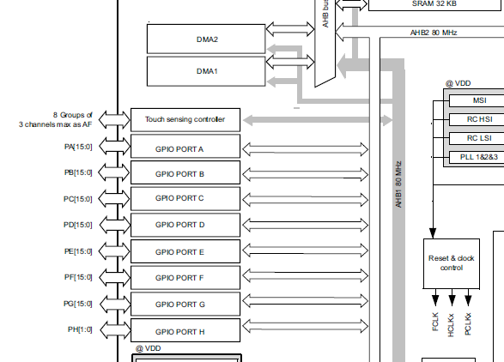
GPIO - Registers
Datasheet(page 17)
GPIO PORT connected to AHB2
Order:
Enable GPIO in AHB2
Setup GPIO mode(input, output)
If output set GPIO state

Slide 3
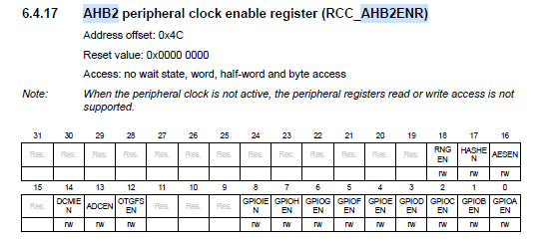

GPIO - Registers
Reference manual(page 251)
To enable GPIOx we need to change the GPIOxEN bit to 1

Slide 4

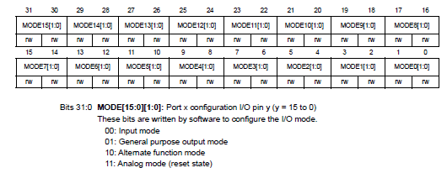
GPIO - Registers
Reference manual(page 303, 304)
To set GPIO to output or input, change the MODEn[1:0] to [0, 0] for input, [0, 1] for output

Slide 5
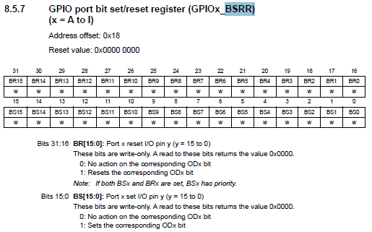
GPIO - Registers
Reference manual(page 307)
To set output to ‘1’ write BSn to ‘1’
To set output to ‘0’ write BRn to ‘1’

Slide 6
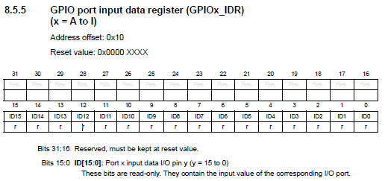
GPIO - Registers
Reference manual(page 306)
To check input from GPIO, check IDn for input state(0 or 1)

Slide 7

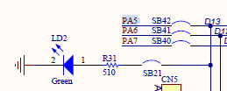
Output in Board
User manual(page 23)
MB(page 4)
From diagram, User LED LD2 connected PA5 Pin
Can be used to check output

Slide 8

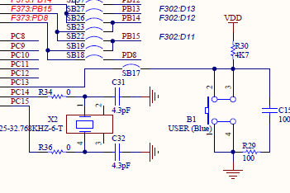
Input in Board
User manual(page 23)
MB(page 2)
From diagram, User button B1 is connected to PC13.
Can be used to check input
PC13 is high when the button is not pressed and low then the button is pressed.

Slide 9
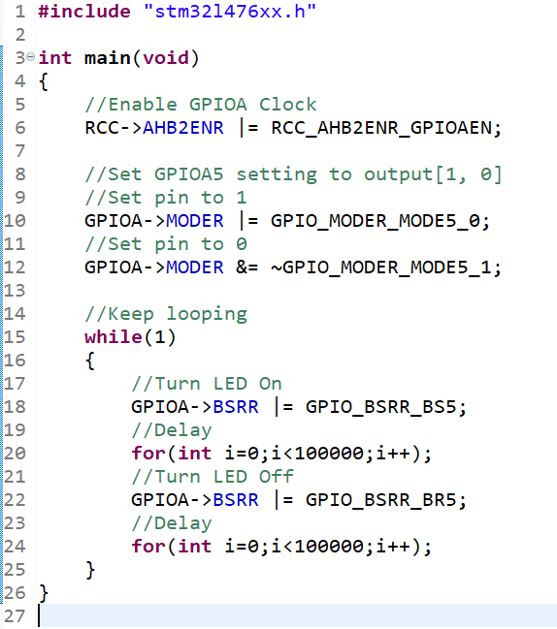
GPIO Output
Try to type code, build, and run.
Should make the LD2 green light blink.
Order:
Enable GPIO Clock
Set GPIO input / output
Toggle output

Slide 10
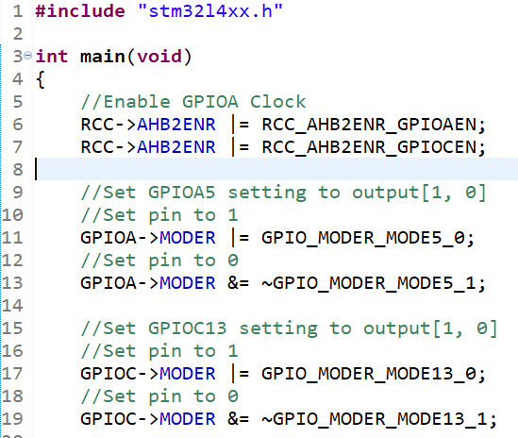
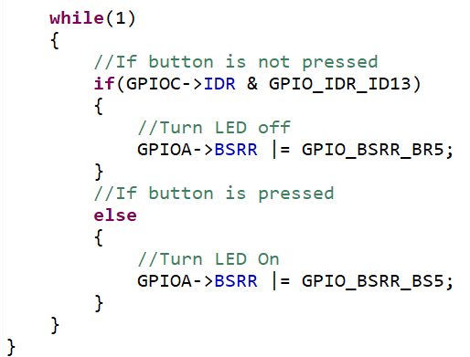
GPIO Input
Try to type code, build, and run.
Should make the LD2 green light light up when the button is pressed.
Order:
Enable GPIO Clock
Set GPIO input / output
Print output as LED

Slide 11
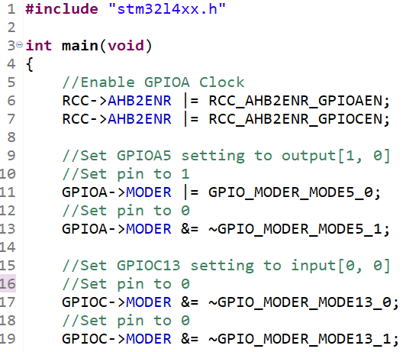
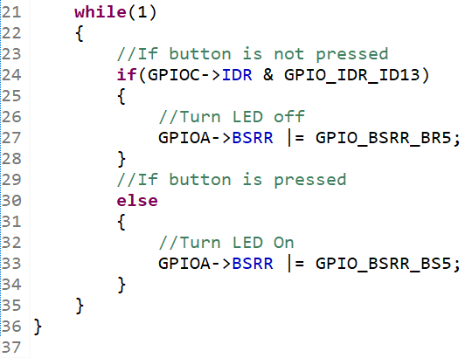
GPIO Input - Code

Slide 12
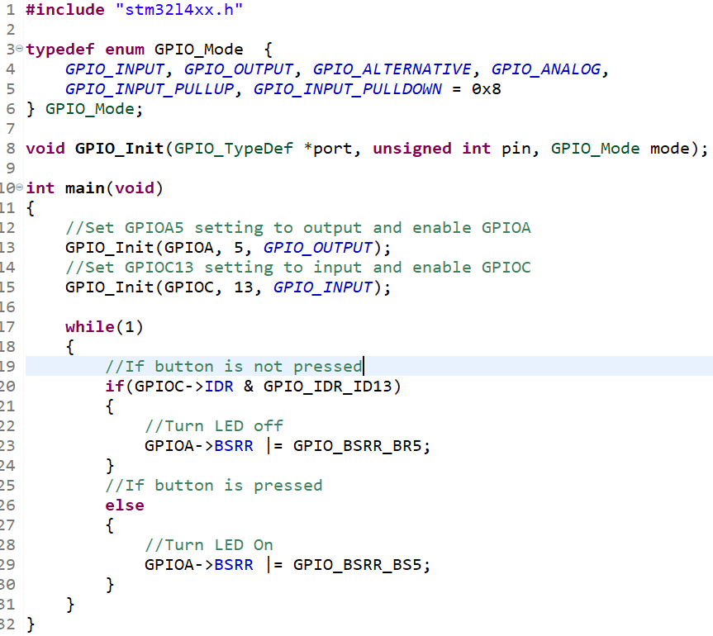
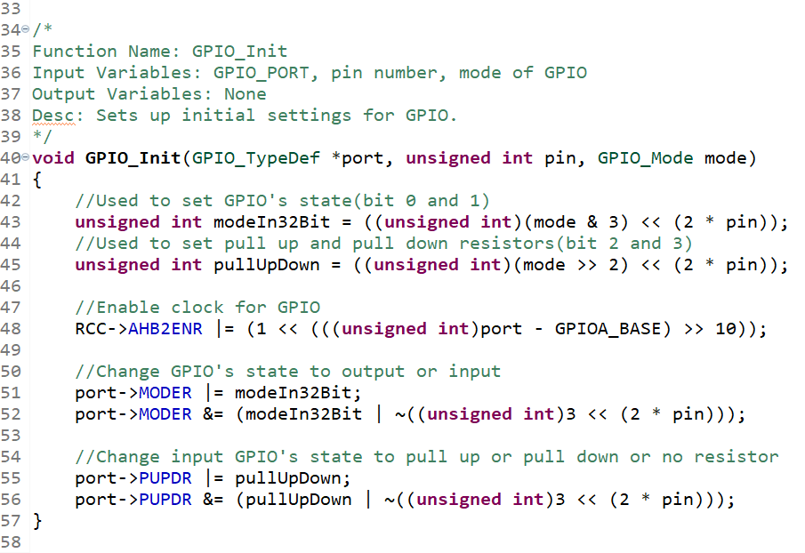
GPIO function

