Slide 1
Weekly Stock Market Predictions
Team 3 Practical A

Slide 2
R1
Sprint Goal
Evaluate Week 22 prediction accuracy
Collect market evidence and perform analysis
Compare outputs from multiple AI models
Produce and document the market prediction.
Identify strengths and weaknesses in our forecasting process
Applying Scrum Techniques

Slide 3
R1
Definition of Done
Market evidence collected
Agent Analyses completed
Four AI model outputs generated
Human review conducted
Final prediction documented
Previous prediction evaluated
Github repository updated
M̶a̶x̶i̶m̶i̶z̶i̶n̶g̶ ̶p̶r̶e̶d̶i̶c̶t̶i̶o̶n̶ ̶a̶c̶c̶u̶r̶a̶c̶y̶

Slide 4
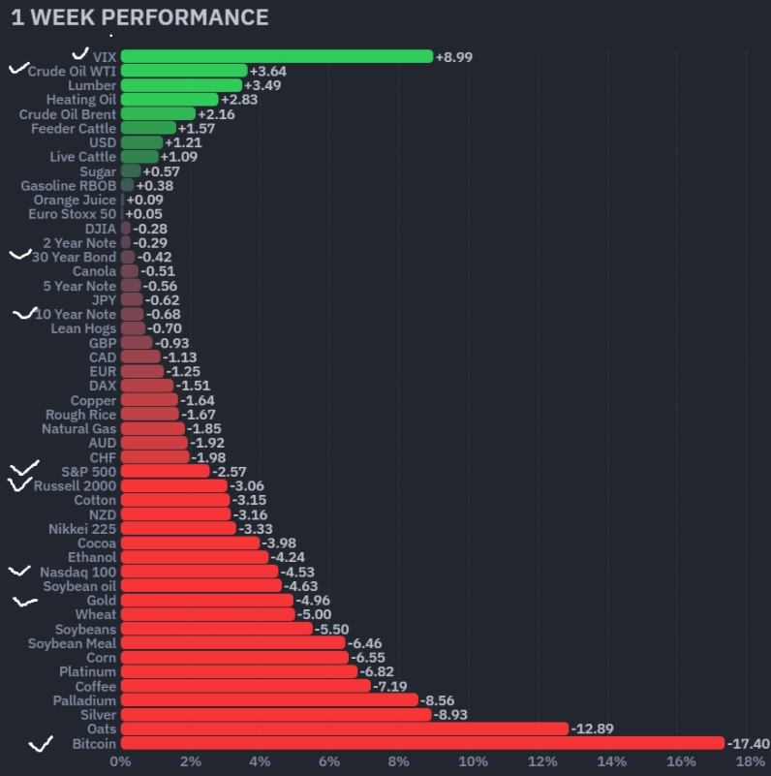
The trend is downward
Almost targets are in decline
Risk and fear increase
R8

Slide 5
R3
Week 1 established that 2026 is a Midterm Election Year.
Week 2 showed early weakness in May.
Week 3 showed even stronger bearish signals in June.
The seasonal trend is becoming increasingly bearish from Week 1 to Week 3.

Slide 6
R4 Macro Picture this Week
Current Fed Rate: 3.50% - 3.75%
Fedwatch Probability: Hold: 99.65%
10-year yield-level: 4.45%
Oil direction: Rising, +3.35%
Most important event this week: US ready to restart strikes on Iran if no deal is made.
No peace deal means Strait of Hormuz remains closed, oil prices may continue rising
Macro Bias: Dovish

Slide 7
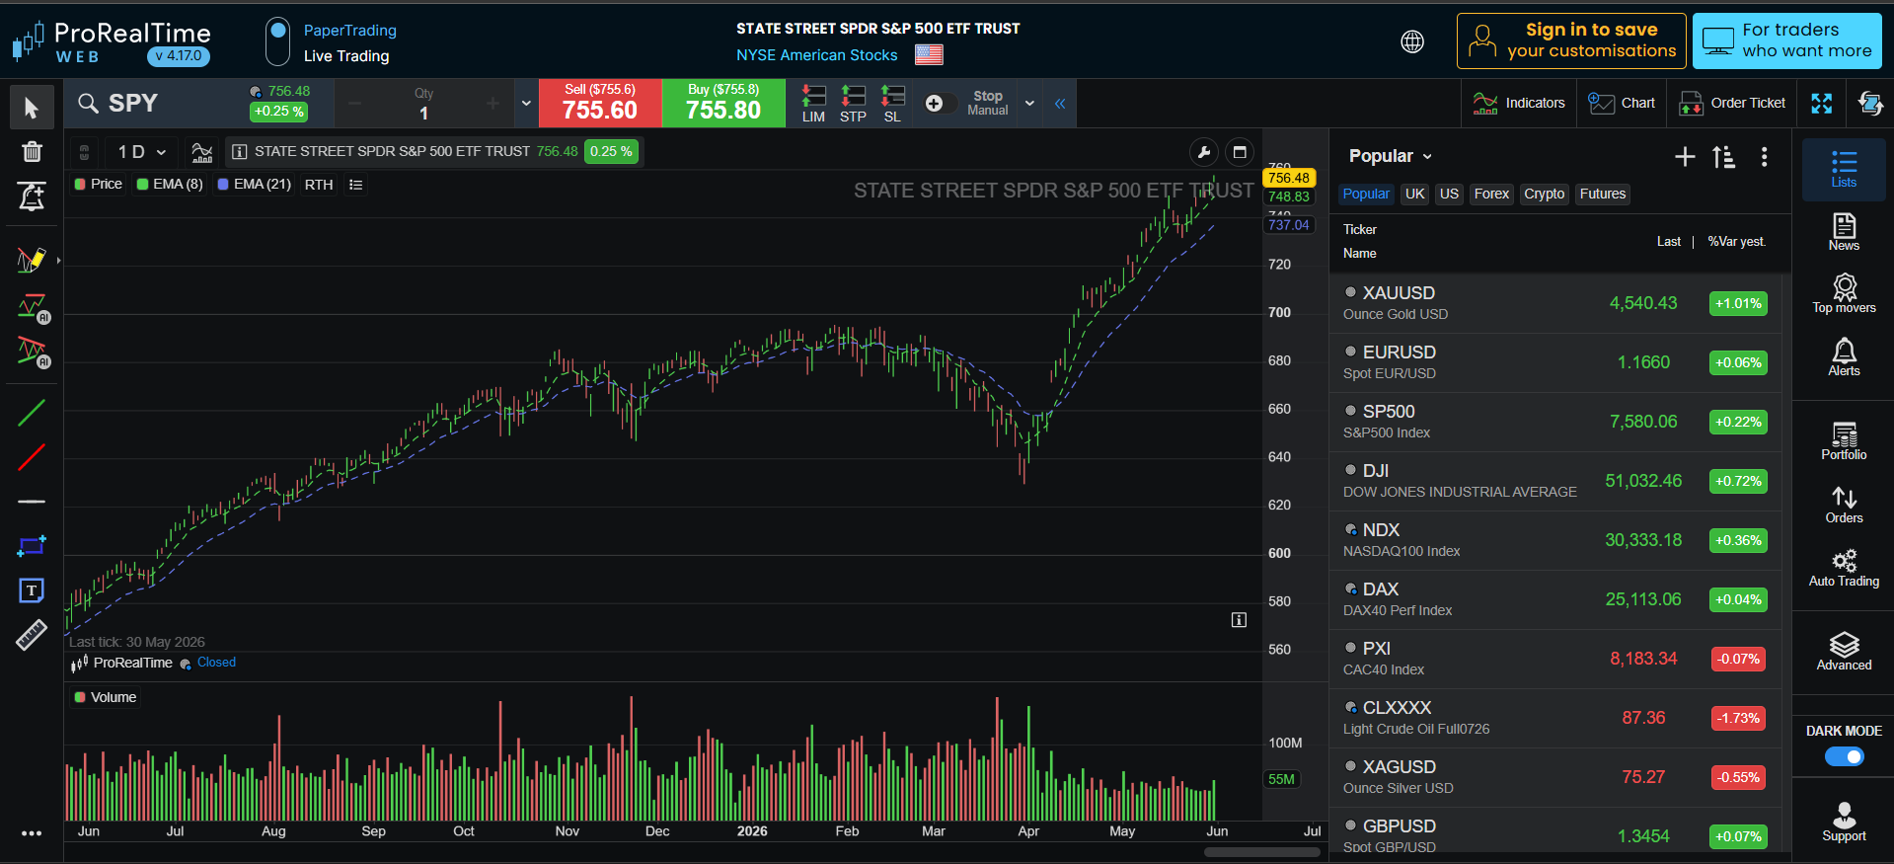
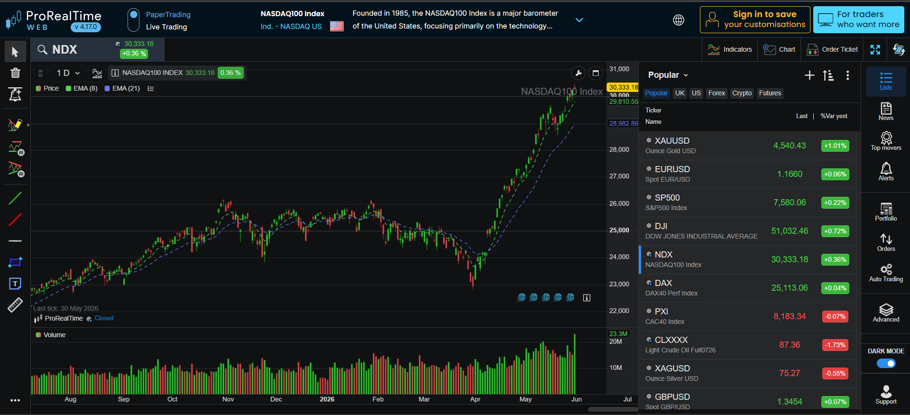
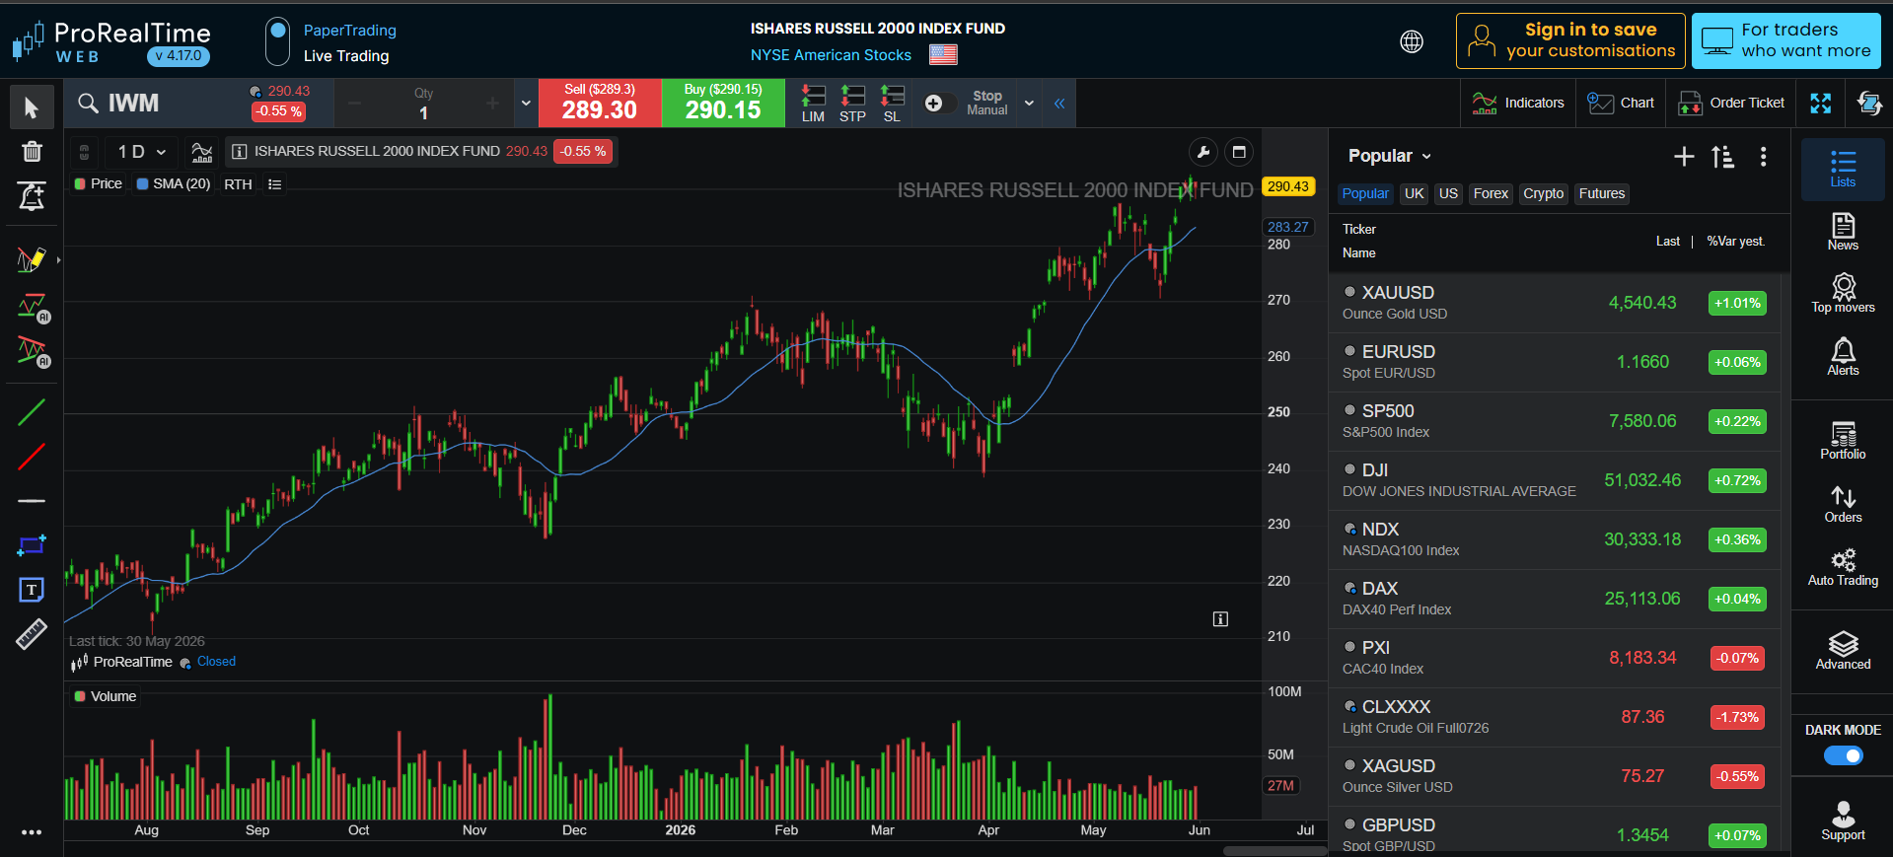
R5 Technical Agent
Key Analysis
SPY: Bullish; support around 748 / 737, resistance near 756–760.
NDX: Strongest chart; price is far above both EMAs, next resistance around 30,500–31,000.
IWM: Bullish but weaker; small pullback near 290–292 resistance, support around 287 / 282.
Heatmap: Mixed breadth; some tech/software strength, but several mega-cap names were red.
Overall bias: Bullish, but watch short-term pullback risk near resistance.
Notes:
For Week 2, I analysed the S&P 500, Nasdaq 100, and Russell 2000 using the 8-day and 21-day exponential moving averages.
All three markets are trading above both EMA lines, and the EMA 8 is above the EMA 21. This indicates positive short-term momentum.
The Nasdaq 100 shows the strongest bullish momentum, followed by the S&P 500. The Russell 2000 is also bullish, but it is slightly weaker and has shown a small pullback near resistance.
Overall, the technical market bias is bullish. However, because the markets are close to resistance after a strong rise, a short-term pullback or consolidation is possible.

Slide 8
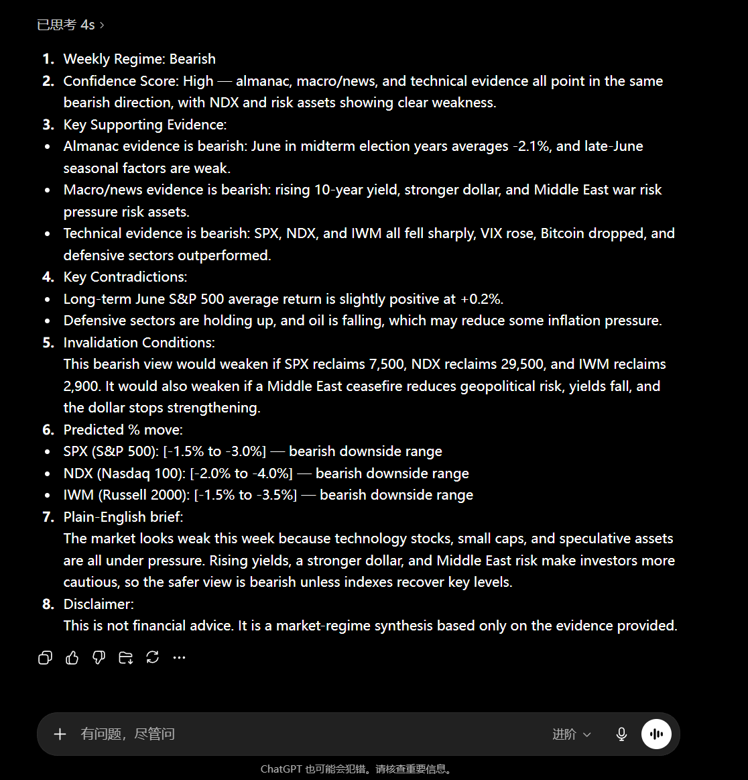
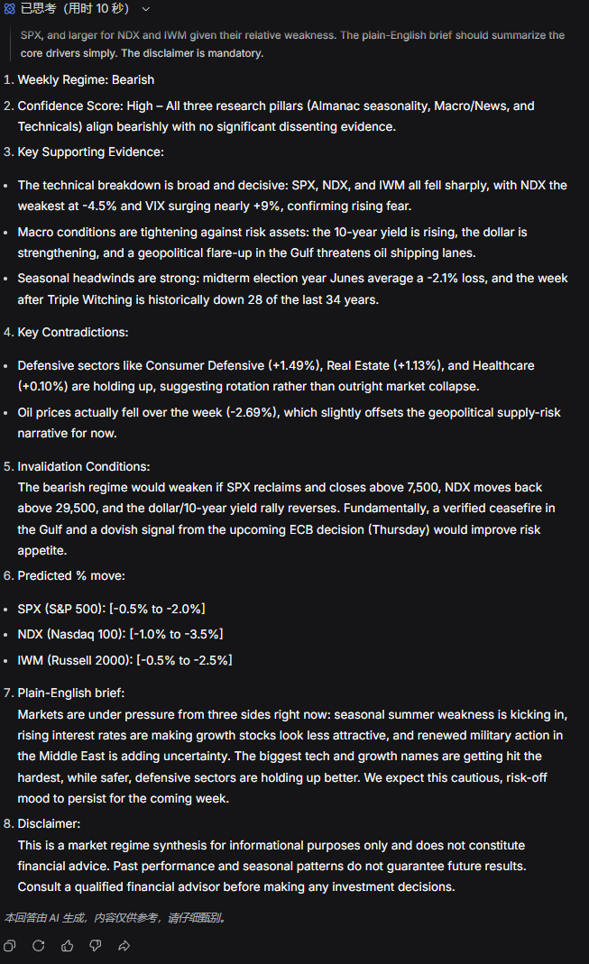
R6

Slide 9
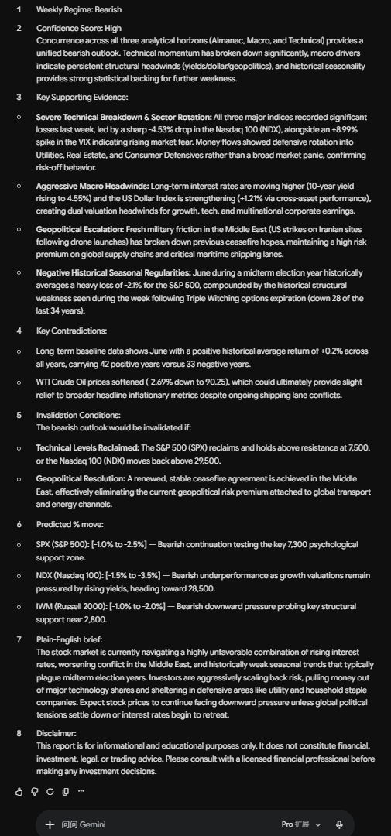
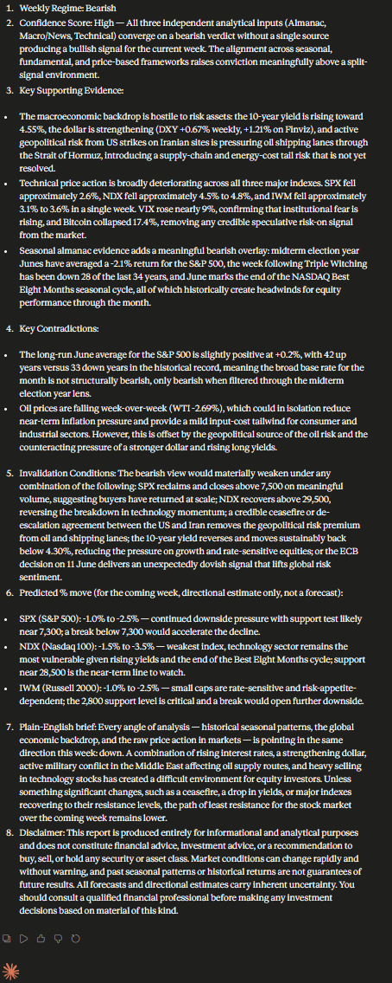
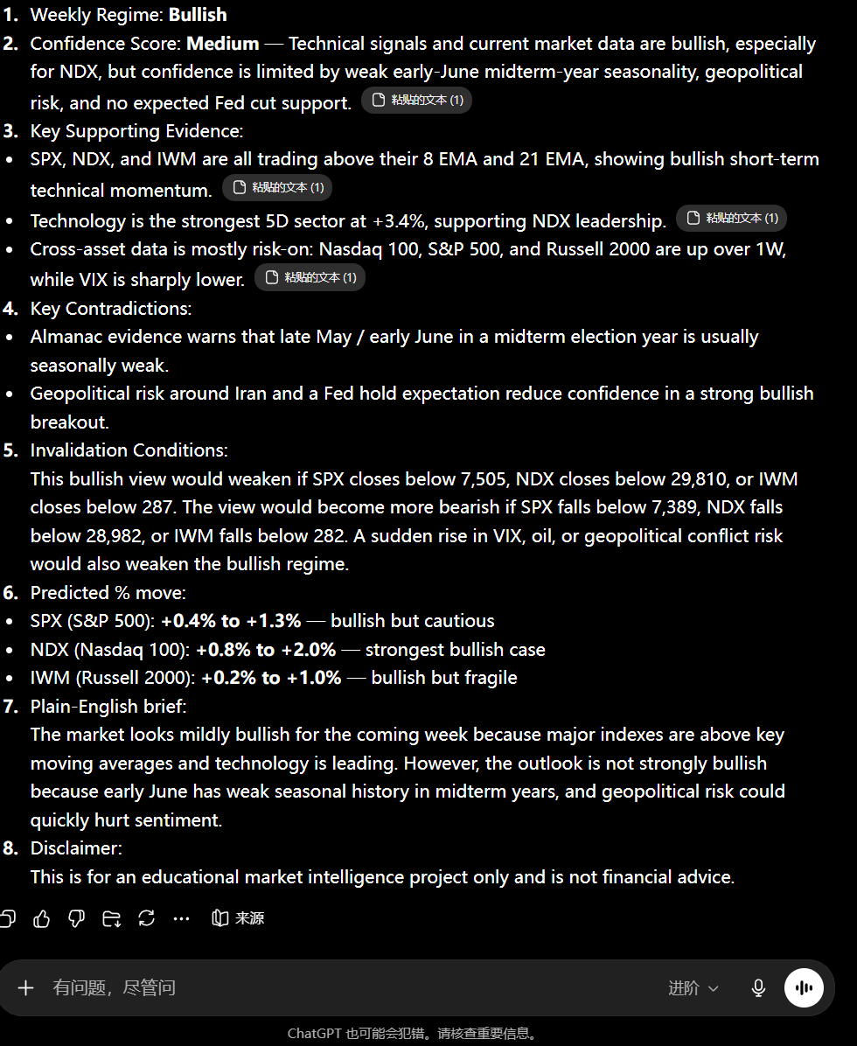

Slide 10
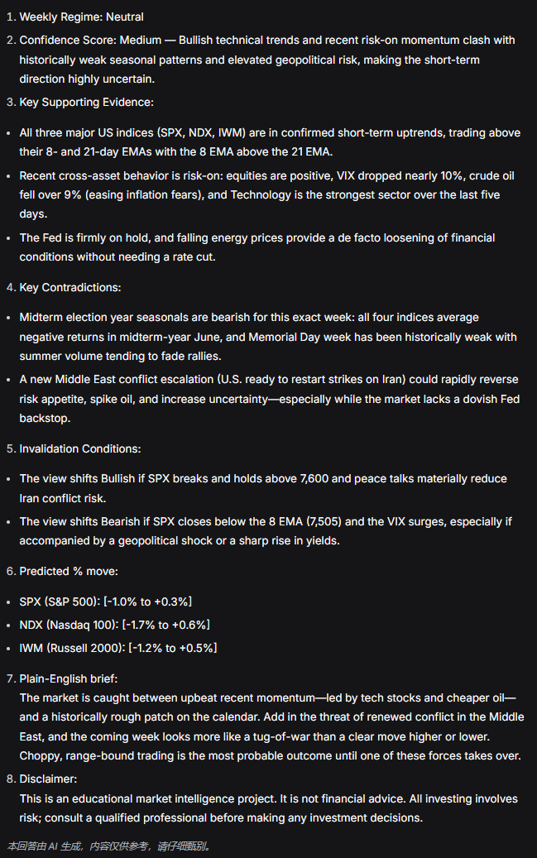
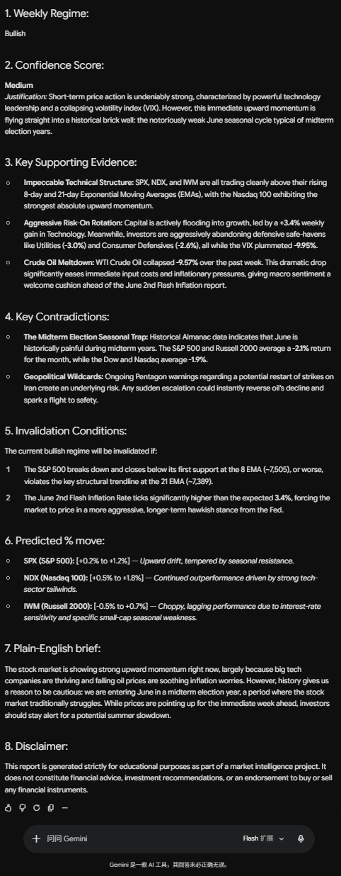
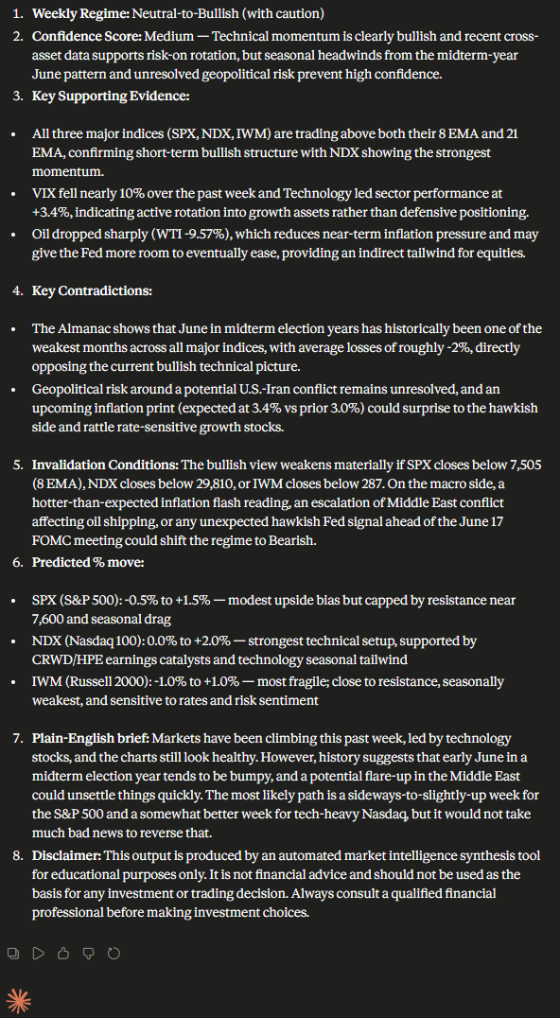

Slide 11
R7 Human Score Analyst Evaluation
Fragile Support:
In a low-liquidity environment, technical supports are highly fragile. A single geopolitical headline (e.g., Iran escalation) can trigger an algorithmic flush.
Actionable Recommendation:
We maintain a Neutral-Bullish stance but mandate a much tighter stop-loss strategy than the AI suggests. We must be prepared for a low-volume technical trap.
R7 Human Evaluation
Macro / News: +1 (Slightly Bullish)
Technical Structure: +2 (Strongly Bullish)
Almanac Seasonality: -1 (Slightly Bearish)
AI Agreement Quality: +1 (Logical Consensus)
Human Wild Card: -1 (Liquidity Risk)
Final Human Score: +2 (Neutral-Bullish)

Slide 12
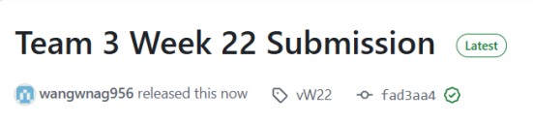
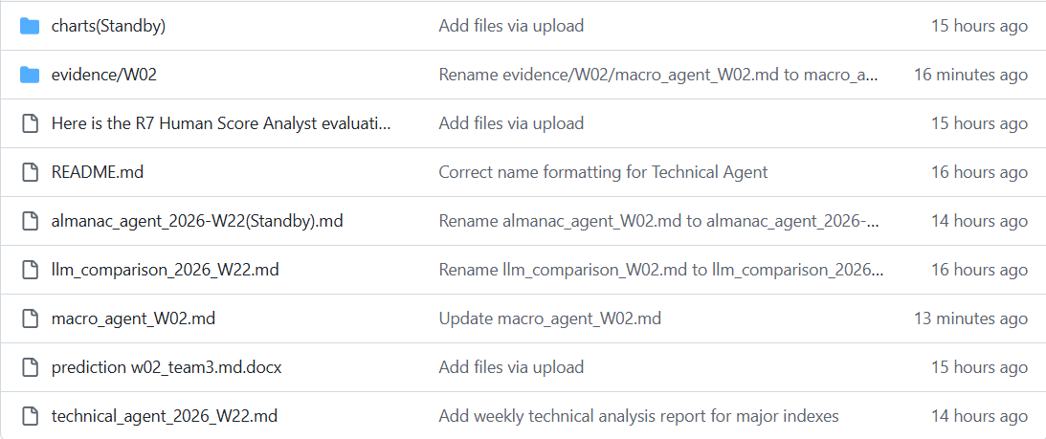
R9 GitHub & Release Management
GitHub Repository Check
README.md updated
evidence/WXX folder uploaded
Screenshots and raw evidence committed
Agent outputs and final prediction committed
PowerPoint file added
Release tag vWXX prepared / published

Slide 13



Learning Log Entry
Low liquidity + waiting for data = EMA support is fragile
A summary in one sentence
Technically bullish, but liquidity risks are collectively underestimated by AI — the core value of human judgment lies in identifying 'technical trap' environments.

Slide 14
R2: Scrum Master
Retrospective Summary
positive
R8, R4, R6, and R7 completed their work on time.
helped keep the project moving
weaknesses
R5, R10, and R2 were delayed, causing extra work for others.
The main issue was role assignments are not enough. >>>> stronger accountability and better communication.
Next sprint: earlier updates, clear deadlines, and better follow-up.

Slide 15
R2: Scrum Master
Standup Summary (W23)
Progress
R8 (market data & evidence) and R4(Macro & News analysis) completed work early.
R3(Almanac analysis), R6 and R7(synthesis & final judgement tasks) completed their tasks.
Blockers
R5, R10, and R2 were delayed.
The short sprint increased pressure.
Actions
Follow up missing work.
Keep the sprint moving.
Key Learning
Better communication.
Earlier progress checks.
Stronger role accountability.

