Slide 1
Weekly Stock Market Predictions
W28
Team 3 Practical A

Slide 2
R1
Sprint Goal
Automate the continuation parts of the forecasting overflow.
Produce a sealed Week 25 market prediction.
Expand the data mining script to 11 new sectors.
Apply Scrum Principles.
Ensure the script for the agents are using the data generated from the data mining script.

Slide 3
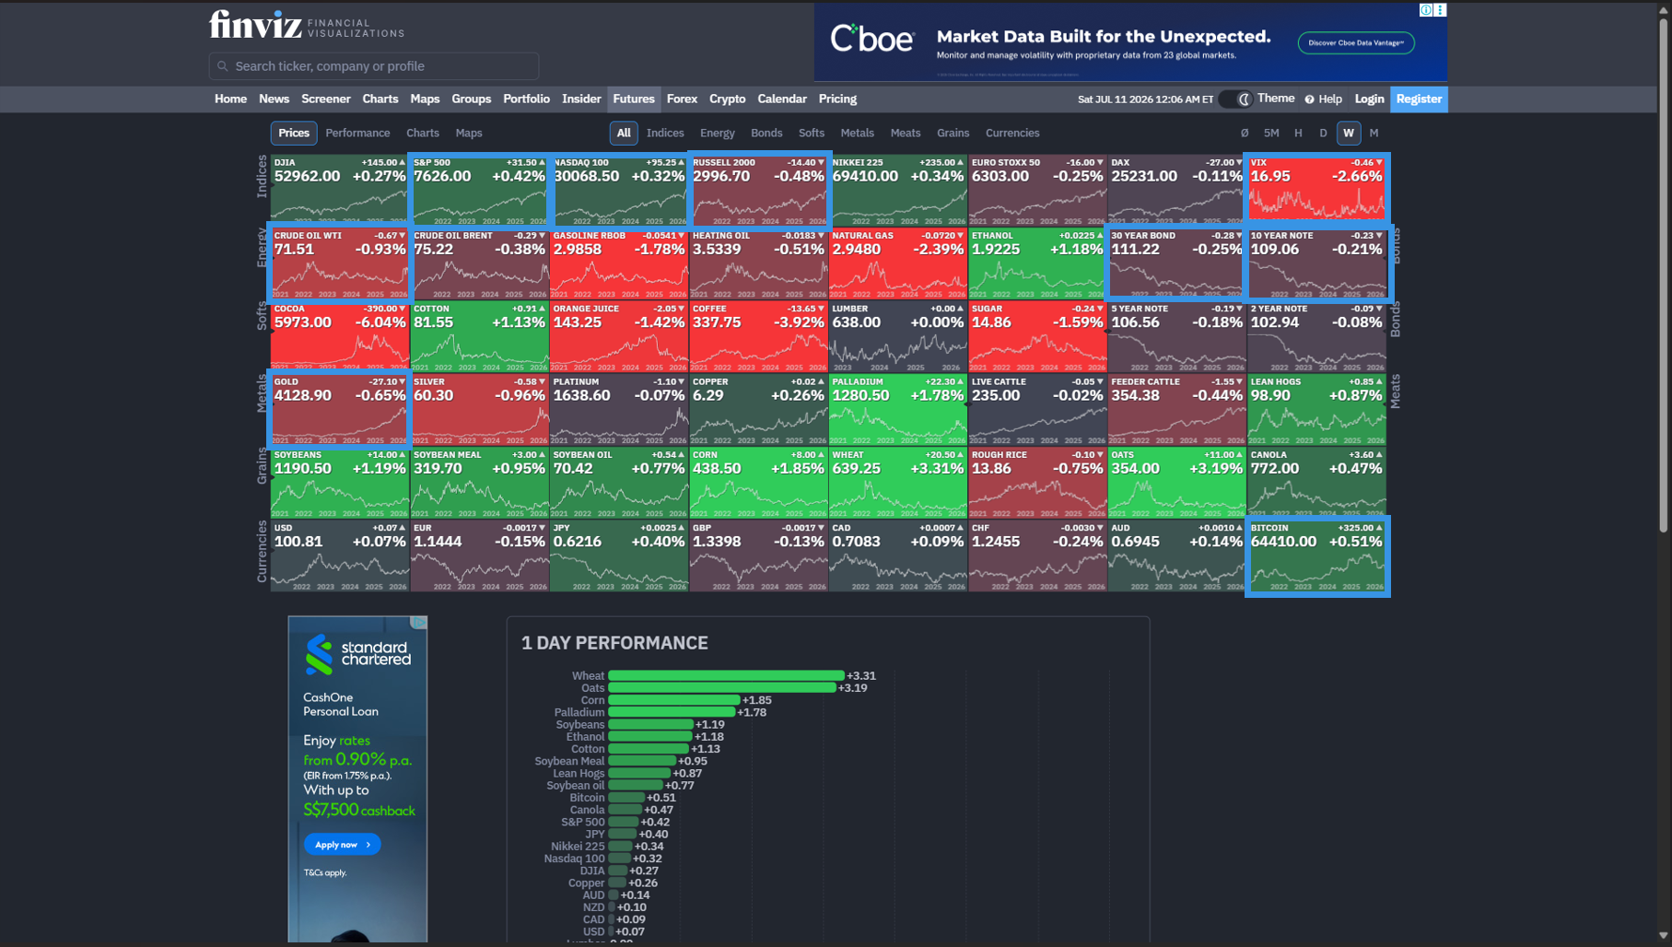
Market growth
Key industries decline

Slide 4
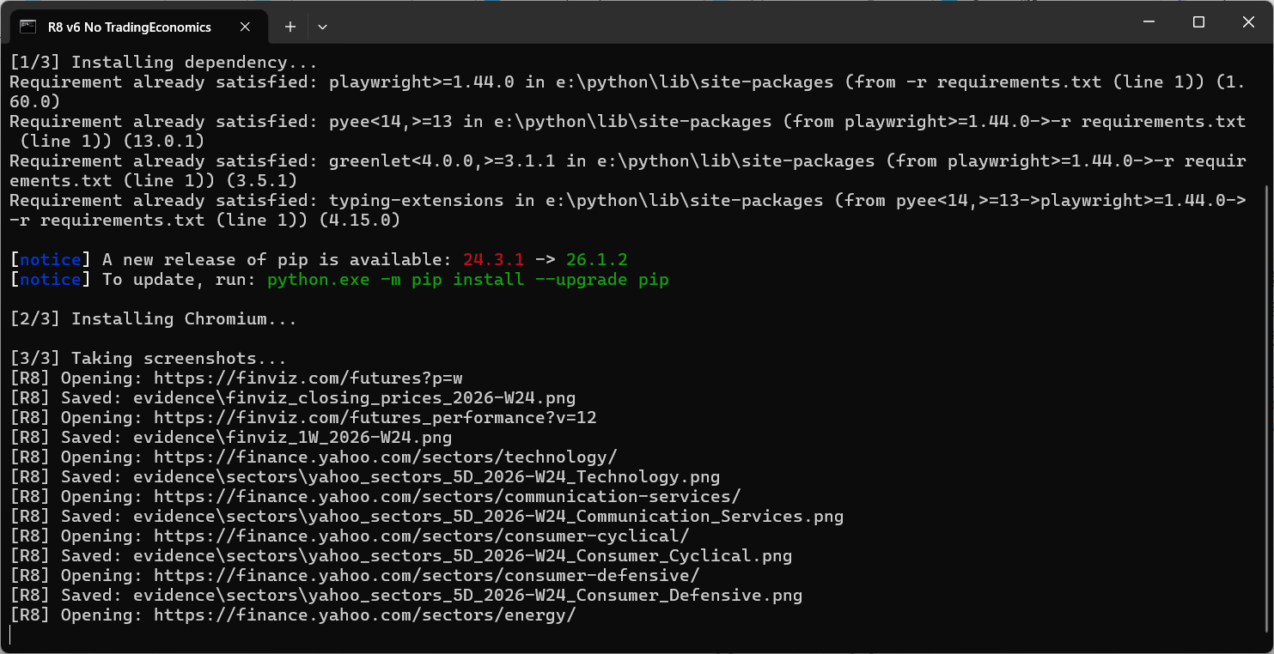
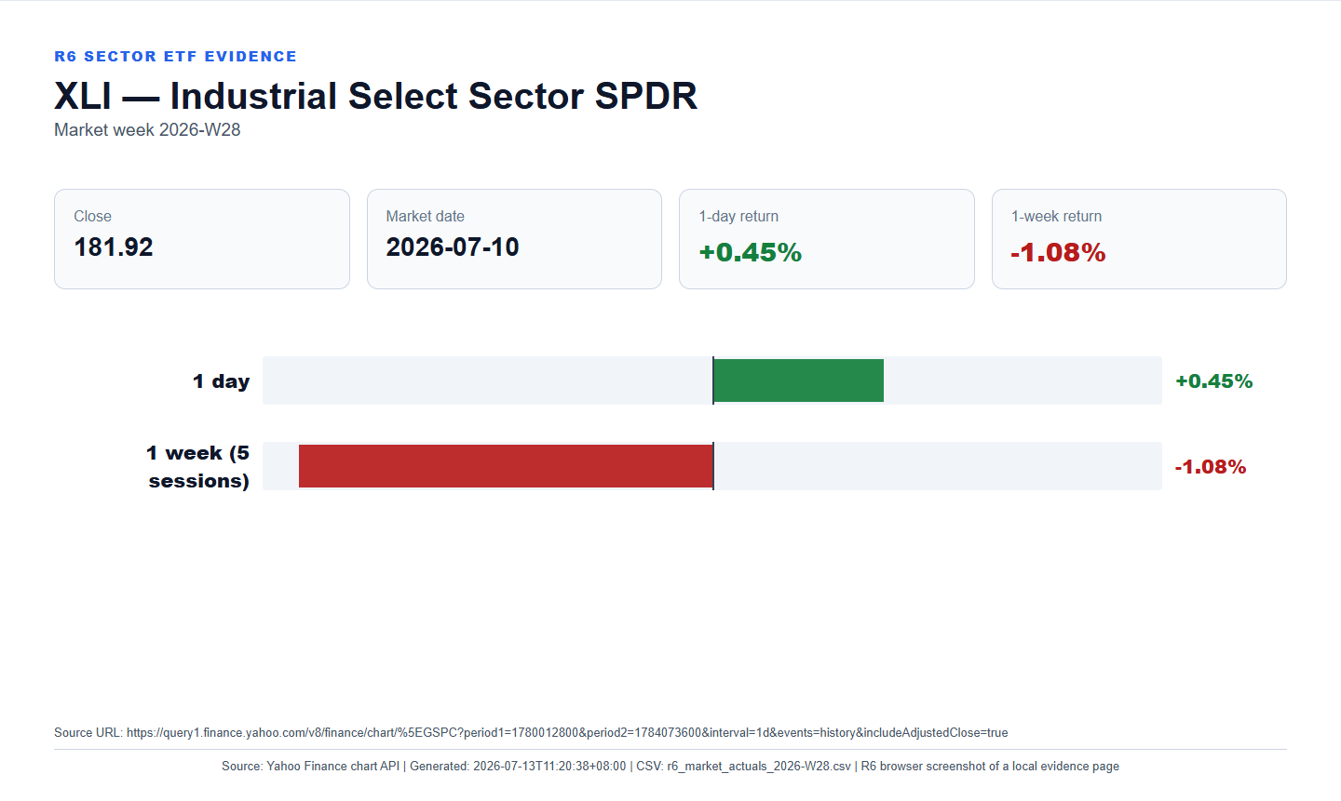
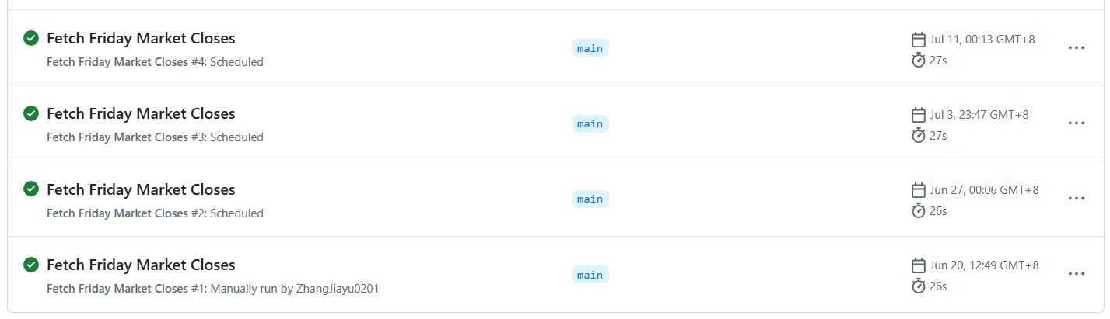
Run automatically locally
Access permission issues
Call issues
Languages issues
Storage address issues

Slide 5
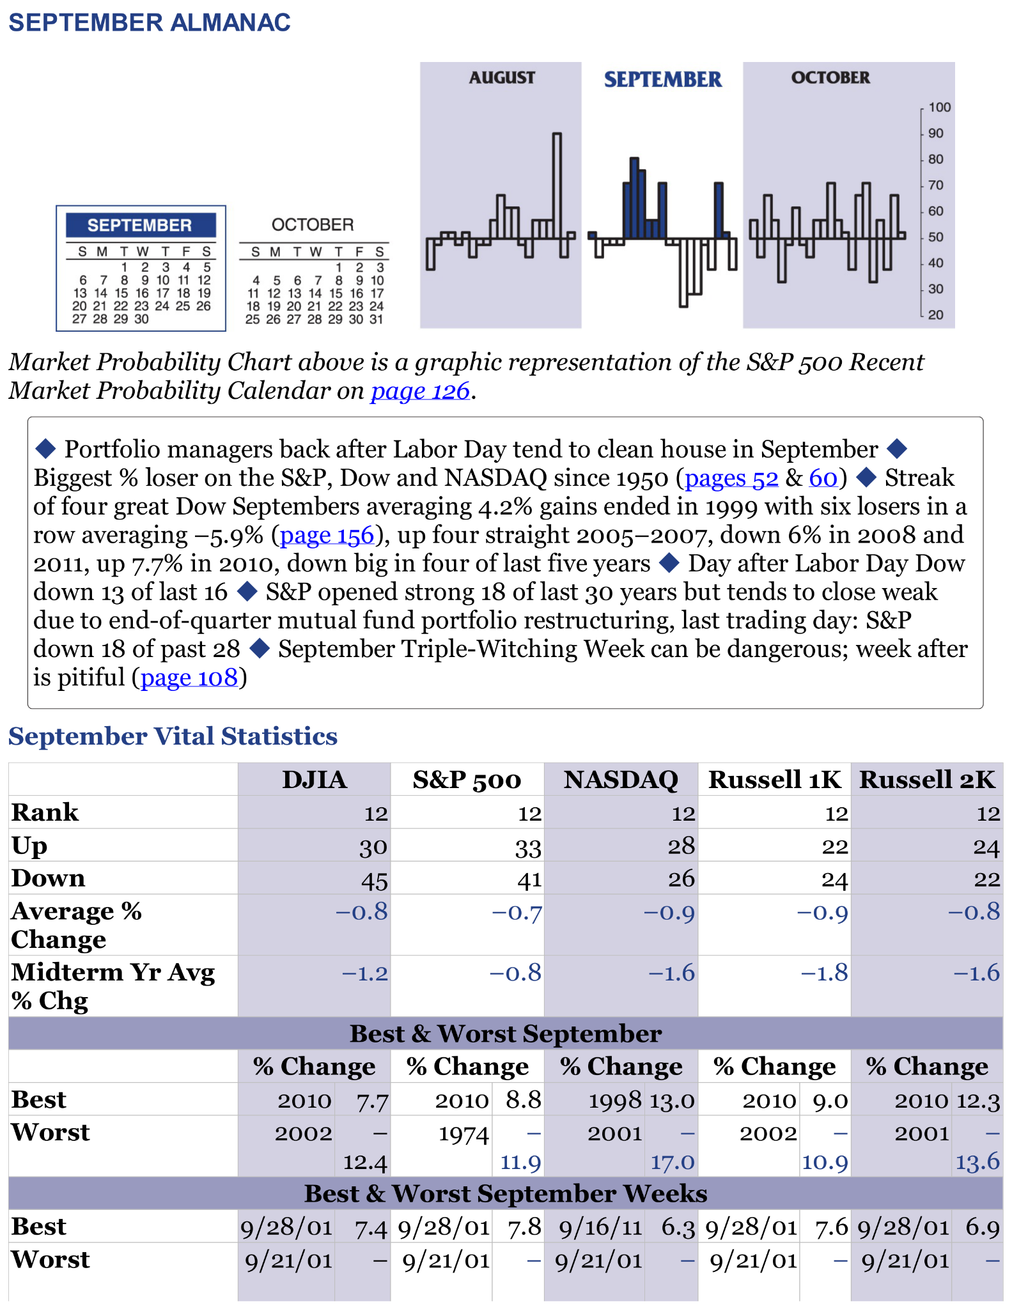
R3
The results show that September is historically the weakest month for the S&P 500. It ranks 12th, has 33 up years and 41 down years, with an average return of -0.7% and a midterm return of -0.8%.
July Bullish
August Weak / Slightly Bearish
September Strong Bearish
https://github.com/juninho4/Team-3-Practical-A-CP3405/blob/main/vW25/evidence/R3%20Almanac%20System.ipynb

Slide 6
R4

Slide 7
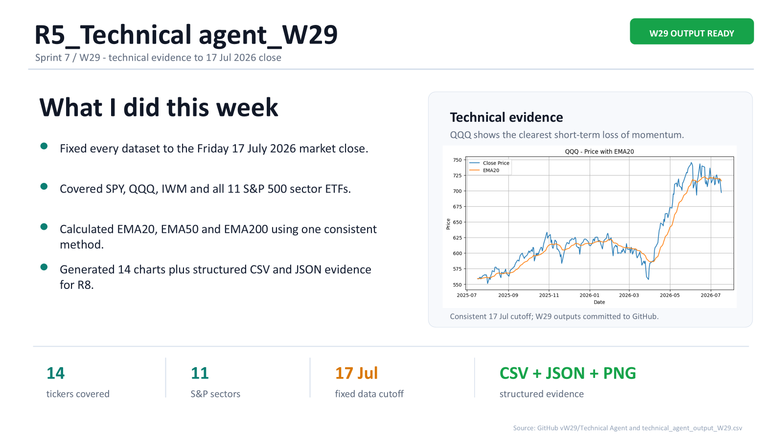

Slide 8
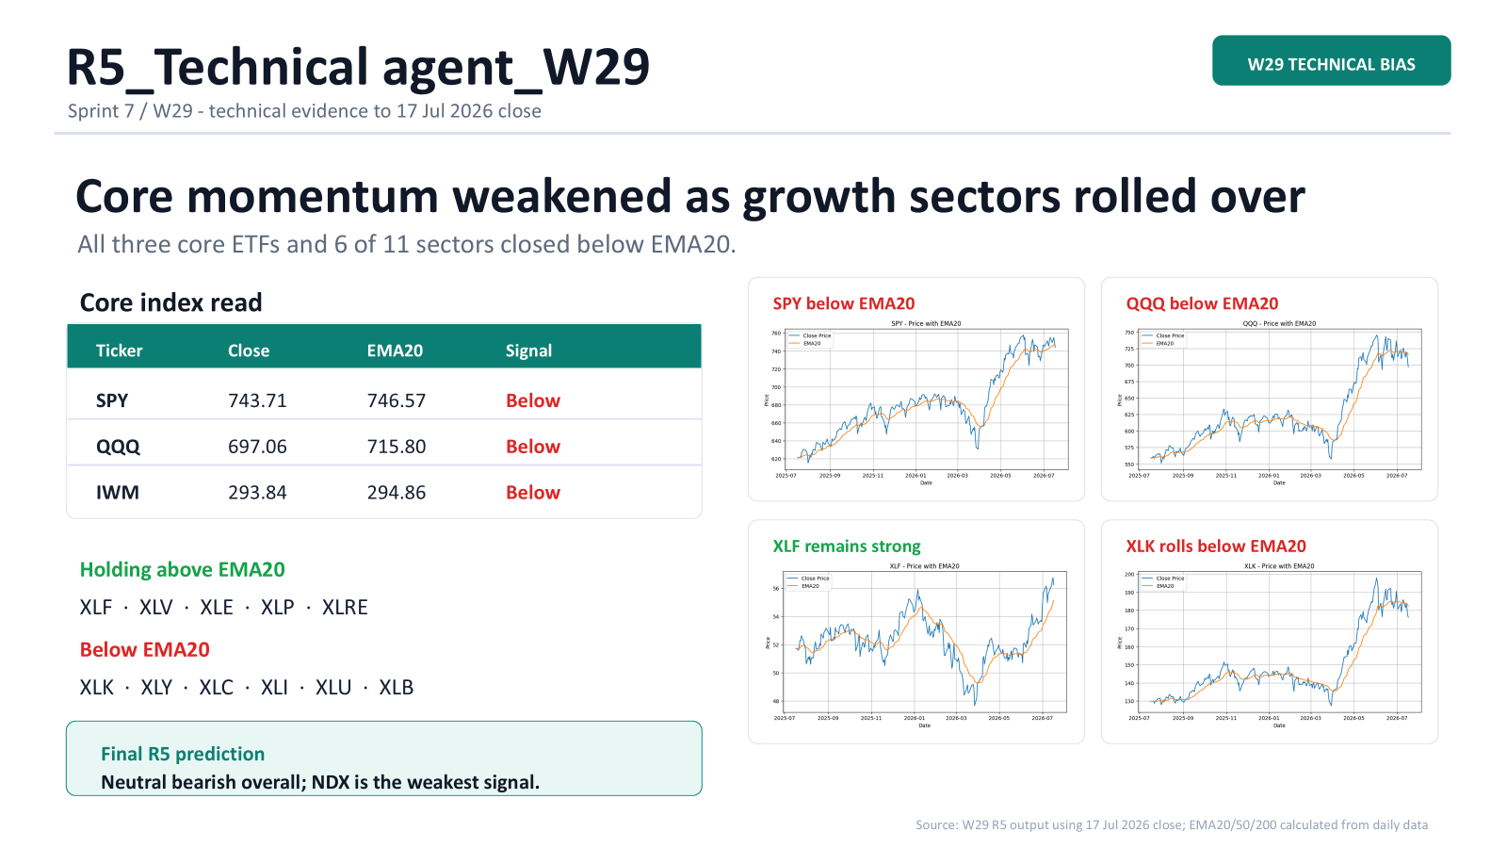

Slide 9
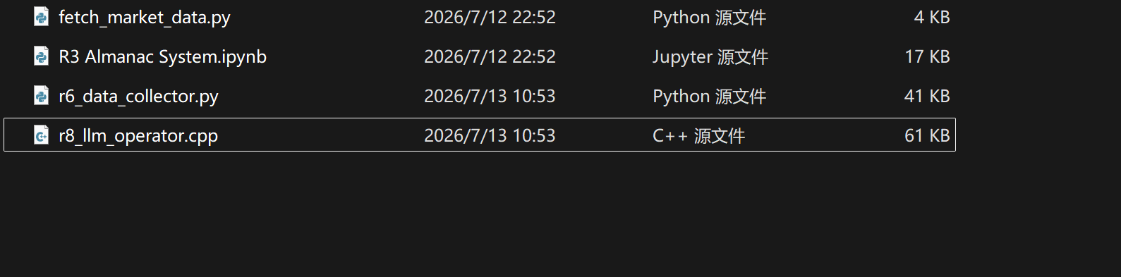
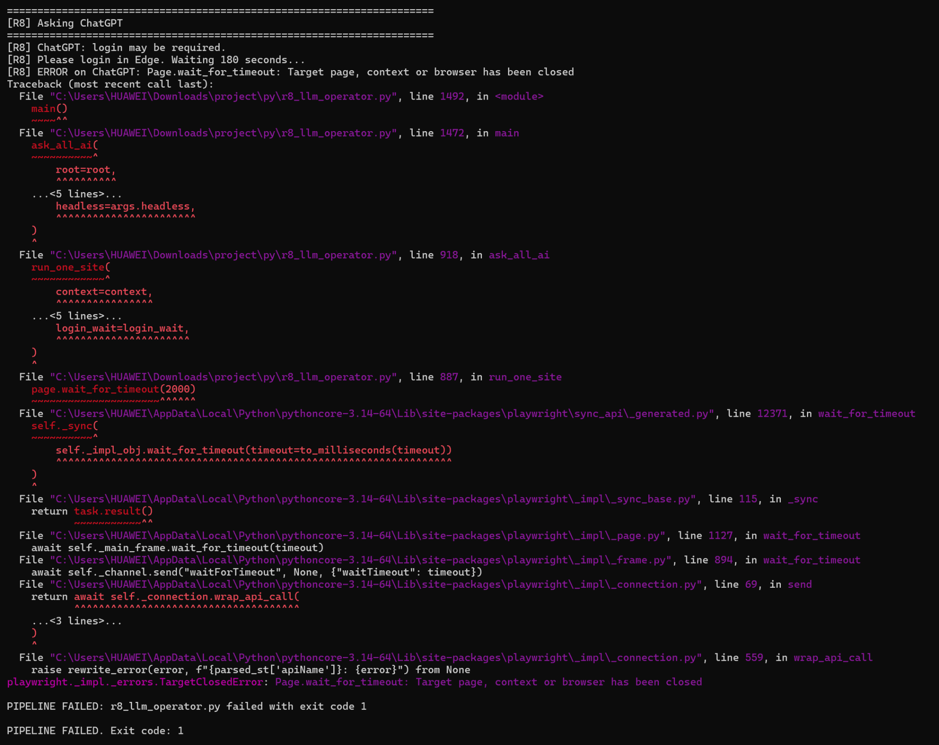

Slide 10
R7
Core Metric: Total Human Score: -1 (Neutral / Uncertain Regime)
Key Pillars:
Technical Structure (+1): Bullish price action and upward momentum across SPX and NDX provide a steady baseline floor.
Macro / News Weight (-1): Hawkish macro conditions persist, actively capping upside breakout potential.
Almanac Seasonal Weight (-1): Mixed transition phase as slight bearish August seasonal headwinds begin to emerge.
AI Agreement Quality (-1): Data Corruption Penalty. Gemini and DeepSeek outputs suffered extraction failures ("Not Found"). Blind reliance on R6's generic "Bullish" synthesis is mathematically unsafe.
Wild Card / Human Insight (+1): Symmetry in Neutrality. ChatGPT and Claude explicitly converged on a "Neutral" regime bracketed by near-identical downside floors (-0.5%) and upside caps (+1.0%).

Slide 11
R7
Strategic Position: Active Directional Override (From Bullish to Neutral)
Relative Strength Ranking: NDX > SPX > IWM (Weakest / Flat)
Final Predicted Weekly Ranges (Human Refinement):
SPX (S&P 500): -0.5% to +1.0% (Perfect overlay of ChatGPT & Claude brackets)
NDX (Nasdaq 100): -0.3% to +1.5% (Tech-driven resilience, but capped by macro)
IWM (Russell 2000): -1.0% to +1.0% (Neutral/Flat; small caps paralyzed by hawkish rates)
Critical Invalidation Conditions:
Upside Invalidation: Major macro cooling or dovish central bank commentary driving SPX past +1.0%.
Downside Invalidation: Broad technical breakdown below short-term support, pushing indices past the -0.5% boundary.

Slide 12
R9
Responsibilities
Collected team members' work
Organised files and documents
Managed weekly deliverables
Prepared submission materials
Outcome
Improved file organisation
Ensured all work was included
Reduced version confusion
Supported team submission

Slide 13
R2
What Went Well
R5 completed the assigned work.
R10 completed Week 28 & 29 logs.
Team started discussing role switching.
Team communication remained active.
Challenges
R6 did not provide a progress update.
Some members reported progress only after reminders.
Actions
Follow up on missing progress earlier.
Encourage regular Discord updates.
Finalise role switching before the next sprint.
Continue improving team communication.
Summary
The sprint was short but productive. Most planned work progressed well, and the team is preparing for the final assessment through better communication and coordination.
Role: R2 Scrum Master
Sprint Duration: 2 Days
Communication: Discord
Focus
Track team progress
Follow up on role updates
Prepare for role switching

