Slide 1
Weekly Stock Market Predictions
Sprint 5 - W25
Team 3 Practical A

Slide 2
R1
Sprint Goal
Automate parts of the forecasting overflow
Measure Week 24 prediction accuracy using Delta Engine
Compare multiple LLM forecasts systematically
Produce a sealed Week 25 market prediction
Improve the forecasting process through Scrum inspection and adaptation
Tier 3
Decision

Slide 3
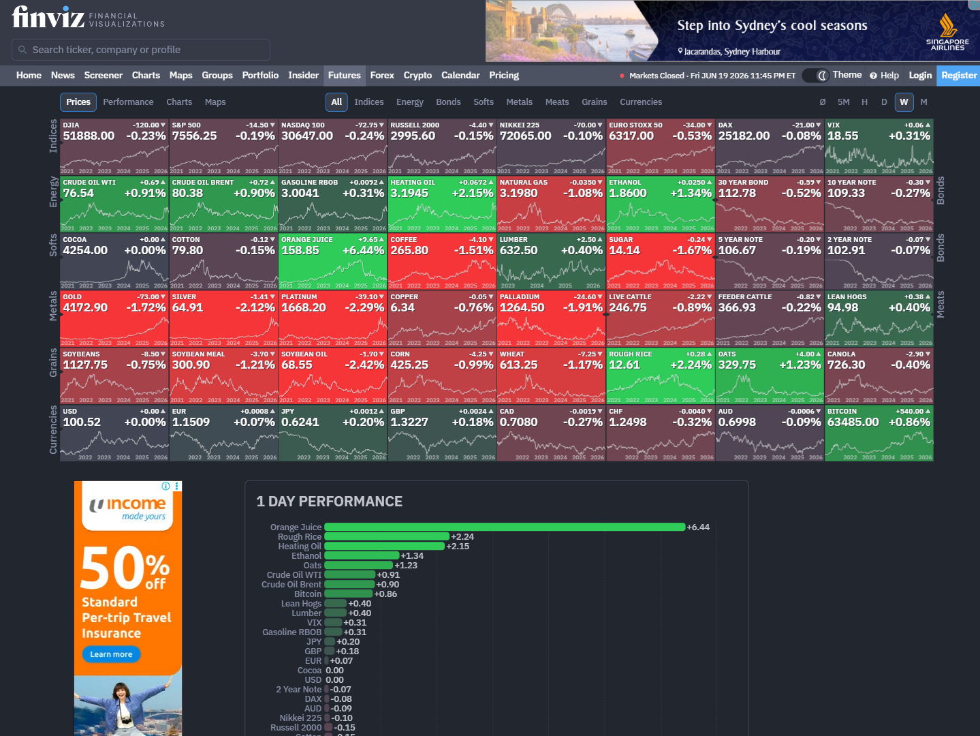
Rise to fall
Fear continues

Slide 4
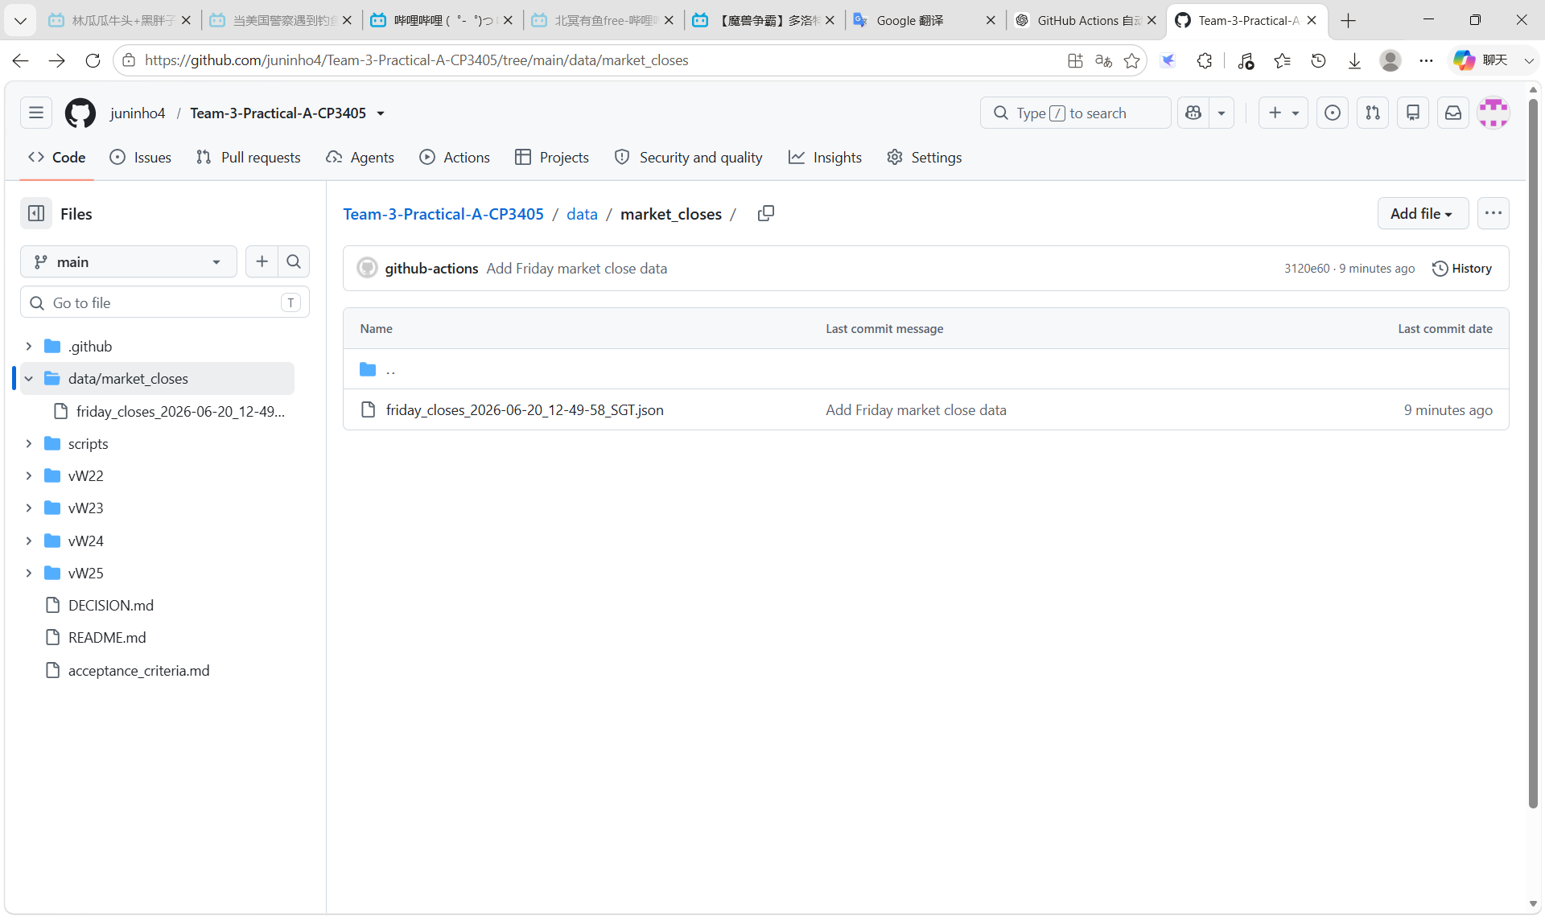
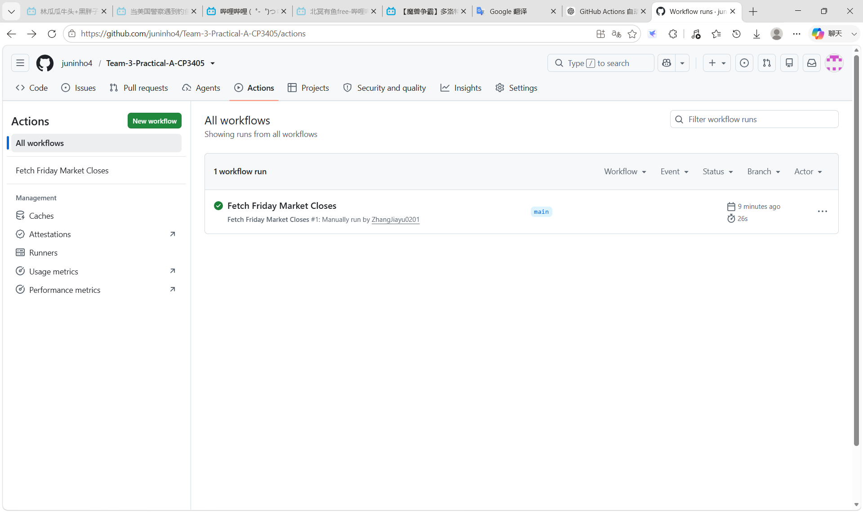
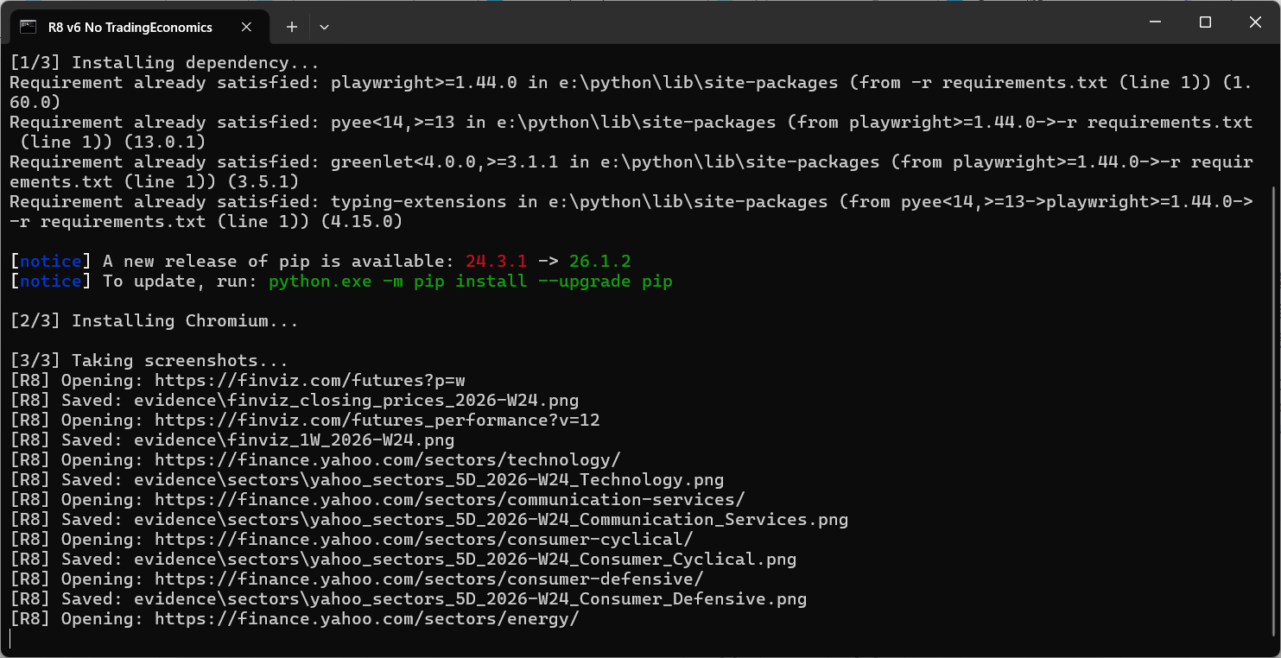
Automation
Weekly execution

Slide 5
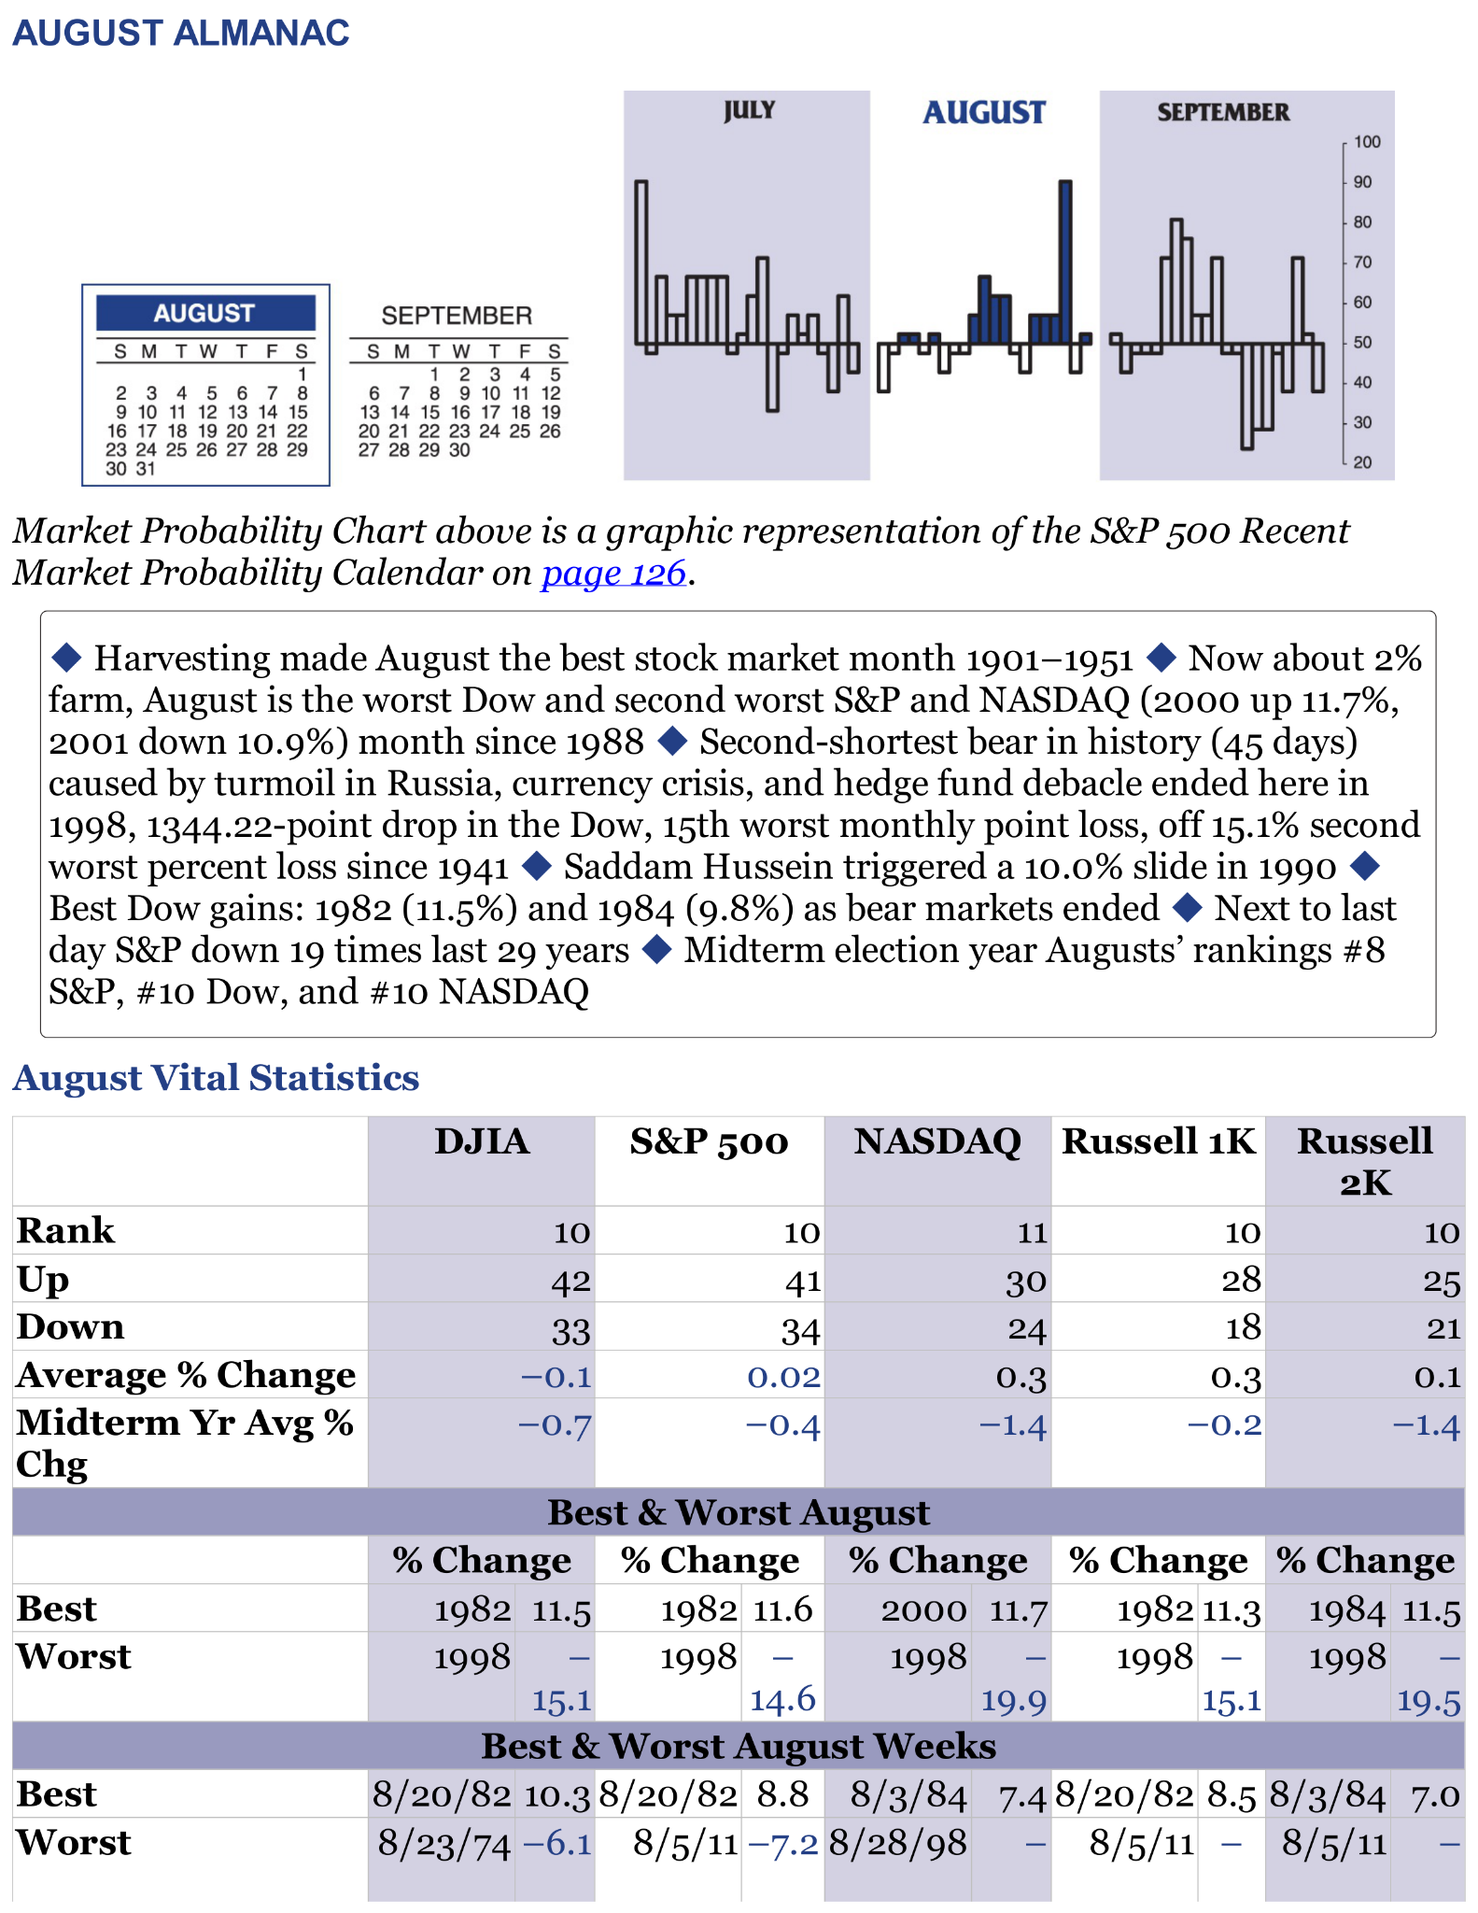
R3
August shows weaker seasonality.
The average return drops from +1.3% in July to only +0.02%.
The Midterm Election Year return becomes negative at -0.4%.
Therefore the outlook changes from Bullish to Slightly Bearish.
The strongest opportunity appears in July, while August shows signs of weakening momentum.
Therefore the Almanac Agent recommends a cautious outlook after July.
https://github.com/juninho4/Team-3-Practical-A-CP3405/blob/main/vW25/evidence/R3%20Almanac%20System.ipynb

Slide 6
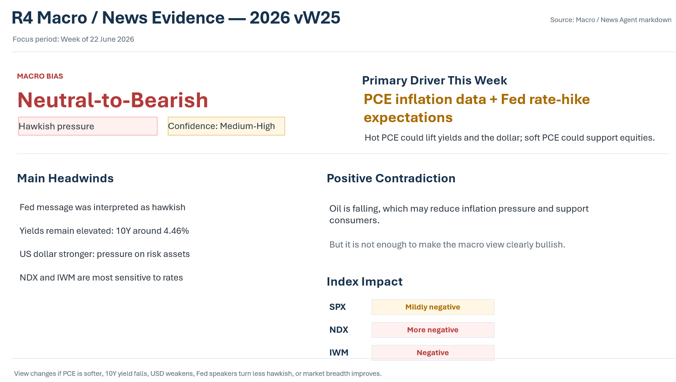

Slide 7
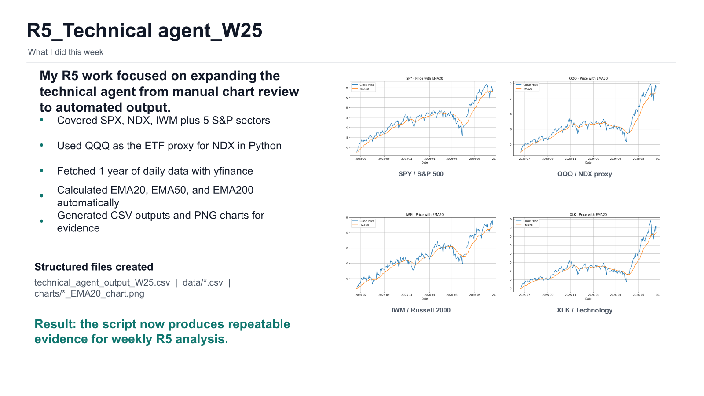

Slide 8
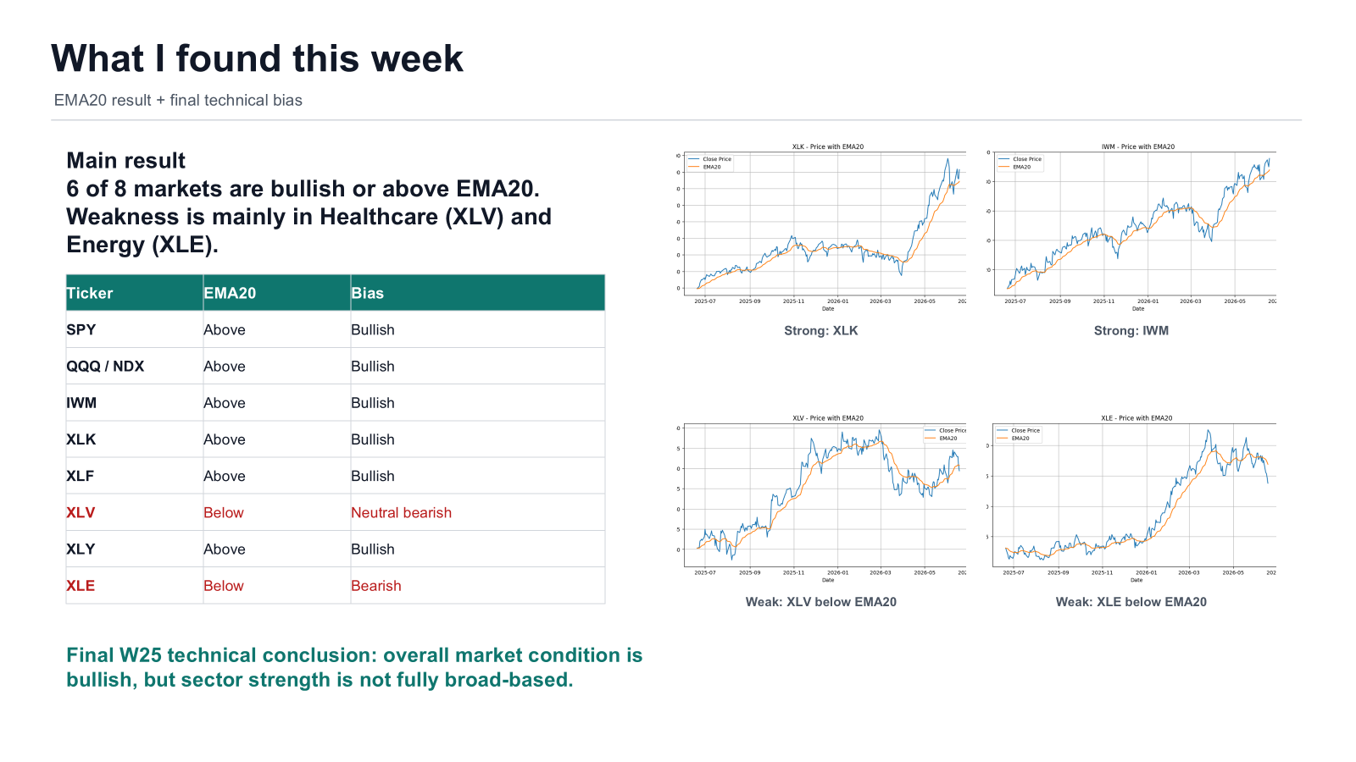

Slide 9
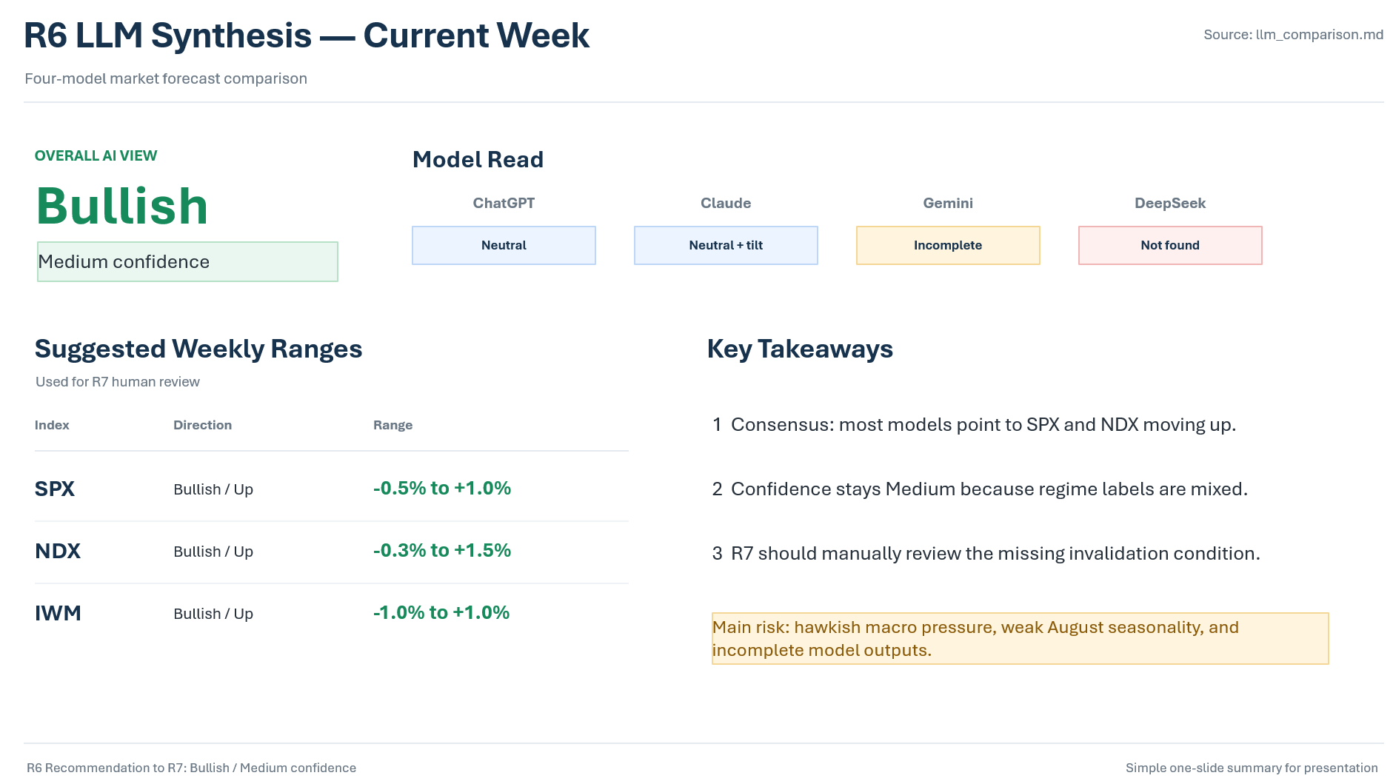

Slide 10
R7
Core Metric: Total Human Score: -1 (Neutral / Uncertain Regime)
Key Pillars:
Technical Structure (+1): Bullish price action and upward momentum across SPX and NDX provide a steady baseline floor.
Macro / News Weight (-1): Hawkish macro conditions persist, actively capping upside breakout potential.
Almanac Seasonal Weight (-1): Mixed transition phase as slight bearish August seasonal headwinds begin to emerge.
AI Agreement Quality (-1): Data Corruption Penalty. Gemini and DeepSeek outputs suffered extraction failures ("Not Found"). Blind reliance on R6's generic "Bullish" synthesis is mathematically unsafe.
Wild Card / Human Insight (+1): Symmetry in Neutrality. ChatGPT and Claude explicitly converged on a "Neutral" regime bracketed by near-identical downside floors (-0.5%) and upside caps (+1.0%).

Slide 11
R7
Strategic Position: Active Directional Override (From Bullish to Neutral)
Relative Strength Ranking: NDX > SPX > IWM (Weakest / Flat)
Final Predicted Weekly Ranges (Human Refinement):
SPX (S&P 500): -0.5% to +1.0% (Perfect overlay of ChatGPT & Claude brackets)
NDX (Nasdaq 100): -0.3% to +1.5% (Tech-driven resilience, but capped by macro)
IWM (Russell 2000): -1.0% to +1.0% (Neutral/Flat; small caps paralyzed by hawkish rates)
Critical Invalidation Conditions:
Upside Invalidation: Major macro cooling or dovish central bank commentary driving SPX past +1.0%.
Downside Invalidation: Broad technical breakdown below short-term support, pushing indices past the -0.5% boundary.

Slide 12
R9
Responsibilities
Collected team members' work
Organised files and documents
Managed weekly deliverables
Prepared submission materials
Outcome
Improved file organisation
Ensured all work was included
Reduced version confusion
Supported team submission

Slide 13
R2
Week 25 Progress
Week 25 Scrum Report
Role: R2 Scrum Master
Achievements
Team communicated through Discord
Clear role responsibilities
R3 completed August forecast
R8 uploaded data early
Most tasks completed on time
Overall Status
Sprint completed successfully
Good teamwork and coordination
Blokers
R4 Not completed work
Lessons & Improvements
Lessons Learned
Clear communication is important
Early preparation improves efficiency
Regular updates help team coordination
Next Sprint
Continue early data uploads
R4 complete the unfinished work next week.
Improve GitHub organization

