Slide 1
Weekly Stock Market Predictions
Team 3 Practical A

Slide 2
R1
Sprint Goal
Evaluate Week 24 prediction accuracy
Collect market evidence and perform analysis
Compare outputs from multiple AI models
Produce and document the market prediction.
Identify strengths and weaknesses in our forecasting process
Make an automation system for gathering data from predefined sources
Applying Scrum Techniques

Slide 3
R1
Definition of Done
Market evidence collected
Agent Analyses completed
Four AI model outputs generated
Human review conducted
Final prediction documented
Previous prediction evaluated
Github repository updated
Data mining automation system finished and works, DECISION.md added
M̶a̶x̶i̶m̶i̶z̶i̶n̶g̶ ̶p̶r̶e̶d̶i̶c̶t̶i̶o̶n̶ ̶a̶c̶c̶u̶r̶a̶c̶y̶

Slide 4
R1
Decision
Tier 2
Most repetitive manual task
Provides immediate value
Realistic to build in 5 days
Creates a foundation for future automation

Slide 5
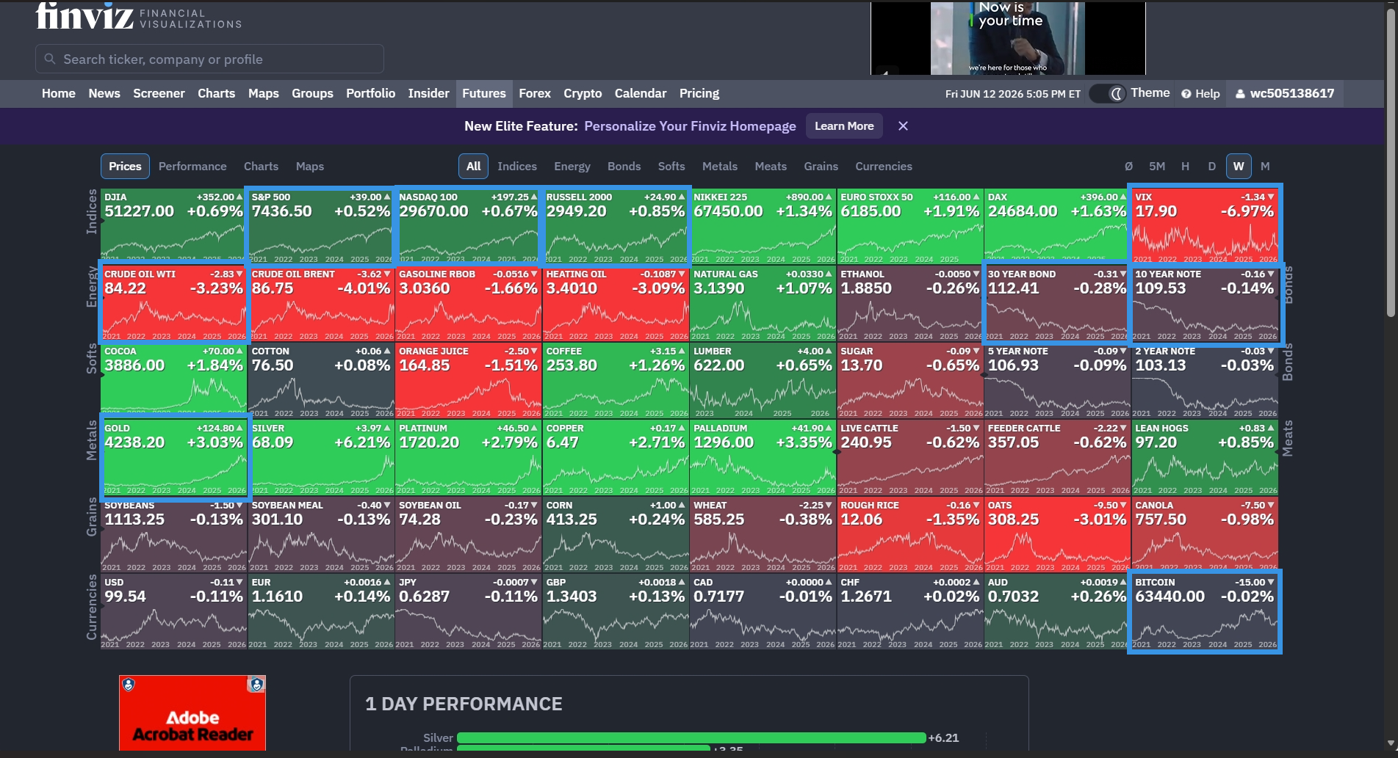
Markets were positive
Small caps strongest
Lower market fear

Slide 6
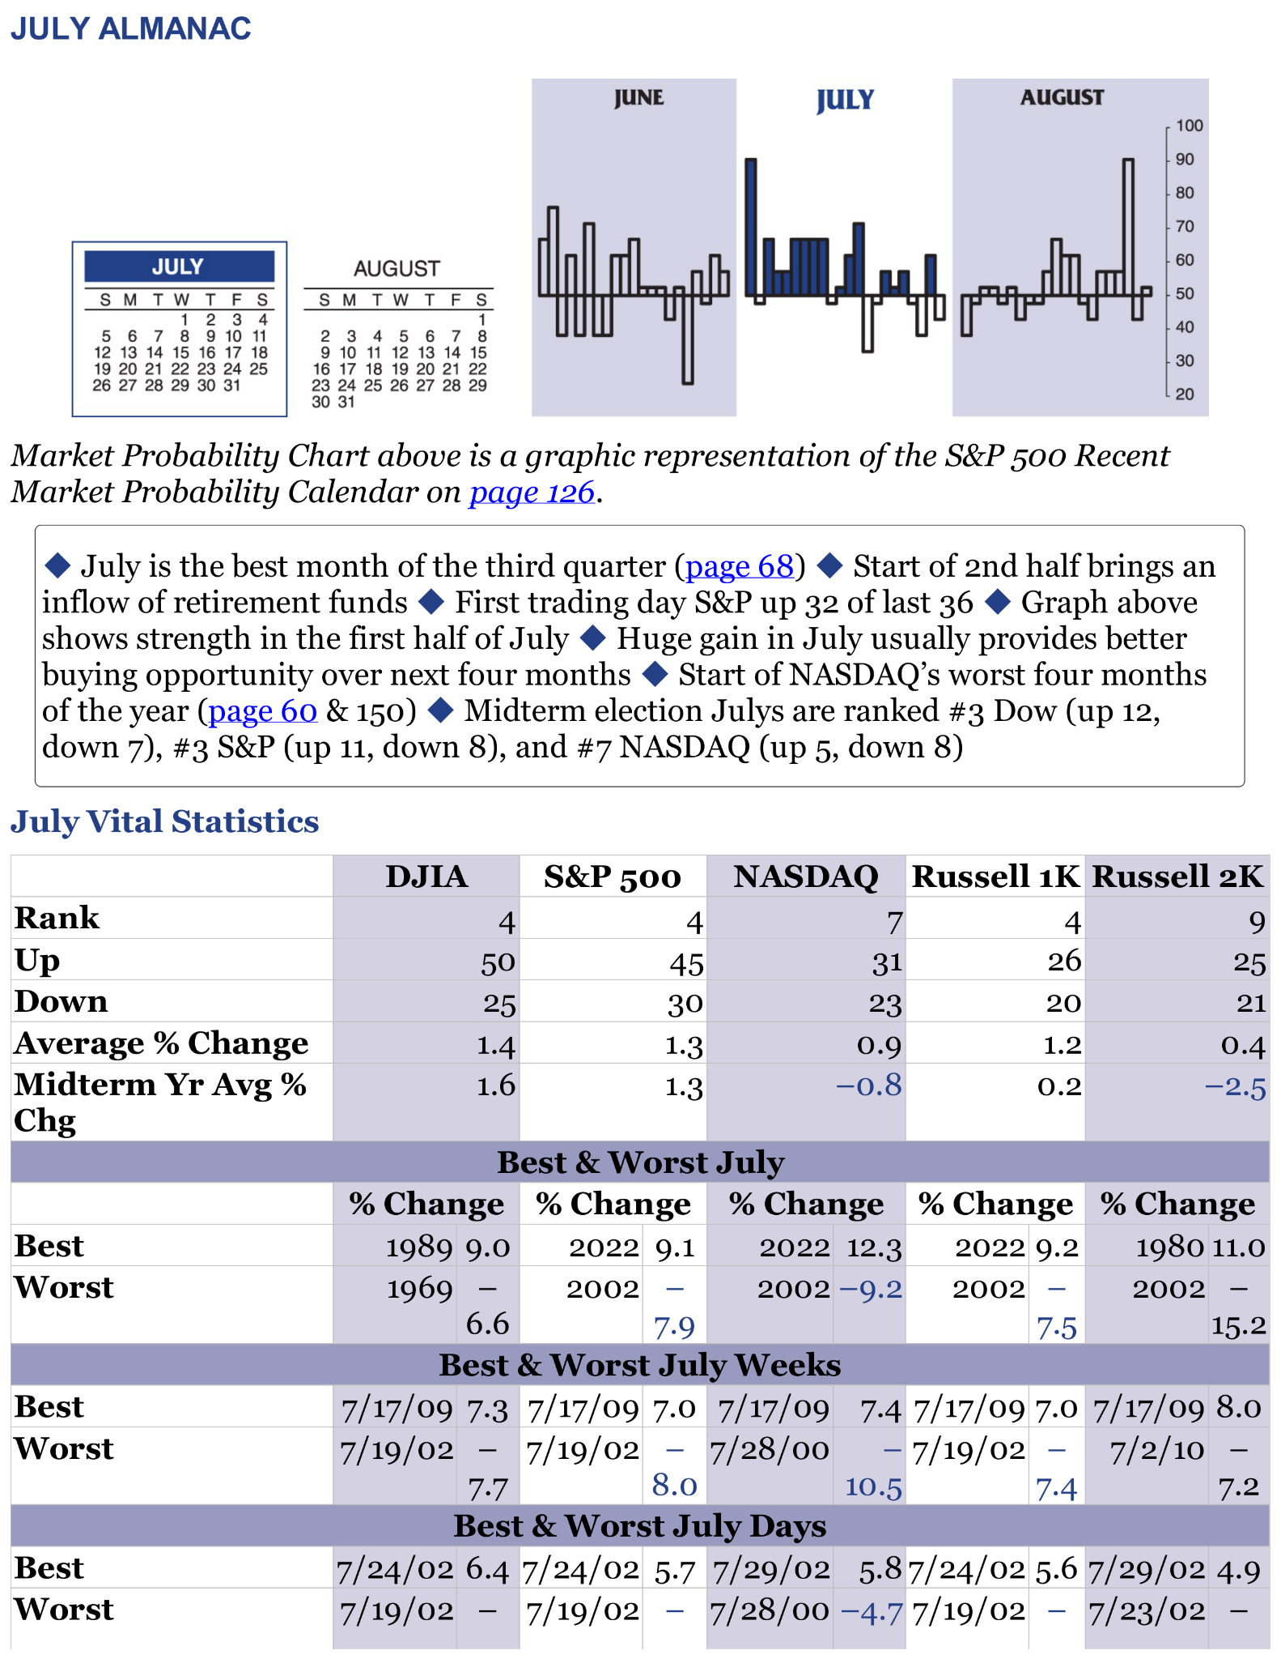
R3
In July, the seasonal outlook improves significantly.
The S&P 500 average July return is +1.3%.
The Midterm Election Year return is also +1.3%.
July is historically the strongest month of the third quarter and ranks #4 overall for the S&P 500.
Therefore, the outlook from Bearish in June to Bullish in July.
https://github.com/juninho4/Team-3-Practical-A-CP3405/blob/main/vW24/agents/almanac/week4_almanac.ipynb

Slide 7
R4

Slide 8
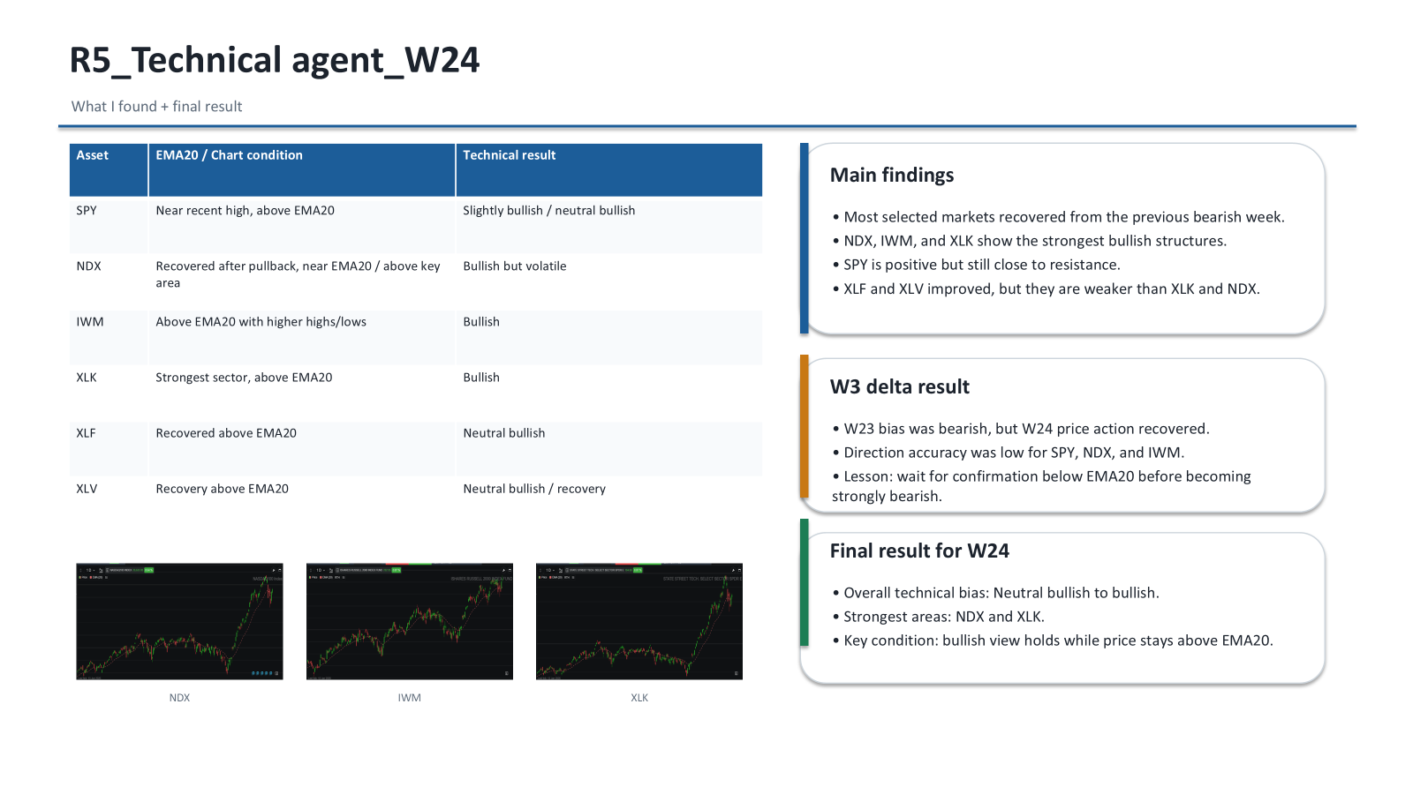

Slide 9
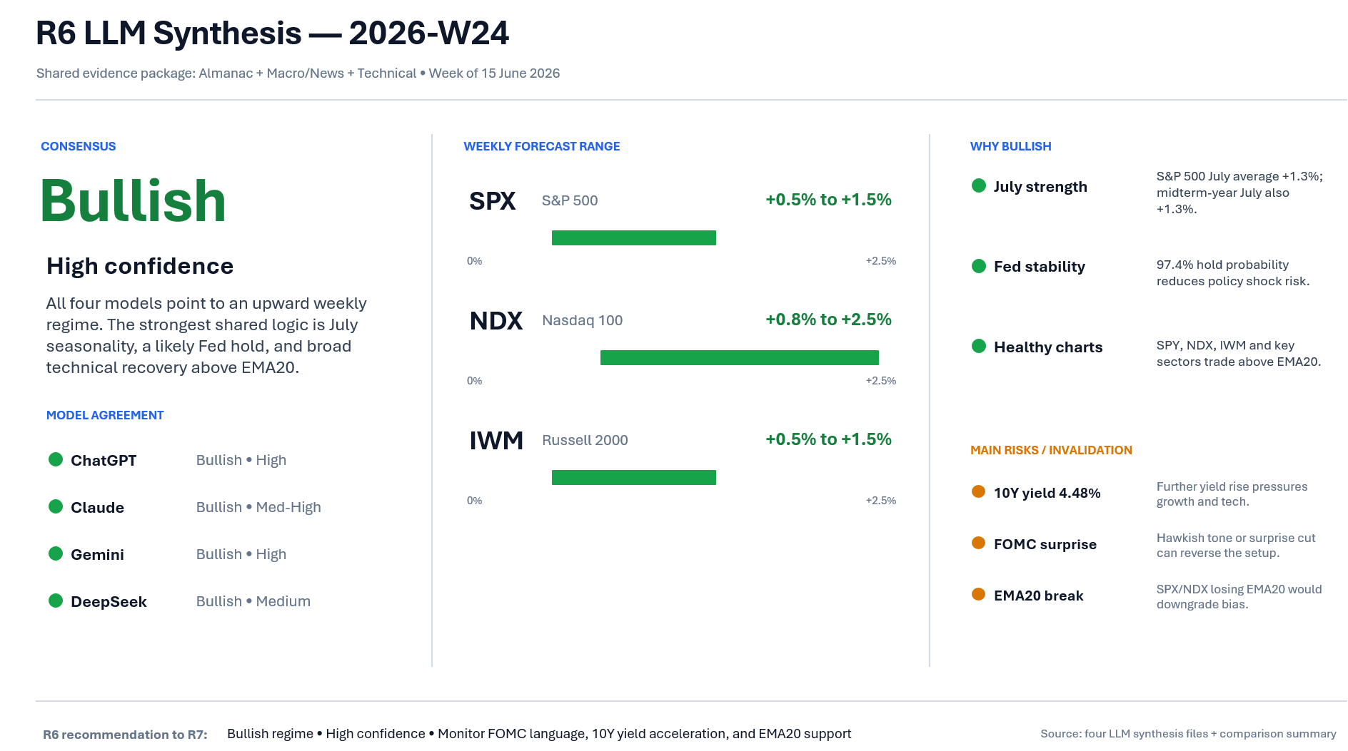

Slide 10
R7
Core Metric: Total Human Score: +7 (Strong Bullish Regime)
Key Pillars:
Technical Structure (+2) & AI Agreement Quality (+2): Unanimous AI alignment; broad-based recovery as SPX, NDX, and IWM successfully reclaim daily EMA20.
Macro / News Weight (+1): Fed rate stability (97.4% pause probability at 3.75%) and falling oil prices act as tailwinds, tempered by a rising 10Y yield (4.48%).
Almanac Seasonal Weight (+1): July historical strength (Midterm July ranks #3) vs. immediate NASDAQ seasonal headwinds.
Wild Card / Human Insight (+1): Rotation Setup Detected. Rising yields + tech seasonal drag indicate mega-cap stagnation, creating an entry window for small-cap outperformance.

Slide 11
R7
Strategic Position: Directional Alignment with AI, Adjustment in Magnitude & Relative Strength
Relative Strength Ranking: IWM (Strongest) > SPX > NDX (Weakest)
Final Predicted Weekly Ranges:
SPX (S&P 500): +0.5% to +1.5% (Aligned with AI consensus)
NDX (Nasdaq 100): +0.5% to +1.8% (Capped lower than ChatGPT's +2.5% due to yield headwinds)
IWM (Russell 2000): +1.0% to +2.5% (Betting on broadening participation & small-cap surge)
Critical Invalidation Conditions:
FOMC delivers a hawkish surprise or an unexpected panic rate cut on June 18.
Major indices lose momentum and close the week below their 20-day EMA support.

Slide 12
R9
Responsibilities
Organised the repository structure into vW22, vW23 and vW24
Managed project files and documentation
Maintained README and repository consistency
Created the vW24 release tag for submission
Outcome
Improved repository organisation and navigation
Ensured all weekly deliverables were stored correctly
Supported team collaboration through GitHub

Slide 13
R2
Overview
Communication through Discord
Sprint duration: 3 days
Clearer role allocation
Better teamwork and execution
Key Progress
R8 uploaded data early
R3 uploaded weather forecast
R5, R6, R7, R9, and R2 completed tasks
GitHub and documentation completed
Main Blocker
One number leave
The issue was resolved through communication

Slide 14
R2
What Went Well
Clear responsibilities
Good communication
Regular progress updates
Most work completed on time
What We Learned
A clear Sprint Goal improves focus
Early discussion reduces confusion
Regular updates help identify blockers
Improvements for Next Sprint
More frequent progress updates
Clarify requirements earlier
Escalate missing work sooner

