Slide 1
Record Linkage Tutorial:
Distance Metrics for Text
William W. Cohen
CALD

Slide 2
Record linkage tutorial: review
Introduction: definition and terms, etc
Overview of Fellegi-Sunter
  Unsupervised classification of pairs
Main issues in Felligi-Sunter model
  Modeling, efficiency, decision-making, string distance metrics and normalization
Outside the F-S model
  Search for good matches using arbitrary preferences
    Database hardening (Cohen et al KDD2000), citation matching (Pasula et al NIPS 2002)

Slide 3
Record linkage tutorial: review
Introduction: definition and terms, etc
Overview of Fellegi-Sunter
  Unsupervised classification of pairs
Main issues in Felligi-Sunter model
  Modeling, efficiency, decision-making, string distance metrics and normalization
Outside the F-S model
  Search for good matches using arbitrary preferences
    Database hardening (Cohen et al KDD2000), citation matching (Pasula et al NIPS 2002)
- Sometimes claimed to be all one needs
Almost nobody does record linkage without it

Slide 4
String distance metrics: overview
Term-based (e.g. TF/IDF as in WHIRL)
  Distance depends on set of words contained in both s and t.
Edit-distance metrics
  Distance is shortest sequence of edit commands that transform s to t.
Pair HMM based metrics
  Probabilistic extension of edit distance
Other metrics

Slide 5
String distance metrics: term-based
Term-based (e.g. TFIDF as in WHIRL)
  Distance between s and t based on set of words appearing in both s and t.
  Order of words is not relevant
    E.g, “Cohen, William” = “William Cohen” and “James Joyce = Joyce James”
  Words are usually weighted so common words count less
    E.g. “Brown” counts less than “Zubinsky”
    Analogous to Felligi-Sunter’s Method 1

Slide 6
String distance metrics: term-based
Advantages:
  Exploits frequency information
  Efficiency: Finding { t : sim(t,s)>k } is sublinear!
  Alternative word orderings ignored (William Cohen vs Cohen, William)
Disadvantages:
  Sensitive to spelling errors (Willliam Cohon)
  Sensitive to abbreviations (Univ. vs University)
  Alternative word orderings ignored (James Joyce vs Joyce James, City National Bank vs National City Bank)

Slide 7
String distance metrics: Levenstein
Edit-distance metrics
  Distance is shortest sequence of edit commands that transform s to t.
  Simplest set of operations:
    Copy character from s over to t
    Delete a character in s (cost 1)
    Insert a character in t (cost 1)
    Substitute one character for another (cost 1)
  This is “Levenstein distance”

Slide 8
Levenstein distance - example
distance(“William Cohen”, “Willliam Cohon”)
s
W | I | L | L | I | A | M | _ | C | O | H | E |  | N
W | I | L | L | L | I | A | M | _ | C | O | H | O | N
C | C | C | C | I | C | C | C | C | C | C | C | S | C
0 | 0 | 0 | 0 | 1 | 1 | 1 | 1 | 1 | 1 | 1 | 1 | 2 | 2
alignment
t
op
cost

Slide 9
Levenstein distance - example
distance(“William Cohen”, “Willliam Cohon”)
s
W | I | L | L |  | I | A | M | _ | C | O | H | E | N
W | I | L | L | L | I | A | M | _ | C | O | H | O | N
C | C | C | C | I | C | C | C | C | C | C | C | S | C
0 | 0 | 0 | 0 | 1 | 1 | 1 | 1 | 1 | 1 | 1 | 1 | 2 | 2
gap
alignment
t
op
cost

Slide 10
Computing Levenstein distance - 1
D(i,j) = score of best alignment from s1..si to t1..tj
D(i-1,j-1), if si=tj //copy
D(i-1,j-1)+1, if si!=tj //substitute
D(i-1,j)+1 //insert
D(i,j-1)+1 //delete
= min

Slide 11
Computing Levenstein distance - 2
D(i,j) = score of best alignment from s1..si to t1..tj
D(i-1,j-1) + d(si,tj) //subst/copy
D(i-1,j)+1 //insert
D(i,j-1)+1 //delete
= min
(simplify by letting d(c,d)=0 if c=d, 1 else)
also let D(i,0)=i (for i inserts) and D(0,j)=j

Slide 12
Computing Levenstein distance - 3
D(i-1,j-1) + d(si,tj) //subst/copy
D(i-1,j)+1 //insert
D(i,j-1)+1 //delete
D(i,j)= min
 |  | C | O |  | H | E | N
M |  | 1 | 2 |  | 3 | 4 | 5
C |  | 1 | 2 |  | 3 | 4 | 5
C |  | 2 | 2 |  | 3 | 4 | 5
O |  | 3 | 2 |  | 3 | 4 | 5
H |  | 4 | 3 |  | 2 | 3 | 4
N |  | 5 | 4 |  | 3 | 3 | 3
= D(s,t)

Slide 13
Computing Levenstein distance – 4
D(i-1,j-1) + d(si,tj) //subst/copy
D(i-1,j)+1 //insert
D(i,j-1)+1 //delete
D(i,j) = min
 |  | C | O |  | H | E | N
M |  | 1 | 2 |  | 3 | 4 | 5
C |  | 1 | 2 |  | 3 | 4 | 5
C |  | 2 | 3 |  | 3 | 4 | 5
O |  | 3 | 2 |  | 3 | 4 | 5
H |  | 4 | 3 |  | 2 | 3 | 4
N |  | 5 | 4 |  | 3 | 3 | 3
A trace indicates where the min value came from, and can be used to find edit operations and/or a best alignment (may be more than 1)

Slide 14
Needleman-Wunch distance
D(i-1,j-1) + d(si,tj) //subst/copy
D(i-1,j) + G //insert
D(i,j-1) + G //delete
D(i,j) = min
G = “gap cost”
d(c,d) is an arbitrary distance function on characters (e.g. related to typo frequencies, amino acid substitutibility, etc)
William Cohen
Wukkuan Cigeb

Slide 15
Smith-Waterman distance - 1
0 //start over
D(i-1,j-1) - d(si,tj) //subst/copy
D(i-1,j) - G //insert
D(i,j-1) - G //delete
D(i,j) = max
Distance is maximum over all i,j in table of D(i,j)

Slide 16
Smith-Waterman distance - 2
0 //start over
D(i-1,j-1) - d(si,tj) //subst/copy
D(i-1,j) - G //insert
D(i,j-1) - G //delete
D(i,j) = max
 |  | C | O |  | H | E | N
M |  | -1 | -2 |  | -3 | -4 | -5
C |  | +1 | 0 |  | -1 | -2 | -3
C |  | 0 | 0 |  | -1 | -2 | -3
O |  | -1 | +2 |  | +1 | 0 | -1
H |  | -2 | +1 |  | +4 | +3 | +2
N |  | -3 | 0 |  | +3 | +3 | +5
G = 1
d(c,c) = -2
d(c,d) = +1

Slide 17
Smith-Waterman distance - 3
0 //start over
D(i-1,j-1) - d(si,tj) //subst/copy
D(i-1,j) - G //insert
D(i,j-1) - G //delete
D(i,j) = max
 |  | C | O |  | H | E | N
M |  | 0 | 0 |  | 0 | 0 | 0
C |  | +1 | 0 |  | 0 | 0 | 0
C |  | 0 | 0 |  | 0 | 0 | 0
O |  | 0 | +2 |  | +1 | 0 | 0
H |  | 0 | +1 |  | +4 | +3 | +2
N |  | 0 | 0 |  | +3 | +3 | +5
G = 1
d(c,c) = -2
d(c,d) = +1

Slide 18
Smith-Waterman distance - 5
c o h e n d o r f
m 0 0 0 0 0 0 0 0 0
c 1 0 0 0 0 0 0 0 0
c 0 0 0 0 0 0 0 0 0
o 0 2 1 0 0 0 2 1 0
h 0 1 4 3 2 1 1 1 0
n 0 0 3 3 5 4 3 2 1
s 0 0 2 2 4 4 3 2 1
k 0 0 1 1 3 3 3 2 1
i 0 0 0 0 2 2 2 2 1
dist=5

Slide 19
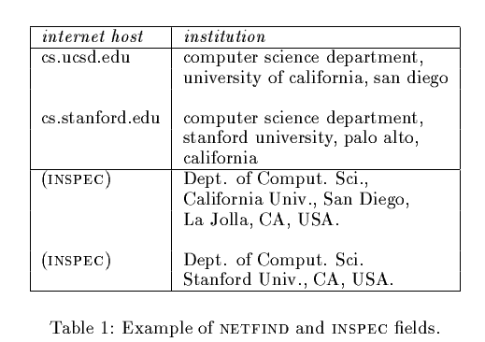
Smith-Waterman distance:
Monge & Elkan’s WEBFIND (1996)

Slide 20
Smith-Waterman distance in
Monge & Elkan’s WEBFIND (1996)
Used a standard version of Smith-Waterman with hand-tuned weights for inserts and character substitutions.
Split large text fields by separators like commas, etc, and found minimal cost over all possible pairings of the subfields (since S-W assigns a large cost to large transpositions)
Result competitive with plausible competitors.

Slide 21
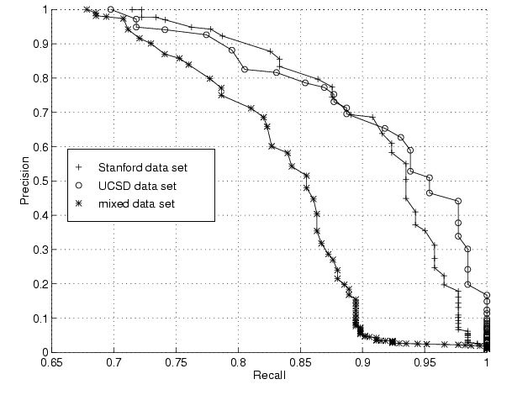
Results: S-W from Monge & Elkan

Slide 22
Affine gap distances
Smith-Waterman fails on some pairs that seem quite similar:
William W. Cohen
William W. ‘Don’t call me Dubya’ Cohen
Intuitively, a single long insertion is “cheaper” than a lot of short insertions
Intuitively, are springlest hulongru poinstertimon extisn’t “cheaper” than a lot of short insertions

Slide 23
Affine gap distances - 2
Idea:
  Current cost of a “gap” of n characters: nG
  Make this cost: A + (n-1)B, where A is cost of “opening” a gap, and B is cost of “continuing” a gap.

Slide 24
Affine gap distances - 3
D(i-1,j-1) + d(si,tj)
IS(I-1,j-1) + d(si,tj)
IT(I-1,j-1) + d(si,tj)
D(i-1,j-1) + d(si,tj) //subst/copy
D(i-1,j)-1 //insert
D(i,j-1)-1 //delete
D(i,j) = max
IS(i,j) = max
D(i-1,j) - A
IS(i-1,j) - B
Best score in which si is aligned with a ‘gap’
Best score in which tj is aligned with a ‘gap’
IT(i,j) = max
D(i,j-1) - A
IT(i,j-1) - B

Slide 25
Affine gap distances - 4
IS
-B
-d(si,tj)
-A
D
-d(si,tj)
-A
-d(si,tj)
IT
-B

Slide 26
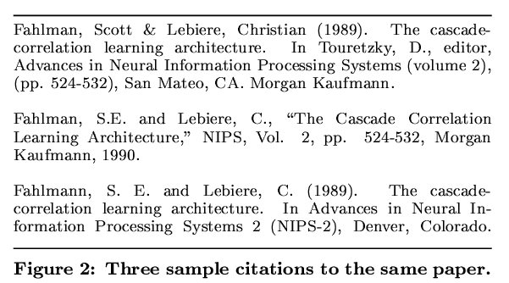
Affine gap distances – experiments (from McCallum,Nigam,Ungar KDD2000)
Goal is to match data like this:

Slide 27
Affine gap distances – experiments (from McCallum,Nigam,Ungar KDD2000)
Hand-tuned edit distance
Lower costs for affine gaps
Even lower cost for affine gaps near a “.”
HMM-based normalization to group title, author, booktitle, etc into fields

Slide 28
Affine gap distances – experiments
 | TFIDF | Edit Distance | Adaptive
Cora | 0.751 | 0.839 | 0.945
 | 0.721 |  | 0.964
OrgName1 | 0.925 | 0.633 | 0.923
 | 0.366 | 0.950 | 0.776
Orgname2 | 0.958 | 0.571 | 0.958
 | 0.778 | 0.912 | 0.984
Restaurant | 0.981 | 0.827 | 1.000
 | 0.967 | 0.867 | 0.950
Parks | 0.976 | 0.967 | 0.984
 | 0.967 | 0.967 | 0.967

Slide 29
String distance metrics: outline
Term-based (e.g. TF/IDF as in WHIRL)
  Distance depends on set of words contained in both s and t.
Edit-distance metrics
  Distance is shortest sequence of edit commands that transform s to t.
Pair HMM based metrics
  Probabilistic extension of edit distance
Other metrics

Slide 30
Affine gap distances as automata
IS
-B
-d(si,tj)
-A
D
-d(si,tj)
-A
-d(si,tj)
IT
-B

Slide 31
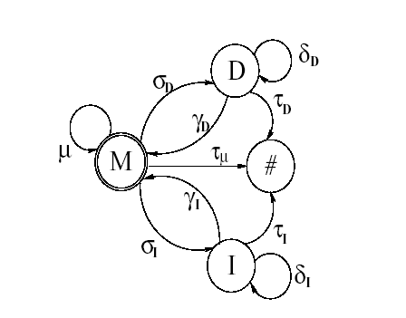
Generative version of affine gap automata (Bilenko&Mooney, TechReport 02)
HMM emits pairs: (c,d) in state M, pairs (c,-) in state D, and pairs (-,d) in state I.
For each state there is a multinomial distribution on pairs.
The HMM can trained with EM from a sample of pairs of matched strings (s,t)
E-step is forward-backward; M-step uses some ad hoc smoothing

Slide 32
Generative version of affine gap automata (Bilenko&Mooney, TechReport 02)
Using the automata:
Automata is converted to operation costs for an affine-gap model as shown before.
Why?
Model assigns probability less than 1 for exact matches.
Probability decreases monotonically with size => longer exact matches are scored lower
  This is approximately opposite of frequency-based heuristic

Slide 33
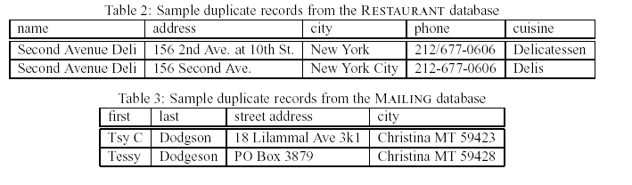
Affine gap edit-distance learning: experiments results (Bilenko & Mooney)
Experimental method: parse records into fields; append a few key fields together; sort by similarity; pick a threshold T and call all pairs with distance(s,t) < T “duplicates”; picking T to maximize F-measure.

Slide 34
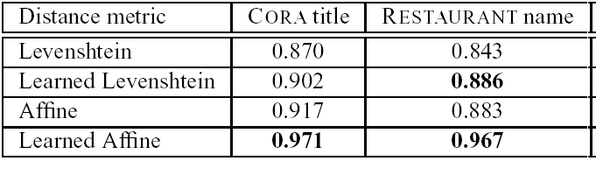
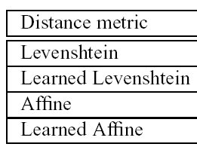
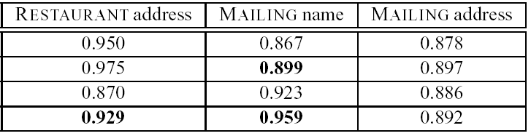
Affine gap edit-distance learning: experiments results (Bilenko & Mooney)

Slide 35
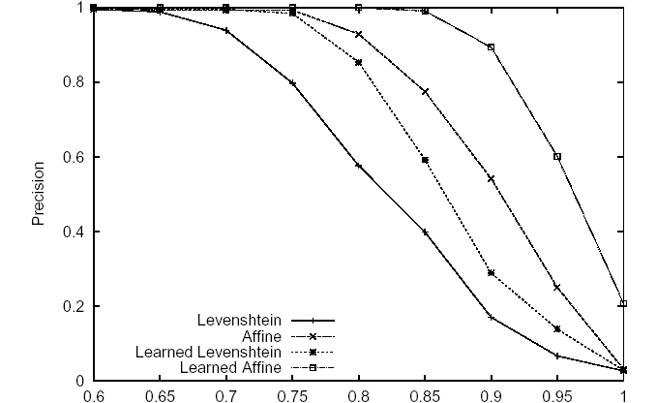
Affine gap edit-distance learning: experiments results (Bilenko & Mooney)
Precision/recall for MAILING dataset duplicate detection

Slide 36
String distance metrics: outline
Term-based (e.g. TF/IDF as in WHIRL)
  Distance depends on set of words contained in both s and t.
Edit-distance metrics
  Distance is shortest sequence of edit commands that transform s to t.
Pair HMM based metrics
  Probabilistic extension of edit distance
Other metrics

Slide 37
Jaro metric
Jaro metric is (apparently) tuned for personal names:
  Given (s,t) define c to be common in s,t if it si=c, tj=c, and |i-j|<min(|s|,|t|)/2.
  Define c,d to be a transposition if c,d are common and c,d appear in different orders in s and t.
  Jaro(s,t) = average of #common/|s|, #common/|t|, and 0.5#transpositions/#common
  Variant: weight errors early in string more heavily
Easy to compute – note edit distance is O(|s||t|)
NB. This is my interpretation of Winkler’s description

Slide 38
Soundex metric
  Soundex is a coarse phonetic indexing scheme, widely used in genealogy.
  Every Soundex code consists of a letter and three numbers between 0 and 6, e.g. B-536 for “Bender”. The letter is always the first letter of the surname. The numbers hash together the rest of the name.
    Vowels are generally ignored: e.g. Lee, Lu => L-000. Later later consonants in a name are ignored.
    Similar-sounding letters (e.g. B, P, F, V) are not differentiated, nor are doubled letters.
    There are lots of Soundex variants….

Slide 39
N-gram metric
  Idea: split every string s into a set of all character n-grams that appear in s, for n<=k. Then, use term-based approaches.
  e.g. “COHEN” => {C,O,H,E,N,CO,OH,HE,EN,COH,OHE,HEN}
  For n=4 or 5, this is competitive on retrieval tasks. It doesn’t seem to be competitive with small values of n on matching tasks (but it’s useful as a fast approximate matching scheme)

Slide 40
String distance metrics: overview
Term-based (e.g. as in WHIRL)
  Very little comparative study for linkage/matching
  Vast literature for clustering, retrieval, etc
Edit-distance metrics
  Consider this a quick tour
    cottage industry in bioinformatics
Pair HMM based metrics
  Trainable from matched pairs (new work!)
  Odd behavior when you consider frequency issues
Other metrics
  Mostly somewhat task-specific

