Slide 1
Instructions Manual HortonWorks sandbox for Hadoop environment
Francis De la Cruz Delgado

Slide 2
Lesson Goals
Being prepared to start developing at Hadoop env.
Understand some important topics about environment.
All trainees have a develop environment at home.

Slide 3
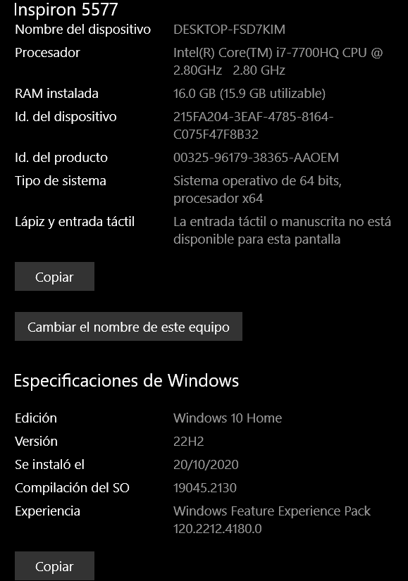
System Requirements
Very important powerful resources:
At least 12 GB of RAM, 16 gb RAM or more recommended.
Reference:

Slide 4

Software Requirements
Install Git
SO Windows :
https://gitforwindows.org/
SO linux DEBIAN / UBUNTU:
-
First of all, Docker is mandatory.
SO Windows :
https://docs.docker.com/docker-for-windows/install/
SO Linux:
https://docs.docker.com/ee/docker-ee/ubuntu/

Slide 5
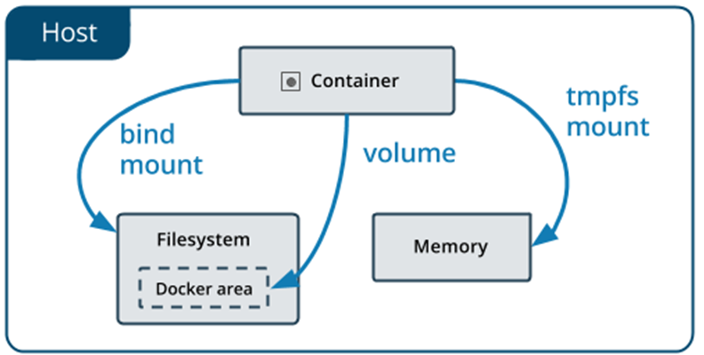
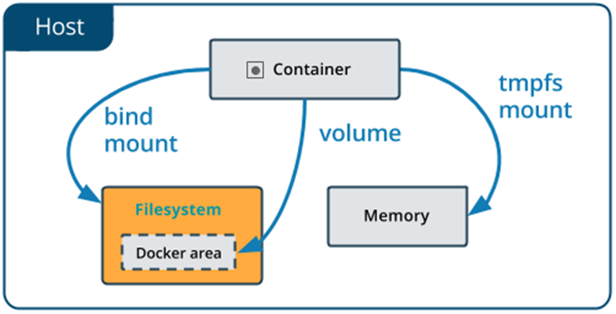
Mounting local memory to docker

Slide 6
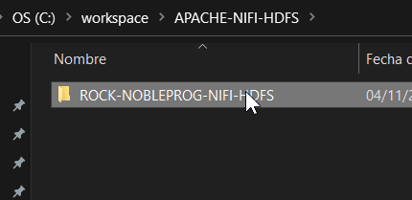
Installation HortonWorks
Create a directory called “Workspace” and inside “APACHE-NIFI-HDFS”
Move to the previously created directory.
Download repository from github.
git clone https://github.com/rockdatio/ROCK-NOBLEPROG-NIFI-HDFS.git
Branch : main

Slide 7
Troubleshooting : ports
To fix this you must temporarily disable the winnat service this is simply done by running this command (must be run as administrator)
# net stop winnat
Start your docker services and start winnat again
# net start winnat

Slide 8
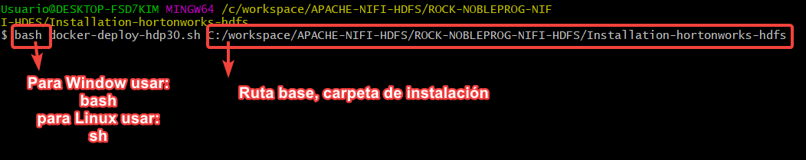
Installation HortonWorks
2. Move to Installation-hortonworks-hdfs
3. Execute with the command bash for window and sh for linux.
Ejm:
# bash docker-deploy-hdp30.sh C:/workspace/APACHE-NIFI-HDFS/ROCK-NOBLEPROG-NIFI-HDFS/Installation-hortonworks-hdfs Nota: Para Linux sh docker-deploy-hdp ….

Slide 9
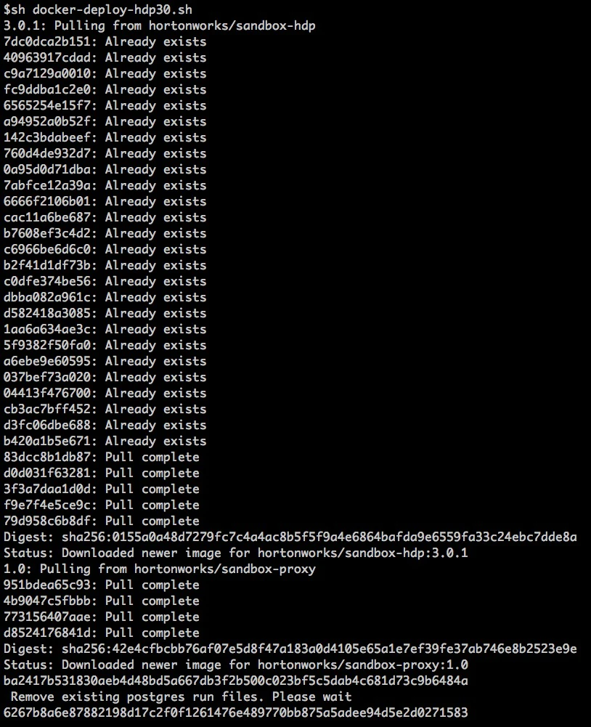

Slide 11
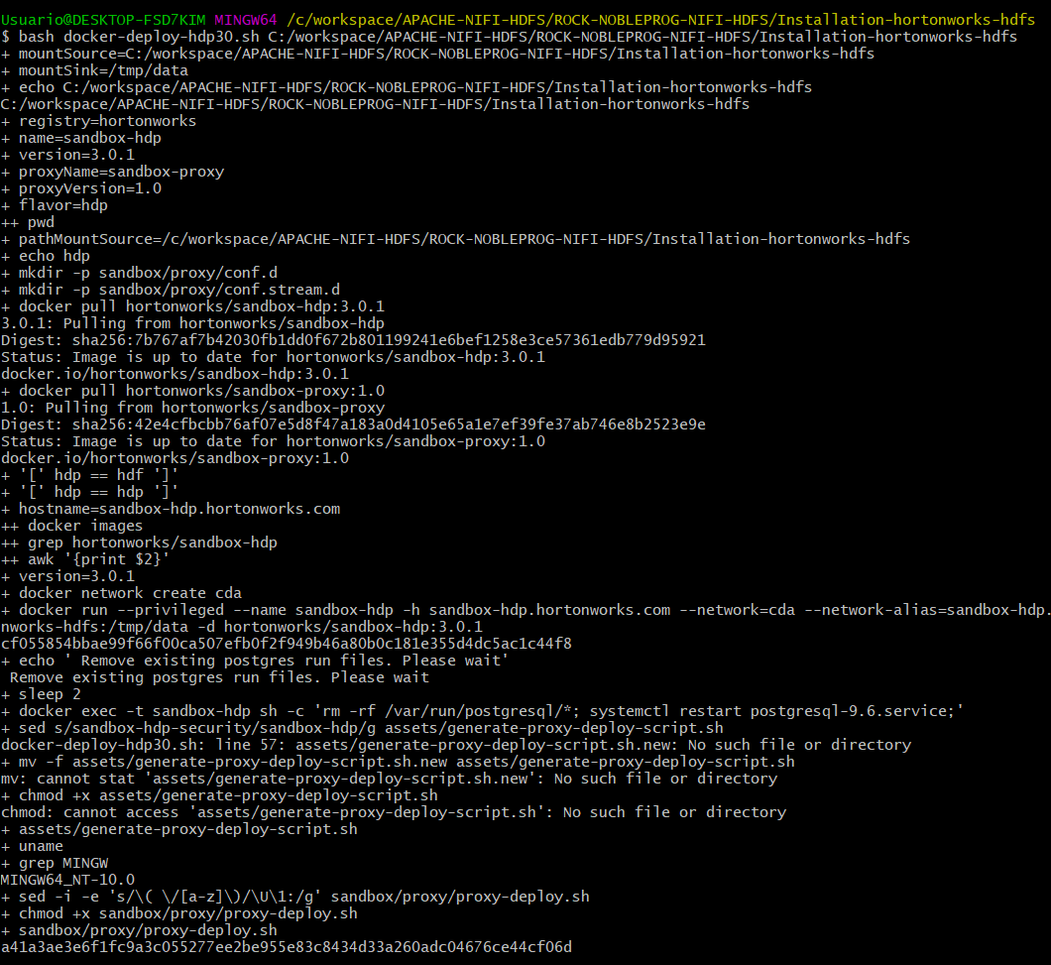
Validation Installation
Note: the first time it will take so long time (27 gb of docker image).
In case of any interruption during the execution abort and execute again.
Consider don't turn off during the downloading.

Slide 12
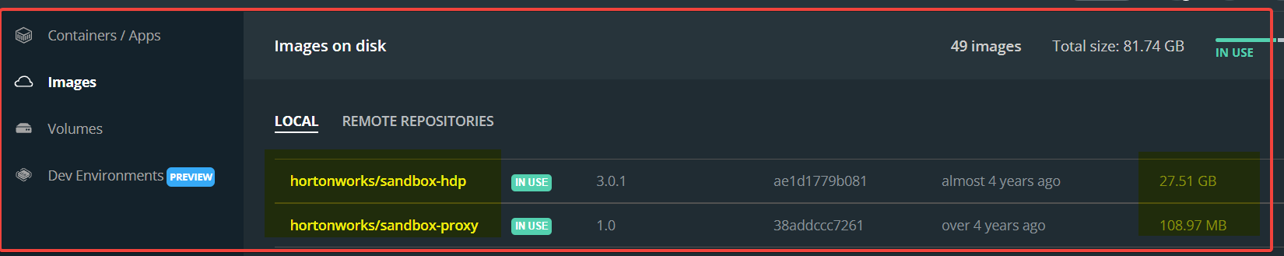
Validation
# docker images or use docker desktop.

Slide 13
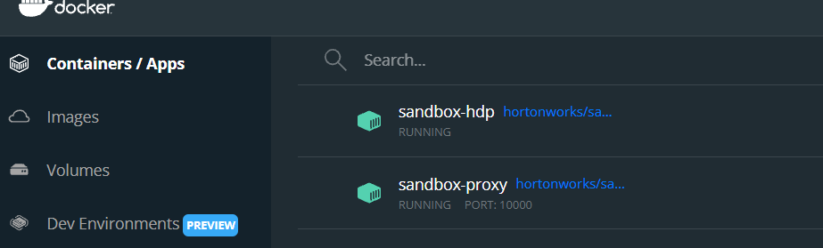
Validation

Slide 14
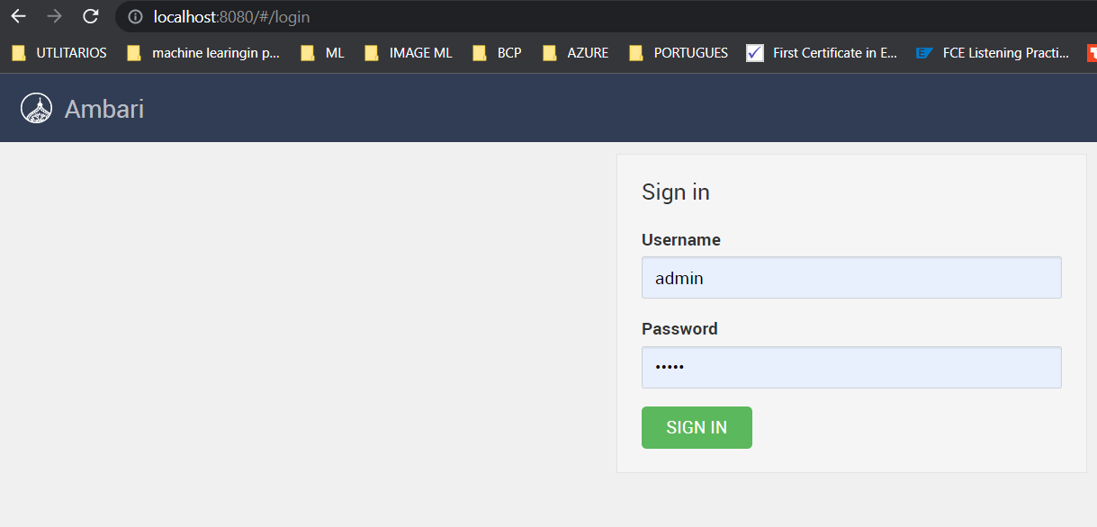
Validation localhost:8080

Slide 15
Setting User and Password for ambari
First get into docker container in order to change password.

Slide 16
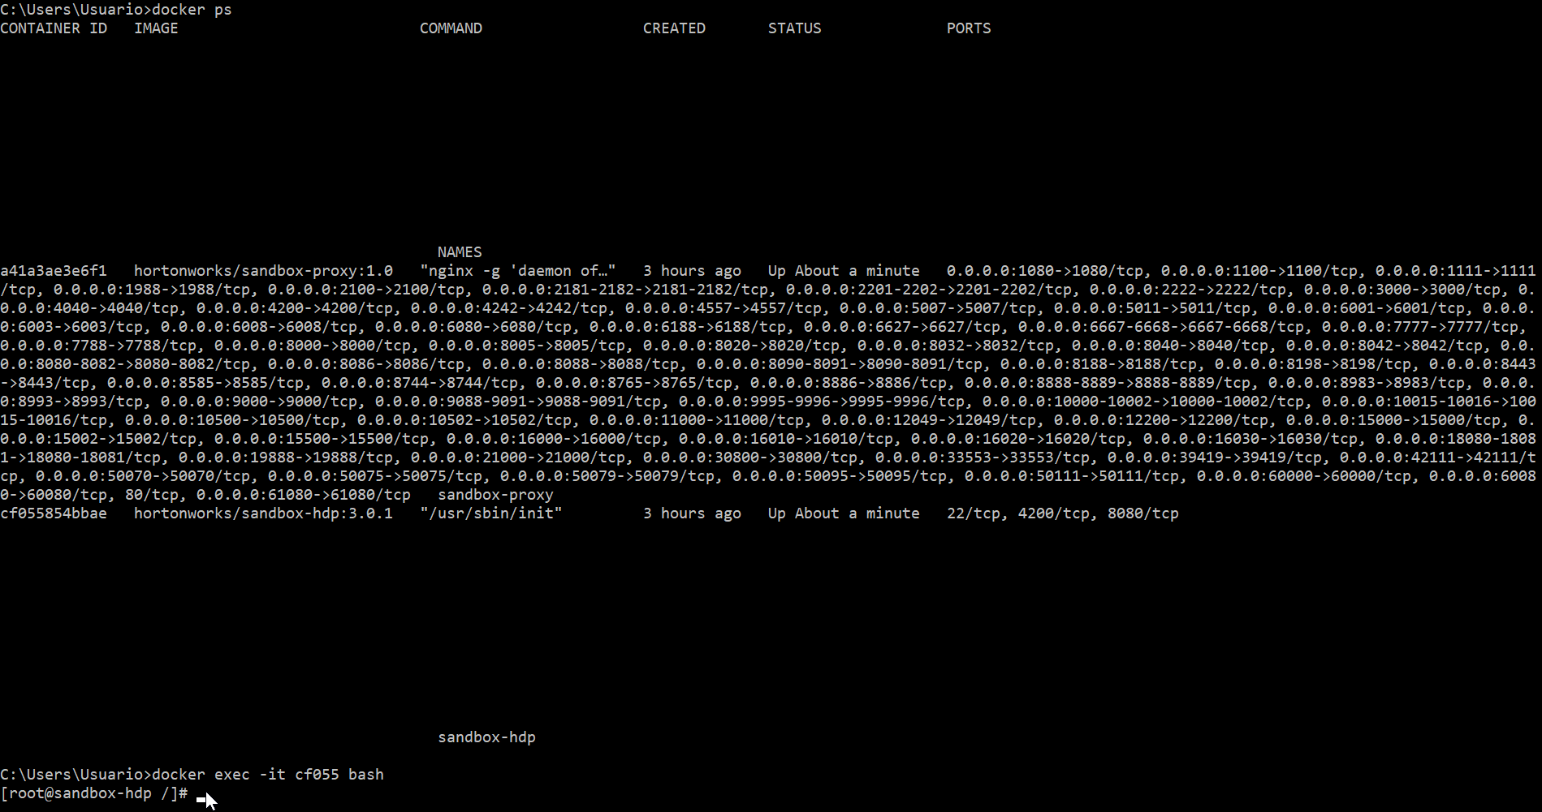

Slide 17
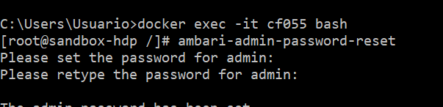
Change user and password
Execute : ambari-admin-password-reset
Set a preference user and password.
Recommended :
User: admin
Password: admin

Slide 18
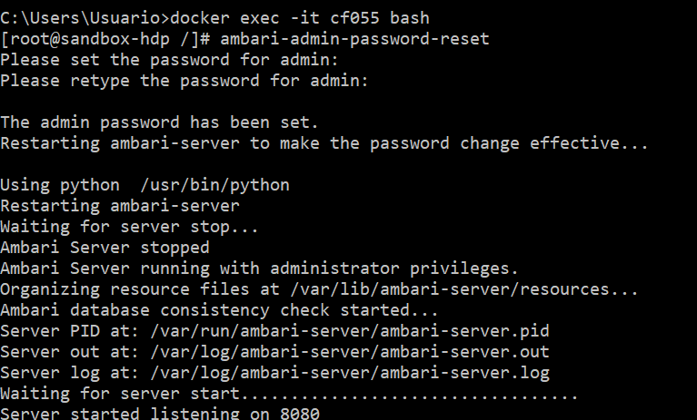
Validation

Slide 19
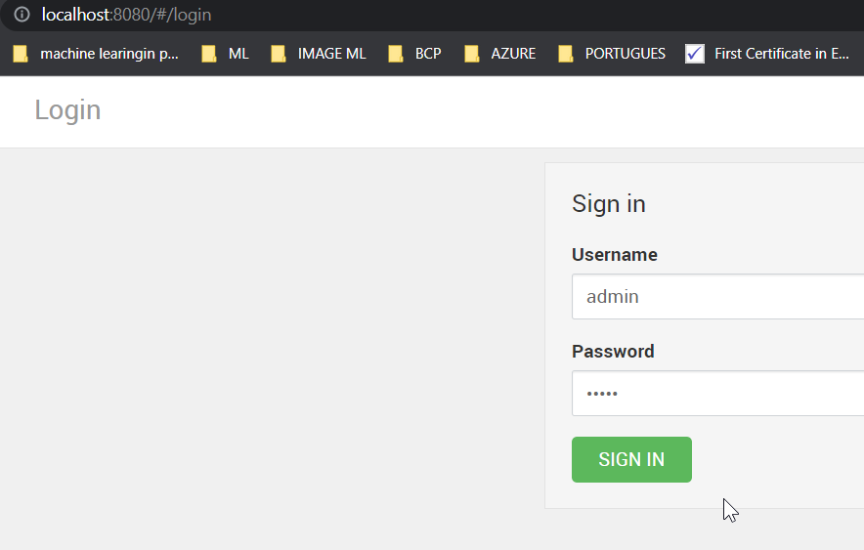

Slide 20
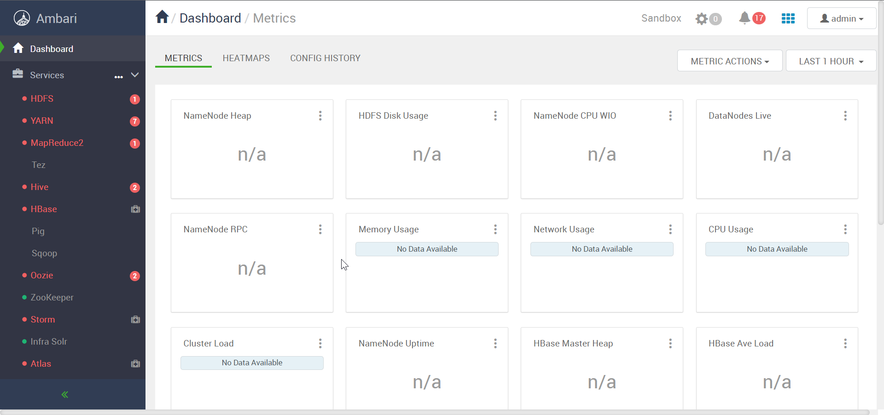
Stop Unnecessary services

Slide 21
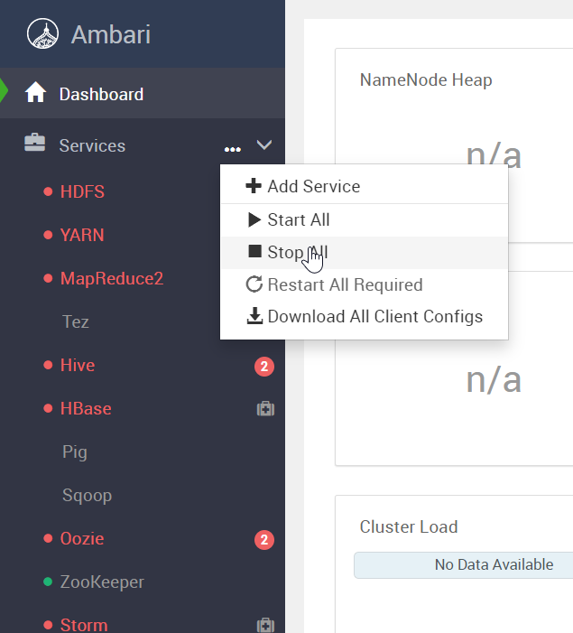

Slide 22
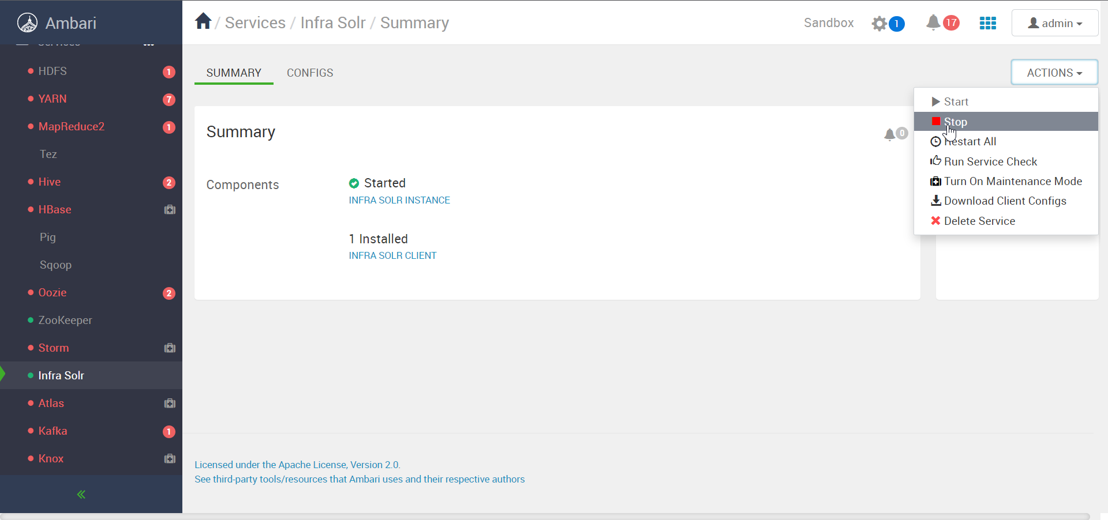

Slide 23
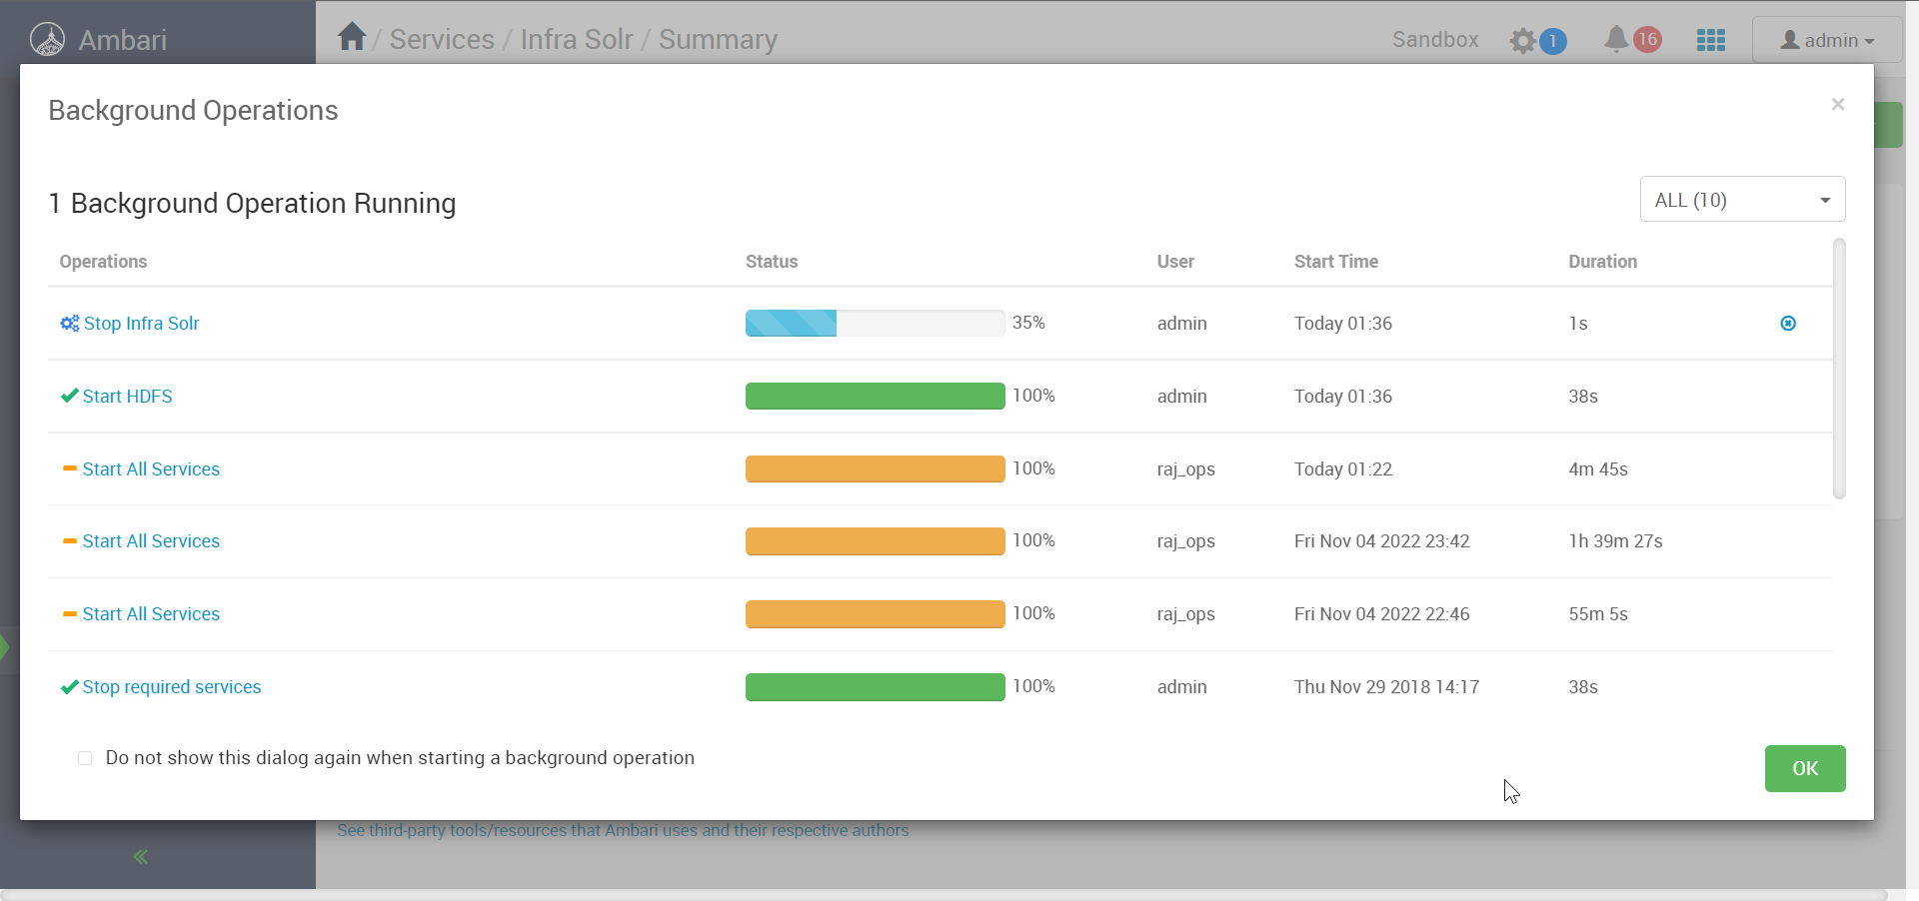

Slide 24
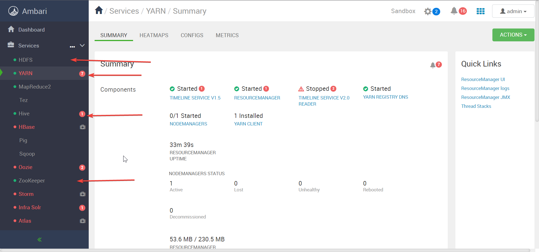
Just start selected Services

Slide 25
Troubleshooting
Troubleshooting about ports
Troubleshooting about execution

Slide 26
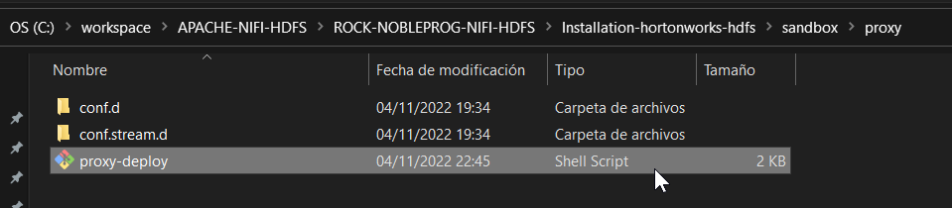
Troubleshooting : ports
In case of getting error like Ports are not available:
We can restart our computer, cause sometimes the computer reserve some range of ports.
Or delete the port from proxy-deploy:

Slide 27
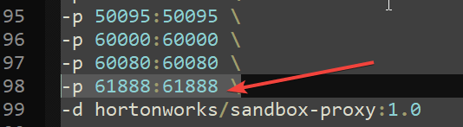
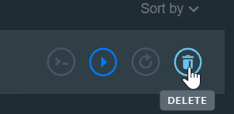
Troubleshooting : ports
Remove that line and execute again.
Note : Remove all containers previously created by script. Using docker commands or docker desktop

Slide 28
Troubleshooting : ports
# docker ps -a
buscar containerId con los nombres sandbox-hdp y sandbox-hdp
# docker rm -f containerId (Por cada container)
docker rm -f a41a3ae3e6f1
docker rm -f cf055854bbae
Remove that line and execute again.
# bash docker-deploy-hdp30.sh C:/workspace/APACHE-NIFI-HDFS/ROCK-NOBLEPROG-NIFI-HDFS/Installation-hortonworks-hdfs

Slide 29
Ambari hortonworks ports available
https://docs.cloudera.com/HDPDocuments/HDP2/HDP-2.6.5/bk_reference/content/ams-ports.html

Slide 30
Troubleshooting : Execution
The first time, this will take so long that probably could be interrupted by network or whatever.
Retry and try to let it download the docker image.

Slide 31
Exposed ports
4480 -- process information unavailable
28930 ResourceManager
3973 JournalNode
7463 DataNode
28039 ApplicationHistoryServer
7848 RunJar
9065 AmbariServer
8332 NameNode
32732 TimelineReaderServer
20255 SecondaryNameNode
[root@sandbox ~]# jps
7246 -- process information unavailable
10992 -- process information unavailable
11440 -- process information unavailable
5301 RunJar
4983 QuorumPeerMain
2712 NodeManager
22329 JobHistoryServer
11162 Jps

Slide 32
Uninstall Sandbox hortonworks
To stop the sandbox – docker stop sandbox-hdp
To remove he sandbox container – docker rm sandbox-hdp
To remove the sandbox image – docker rmi -f sandbox-hdp

Slide 33
ORIGINAL RESOURCE
https://www.cloudera.com/downloads/hortonworks-sandbox.html

Slide 34
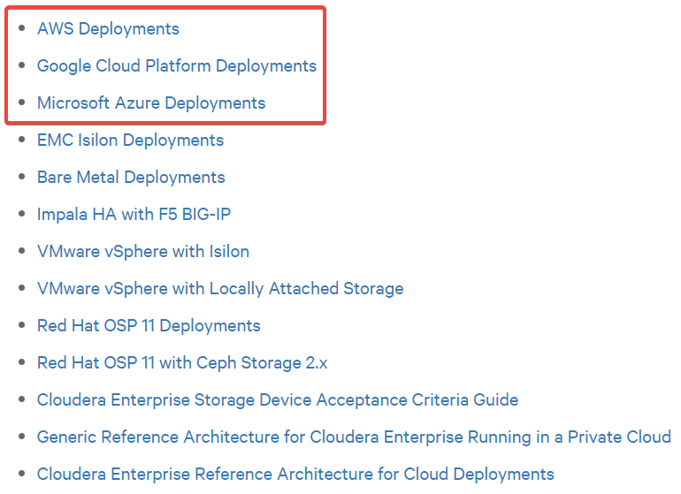
Another Installation
https://docs.cloudera.com/documentation/other/reference-architecture/topics/ra_introduction.html

