Slide 1

COMPUTER CRIMES
BY
PRESIDENT’S COUNSEL KALINGA INDATISSA

Slide 2
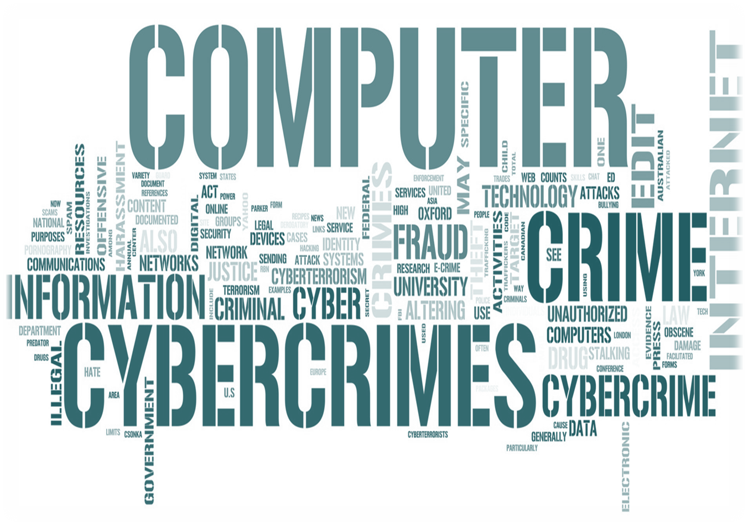

Slide 3
WHAT IS A CRIME?
An act against the State prohibited by law under pain of punishment.
Criminal law is directly connected to Social Order.

Slide 4
HISTORY
Mesopotamien Code of UR-NAMMU (2100 BC – 2050 BC)
Eye for an eye
Tooth for a tooth
Ear for an ear
Penal sanctions are attached.

Slide 5
TRADITIONAL CRIMES
Murder
Rape
Theft
Hurt
Robbery
Criminal trespass

Slide 6
LAW/CRIMINAL
Social needs.
Make provisions to deal with criminal activity.
Must change time and again.
    PTA
    Poisons Opium and Dangerous Drugs Ordinance

Slide 7
HISTORY OF COMPUTERS
Computing system was needed.
  Since 1880 attempts were made;
1936 – Alan Turing- Turing machine
1943-1944 – John Mauchly and Presper Eckert of University of Pennsylvania build Electronic Numerical Integrator and Calculator (ENIAC)
1946- They build UNIVAC, the 1st commercial computer for business and government applications.

Slide 8
HISTORY OF COMPUTERS
1971- Alan Shugart invents floppy disk.
1973- Robert Metcalfe – Ethernet – connection of multiple computers.
1976- 1st April- Apple 1 – 1st computer with a single circuit board is invented.
1981- IBB personal computer – MS-DOS.
1985- Windows/Microsoft.
  Domain name registration made possible.
  Symbolic.com

Slide 9
HISTORY OF COMPUTERS
1990- HTML – Hyper Text Markup Language
1996- Sergy Bin/Larry Page – Google Search Engine
1999- WIFI
2005- YouTube
2007- iPhones
2009- Windows 7
2010- iPad

Slide 10
INTERNET
Information gateway.
Educational purposes.
Social media.
Medium of communication
Storage of information.
Recreational.
Sports/Games.
Trade – amazon.com etc.

Slide 11
Computer Misuse Act of UK – 1990
Document – Interpretation
Property – interpretation
2 issues faced by our system
Document – Benwell v Republic 1978-79 2 SLR 178
Diskette – Derby & Company v Weldon 1991 1 WLR 73

Slide 12
“Property” – Tangible Property
Nagaiah v Jayasekera – 28 NLR 467
Lowe v Blease – 1975 Criminal LR 513
Oxford v Moss – 1978 Criminal Appeal Rep. 183 – confidential information

Slide 13
LAWS IN SRI LANKA
Computer Evidence Act, No 14 of 1995
Intellectual Property Act, No 36 of 2003
Electronic Transactions Act, No 19 of 2006
Payment Devices Frauds Act, No. 30 of 2006
Computer Crimes Act, No 24 of 2007

Slide 14
ISSUES
Jurisdiction
Law
Proof
Social issues
Business issues
IP issues

Slide 15
INTERNATIONAL DOCUMENTS
Budapest Convention- Council of Europe – France 2001
1st March 2006 – Additional Protocol came into operation
Sri Lanka is a signatory

Slide 16


TECHNOLOGY
Cyber Space
Internet
Skype
Viber
Whatsapp
You Tube
Smart phones

Slide 17
COMPUTER CRIMES
Sec 2 – Universal Jurisdiction
Act committed within SL or not
The computer affected was in SL or not – viruses
The computer used to commit an offence was in SL or not
Damage caused in SL or not

Slide 18
UNAUTHORIZED ACCESS
Sec 3 – Intentional commission of an act in order to gain access to a computer or any information without any authority.
Rs 100,000/- 5 years RI
Kandy – Bank case/password change on a phone
HACKING OFFENCE

Slide 19
HACKING
Communications Decency Act was being debated – www pages of the US Department of Justice- Replacement of the logo
Jurassic Park – The Lost World
Amended the title to Jurassic Duck – The Lost Pond

Slide 20
ULTERIOR INTENT OFFENCE
SECTION 4
Hacking with the intention of committing a further offence.
Original access is authorized – NO OFFENCE

Slide 21
UNAUTHORIZED MODIFICATION OF MATERIAL
SECTION 5
Intentionally/without authority
Causes a computer to perform a function
Knowing
That the function will result in modification/damage/potential damage
To a computer/programme
Rs 300,000/- 5 years
ERASURE/DELETION/ADDITION/ALTER FUNCTION VIRUSES

Slide 22
NATIONAL SECURITY, PUBLIC SECURITY, NATIONAL ECONOMY
SECTION 6
5 YEARS

Slide 23
ILLEGAL DATA
SECTION 7
Purchase – DVDs.
Reception – emails.
Retains.
Sells.
Downloads, uploads, copies information/Data.

Slide 24
ILLEGAL INTERCEPTION OF DATA
SECTION 8
Telephone tapping.
Service providers liability.
It is not safe.

Slide 25
IP VIOLATIONS
ACT NO 36/2003
Copyright violations – DVDs.
Trade Mark violations.
Software programming.
Confidential information.

Slide 26


Slide 27
TEN SIMPLE TIPS TO AVOID ONLINE FRAUD
SOURCE – www.independent.co.uk
Install protection on your computer with anti-virus or full security suite products.
Make sure you regularly update your operating system to minimise your system vulnerabilities

Slide 28
Secure your network and use this to shop online. Do not use someone else's as it may not be secure
Do not click on links sent out by unsolicited spam or phishing emails. Go direct to the website URL.
Let your system browser help you stay safe. Enable your browser phishing and malware protection filters

Slide 29
Use a credit card instead of a debit card. Credit cards may offer increased protection
Always look for the website URL to be shown as HTTPS and look for the padlock icon. Banking data sent over unsecured websites may be vulnerable to online thieves
Look at customer reviews for websites if you are not sure on using the site

Slide 30
If a deal sounds too good to be true - it probably is. Be wary of receiving unsolicited mail asking them to visit sites for cheap deals on hard-to-get items
If you are still in doubt, consider alternative payment methods such as PayPal, gift cards or pre-paid credit cards

Slide 31


THANK YOU

