Slide 1

CYBERCRIME
By
Justice K. Kumudini Wickremasinghe
M.A. (Human Rights) Uni. Of
Oslo, Norway
Trainer – European Union & Council of Europe

Slide 2


Slide 3
Contents
Introduction
The International dimension of Cybercrime
Budapest Convention
Mutual Legal Assistance Treaties & Laws
Sri Lankan Statutes
Some practical Issues regarding international cybercrime investigations

Slide 4
Introduction
Internet is globally available, creating more opportunities for criminals
It is used by almost everybody on the planet and enables to commit crimes remotely
Cybercrime is the most transnational of all crimes
The main cause of data breaches are malicious or criminal attacks — and they are responsible for 48 percent of all data breaches
Affects the right to private life of hundreds of millions of individuals whose personal data are stolen

Slide 5
Can be an attack against the dignity and the integrity of individuals
Investigating cybercrime requires efficient international cooperation
Without such cooperation, investigations are unlikely to succeed
Cybercrime must be approached as a global phenomenon
The international dimension is essential for a proper understanding of the whole reality of computer criminality

Slide 6

Trojan Horse
The term comes from a Greek story of the Trojan War, in which the Greeks give a giant wooden horse to the Trojans, as a peace offering. But after the Trojans drag the horse inside their city walls, Greek soldiers sneak out of the horse's hollow belly and open the city gates, allowing their compatriots to pour in and capture Troy.

Slide 7
Trojan Horse (Virus)
A malicious program disguised as legitimate software
Trojan programmes work in a similar way of classical myth of the Trojan horse: they look useful or interesting to an unsuspecting user: as a matter of fact a normal user wouldn’t see them at all.
Trojans can be employed by cyber-thieves and hackers trying to gain access to users' systems.
Users are typically tricked by some form of social engineering into loading and executing Trojans on their systems.

Slide 8
Bodies/Agencies that have developed mechanisms for formal international cooperation include:-
United Nations (UN)
Council of Europe
International Telecommunication Union (ITU)
African Union
The Commonwealth
United Nations Office on Drugs and Crime

Slide 9








Slide 10
INTERPOL
Law enforcement agencies
194 members (as of 2019)
Objective
to enhance and facilitate international police co-operation
to organize a global police communication system
to develop specific databases and police information analyses
To provide assistance to its members
On a permanent basis (24 hours a day, 7 days a week)
Web based communication system
Network for informal request of cooperation
Objective
To enable police to immediately identify experts in other countries

Slide 11
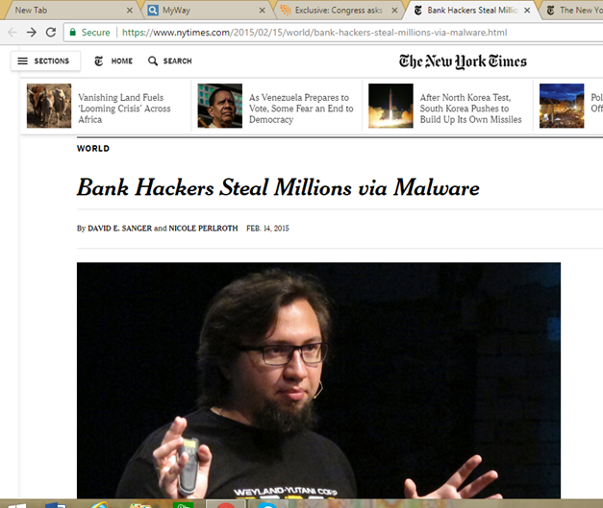

Slide 12
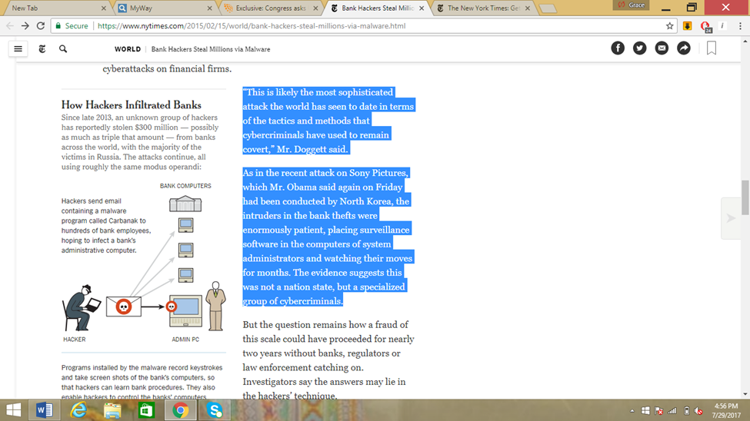
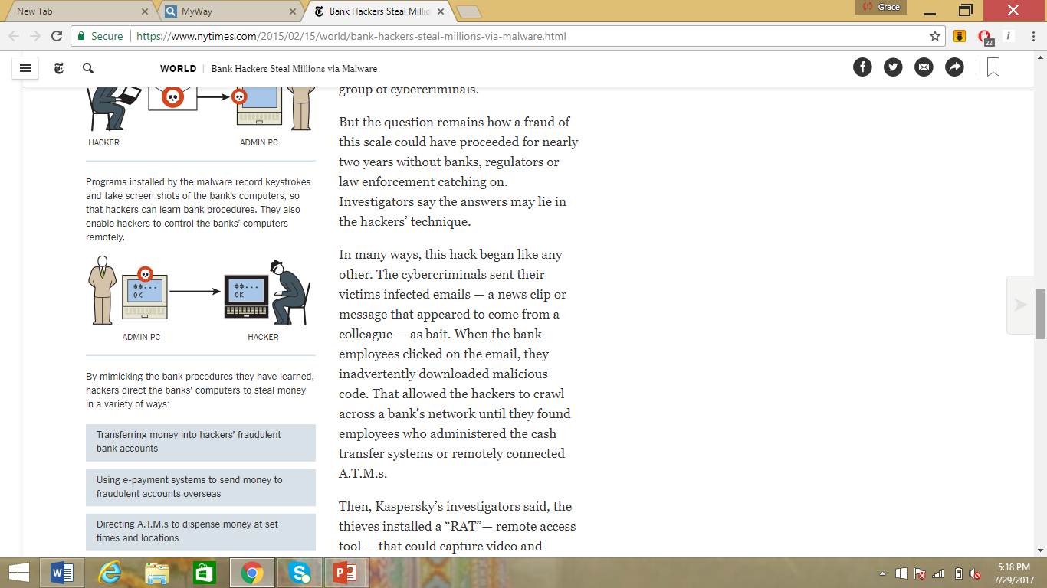

Slide 13
The “Budapest” Convention on Cybercrime of the Council of Europe
Opened for signature on 23 November 2001 in Budapest, Entered into force in 2004
Followed by Cybercrime Convention Committee (T-CY)
Open for accession by any State – 64 Ratifications so far (most recent ‘Peru’)
Sri Lanka ratified the convention in May 2015 [the first South Asian country and the second Asian Country (after Japan) to ratify the Convention]
Many more have used the Budapest Convention as a guideline for domestic legislation
As of today, the only International Treaty on Cybercrime and Electronic evidence

Slide 14
The “Budapest” Convention contd.
In concrete investigations
New and very innovative investigative tools
mainly when international cooperation is needed
when the crime under investigation is one of the offences described in the Convention
also in any other case, if the crime was committed by the means of a computer system or the evidence of the crime is recorded in digital storage
Minimum standard of crimes, intended to be common to all the countries in the world.
New channels to international cooperation
Innovative and exceptional provisions

Slide 15
Budapest Convention Contd.
The first time that international community made efforts to draft a universal treaty on cybercrime matters
Purpose - to be accepted by most of the States in the world
Each Party will be able to use it as a framework for international cooperation
International co-operation tools
Operational and procedural rules
Common to other international conventions
Some of them, very innovative

Slide 16
United Nations Convention on the Use of Electronic Communications in International Contracts
Entered into force on 01 March 2013
18 Signatories
Sri Lanka ratified it on 07th July 2015

Slide 17
Mutual Legal Assistance Treaties
Formal cooperation between two or more countries
Usually include provisions for gathering and exchange of information
Usually provide for situations in which requests may be refused
Usually provide for requirements that request for assistance must comply with

Slide 18
Mutual Legal Assistance Laws
Domestic Legislation may provide for mechanisms to cooperate with countries, whether or not there is an MLAT with them
These laws may contain provisions that enable cooperation in different areas, including realizing or making requests for expedited preservation of stored data, search and seizure of data, interception of content data and collection of traffic data
In Sri Lanka - Mutual Assistance in Criminal Matters Act No. 25 of 2002

Slide 19
Sri Lankan Statutes
Evidence (Special Provisions) Act, No. 14 of 1995
Mutual Assistance in Criminal Matters Act, No. 25 of 2002
Mutual Assistance in Criminal Matters (Amendment) Act, No. 24 of 2018
Electronic Transactions Act, No. 19 of 2006
Electronic Transactions (Amendment) Act, No. 25 of 2017
Payment Devices Frauds Act, No. 30 of 2006
Computer Crime Act, No. 24 of 2007

Slide 20
Evidence (Special Provisions) Act No. 14 of 1995
Section 07 - Notice to have access to inspect
Section 07(1)(a): The party proposing to tender such evidence shall provide the opposing party, a list of such evidence to be tendered by that party, together with a copy of such evidence or such particulars thereof, not later than forty-five days before the date fixed for inquiry or trial
Section 07(1)(b): Any party to whom a notice has been given under the preceding provision may, within fifteen days of the receipt or such notice apply to the party giving such notice, to be permitted access to the evidence ought to be produced, the machine, device or computer, used to produce the evidence or any records relating to the production of the evidence or the system used in such production.

Slide 21
Evidence (Special Provisions) Act No. 14 of 1995 Contd.
Section 07(1)(c): Upon receipt of the application to be permitted access to, and to inspect, the party proposing to tender such evidence shall, within reasonable time, but not later than fifteen days after the receipt of the application, comply with the request and provide a reasonable opportunity to the party applying, to have access to, and inspect, such evidence, machine, device, computer, records or systems, as is mentioned in the application.
Section 07(1)(d): Where the party proposing to tender such evidence is unable to comply, or does not comply with or where the parties are unable to agree on any matter relating to the notice or the application for access and inspection or the manner and extent of the inspection, the court may on application made by either party, make such order or give such direction, as the interests of justice may require.

Slide 22
Skype Case
The ruling of 19/02/2019 of the Belgian Court of Cassation in the Skype-case
The conviction of Skype has been affirmed
The Highest Belgian Court affirms the concept of jurisdiction developed in the Yahoo-case, which according to the Court is also applicable for traffic data and real time interception.
The plaintiff is prosecuted for failure to communicate the required information in accordance with Article 88bis of the Code of Criminal Procedure and for failure to provide technical assistance with the wiretapping measure of Article 90quater of that Code, but not for not having a technical infrastructure on Belgian territory.

Slide 23
Some practical issues regarding international cybercrime investigations
The level of knowledge and experience of police officers and prosecutors when reporting and filling charges to them could be of crucial importance for proper understanding of the case and for the timely and adequate actions to be taken in order to preserve and obtain evidence.
Police officers and prosecutors may need to seek additional assistance when needed, both from within “the house“ as well as from the outside, including cooperation and contribution by the victim who will naturally have an interest in solving the case.
Specifying the legal instrument used to seek assistance - Treaty, Convention or other instrument of cooperation.
Identifying clearly who is conducting the investigation/prosecution. Provide all necessary contact details and preferred means of communication.

Slide 24
Issues regarding international cybercrime investigations contd.
Lack of reliable reporting systems and centralized collection of statistics
Summarizing the case - provide a detailed outline of the case under investigation or prosecution, including a summary of the evidence that supports the investigation/prosecution. Explain rationale for evidence and actions being sought in regard to the on-going investigation.
Reference to the applicable national legal provisions – full text of all relevant legal provisions under investigation/prosecution, including applicable sentencing provisions.
Legislation not always in line with recognized international standards
Lack of collaboration with Service Providers

Slide 25
Issues regarding international cybercrime investigations contd.
Precise identification of the assistance being sought - what are you seeking exactly.
Provide the following information:
For witness statement/testimony:
Wherabouts of the person
National procedural rules related to the witnesses
The specific information and list of questions sought from the witnesses
For documentary evidence:
A clear indication of the documents to acquire
A clear indication as to the place where the documents/items/evidence can be found or the person or the entity which detains them

Slide 26
Issues regarding international cybercrime investigations contd.
Provide the following information:
For electronic evidence:
Specify as many details as possible related to electronic evidence to acquire, provide necessary technical information on sought evidence if available (server/system time, time framework, identification details such as IP and MAC addresses, email address, user account details, etc.)
Indicate the place and details where the assets can be found or the person or the entity which detains them

Slide 27
Issues regarding international cybercrime investigations contd.
Provide the following information:
For execution of a search warrant:
enclose valid search warrant issued by domestic judicial authority
provide precise indications of the places and objects to be searched
specify detailed rules to follow in executing the search
provide accurate indications on the evidence to be searched
For seizure/confiscation:
provide a copy of the valid seizure or confiscation order issued by the domestic judicial authority
precise indications of the items to be seized/confiscated
indicate any specific rules if needed in executing the search

Slide 28
Issues regarding international cybercrime investigations contd.
Provide the following information:
For special investigative measures:
provide a copy of the valid warrant for SIMs issued by the competent domestic judicial authority
specify the scope and nature of actions to be taken
specify the special conditions to be observed – identity/anonimity of undercover agents, technical and logistics requirements, covering of costs and expenses, channels of communications specified, etc.

Slide 29
Issues regarding international cybercrime investigations contd.
Highlight any specific confidentiality requirements.
Set out and specify urgency level in the execution of the request as well as the time limits.
Proper and as accurate as possible identification of the suspect(s) – bear in mind this is a virtual world – identity could be easily hidden, altered, stolen.
Proper identification and of prioritization evidence to be requested by MLAT – setting up priorities – choosing only the vital ones for the investigation – rationalisation of resources and increasing efficiency.

Slide 30
Issues regarding international cybercrime investigations contd.
Identifying appropriate point of contact in other countries – 24/7 points in light of Budapest Convention, Interpol channels, etc. – especially for “hot pursuit” cases where immediate action is to be taken in order to secure and preserve digital data (electronic evidence).
Needs to have an effective coordination of cross-border cybercrime investigations
Establishing informal contacts with appropriate counterparts prior to submitting formal MLAT in order to inform them about the upcoming MLAT, conducting operational checks in order to specify the request as detailed as possible.

Slide 31
Issues regarding international cybercrime investigations contd.
Making sure the jurisdiction was properly identified in terms of where evidence/offenders/victims are located bearing in mind purely technological matters such as ownership of electronic data, server/provider physical location and legal residence of the server/provider owner(s) – i.e. servers located in one country or cloud-computing case with owners registered and operating from different jurisdiction.
Different time zones – difficulties in establishing contacts even when using modern means of communication (i.e. teleconferences) – it could delay investigation/MLAT requests and increase of costs – there are still police and prosecution offices with no access to international phone calls!

Slide 32
Issues regarding international cybercrime investigations contd.
Translation of documents – many states require MLATs translated into their official language(s).
Language barriers during direct and informal contacts between law enforcement officials, prosecutors and judges.
Be prepared for delays due to the different importance levels of cybercrime investigations in different countries.
Consider providing technical and expert support if requested party has no own capacities to execute your request.

Slide 33
Issues regarding international cybercrime investigations contd.
Consider requesting and deploying conventional/ traditional investigative tools and measures whenever possible – police officers/prosecutors more used to it, could sometimes equally serve the purpose and provide sufficient evidence for successful investigation and criminal proceeding.

Slide 34
Issues regarding international cybercrime investigations contd.
Most problems are related to procedural law
Implementation of the procedural law provisions
General powers Vs. specific measures
Need to fully implement the Budapest Convention
Additional Protocol will largely be built on existing provisions and standards
Need new measures and additional safeguards
Cooperation with the EU Member States –data protection

Slide 35

THANK YOU!

