Slide 1
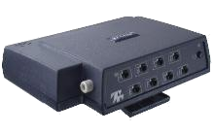
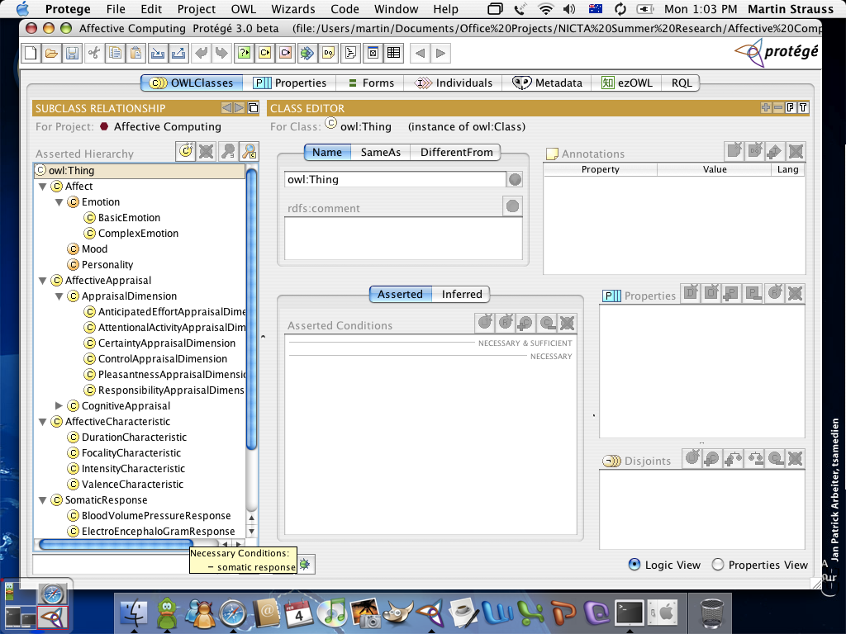
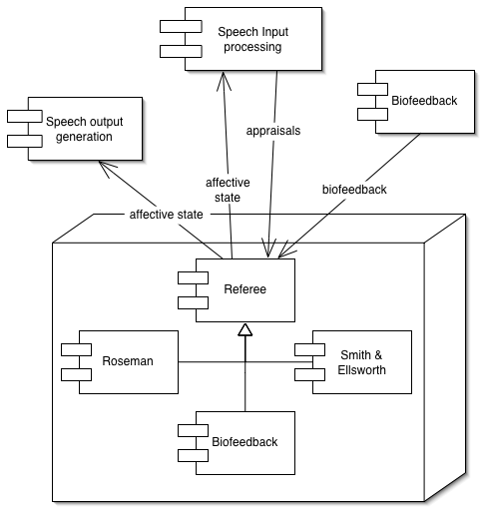
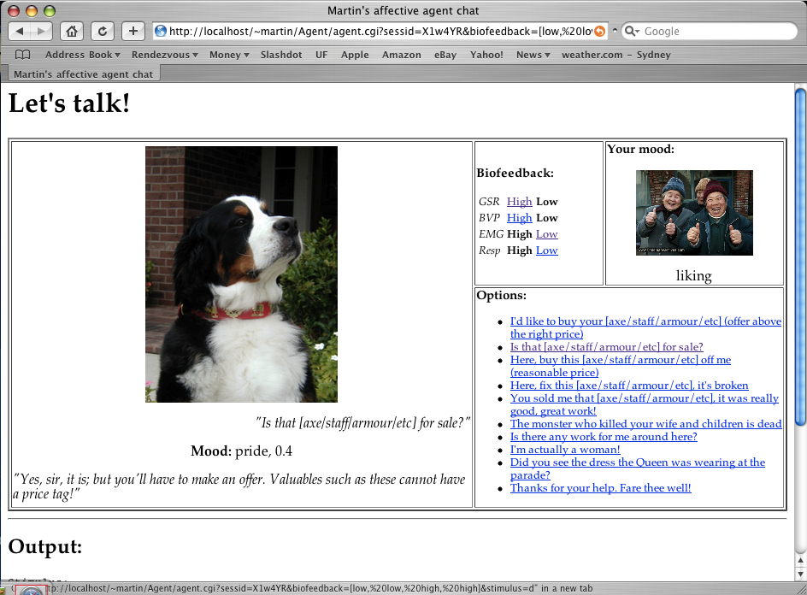

2005
The Logics of Emotion
A survey of the field of Affective Computing
Martin Strauss
Supervisor: Maurice Pagnucco, School of CSE, UNSW, and KRR program, NICTA
What is Affective Computing?
As computing devices become more common, affordable and miniaturised, one can imagine a future in which such devices are capable of adapting and responding to user needs by being aware of the user's mental and emotional state. For example, if a device determines that the user is stressed, it adapts its behaviour to present information in a more terse manner whereas if it senses that the user is relaxed, the information can be presented in a more verbose way.
This project investigated the types of concepts that need to be represented in order to model users' mental and emotional states. In particular, to consider what sorts of information can be gathered about the user, how this can be represented, and how such representation might be used for the purpose of reasoning to infer information about the users' mental and emotional state.
Cognitive Appraisal Models
We can determine the likely emotions in a given situation by appraising the situation according to a model such as:
Ortony, Clore and Collins 1988, Roseman 1996 et al
Cognitive appraisals of a situation:
  Motive-consistent vs. motive-inconsistent
  Self-caused vs. other-caused vs. circumstance-caused
  Appetitive goal vs. aversive goal
  High vs. low control potential
  Characterological vs. non-characterological event
Smith and Ellsworth 1985, Baillie-de Byl 2003 et al
Appraisal dimensions of a situation:
  Pleasantness
  Anticipated effort
  Attentional activity (scale from attractive to repulsive)
  Certainty
  Degree of self-control (vs. other-control)
  Degree of human control (vs. situational control)
Models of Emotion
Sensing a user’s affective state
Biofeedback
Devices such as the ProComp Infiniti+ (above) and the TekScan Body Pressure Measurement System can gather biological data such as:
  galvanic skin resistance (related to emotional arousal)
  blood pressure (related to positive or negative valence)
  EEG patterns (showing brain activity)
  EMG patterns (showing muscle activity)
  respiration rate and amplitude, and
  muscle pressure against a chair, keyboard or mouse, etc.
Facial Expression Recognition
Systems such as FACS (Ekman & Friesen, 1977) can classify individual images or video clips of a face according to regions of movement density in the image; patterns correspond to the emotion being portrayed by that face.
Gesture Recognition
Posture and head and eye movement can also indicate a user’s emotional state; these can be detected by systems such as the TekScan BPMS and Seeing Machines FaceLAB.
Vocal Prosody Recognition
Two kinds of affective cues:
  emphasis on the important parts of speech
  subtle overall cues to the speaker’s affect.
The Ontology
Concepts
Affect
  Emotion
    BasicEmotion
    ComplexEmotion
  Mood
  Personality
AffectiveAppraisal
  CognitiveAppraisal
  AppraisalDimension
SomaticResponse
AffectiveCharacteristic
Relationships
hasAffectiveProperty / isAnAffectivePropertyOf
  hasCharacteristic / isACharacteristicOf
  hasSomaticResponse / isASomaticResponseOf
  hasCognitiveAppraisal / isACognitiveAppraisalOf
  hasAppraisalDimension / isAnAppraisalDimensionOf
consistsOf/isAPartOf
isLikelyWhen/tendsTowards
Taste of Research Summer Scholarship Program
The Affective Shopkeeper
The Affective Shopkeeper is a conversational agent system demonstrating an application of the ontology. It takes the form of a NPC shopkeeper in a hypothetical role-playing computer game. The architecture of the system is shown at right.
Conversation takes the following form:
The biofeedback module reads the user’s emotion
The dialogue input module gets an utterance from the user
The referee module uses the knowledge base modules to determine the agent’s current mood
The dialogue output module uses the current mood and the user’s utterance to determine an appropriate response.
A sample interaction is shown at left.
UNSW
ENGINEERING @ UNSW

