Slide 1

Project Icarus
  CCD Camera Control Software
  Developed by Team U
Notes:
Hello and welcome, or something
We're Team U, this is Dave, Aditya and I'm Martin

Slide 2
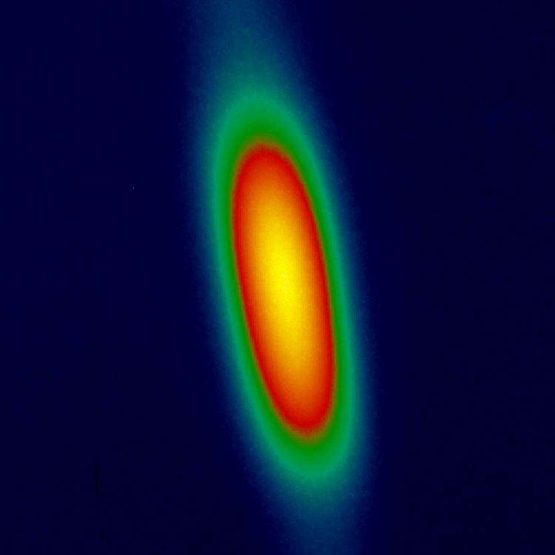
Outline
Our Client
Our Client's Problem
Our Solution
Challenges faced during the project
  Challenges faced during Design
  Challenges faced during Coding
  Challenges faced during Testing
What we learnt from this project
Notes:
We're going to introduce our client, the problem and our solution
Aditya's going to talk a bit about our design and the implementation
and Dave's going to talk a bit about the testing of our project.
We'll talk a bit about things we learnt from this project,
and then we'll have time for some questions.

Slide 3
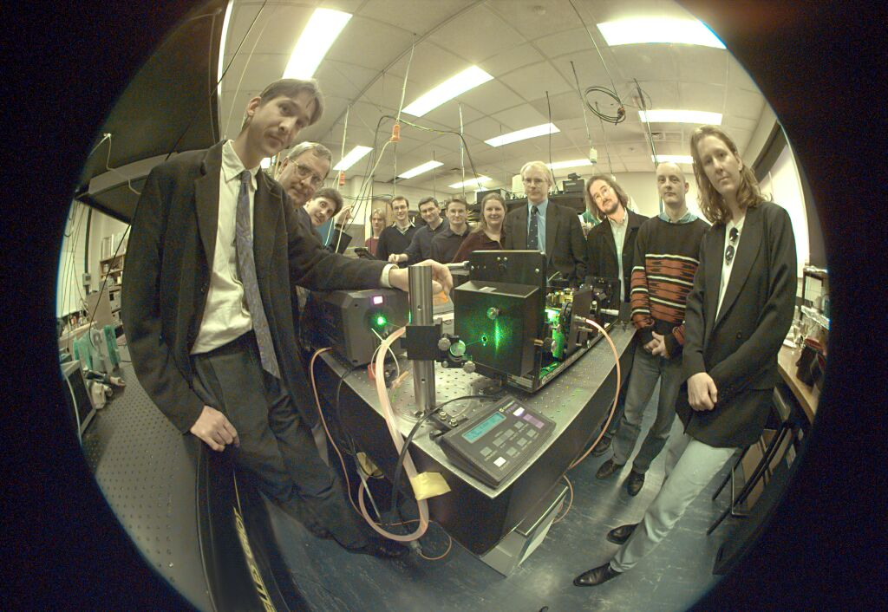
Our Client
Associate Professor Robert Scholten
Atomic Optics Group, School of Physics
Notes:
Our client was the Atomic Optics Group in the School of Physics
in particular Associate Professor Robert Scholten
He's come here to hear us today, i'll point him out and embarrass him...

Slide 4
Notes:
Here's a better photo of Rob, on the left, and the rest of the Optics Group.

Slide 5
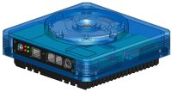
The Problem
CCD cameras (Roper, and now mainly Apogee)
CCD = “Charged Coupling Device”
IDL for maths, but not image capturing
Maxim for image capturing, but not maths
Need to connect the functionality
Notes:
Among other research, the Optics Group use CCD cameras to take images of gas clouds, and clouds of atoms.
CCD stands for Charged Coupling Device, basically it's a chip that takes an image, they're in every digital camera, this one's just much higher quality (and more expensive!)
The CCD cameras are made by Roper and Apogee
they have new Apogee cameras, this is a picture of one here. (you put the lens on here, etc)
This camera connects to the computer via USB 2.
The problem is this:
IDL is the best way to analyse and do maths on the captured images, but it can't talk directly to the camera;
Software that can talk directly to the camera, Maxim, has very limited image processing and analysis capabilities.
Our task was to connect the camera and IDL somehow.

Slide 6
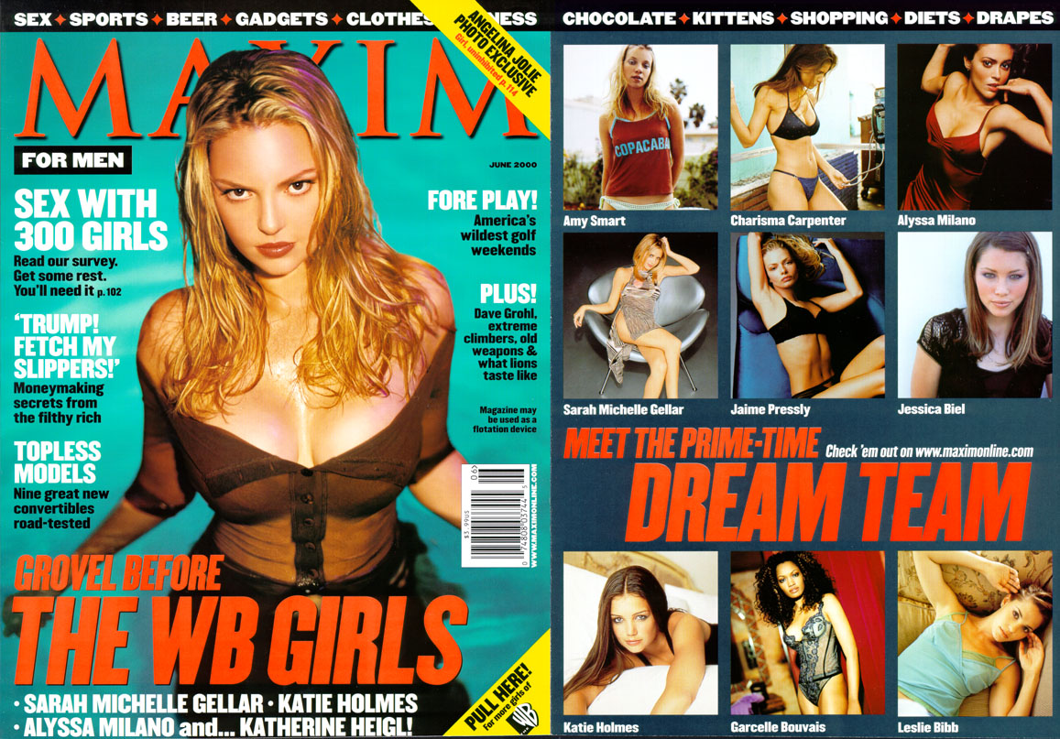
Maxim
Notes:
This is the Maxim you're probably more familiar with, but...

Slide 7
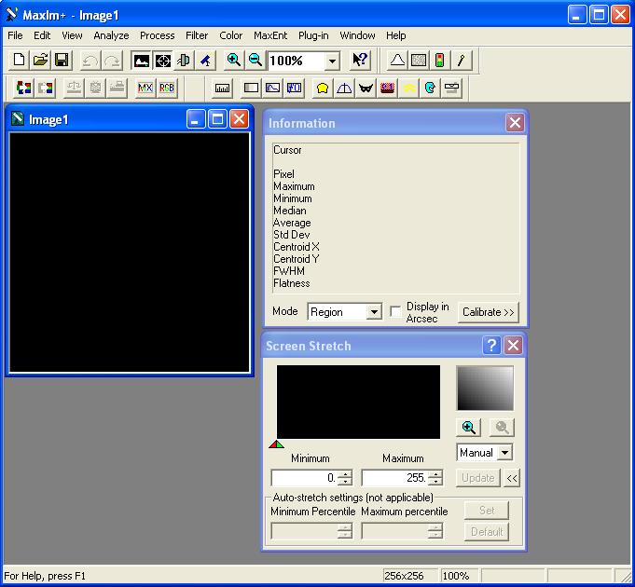
Maxim
Notes:
This is really Maxim, here's the image preview window, and you can see a few image manipulation functions, but not much.

Slide 8
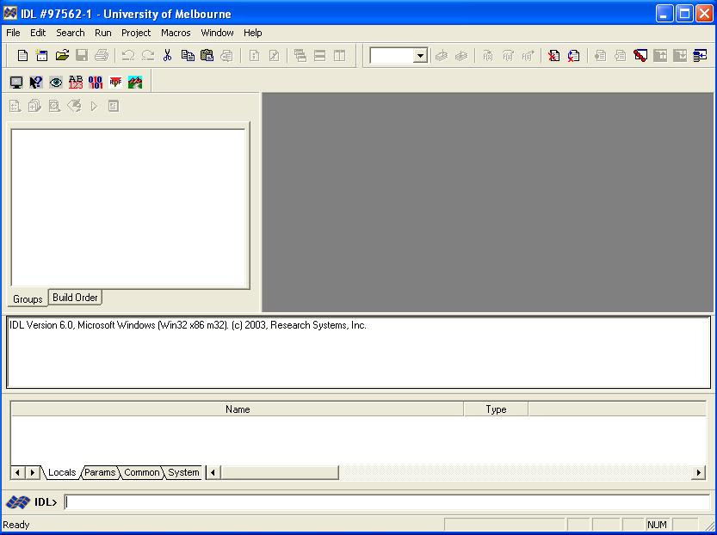
IDL
Notes:
This is IDL.
Some of you might have used it already;
It's a combined command-line interpreter and IDE, sort of like Matlab, which some of you will also have used.
You can type commands in HERE,
view the output HERE
see variables HERE
and this bit is for projects, you have all your code files in HERE, and you can open and edit them in THIS space.

Slide 9
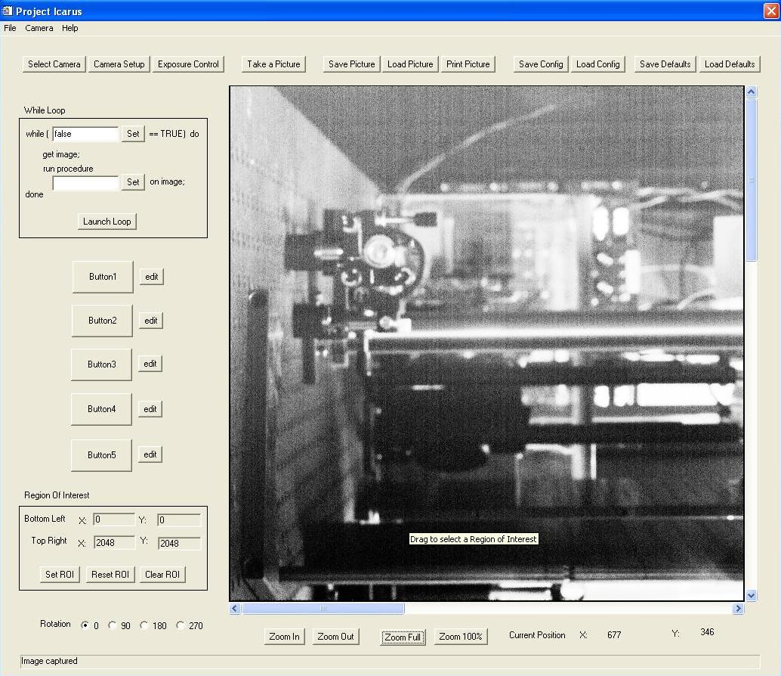
Project Icarus
Notes:
This is the GUI frontend to our software.
Cue video
commentary

Slide 10
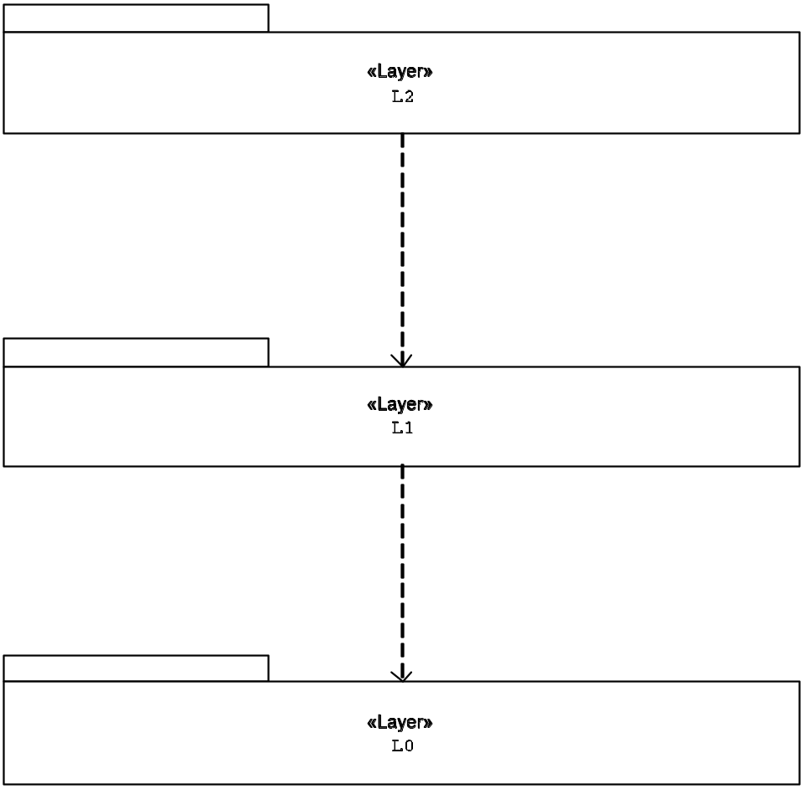
Design
HAL in C++ to interface with camera driver
HAL wrapper in IDL
GUI for common functions

Slide 11
Design Challenges
IDL capabilities / limitations (as a language)
  Object Oriented? well...
  Error handling
COM component handling in IDL
IDL documentation
  Incomplete, inconsistent, unhelpful
  wrong level of detail
  lack of code examples

Slide 12
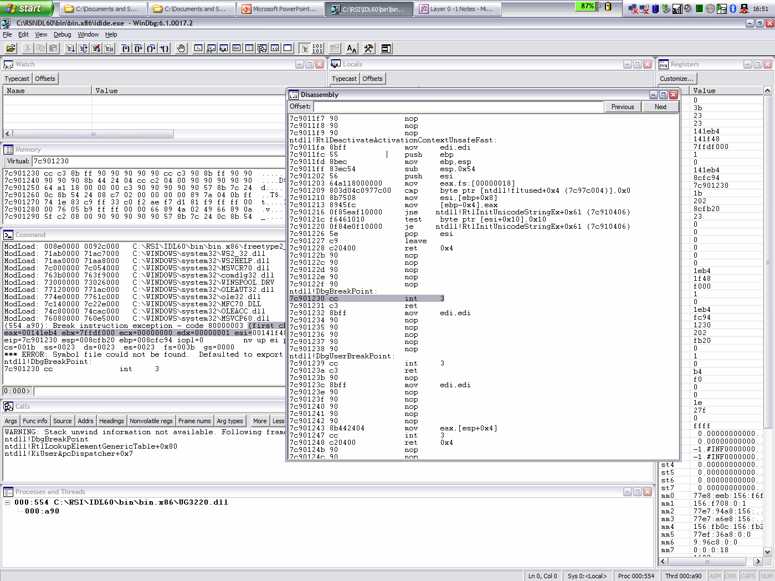
Disassembled IDL

Slide 13
Coding Challenges
IDL limitations as a IDE
  No memory protection
  Annoying editor - difficult to follow our own formatting guidelines
IDL GUIbuilder limitations
  lack of support for all widget functionality
  need to manually edit “do not manually edit these files” files
Need to code with access to camera (ie, access to the lab)

Slide 14
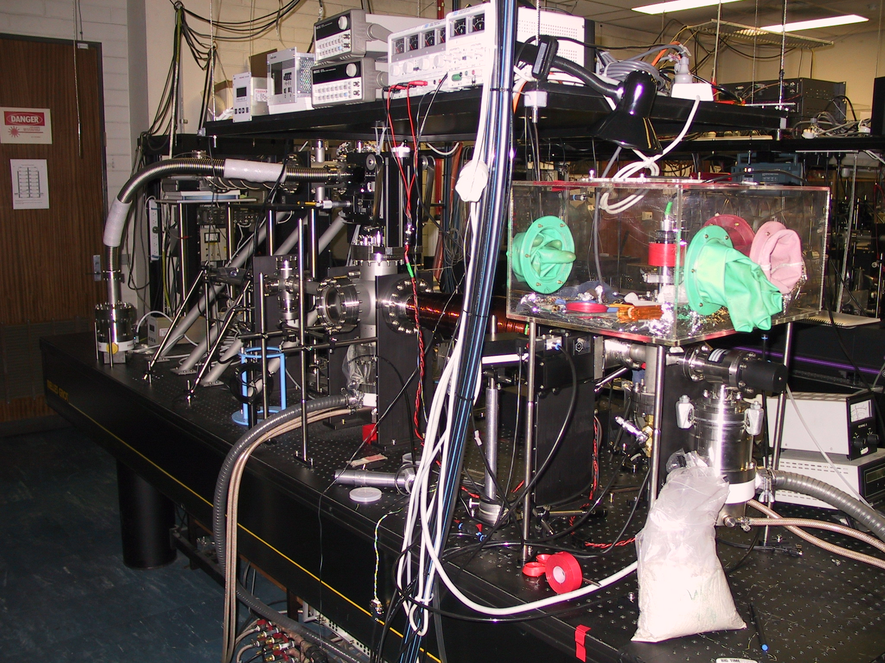

Slide 15
Testing Types
Layer 0
  Code Reviews
  Function Testing
Layer 1
  Code Reviews
  Functional Testing (GUI)
  Stress Testing
Layer 2
  Code Reviews
  Sequence Testing

Slide 16
Function Testing
Mostly undertaken in Layer 0 testing
GUI function tests in Layer 1
Test harness written to simplify testing for L0
  IDL Procedure with Breakpoint
  Run Layer 0 functions from command line
Several testing methods employed for testing
Equivalence Class testing used heavily

Slide 17
Stress Testing
Tested both L0 functionality and L1 data structures
1000 loop iterations
  1000 Pictures exposed and retrieved from camera
  5000 Other calls to camera, changing/retrieving information
  Approx run time 1hr 45min
Test driver written to call pseudo-random L0 functionality interfacing with CCD camera

Slide 18
Testing Challenges
Need access to the camera (and lab) to test
  Only one camera, only one computer
  No concurrent development possible!
Input/Output domains
  sometimes just an effect on or attribute of the camera

Slide 19
Project Status
Handed to client
Acceptance testing passed
Client happy!
Notes:
We handed the project to the client on Monday afternoon
All acceptance criteria were met
The client is very pleased with our work!

Slide 20
What We Learnt
Risk identification
  IDL limitations - risk of having to redo work
  Prototype early
  Don't believe documentation
  Do Risk Management first, not later
Config Management/Change Control
Notes:
Risk identification is a key part of the project management
We began serious risk management procedures quite late in the project.
Key risk that we overlooked – the fact that we didn't know IDL
Didn't understand limitations, needed to redo lots of design and some implementation work in the end
Our configuration management could also have been better
a few occasions where code regressed due to bad change management procedure

Slide 21
What We Learnt
Goals and deadlines
  Smaller and sooner is better
Task allocation
  Don’t let one person run away with a task!
  Email task allocation/tracking system
Daily “objectives meetings” during holidays
  Short, achievable goals
  Everyone knows where the project stands
Notes:
Learnt a lot about delegation of tasks
Smaller goals and earlier deadlines are always better – less risk impact if they're left incomplete, and easier to chase up
Don't let one person disappear with lots of the code for months at a time!
Not all doom and gloom – we had some successful procedures too
After trying lots of task tracking software etc, we decided on an email-based task management system
Denis wrote a template, and PM and XO mailed out tasks and we replied to the emails with hours and status. Much quicker and easier than any of the other systems
Daily meetings in holidays meant we got lots and lots done – we could set day-by-day goals, and we also all knew what had been done the previous day and what had to be done the following day

Slide 22
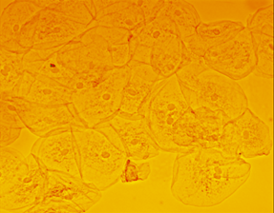
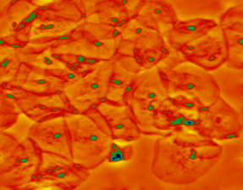
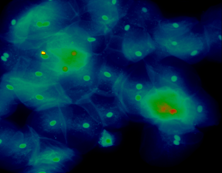
Wrap up
Questions?
Cell Walls
Nuclei
Nuclei
50 µm
50 µm
50 µm
Notes:
Well, that's it for our 340 project...
Any questions?

