Slide 1
Patterns in a
Security Alarm System (SAS)
AGENDA
Domain Model
The Patterns
  Iterator
  Observer
  Abstract Factory
  Singleton

Slide 2
Security Alarm System (SAS)
Domain Model
Observable Item
Monitoring
Authority
Notify()
Door
Window
Room Temp
Monitoring Co.
Police
Fire
Owner
Sensor
Observes
Triggers
EVENT
Break In
Thermostat
Motion Detector
Attach(Observer)
Detach(Observer)
Notify()
Trigger()
Notifies
Magnetic Switch
Smoke Sensor
Open Event
Break Event
Temp Event
Smoke Event
Notes:
We have observable items. Examples are Doors, Windows, etc. Each item has a sensor that detects something specific on the item. Examples are Break-in glass, Magnetic Switch, etc. The sensors observe the items. When something changes on the item, the sensor triggers an event. Examples of those events are Open, Break, etc. When an event is triggered it notifies a specific monitoring authority according to the sensor configuration. Examples are the Owner or the Police Dept.

Slide 3
ITERATOR PATTERN
Applicability
Access an aggregate object's contents without exposing its internal representation.
Support multiple traversals of aggregate objects.

Slide 4
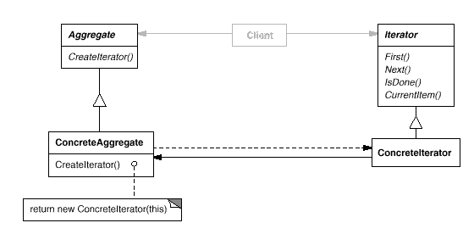
ITERATOR PATTERN

Slide 5
ITERATOR PATTERN in SAS
Abstract List
Iterator
CreateIterator()
Count()
AppendItem()
RemoveItem()
First()
Next()
IsDone()
CurrentItem()
Zone List
ZoneIterator
Sensor List
Zone
SensorIterator
Sensor

Slide 6
OBSERVER PATTERN
Applicability
When a change to one object requires changing others, and you don't know how many objects need to be changed.
When an object should be able to notify other objects without making assumptions about which objects they are.

Slide 7
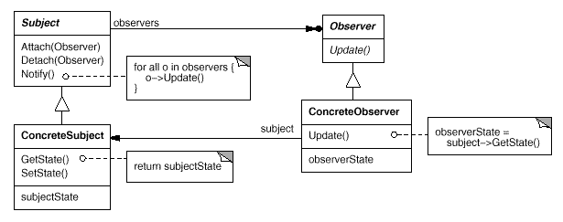
OBSERVER PATTERN

Slide 8
OBSERVER PATTERN in SAS
EVENT
observers
Monitoring
Authority
Attach(Observer)
Detach(Observer)
Trigger()
for all o in observers
o.Notify()
Notify()
Open Event
Break Event
Temp Event
Smoke Event
Monitoring Co.
Police
Fire
Owner
Notes:
Events observe o

Slide 9
ABSTRACT FACTORY PATTERN
Applicability
A system should be independent of how its products are created, composed, and represented.
A system should be configured with one of multiple families of products.

Slide 10

ABSTRACT FACTORY PATTERN

Slide 11
ABSTRACT FACTORY PATTERN in SAS
Sensor
Sensor Factory
Break In
Thermostat
Motion Detector
CreateSensor()
CreateEvent()
Magnetic Switch
Smoke Sensor
Window Sensor
EVENT
Attach(Observer)
Detach(Observer)
Trigger()
Door Sensor
Open Event
Break Event
Temp Event
Smoke Event
Notes:
Events observe o

Slide 12
SINGLETON PATTERN
Applicability
There must be exactly one instance of a class, and it must be accessible to clients from a well-known access point.

Slide 13
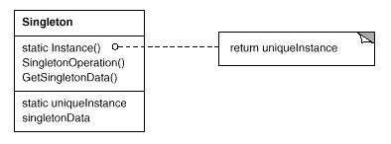
SINGLETON PATTERN

Slide 14
SINGLETON PATTERN in SAS
SAS <<controller>>
static myInstance
static getInstance()
return myInstance

