Slide 1
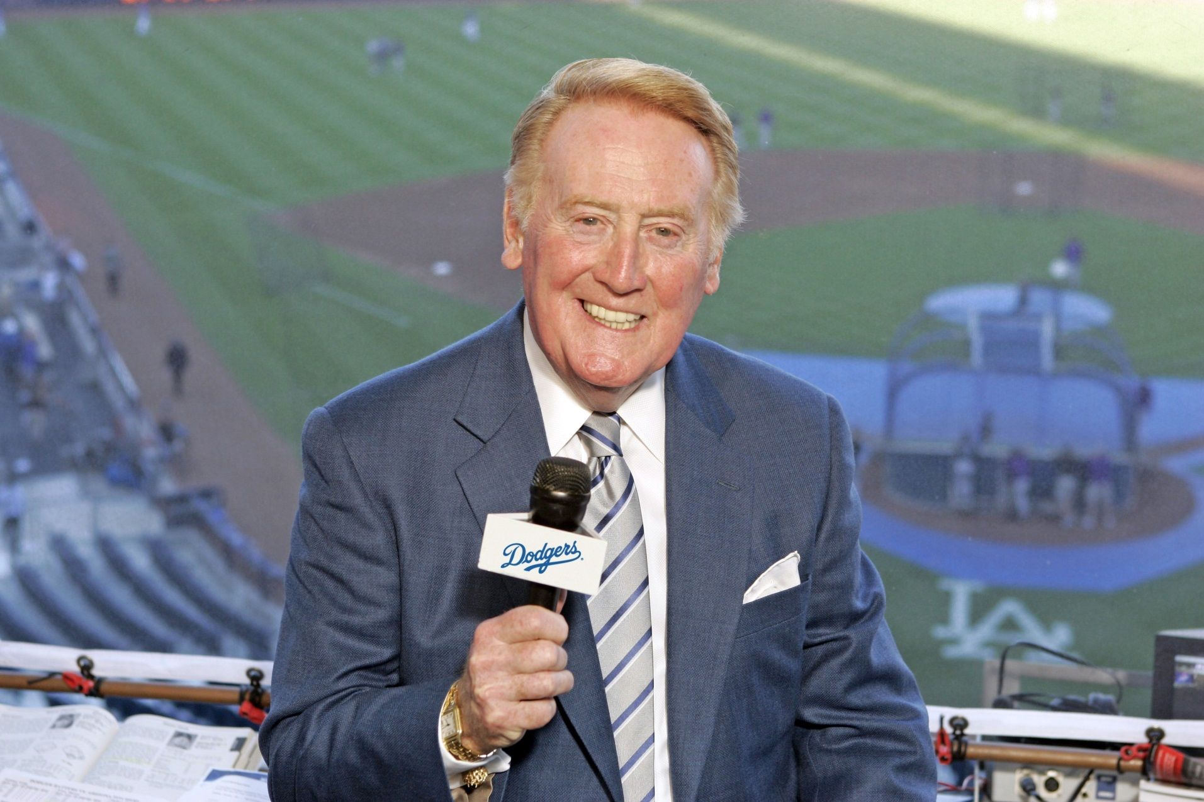
Brian Cano
“It’s Time for Dodger Baseball” (and Python)

Slide 2
Salary vs Wins
Is there a relationship between team salary and regular season wins? (yes)
Are the Dodgers efficient or not?
Do they appear to be outliers?
Choices of baseball data:
Google Cloud (BigQuery REST API); actively managed
The Lahman Baseball Database (data warehouse of .csv files)

Slide 3
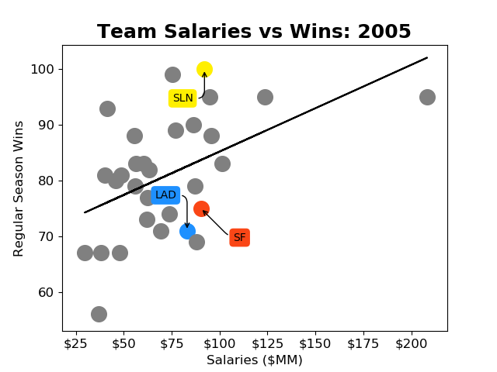
Seasonal Regression Analysis
.csv to pandas dataframe to matrices
NaN removal and indexing
Matplotlib for plotting
Linear regression from scikit-learn
Team-dependent colors
(x, y)-dependent colors

Slide 4
Seasonal Regression Analysis
Genius front offices
Talented players delivering
Overpaid bums
Cheap losers

Slide 5
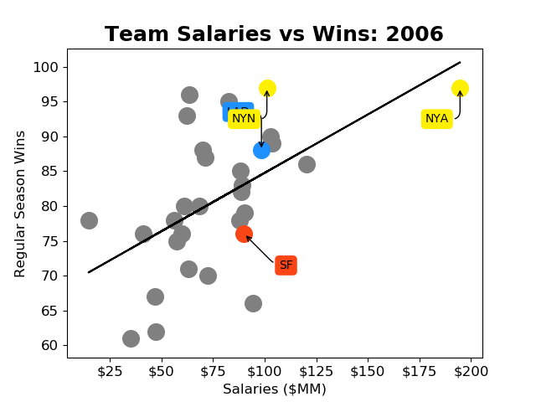
Seasonal Regression Analysis

Slide 6
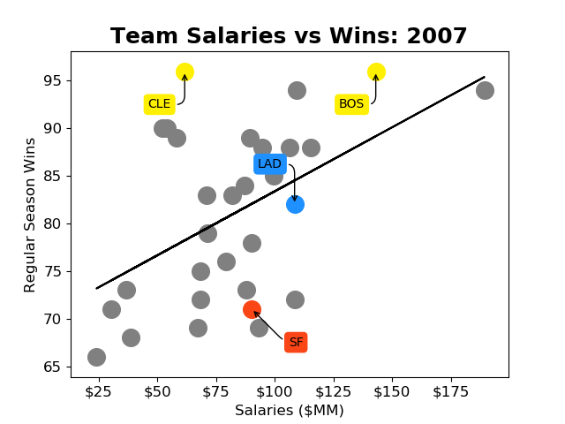
Seasonal Regression Analysis

Slide 7
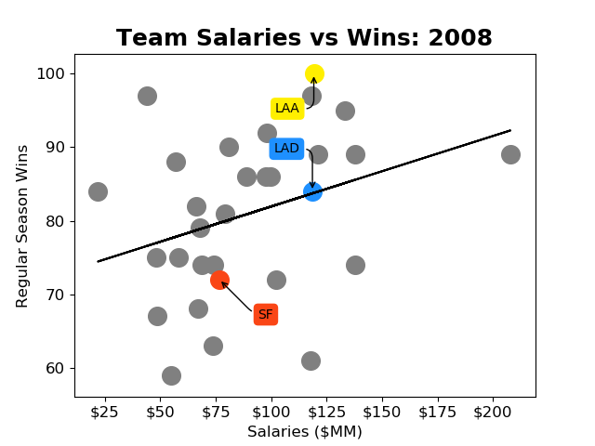
Seasonal Regression Analysis

Slide 8
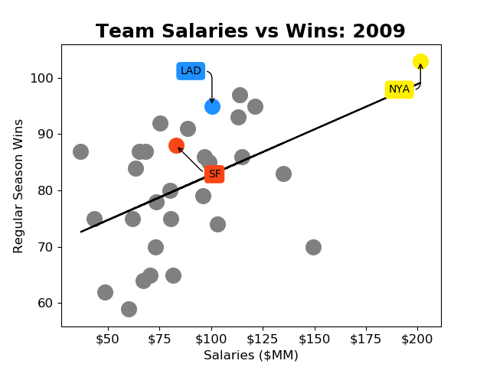
Seasonal Regression Analysis

Slide 9
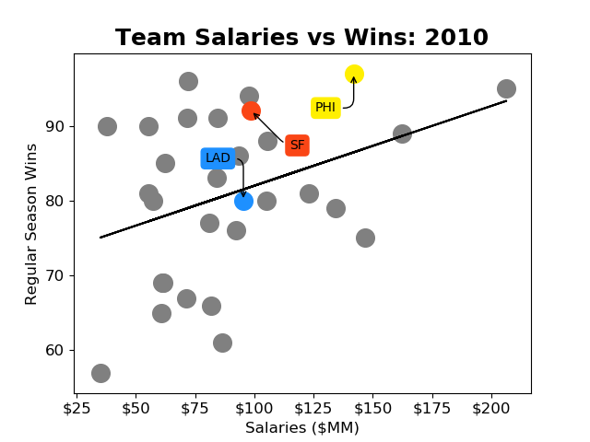
Seasonal Regression Analysis

Slide 10
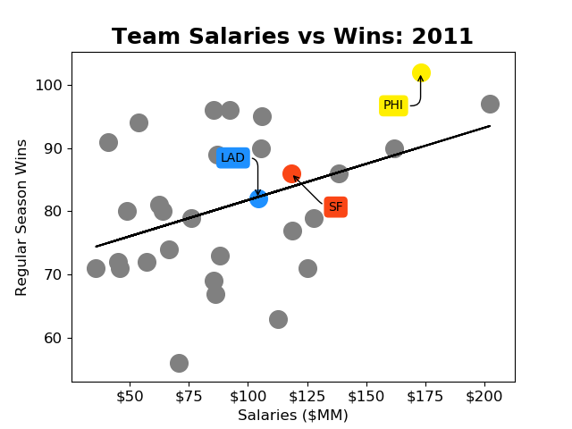
Seasonal Regression Analysis

Slide 11
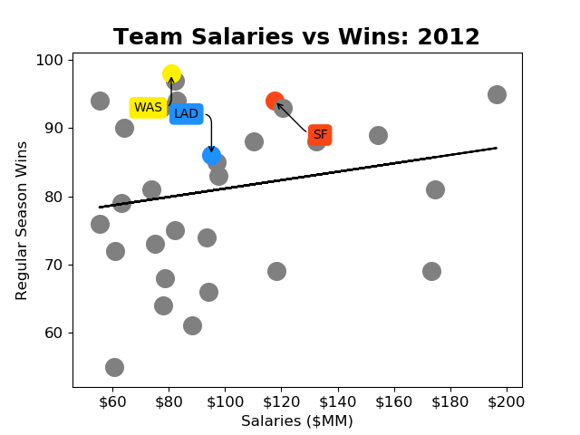
Seasonal Regression Analysis
MLB forced sale; new new ownership mid-season

Slide 12
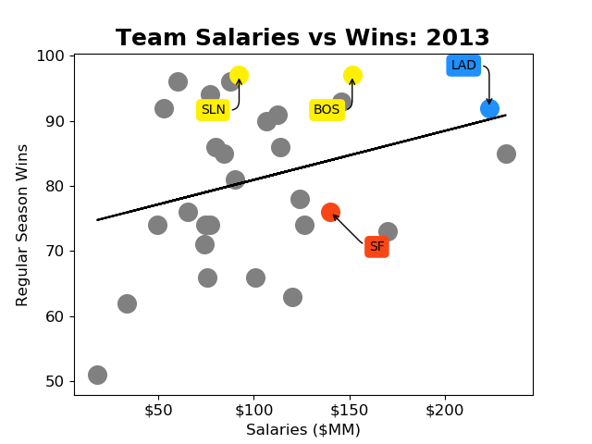
Seasonal Regression Analysis

Slide 13
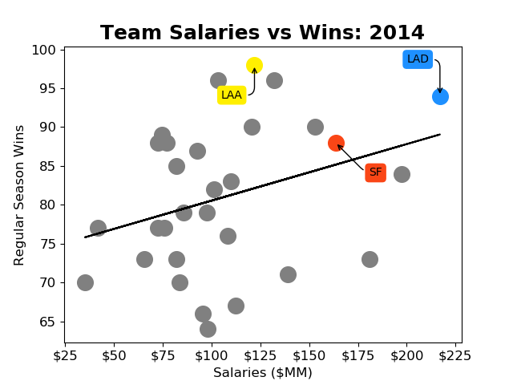
Seasonal Regression Analysis

Slide 14
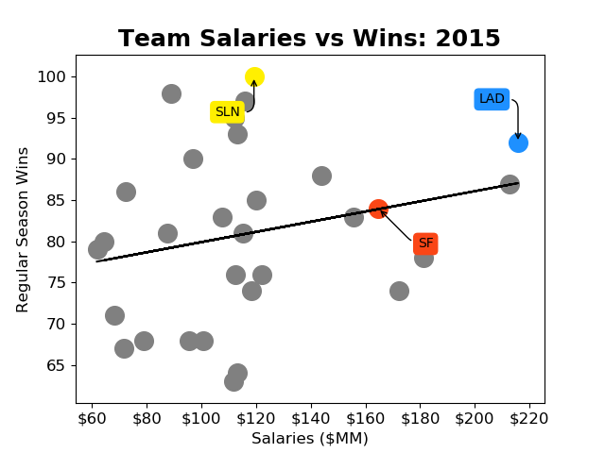
Seasonal Regression Analysis

Slide 15
Seasonal Regression Analysis

Slide 16
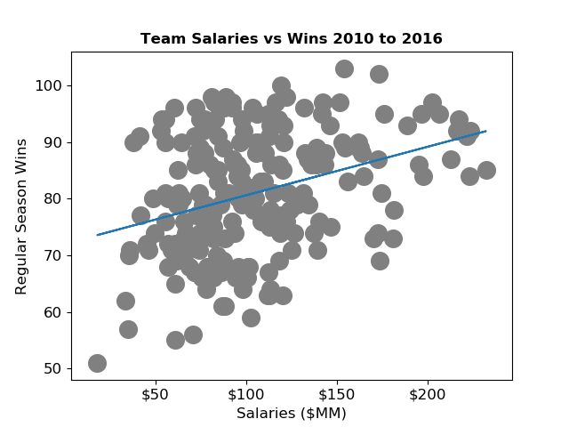
Regression Analysis over Multiple Seasons

Slide 17

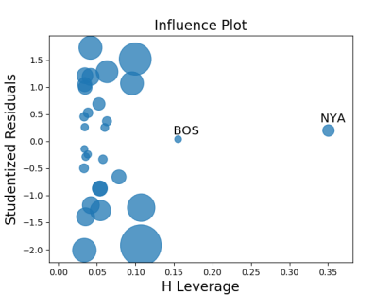
Looking for tools
predictive
scikit-learn from sklearn.linear_model import LinearRegression
Confidence intervals? Outliers?
Also: Goodness of fit
Influence Plot
statsmodels API
Ordinary least Squares
in-sample statistics

Slide 18

Influencers for 2010 Season
Influencers (high leverage)but not outliers

