Slide 1
2ND discussion ON Quality Factor
Junjie Wang
Qnx8538
3/1/2023

Slide 2
Outlines
Recap from last time
Admit my mistake
Low field limit
High field approximation
High field zT approximation form and its B factor
Supp. Integrations in High field limit
Some Discussion on my B factor

Slide 3
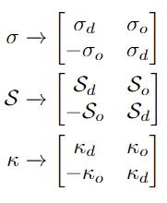
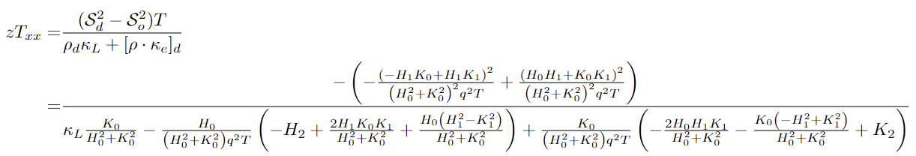
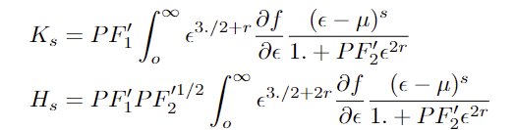
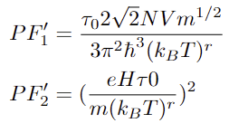
Recall From Last Slides
Lorentz Force generates non-dissipative current additional to the original one.
so
For zT changing with H field, if we focus on diagonal zT
In Higher Temperature, Phonon scattering dominates
Assigned r = -1/2, and I will continue on with this value.

Slide 4
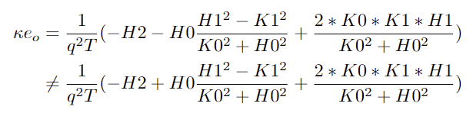
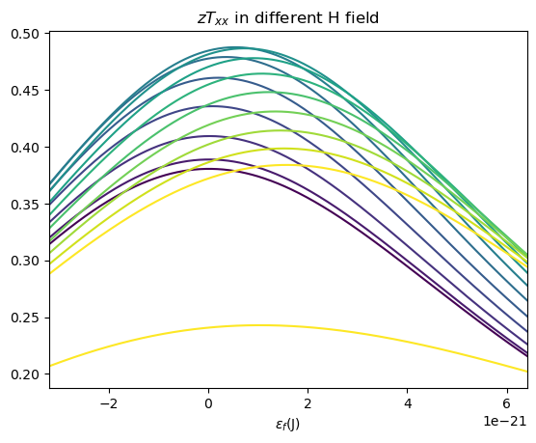
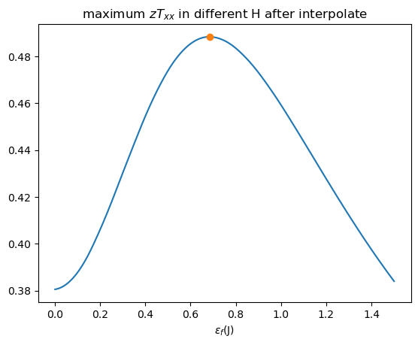
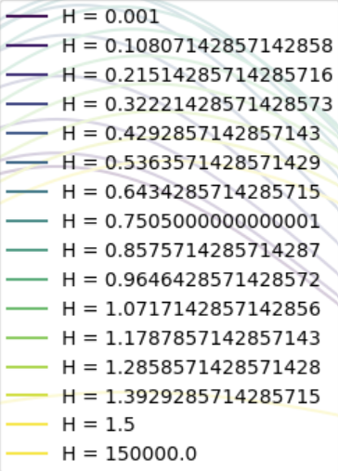
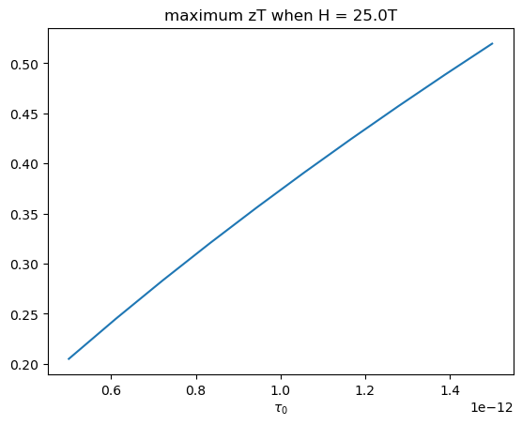
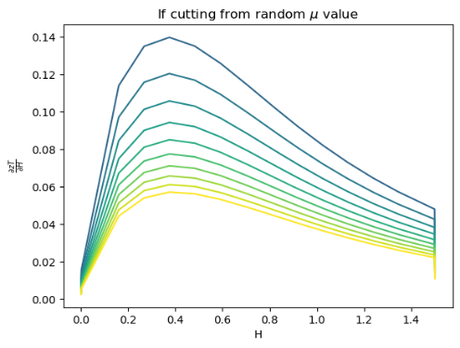

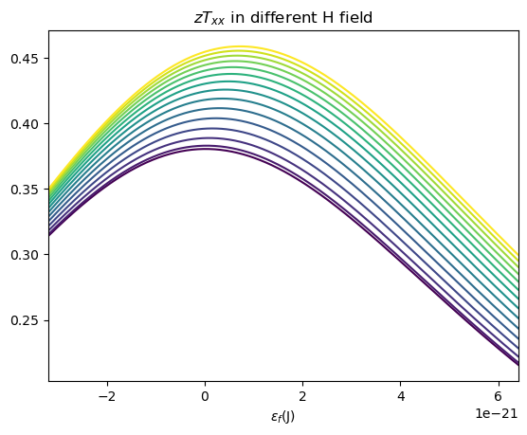
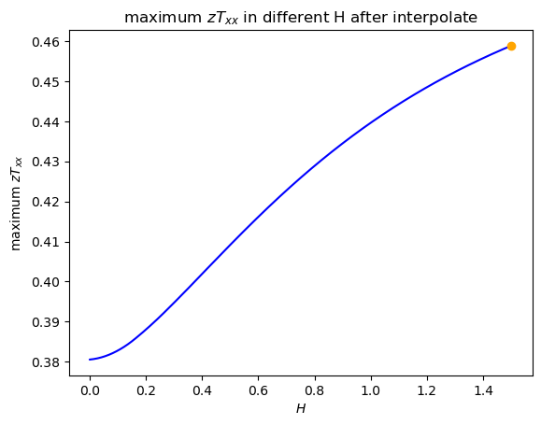
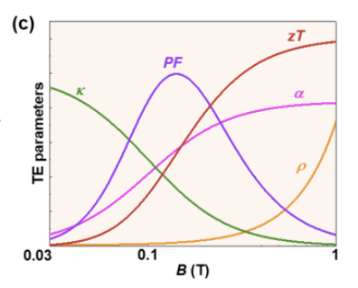
About my Mistake
Incorrect
Should be
DOI: https://doi.org/10.21203/rs.3.rs-3066848/v1
H

Slide 5
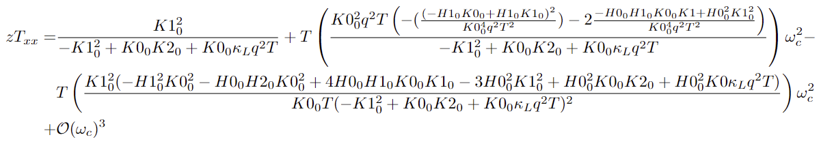
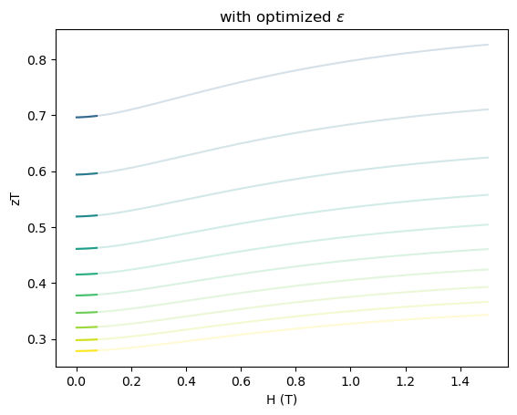

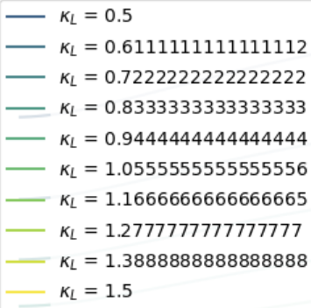
Low field Approximation
zT with different material properties are disjoint functions

Slide 6
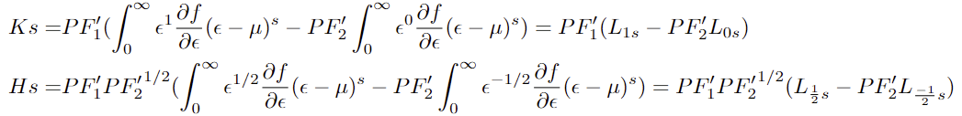
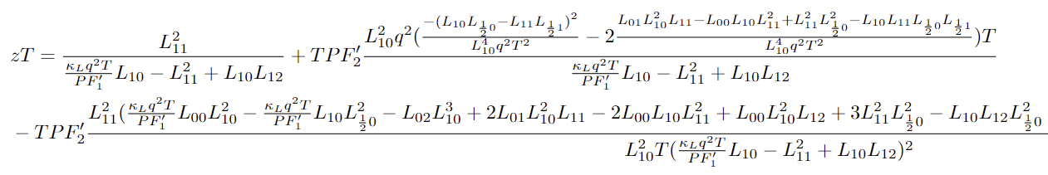
Check availability
Integral approximate:
zT can be expand as:
Not canceled that well simply from analytical form

Slide 7
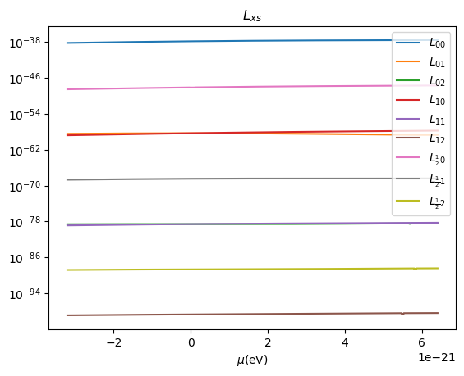

Slide 8
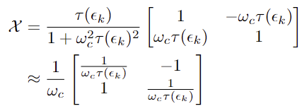
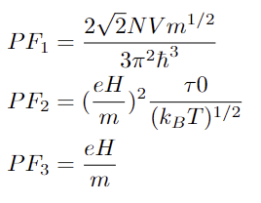
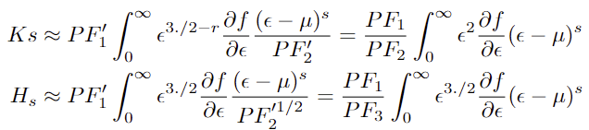
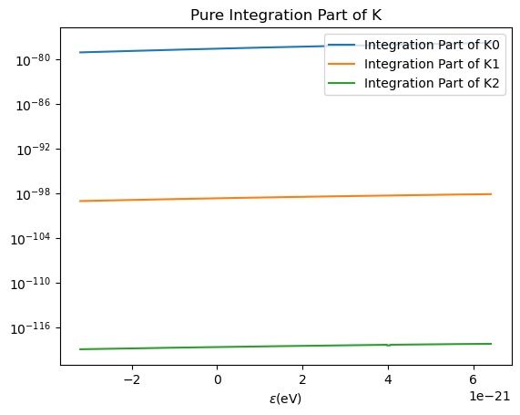
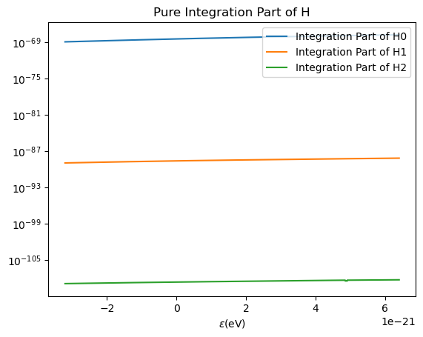
Higher Field Approximation
1. Tensor Approximation
2. Integration Approximation

Slide 9


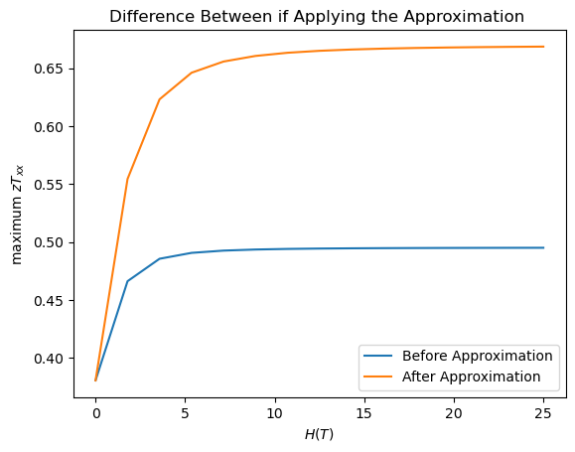

Some Additional Approximation to higher H field and Quality factor from that
Since we know zT will converge to some value in the High B field in this model, why don’t we make some crazy simplification
It looks crazy but it leads to a Quality Factor from
One clear Issue about this is the
H field dependence, but since that is
not one of material properties.

Slide 10


Some Discussion on the Quality Factor
Compare with Stephen Kang’s Quality Factor
Other looks fine but the scattering constant goes to the denominator, that may due to the high field approximation
Not Sure if I can “take it back” to:

