Slide 1
3rd discussion ON Quality Factor
Junjie Wang
Qnx8538
6/13/2023

Slide 2
Outlines
Recap from last time
Slop of change in zT wrt ext H
High field quantization
B factor in carrier transport parallel to ext H
B factor in carrier transport perpendicular to ext H
Try bipolar conduction condition

Slide 3
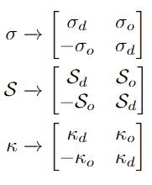
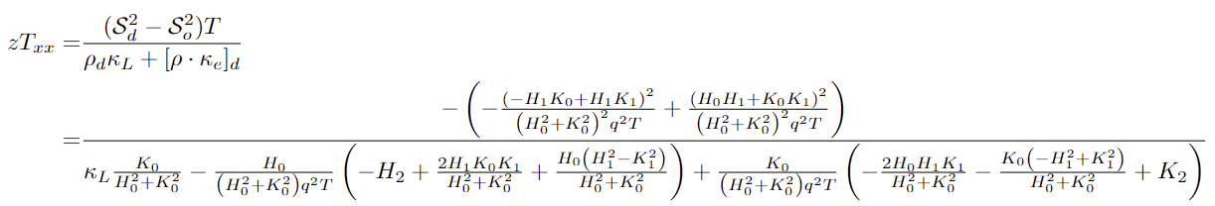
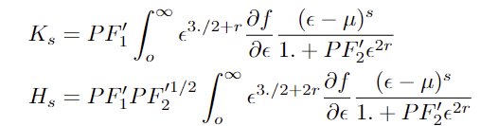
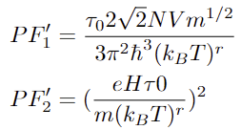
Recall From Last Slides
Lorentz Force generates non-dissipative current additional to the original one.
so
For zT changing with H field, if we focus on diagonal zT
In Higher Temperature, Phonon scattering dominates
Assigned r = -1/2, and I will continue on with this value.

Slide 4
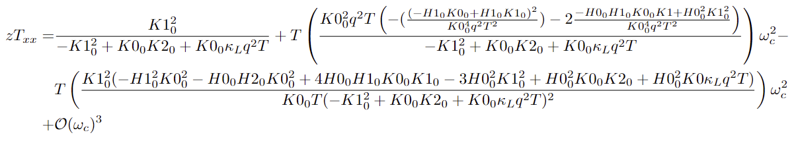
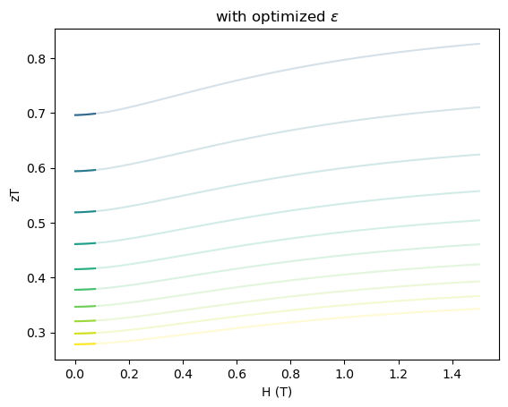
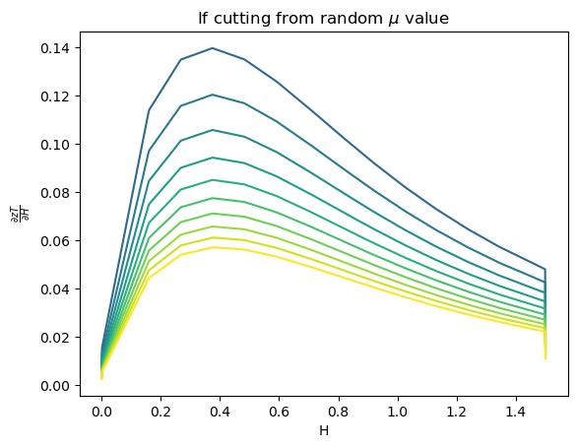

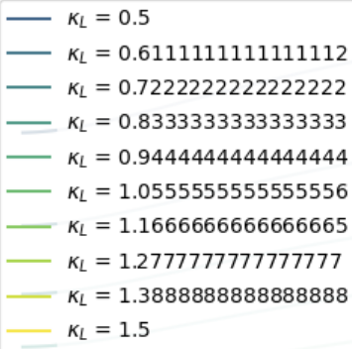
Low field Approximation
zT with different material properties are disjoint functions

Slide 5
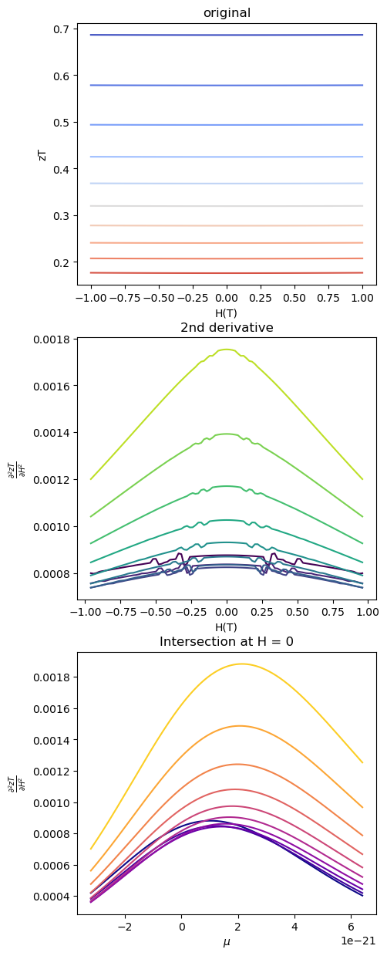
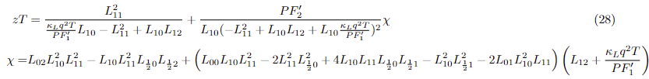
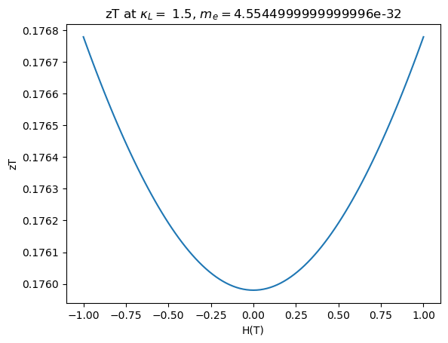
Potential increase of zT at H=0
Expanding zT at lower H field
Only second and higher order exists
Cannot be extracted due to its μ dependency

Slide 6
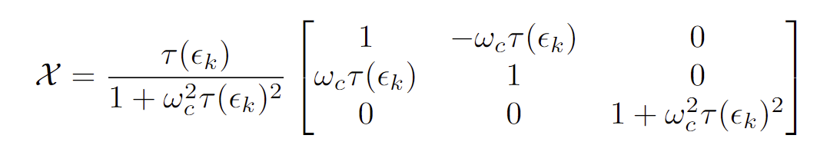
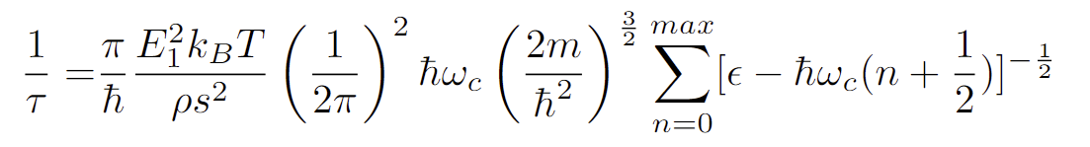
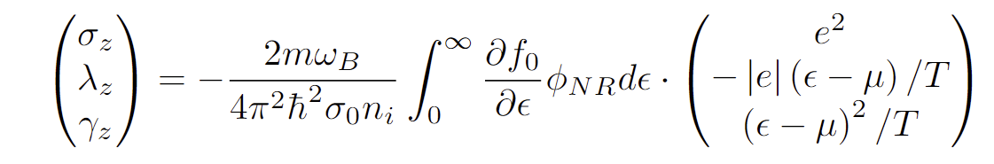
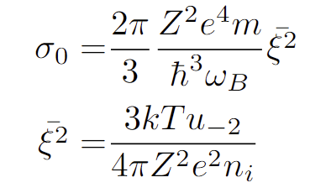
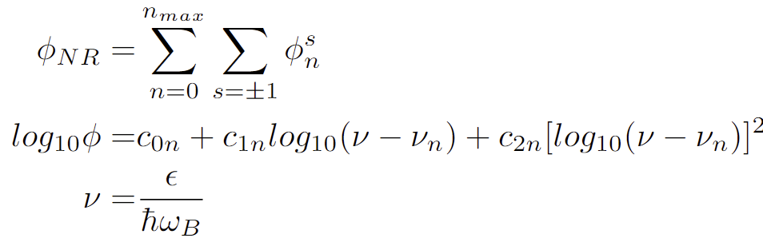

carrier transport parallel to H
Intuitively, magnetic field won’t impact on Transportation
Recall in non-quantization case:
Now when scattering rate is quantized:
The transportation element will be:
With considering interband scattering
1

Slide 7
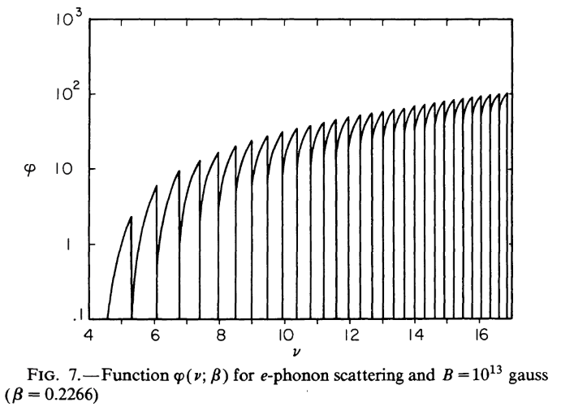
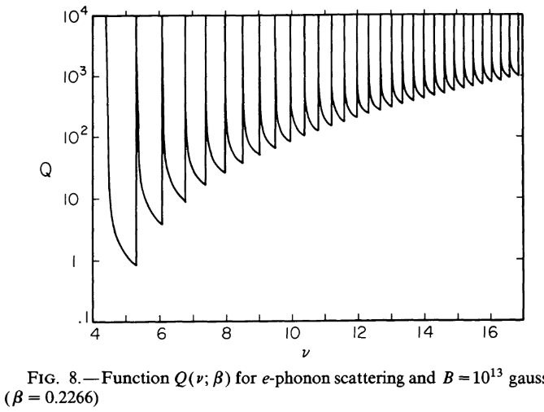
Some Calculation

Slide 8
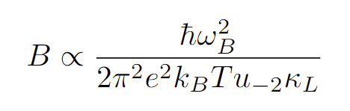
Quality factor from that
The zT in this direction does not have contributions from other axis
Easier to find a quality factor
1
Have a factor but trivial
not showing zT improves but only quantized
In other types of material (ferromagnetic), resistivity increase when the current aligns more with the external field

Slide 9
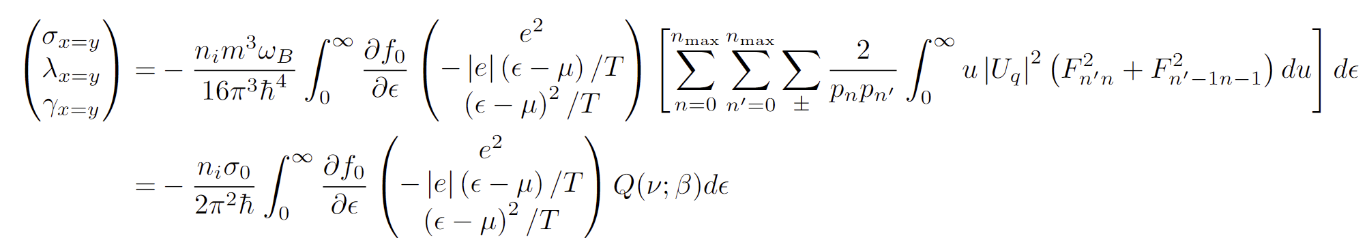
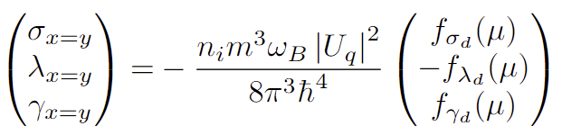
carrier transport perpendicular to H
Dissipative and Non-dissipative current forms a tensor
Dissipative
The integration part will only depends on μ
Here I also take the interacting potential to be a δ-function

Slide 10
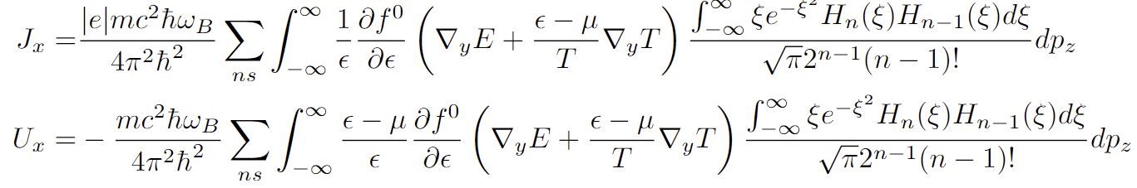
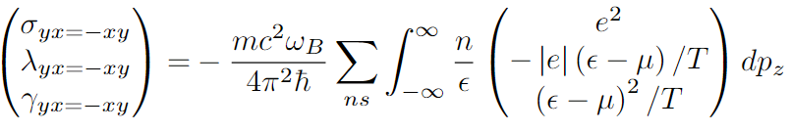
Conti.
Non-dissipative current density
From the current density can get transport properties
Can still be separated into 2 parts

Slide 11
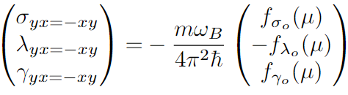
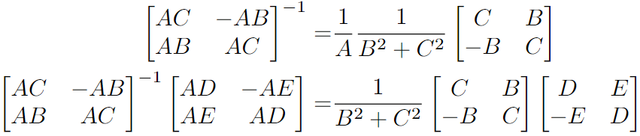

Quality factor from that
The dissipative and non-dissipative transport elements can forms the tensor
Some matrix manipulation

Slide 12
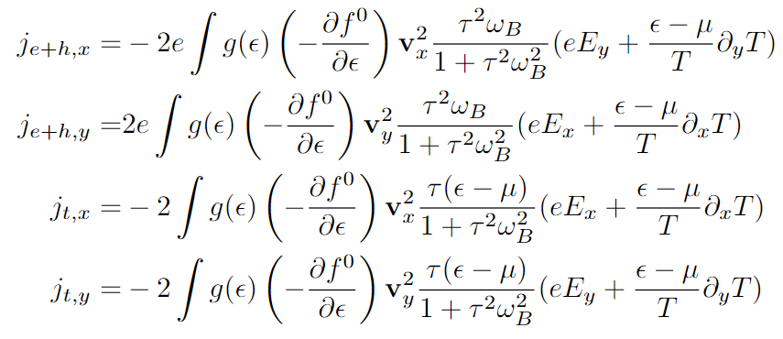
Bipolar carrier transport (I know not true)
Assuming same concentration of positive and negative carriers
Thermal conduct purely diagonal
Electrical conduct purely off-diagonal
,

