Slide 1
Capstone project battle of neighborhood

Slide 2
1.Purpose
This document is the report of the IBM Data Science Professional Certificate program – Coursera Capstone.
2.Introduction
Singapore is a small country and one of the most visited countries in Asia. There are lots of websites where travelers can recieve recommendations of places to stay or visit. However, most of these websites provides recommendation simply based on usual tourist attractions or key residential areas that are mostly expensive or already known for travelers based on certain keywords like "Hotel", or "Backpackers" etc. The purpose of this project is to collect and provide a data driven recommendation that can supplement the recommendation with statistical data. This will also be utilizing data retrieved from Singapore open data sources and FourSquare API venue recommendations.

Slide 3
3.Data acquisition
This demonstration will make use of the following data sources:
* Singapore Towns and median residential rental prices.
* Singapore Towns location data retrieved using Google maps API.
* Singapore Top Venue Recommendations from FourSquare API

Slide 4
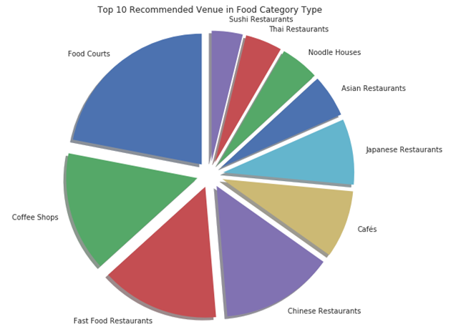
4.Some results
Top 10 most common venue types

Slide 5
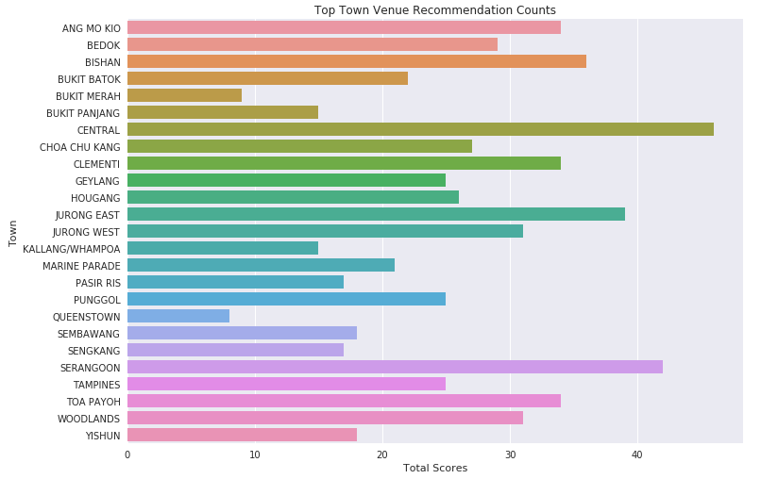
Top 10 venue recommendation scores

Slide 6
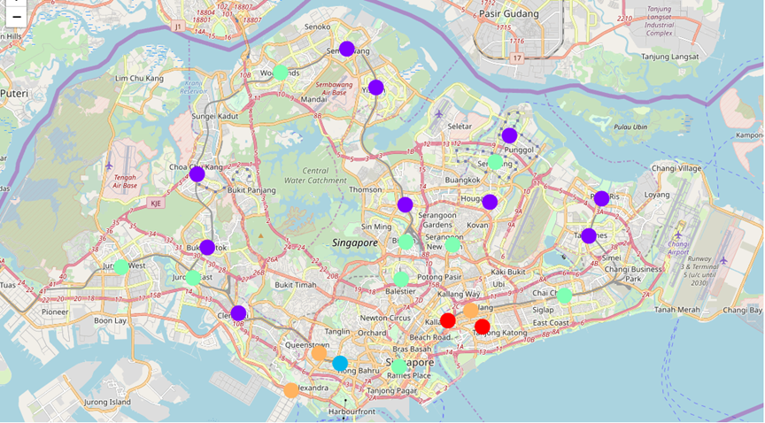
Clustered map

Slide 7
5.Conclusion
in this project, The generated clusters from our results shows that there are very good and interesting places located in areas where the median rents are cheaper. This kind of results may be very interesting for travelers who are also on budget constraints. Our results also yielded some interesting findings. For instance, The initial assumption among websites providing recommendations is that the Central Area that have the highest median rent also have better food venues. The results however show that while Marine Parade, a cheaper location has better rated food courts. Result shows that most popular food venue among Singaporeans, residents and visitors are Food Courts, Coffee Shops and Fast Food Restaurants. The highest rated Food Courts are located in Marine Parade, and in Central Area.

