Slide 1
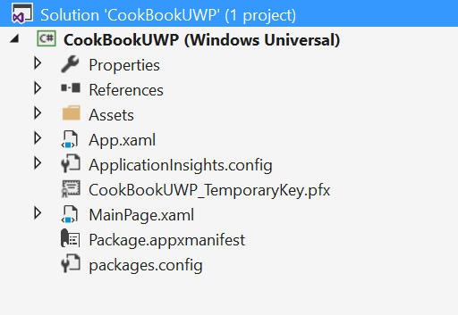
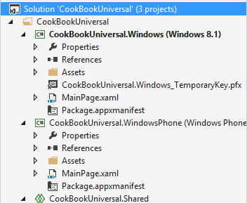
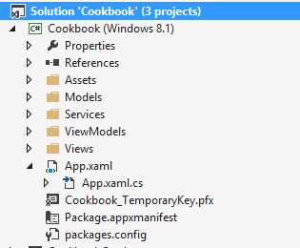
Universal Windows Platform (UWP)
Windows Store Apps (Windows 8)
Universal Windows 8 Apps (Windows 8.1)
Universal Windows Platform (Windows 10)

Slide 2
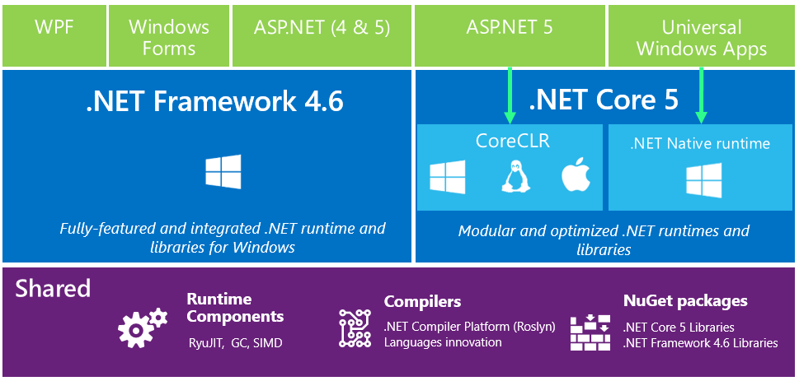
https://blogs.msdn.microsoft.com/bethmassi/2015/02/25/understanding-net-2015/

Slide 3
“
UWP becomes the one platform for developers.
Learn one set of core APIs for all devices.
„

Slide 4
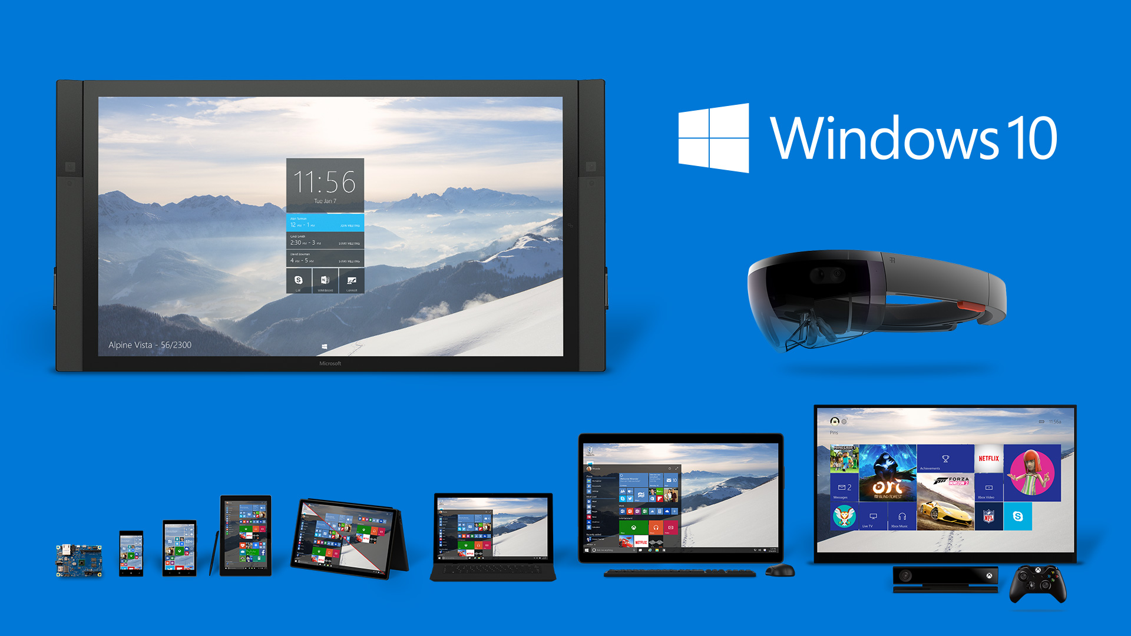

Slide 5
1 API for all platforms
1 App-Package for all platforms
1 Store for all platforms

Slide 7
Universal Windows Platform
NOT the lowest common denominator
„Build once, optimize for each device“
Capability-Check instead of Device-Check
Responsive Layout
Standard controls
New controls
Visual State Triggers

Slide 8
Enhancements in Windows 10
Adaptive Tile Templates
Toasts with actions
App Services
„Web of Apps“
Cortana

Slide 9
“
Using our own technology was a key feature for 10
„

Slide 10
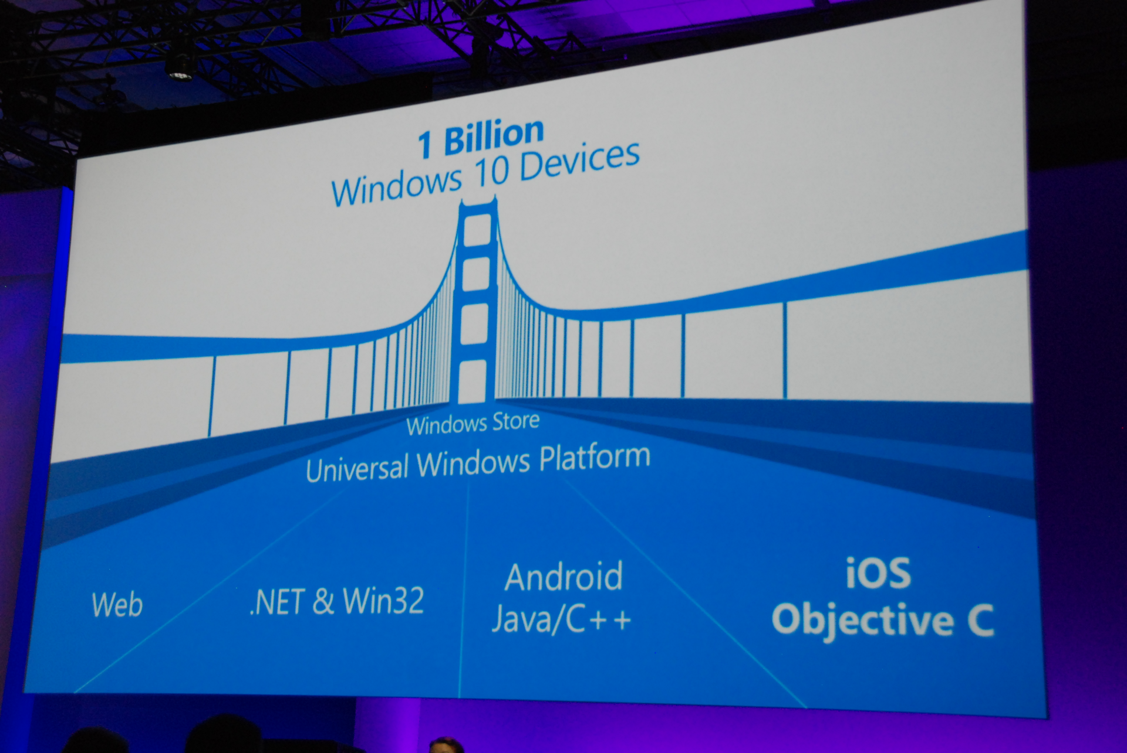
Universal Windows Platform Bridges
Project Islandwood
Project Astoria
Project Centennial
Project Westminster

Slide 11
Project Westminster: Hosted Web Apps
Deploy websites as UWP-App
Provide the URL in the store profile
Deployment location and update strategy up to the developer
Use Windows APIs in JavaScript: Cortana, Live Tiles, etc.

Slide 12
Project Centennial: Classic Windows Apps
Deploy Win32 / .NET-Apps in the Windows Store
Runs only on Windows PCs
New deployment model: AppX
Converter from MSI to AppX available
Main goals: Security and clean uninstall
Registry
System32, AppData, etc.
Usually not much code changes necessary
UWP features can be added

Slide 13
Project Astoria: Android (dead)
Goal: Reuse of Android code and tools
Map Android UX concepts to Windows concepts
Java-API for UWP features
Currently no progress: https://blogs.windows.com/buildingapps/2016/02/25/an-update-on-the-developer-opportunity-and-windows-10/#7RyeXZ06wL6H6VB7.97

Slide 14
Project Islandwood: iOS
Reuse Objective C code
Visual Studio integration
Import of Xcode projects
UWP features can be added

Slide 15
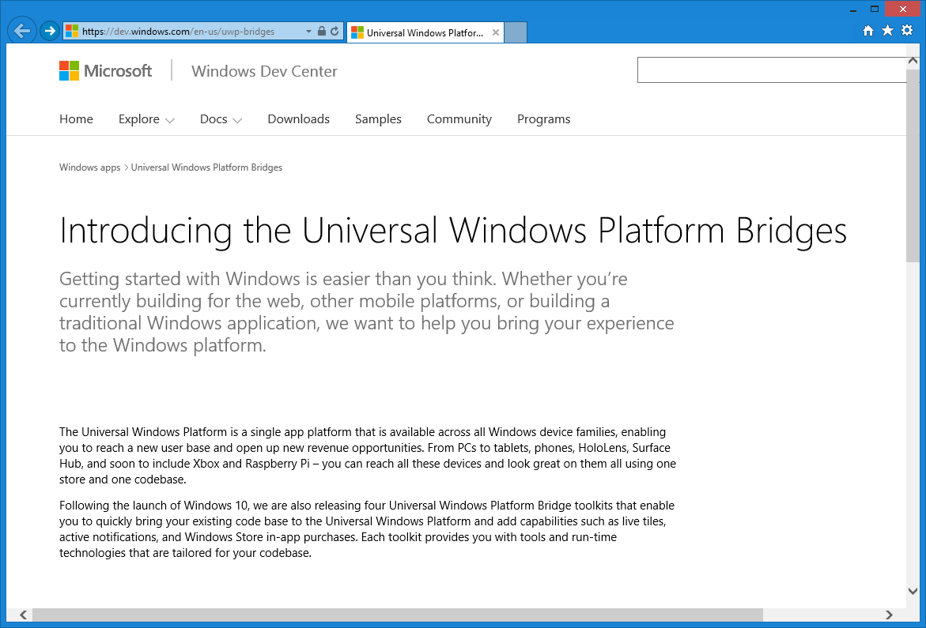
Universal Windows Platform Bridges
https://dev.windows.com/en-us/uwp-bridges

