Slide 1
In-memory data structure: SkipList
System Software Lab.
Name: Gyeongjun Ha
Date: 2025/02/11

Slide 2
Contents
SkipList (memtable/skiplist.h)
Code-Level Analysis (Node and Insert)
Experiment
Hypothesis and Design
Experiment
Result and Discussion
Limitations

Slide 3
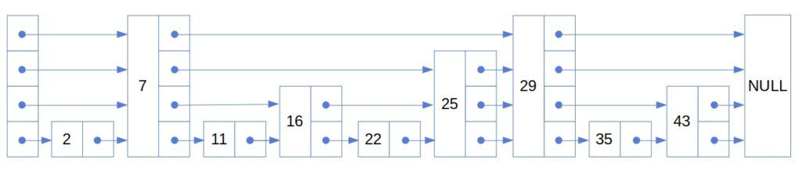
SkipList (memtable/skiplist.h)
MemTable
In-memory data structure holding data before they are flushed to SST files.
Based on SkipList(default), HashLinkList, HashSkipList or Vector.
Skiplist-based MemTable
Consists of multiple nodes with “random” height (levels).
General good performance to both read and write, random access and sequential scan.
Support Concurrent Insert and Insert with Hint.

Slide 4
SkipList (memtable/skiplist.h)
Question:
What exactly means “Random” height?

Slide 5
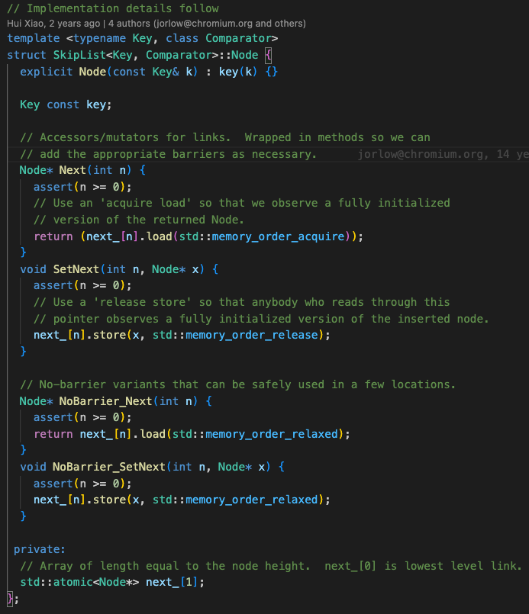
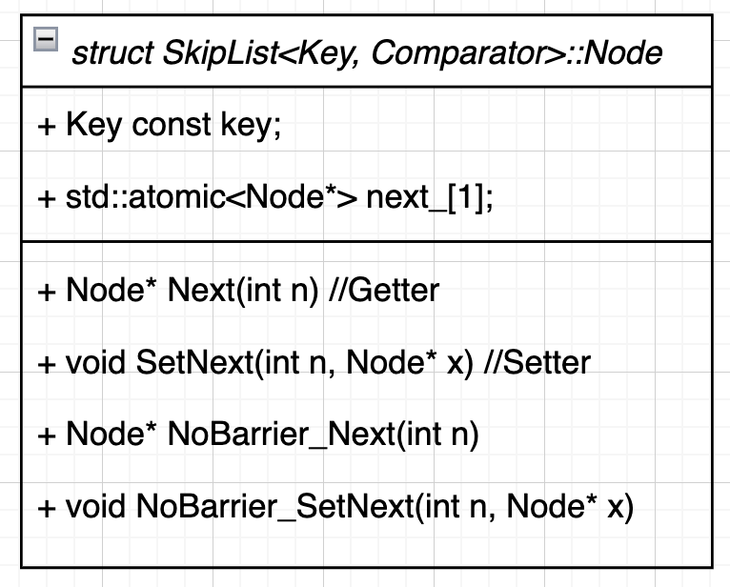
Node (memtable/skiplist.h)
key = xxxxx…xxx;
next_ ->
Dynamically allocated later by NewNode()
next_[0] | next_[1] | … | next_[RandomHeight()-1]
RandomHeight()
Node Instance

Slide 6
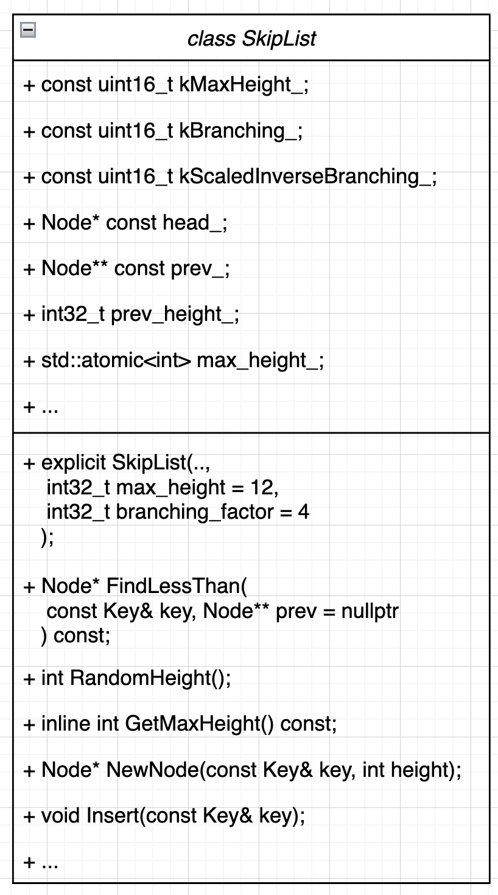
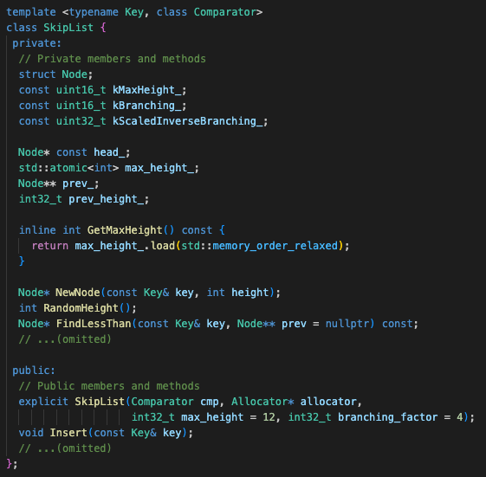
SkipList (memtable/skiplist.h)

Slide 7

SkipList (memtable/skiplist.h)
Member or Method | Description
kMaxHeight_ | The max height of a skiplist
kBranching_ | The branching factor of a skiplist
kScaledInverseBranching_ | The scaled inverse of the branching factor
head_ | The head node of a skiplist
prev_ | An array of the largest nodes smaller than the target node at each level
max_height | The current max height of the skiplist
kMaxHeight_ = 12;
kBranching_ = 4;
kScaledInverseBranching_ = ($\frac{Random∷kMaxNext + 1}{kBranching_})$;
prev_height = 1;
max_height = 1;
head_ ->
prev_ ->
Random::kMaxNext = 2³¹ - 1
kMaxHeigh (default: 12)
Key key = 0; | next_[0] | next_[1] | … | next_[kMaxHeight-1]
head_ | head_ | … | head_
SkipList Instance

Slide 8
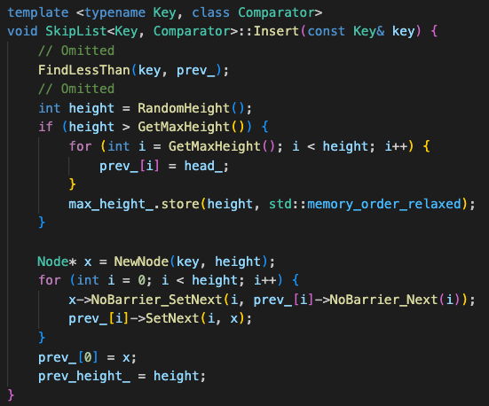
Insert operation (memtable/skiplist.h)
Insert(”17”)
1
2
3

Slide 9
Insert operation (memtable/skiplist.h)
FindLessThan(key, prev_);
prev_[3]
1
prev_[3] is the pointer to Node(”7”). (17 < 29)

Slide 10
Insert operation (memtable/skiplist.h)
FindLessThan(key, prev_);
prev_[3]
1
prev_[2]
prev_[3] is the pointer to Node(”7”). (17 < 29)
prev_[2] is the pointer to Node(”7”). (17 < 25)

Slide 11
Insert operation (memtable/skiplist.h)
FindLessThan(key, prev_);
prev_[3]
1
prev_[2]
prev_[1]
prev_[3] is the pointer to Node(”7”). (17 < 29)
prev_[2] is the pointer to Node(”7”). (17 < 25)
prev_[1] is the pointer to Node(”16”). (17 > 16), (17 < 25)

Slide 12
Insert operation (memtable/skiplist.h)
FindLessThan(key, prev_);
prev_[3]
1
prev_[2]
prev_[1]
prev_[0]
prev_[3] is the pointer to Node(”7”). (17 < 29)
prev_[2] is the pointer to Node(”7”). (17 < 25)
prev_[1] is the pointer to Node(”16”). (17 > 16), (17 < 25)
prev_[0] is the pointer to Node(”16”). (17 > 11), (17 > 16), (17 < 22)

Slide 13
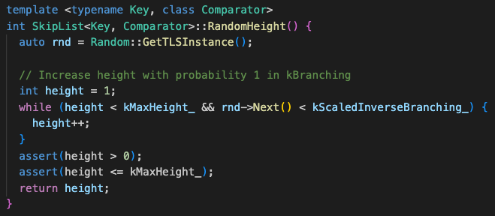

Insert operation (memtable/skiplist.h)
2. RandomHeight and NewNode
prev_[3]
prev_[2]
2
prev_[1]
prev_[0]
CALL
(Implementation)
kScaledInverseBranching_ = ($\frac{Random∷kMaxNext + 1}{kBranching_})$;

Slide 14
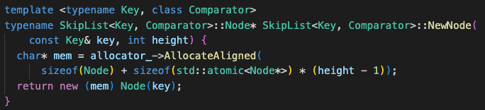
Insert operation (memtable/skiplist.h)
2. RandomHeight and NewNode
prev_[3]
prev_[2]
2
prev_[1]
prev_[0]
CALL
(Implementation)

Slide 15
Insert operation (memtable/skiplist.h)
2. RandomHeight and NewNode
prev_[3]
prev_[2]
2
prev_[1]
prev_[0]
If RandomHeight() returned 2, the current state is as follows:
Node* x
point to
next_[1]
17
next_[0]

Slide 16
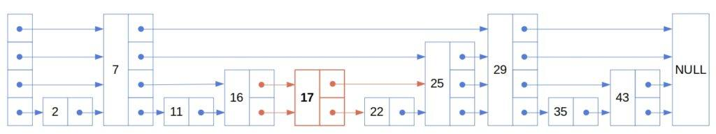
Insert operation (memtable/skiplist.h)
3. Insert Node(“17”)
prev_[3]
prev_[2]
prev_[1]
prev_[0]
①
②
3
②
①

Slide 17
Insert operation (memtable/skiplist.h)
3. Insert Node(“17”)
prev_[3]
prev_[2]
prev_[1]
prev_[0]
①
②
3
②
①

Slide 18

Hypothesis and Design
If the coin flip probability is too low (increase branching_factor_), the SkipList will converge to a common linked list, losing its search advantage.
Conversely, if it’s too high (decrease branching_factor), too many nodes will appear at each level, also diminishing the search efficiency.
In RocksDB, the coin flip probability is set to 25% instead of 50% and Why?
RandomHeight(), kScaledInverseBranching, kBranching_
memtable/skiplist.h
memtable/inlineskiplist.h

Slide 19
Hypothesis and Design
The impact of coin flip probability in SkipList on the Average Latency of Write and Read operations.
If the hypothesis is correct, lower probabilities should correspond to higher average latency.
If the probability becomes too high, the average latency should also increase.
Experiment tool
Instead of using db_bench, which involves various variables such as Flush and Compaction, use skiplist_test to independently test SkipList.
branching_factor_ (kBranching_) = [2, 4, 8, 16, 32] and N (or R) = [1M, 2M, 4M, 8M, 16M]
Let’s check it out!!

Slide 20
Experiment
We analyzed how insert operation works in SkipList at the code level and understood real meaning of Random height.
We reviewed the file “memtable/skiplist.h”, but figured out that RocksDB actually uses “memtable/inlineskiplist.h”.
modified for a multi-threaded environment and memory efficiency.
but the same core algorithm.

Slide 21
Experimental Environment
Version
OS | Ubuntu 20.04.5 LTS(64-bit)
Kernel | Linux 5.15.0-131-generic
CPU | 8 * 11th Gen Intel(R) Core(TM) i5-1155G7 @ 2.50GHz
MEM | 16GB
SSD | imation M.2 PCIe 1TB SSD X831B

Slide 22
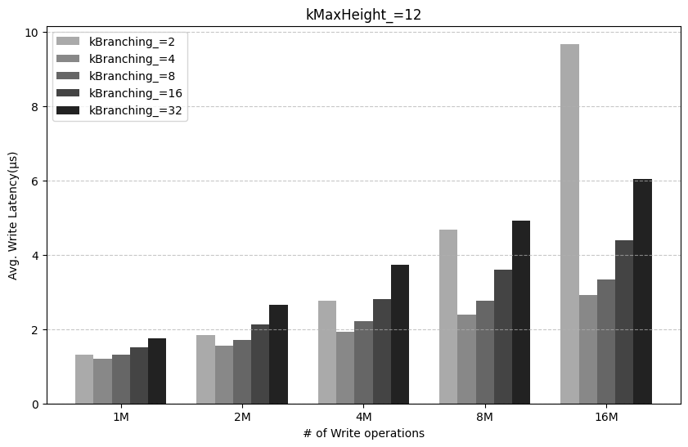
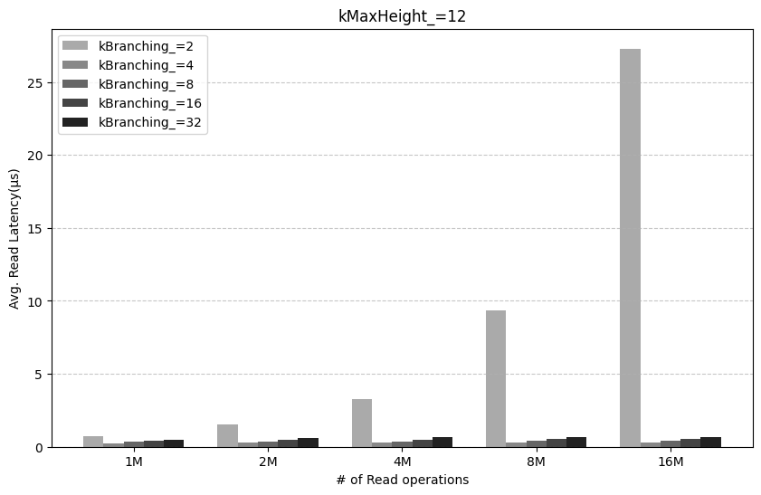
Results and Discussion

Slide 23
Results and Discussion
The best performance is observed when kBranching_ is 4.
Lower probabilities (8, 16, 32) should correspond to higher average latency.
The higher the probability (max=2), the greater the average latency.

Slide 24
Results and Discussion
>
Observations
1. In most cases, Read operations are significantly faster than Write operations.
The reason is likely due to the write overhead involved in dynamically creating nodes and linking pointers at each level.

Slide 25
Results and Discussion
Observations
2. When kBranching_ is 2, Write and Read operations show the worst performance.
As expected, higher probabilities lead to more nodes, resulting in lower performance.
The performance also drops significantly compared to other probabilities, increasing the number of operations. (especially, read ops)
Why..?

Slide 26
Limitations
The experiment did not take the effect of height (kMaxHeight_) into account.
Fixed at a default value of 12.
There may be a correlation between probability and height as well.
For a sophisticated analysis, it would be beneficial to include additional metrics beyond latency, considering various perspectives:
CPU Instruction
Memory usage
Number of SkipList nodes
…

Slide 27
Thank you QnA?

