Slide 1
WAL (Write Ahead Log)
System Software Lab.
Name: Gyeongjun Ha
Date: 2025/02/03

Slide 2
Contents: WAL
What is WAL(Write Ahead Log)?
How does it work?
WAL Overhead
Hypothesis
Design and Experiment
Result and Discussion
Code-Level Analysis (ongoing)
Summary
References

Slide 3
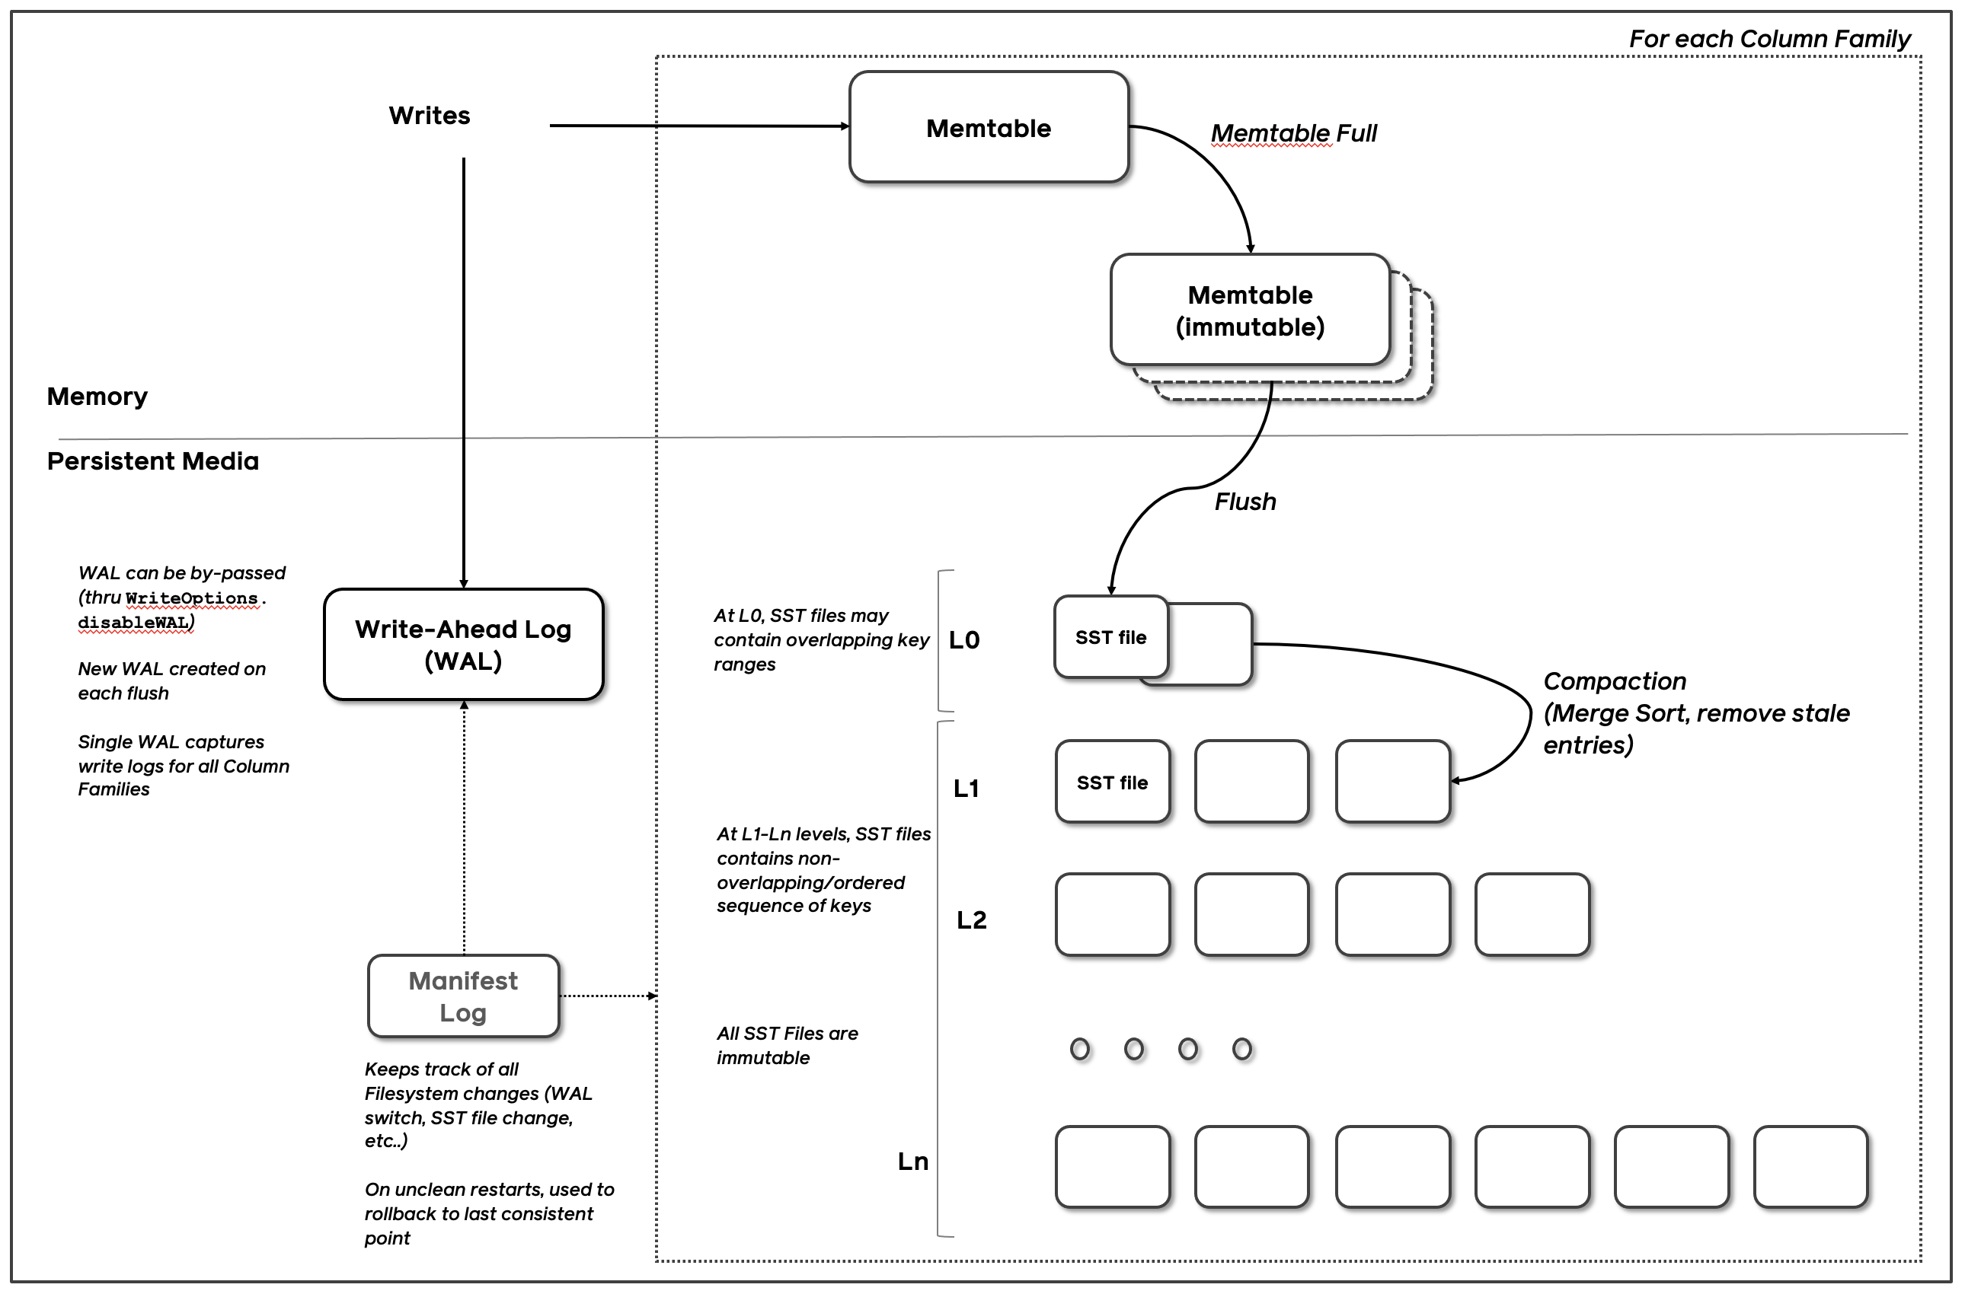
What is WAL(Write Ahead Log)?
Journals or Logs:
The metadata that describes a data system's hist-ory of state.
Key to RocksDB’ integrity and recovery.
RocksDB has two types of journals:
Write Ahead Log (WAL)
MANIFEST
WAL is for journaling the in-memory state updates, while MANIFEST is for journaling the on-disk state updates.
Ref: https://github.com/facebook/rocksdb/wiki/RocksDB-Overview

Slide 4
How does it work?
“default”
“new_cf”
Life Cycle of a WAL
For example, a RocksDB instance db is created with two column families ”default” and ”new_cf” (kind of logical partion).
Once the db is opened, a new WAL will be created on disk to persist all writes.
Key Point: A single WAL captures write logs for all column families!
WAL File

Slide 5
How does it work?
: new data
“default”
“new_cf”
Life Cycle of a WAL
3. db->Put(”new_cf”, “key1”, “value1”);
db->Put(“default”, “key2”, “value2”);
db->Put(“new_cf”, “key3”, “value3”);
db->Put(“default”, “key4”, “value4”);
At this point the WAL should have recorded all writes.
Note that the WAL will stay open and keep recording future writes until its size reaches -max_total_wal_size.
(”key2”, “value2”)
(”key1”, “value1”)
(”key4”, “value4”)
(”key3”, “value3”)
Put(1)
Put(2)
Put(3)
Put(4)
WAL File(.log)
(default size: [sum of all write_buffer_size * max_write_buffer_number] * 4)

Slide 6
How does it work?
“default”
“new_cf”
Life Cycle of a WAL
5. If user decides to flush the new_cf, new_cf’s data(key1 and key3) is flushed to a new SST file.
And then, a new WAL is created and all future writes to all column families now go to the new WAL
The older WAL will not accept new writes but the deletion may be delayed.
(”key2”, “value2”)
(”key1”, “value1”)
(”key4”, “value4”)
(”key3”, “value3”)
FLUSHED
Put(1)
Put(2)
Put(3)
Put(4)
the older WAL
(Immutable)
a new WAL

Slide 7
How does it work?
: new data
: live data
“default”
“new_cf”
Life Cycle of a WAL
7. db->Put(“new_cf”, “key5”, “value5”);
db->Put(“default”, “key6”, “value6”);
Because the older WAL still contains live data for at least one column family (default), it cannot be deleted yet.
(”key2”, “value2”)
(”key5”, “value5”)
(”key4”, “value4”)
(”key6”, “value6”)
Put(1)
Put(2)
Put(3)
Put(5)
Put(6)
Put(4)
the older WAL
(Immutable)
a new WAL

Slide 8
How does it work?
: Live data
“default”
“new_cf”
Life Cycle of a WAL
db->Flush(“default”) or Auto Flush
The older WAL will be archived and purged separately.
(”key2”, “value2”)
(”key5”, “value5”)
(”key4”, “value4”)
(”key6”, “value6”)
1. FLUSHED
Put(1)
Put(2)
Put(3)
Put(5)
Put(6)
Put(4)
2. ARCHIVED
OR
DELETED
the older WAL
(Immutable)
a new WAL
(may be immutable too)

Slide 9
How does it work?
To summarize
WAL is created when:
A new DB is opened.
A column family is flushed.
WAL is deleted (or archived if archival is enabled) when:
All data in the WAL have been persisted to SST files.
So, why use WAL?
In the event of a failure, It can be used to completely recover the data in the Memtable.
Ensure data integrity and durability.
But, trade-off may occur between performance and reliability.

Slide 10
WAL Overhead
As you can see in the previous slides, additional file write operations (e.g, flush, write, fsync, fdatasync, etc.) will occur when WAL is enabled.
“default”
“new_cf”
In-Memory
On-Storage
flush, write, fsync, fdatasync, …
WAL File

Slide 11
Hypothesis
When using WAL, every update request logs to WAL, causing additional file writes that negatively impact write performance (Write latency).
Thus, writes with WAL enabled will always have higher latency than those without it.
Let’s prove it now!

Slide 12
Experimental Environment
Version
OS | Ubuntu 20.04.5 LTS(64-bit)
Kernel | Linux 5.15.0-131-generic
CPU | 8 * 11th Gen Intel(R) Core(TM) i5-1155G7 @ 2.50GHz
MEM | 16GB
SSD | imation M.2 PCIe 1TB SSD X831B

Slide 13
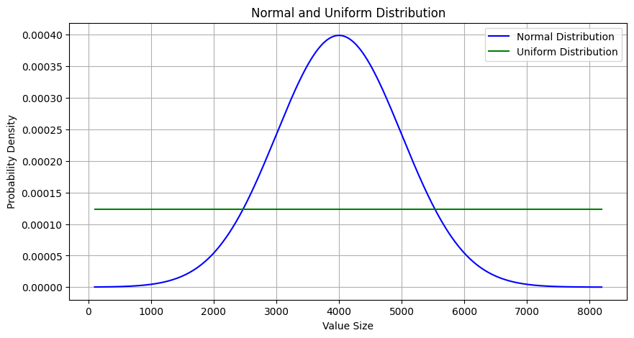
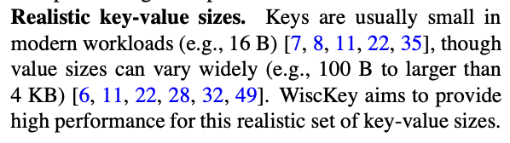
Design and Experiment
$ ./db_bench -use_direct_io_for_flush_and_compaction=true \
-value_size_distribution_type=$DISTRIBUTION_TYPE \
-value_size_min=100 \
-value_size_max=8192 \
-disable_wal=$BOOL \
-histogram \
--benchmarks=$FILL_TYPE
To create a more realistic workload with varying value sizes(instead of a fixed value size workload)
OPTION | DESCRIPTION
-use_direct_io_for_flush_and_compaction | Use O_DIRECT for background flush and compaction writes
-value_size_distribution_type | Value size distribution type
-value_size_min/-value_size_max | Min/Max size of random value
-disable_wal | WAL ON(false) / WAL OFF(true)
-histogram | Print histogram of operation timings.
--benchmarks | Comma-separated list of operations to run in the specified order.
Lu, Lanyue, et al. "Wisckey: Separating keys from values in ssd-conscious storage."
ACM Transactions On Storage (TOS) 13.1 (2017): 1-28.

Slide 14
Design and Experiment
$ ./db_bench -use_direct_io_for_flush_and_compaction=true \
-value_size_distribution_type=$DISTRIBUTION_TYPE \
-value_size_min=100 \
-value_size_max=8192 \
-disable_wal=$BOOL \
-histogram \
--benchmarks=$FILL_TYPE
Enable or Disable WAL
OPTION | DESCRIPTION
-use_direct_io_for_flush_and_compaction | Use O_DIRECT for background flush and compaction writes
-value_size_distribution_type | Value size distribution type
-value_size_min/-value_size_max | Min/Max size of random value
-disable_wal | WAL ON(false) / WAL OFF(true)
-histogram | Print histogram of operation timings.
--benchmarks | Comma-separated list of operations to run in the specified order.

Slide 15
Design and Experiment
$ ./db_bench -use_direct_io_for_flush_and_compaction=true \
-value_size_distribution_type=$DISTRIBUTION_TYPE \
-value_size_min=100 \
-value_size_max=8192 \
-disable_wal=$BOOL \
-histogram \
--benchmarks=$FILL_TYPE
”fillseq” for performing sequential writes, “fillrandom” for random writes
OPTION | DESCRIPTION
-use_direct_io_for_flush_and_compaction | Use O_DIRECT for background flush and compaction writes
-value_size_distribution_type | Value size distribution type
-value_size_min/-value_size_max | Min/Max size of random value
-disable_wal | WAL ON(false) / WAL OFF(true)
-histogram | Print histogram of operation timings.
--benchmarks | Comma-separated list of operations to run in the specified order.

Slide 16
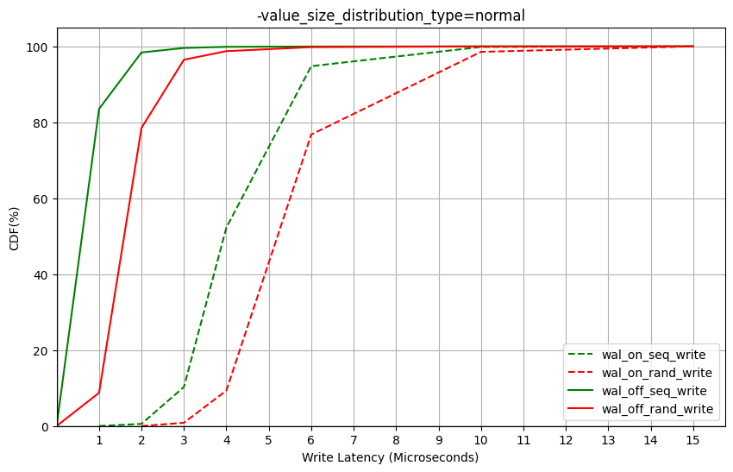
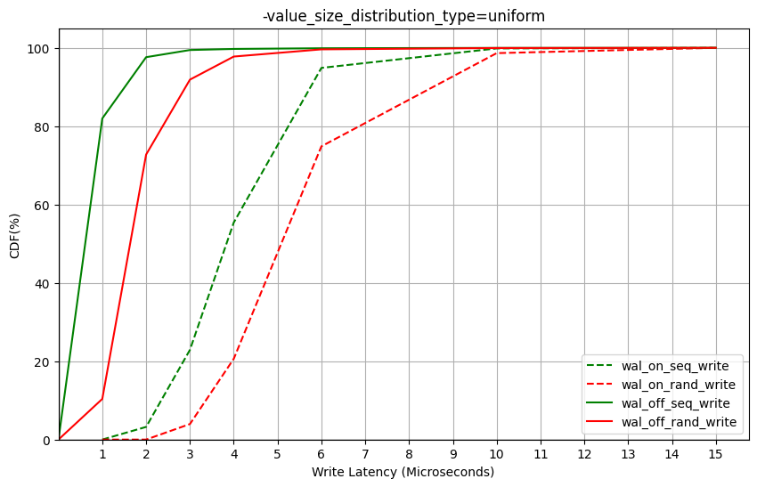
Result and Discussion
VARIABLE | VALUE
$DISTRIBUTION_TYPE | fixed | normal | uniform
$BOOL | true | false
$FILL_TYPE | ”fillseq” | “fillrandom”
Value Size: Normal
Value Size: Uniform

Slide 17
Result and Discussion
Regardless of sequential or random, write operations with WAL ON have higher average latency.
Value Size: Normal
Value Size: Uniform

Slide 18
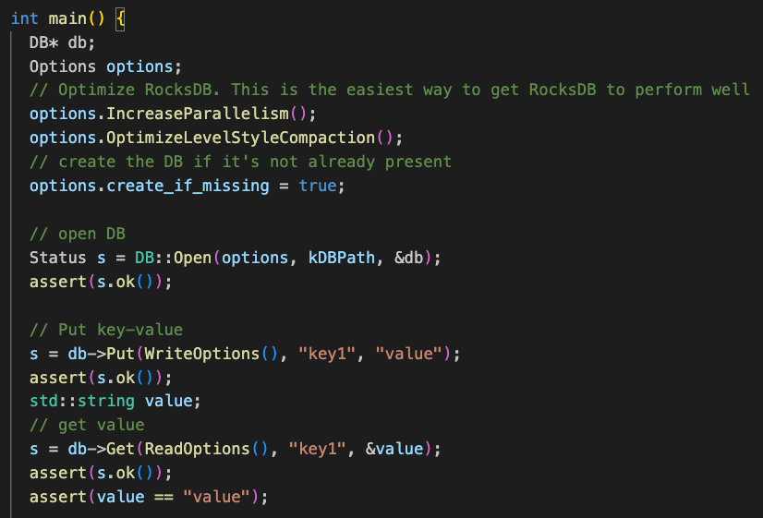
Code-Level Analysis
RocksDB 6.11.4, commit: f15414b6562f39953281e5dd0e95dd8c506d5c87
Anaysis tool: ftracer(https://github.com/finaldie/ftracer)
simple_example.cc

Slide 19
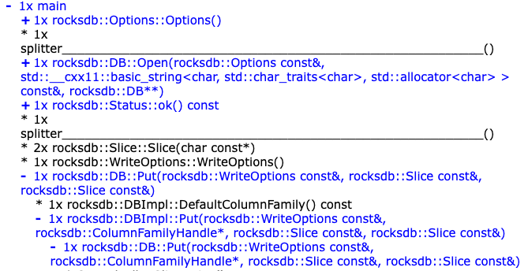
Code-Level Analysis
RocksDB 6.11.4, commit: f15414b6562f39953281e5dd0e95dd8c506d5c87
1.
2.
3.
Ref: https://finaldie.com/learning/rocksdb_6_11_4

Slide 20
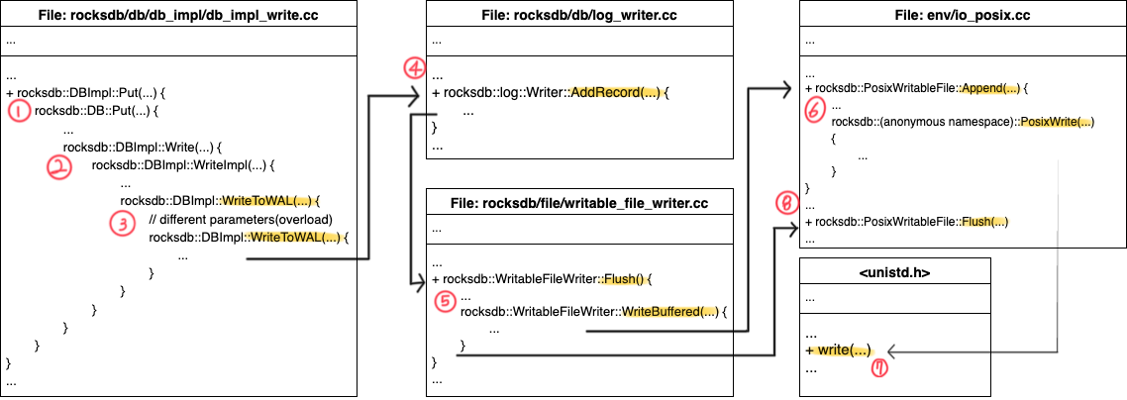
Code-Level Analysis(ongoing)
RocksDB 6.11.4, commit: f15414b6562f39953281e5dd0e95dd8c506d5c87
Ref: https://github.com/DKU-StarLab/leveldb-study/blob/main/analysis
[analysis]WAL,Manifest_week5.pdf

Slide 21
Summary
Last weeks
Learn how to use db_bench
Studied RocksDB’ key mechanisms, Compaction and WAL
This week
Code-Level Analysis(ongoing)
Try to improve WAL overhead
Advanced experiments on WAL trade-off

Slide 22
References
[1] 신호진, and 최종무. "RocksDB 에서 집약과 WAL 의 성능 특성 분석." 한국정보과학회 학술발표논문집 (2021): 1470-1472.
[2] SSLAB at DkU. LevelDB Wiki. Accessed 4 Feb. 2025, https://sslab.dankook.ac.kr/leveldb-wiki/.
[3] SSLAB at DKU. DKU-StarLab GitHub Repository. Accessed 4 Feb. 2025, https://github.com/DKU-StarLab/.
[4] Finaldie. Learning RocksDB 6.11.4. Accessed 4 Feb. 2025, https://finaldie.com/learning/rocksdb_6_11_4.
[5] Facebook. RocksDB Wiki. Accessed 4 Feb. 2025, https://github.com/facebook/rocksdb/wiki.
[6] Lu, Lanyue, et al. "Wisckey: Separating keys from values in ssd-conscious storage." ACM Transactions On Storage (TOS) 13.1 (2017): 1-28.

Slide 23
Thank you QnA?

