Slide 1
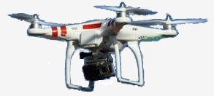
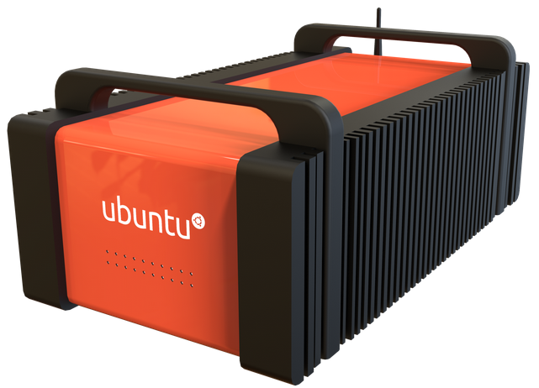
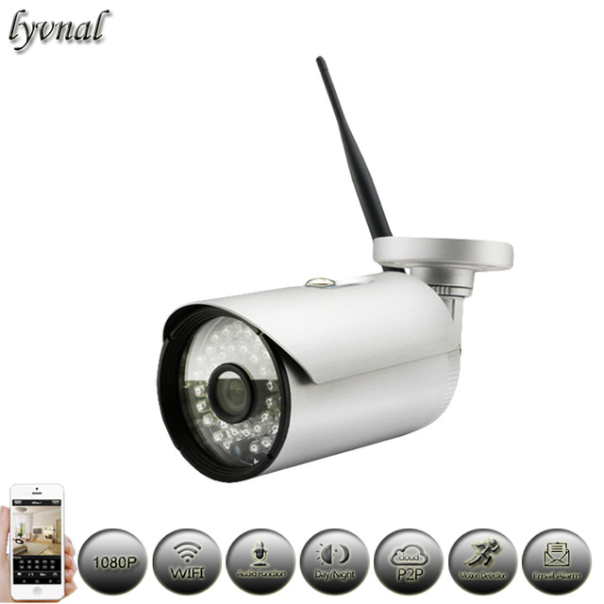
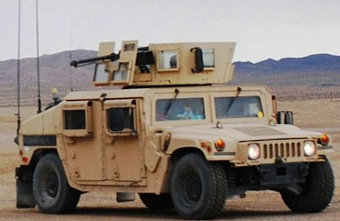
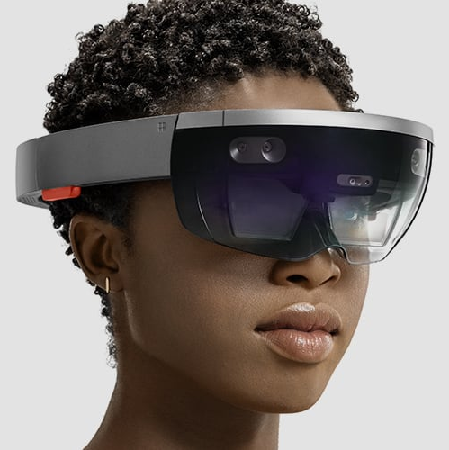
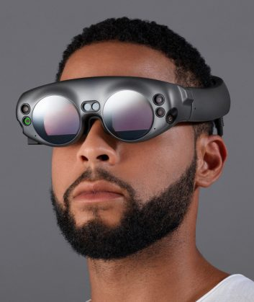
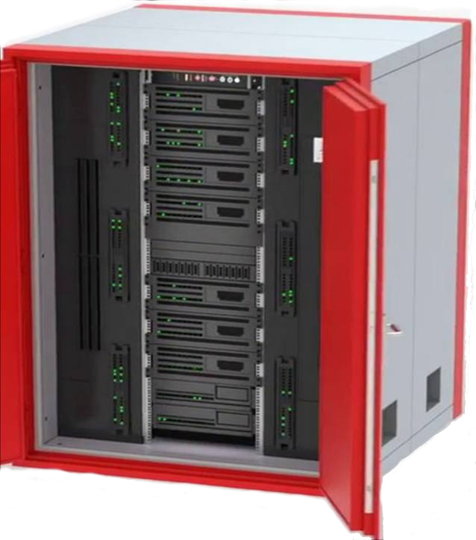


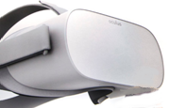

Cloudlets
Drones
low-
latency
high-
bandwidth
wireless
network
Luggable
Static & Vehicular
Sensor Arrays
Vehicular
Microsoft
Hololens
Magic Leap
Intel
Vaunt
Oculus Go
ODG-8
Coffee Shop
Mini-datacenter
AR/VR Users
Tier 3
Tier 2

