Slide 1
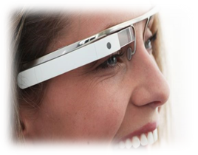
Cognitive
Modules
Wireless
first hop
Face
detection
Control
Module
Wearable device
Sensor streams
PubSub
Object detection
Sensor control
Context Inference
OCR
User assistance
Sensor flows
…
User Guidance
Module
Cognitive flows
VM or container
boundary
Cloudlet

