Slide 1
SIMULATION OF BACKOFF PROCESS
Presented By:
Jie Hou
Junjun Ruan
Neha Singh

Slide 2
Introduction
Investigate the Backoff Process
Model the system with time slotted transmission
Contention is modeled by comparing the chosen delays
Delay added to current time for its next transmission
Collision occur when more than one node chooses the same time slot for transmission

Slide 3
Investigate
The change in Optimum CW with the change in User Nodes
The change in CW* with different user in different L
The change in fairness with different CW

Slide 4
Problem 1
Examine the change in Optimum Contention Window (CW*) with the change in user nodes
Find the best contention window with maximum throughput
- Choose a Random N
- Choose a Random CW
- Calculate Throughput with L = 1
- Find the CW with Maximum Throughput
- Repeat the step for different N and CW
Relationship obtained between CW* and N :
CW* = 2N

Slide 5
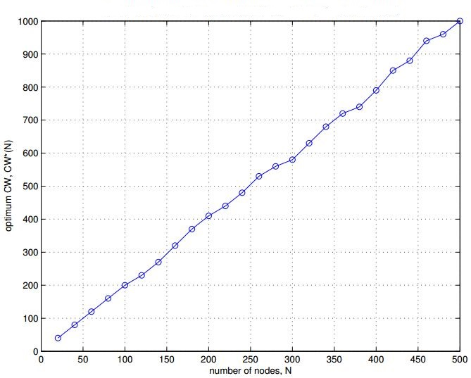
Figure for CW*N as a Function of N
Figure 1: Relationship Between CW* and N

Slide 6
Problem 2
How to model this problem:
Successful Transmission:
only one node is sending package in current time, no other nodes choose to send packet during this time: current_time - L + 1 ~ current_time + L – 1
Collision:
two arrays separately record nodes who are sending packages: current_time - L + 1 ~current time and current time ~ current time + L – 1
Next Transmission Time:
current time + L + random number (0~1)

Slide 7
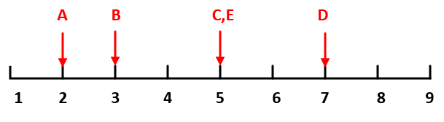
Problem 2 (Example)
Figure 2: Collision model when L = 5, current time = 5

Slide 8
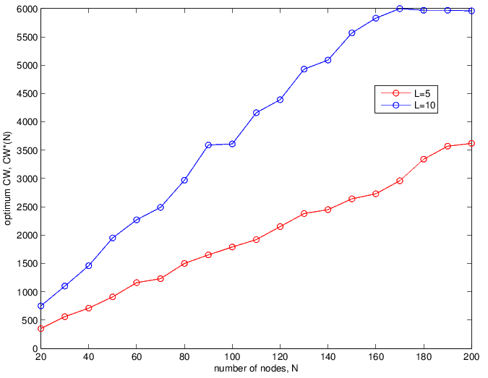
Problem 2: N and CW*
Figure 3: relationship between N and CW* with different L

Slide 9
Problem 2 (Continue...)
For different L, the relationship between N and CW* is:
L = 1, CW* = 2N
L = 5, CW* = 18N
L= 10, CW* = 38N
Conclusion: L ↑, CW* ↑
Analysis: when L ↑, more collisions happen.

Slide 10
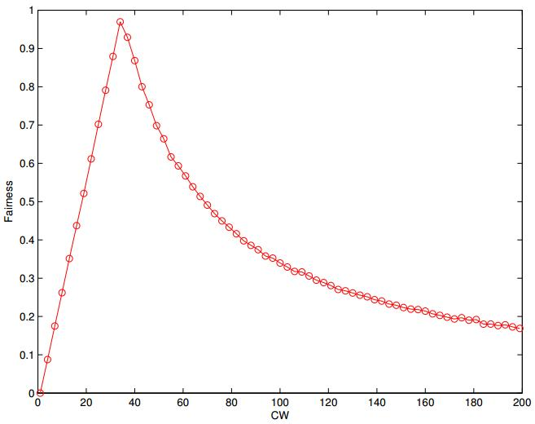
Problem 3b-CW and fairness
Fairness:
CW < 35: CW = 35: ≈ 1(max) CW > 35:
(will go down to very close to 0 eventually)
Figure 4: Relationship between CW(one particular node) and fairness

Slide 11
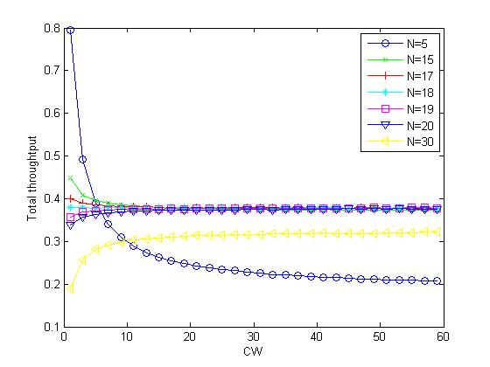
Problem 3b—CW and S
Less CW(the particular node) makes more chance to send package, it also bring more collision. They compete with each other.
N<18 more chance than collision N=18 chance and collision balanced
N>18 more collision
Figure 5: Relationship between CW (one particular node) and the system throughput when nodes number(N) is different

Slide 12
THANKYOU

