Slide 1
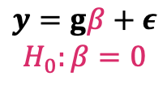
?
Trait
(e.g., AD)
SNP
$$y=gβ+ε$$
$$H_{0}:β=0$$

Slide 2

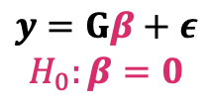
gene
gene
SNP 1
?
SNP 2
Trait
(e.g., AD)
$$⋯$$
SNP q
$$y=Gβ+ε$$
$$H_{0}:β=0$$

Slide 3
gene
IDP
SNP 1
?
SNP 2
Trait
(e.g., AD)
$$⋯$$
SNP q
$$y=Gβ+ε$$
$$H_{0}:β=0$$

Slide 4
IDP
Unobserved
confounder
SNP 1
?
SNP 2
Trait
(e.g., AD)
$$⋯$$
SNP q

Slide 5

IDP 1
Unobserved
confounder
SNP 1
?
IDP 2
SNP 2
Trait
(e.g., AD)
IDP 3
$$⋯$$
$$⋯$$
SNP q
IDP K

