Slide 1





Unobserved
confounders
IDP 1
IDP 2
SNP 1
?
$$⋯$$
IDP$K_{1}$
SNP 2
Trait
(e.g., AD)
$$⋯$$
IDP 1
SNP J
IDP 2
$$⋯$$
IDP$K_{2}$

Slide 2
Unobserved
confounders
IDP 1
IDP 2
SNP 1
$$⋯$$
IDP$K_{1}$
SNP 2
Trait
(e.g., AD)
$$⋯$$
IDP 1
SNP J
IDP 2
$$⋯$$
IDP$K_{2}$

Slide 3

Unobserved
confounders
SNP 1
SNP 2
IDP
Trait
(e.g., AD)
$$⋯$$
SNP J

Slide 4
Unobserved
confounders
SNP 1
SNP 2
IDP 1
Trait
(e.g., AD)
$$⋯$$
SNP J

Slide 5
2. Exchangability
Unobserved
confounders
IV g₁
?
IV g₂
1. Relevance
IDP
Trait
(e.g., AD)
$$⋯$$
IV g_{J}
3. Exclusion Restriction

Slide 6


Unobserved
confounders
SNP 1
IDP 1
?
SNP 2
IDP 2
Trait
(e.g., AD)
$$⋯$$
$$⋯$$
IDP K
SNP J

Slide 7
Unobserved
confounders
SNP 1
IDP 1
SNP 2
IDP 2
Trait
(e.g., AD)
$$⋯$$
$$⋯$$
IDP K
SNP J

Slide 8
Unobserved
confounders
SNP 1
IDP 1
SNP 2
IDP 2
Trait
(e.g., AD)
$$⋯$$
$$⋯$$
IDP K
SNP J

Slide 9
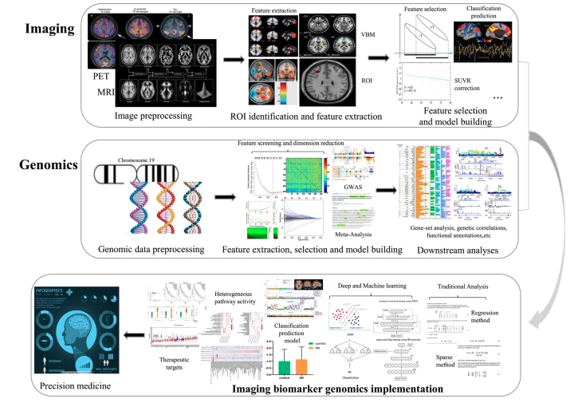
AD

