Slide 1
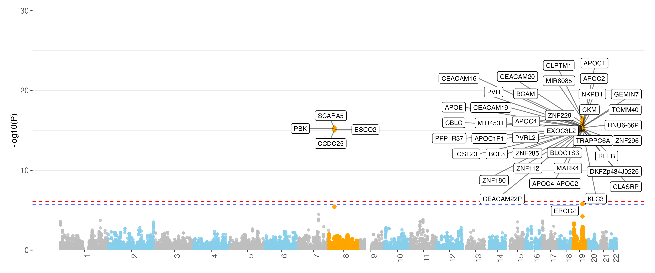
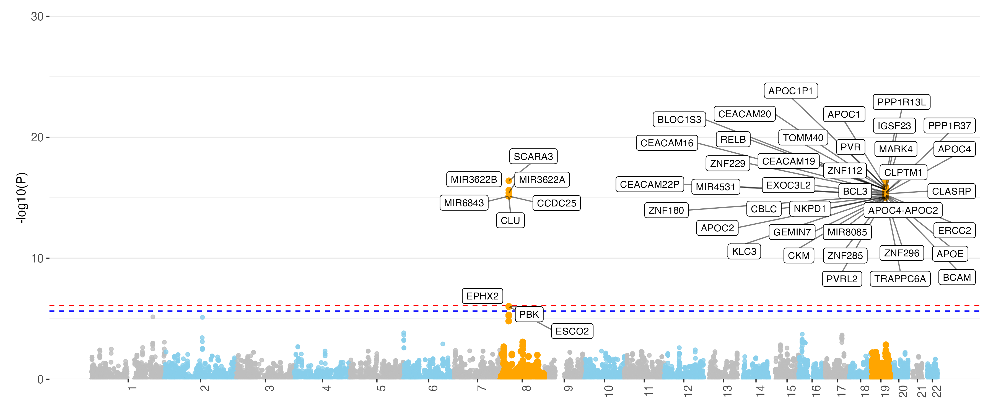
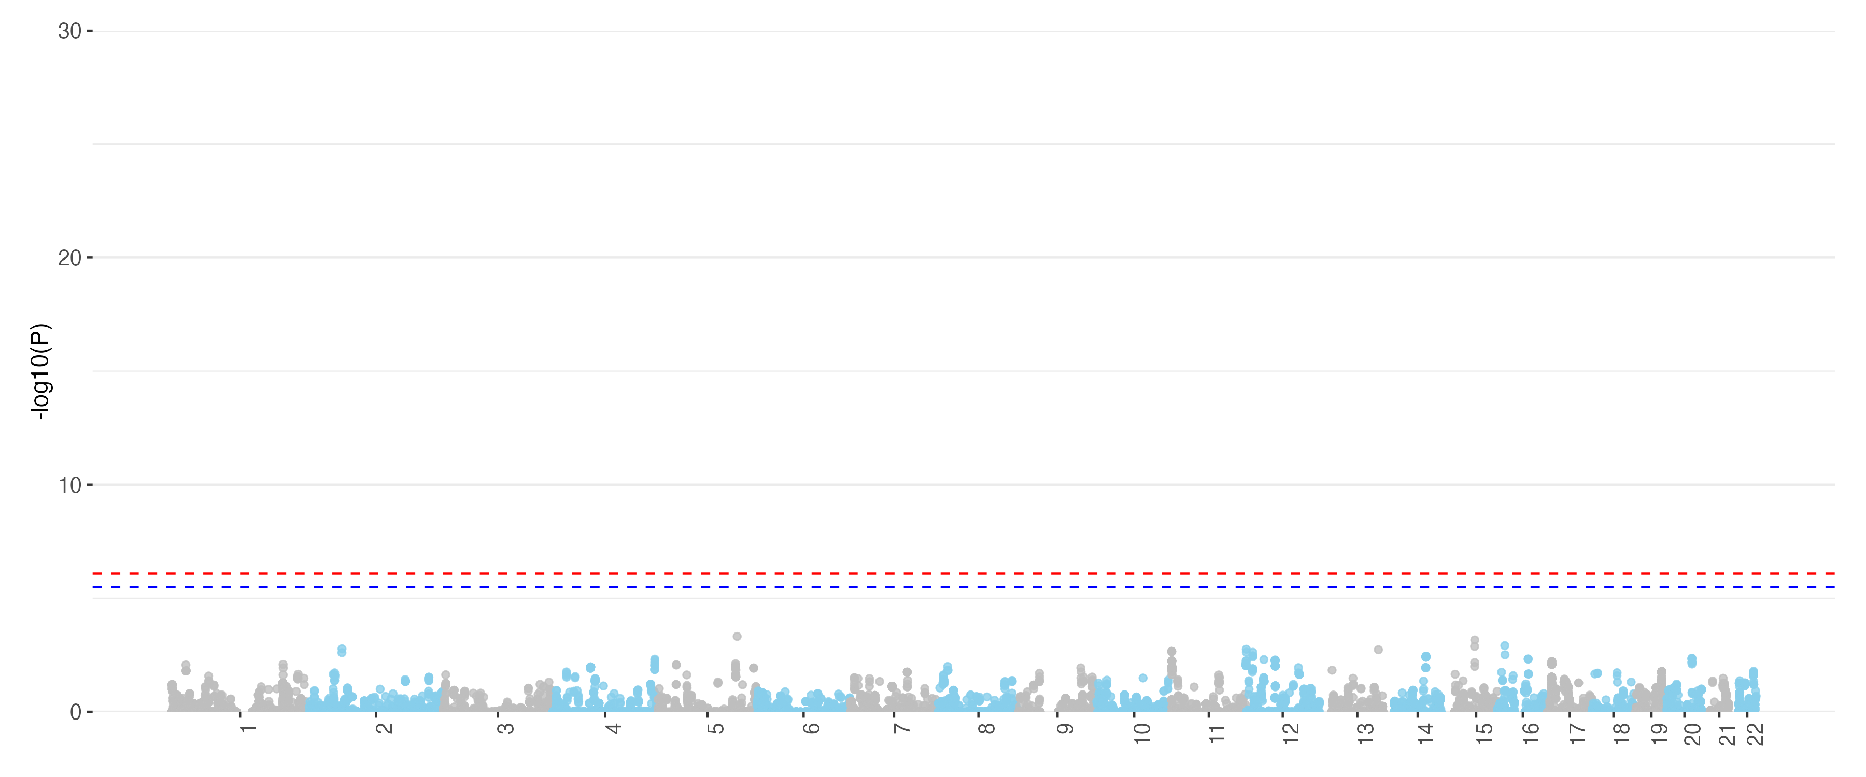
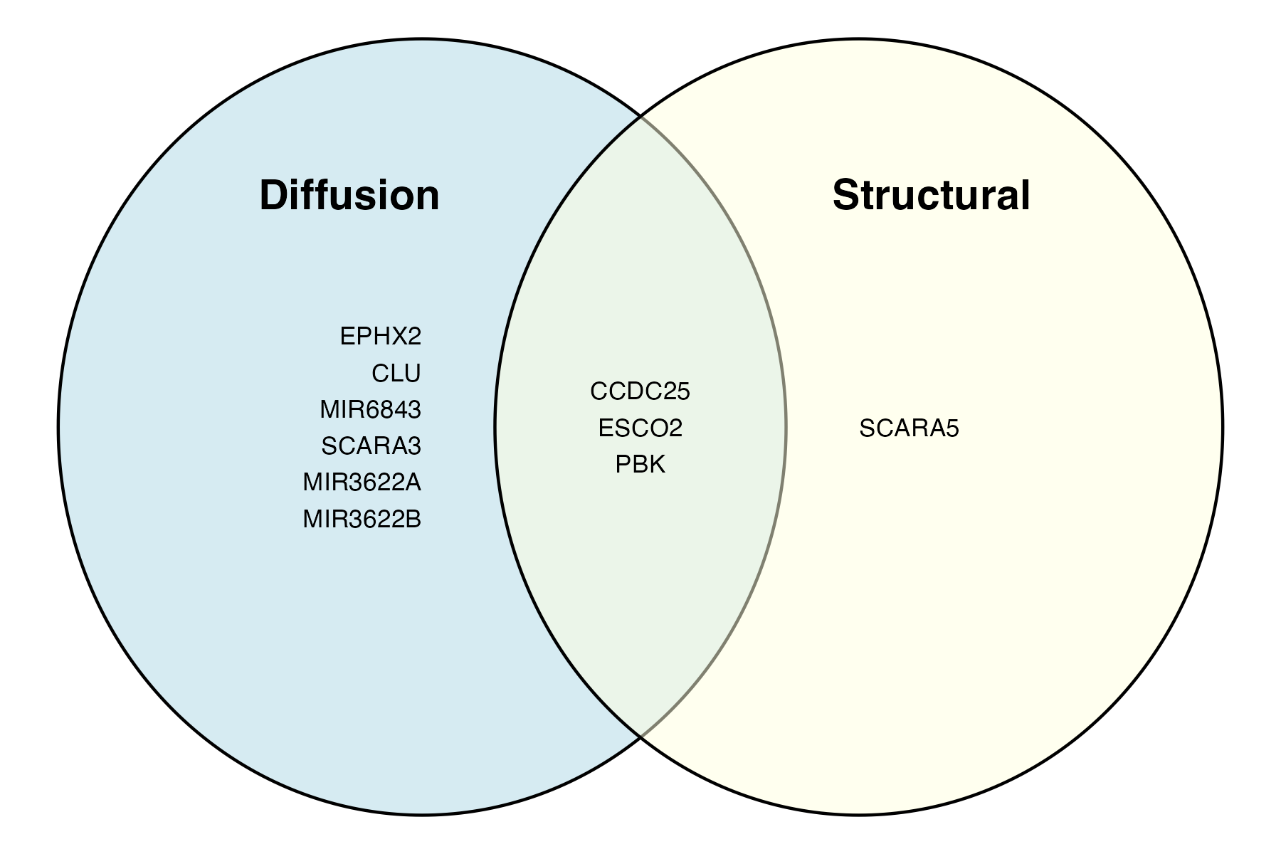
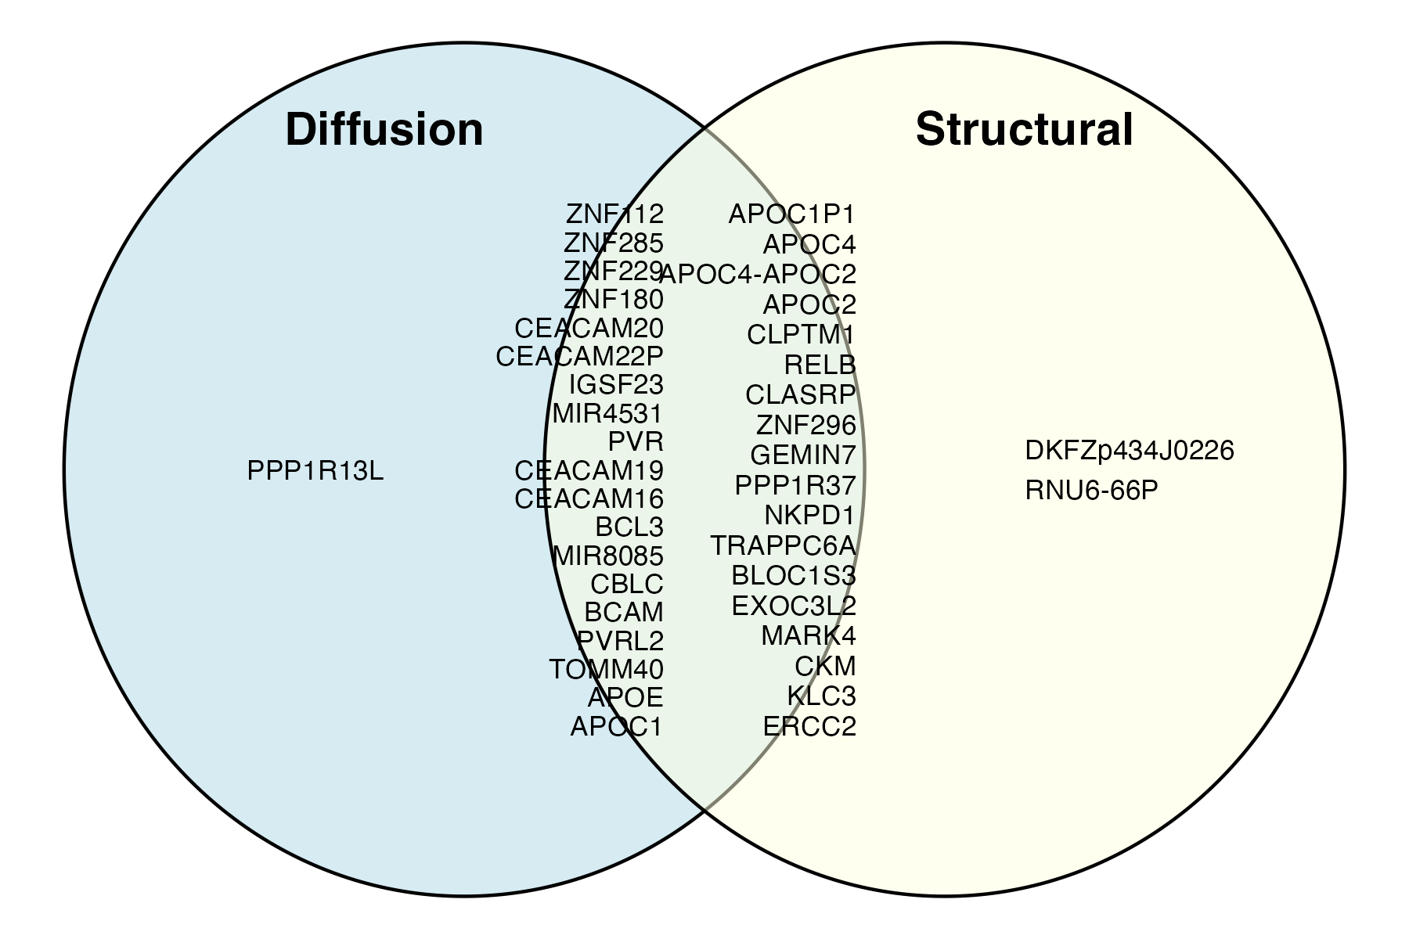
A. Structural MRI | other modalities
B. Diffusion MRI | other modalities
C. Functional MRI | other modalities
D.
Chr 8
Chr 19
Notes:
IGAP

