Slide 1


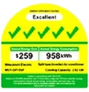
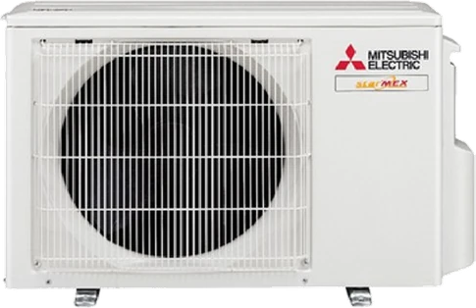
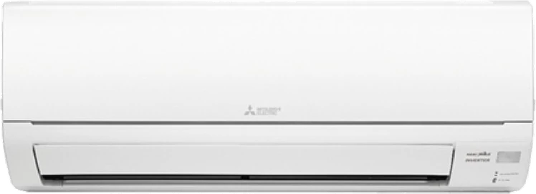

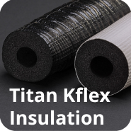

System 1
Single split · 1 room · 5 Ticks
Free Upgrade To Premium Materials

Slide 2
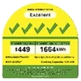
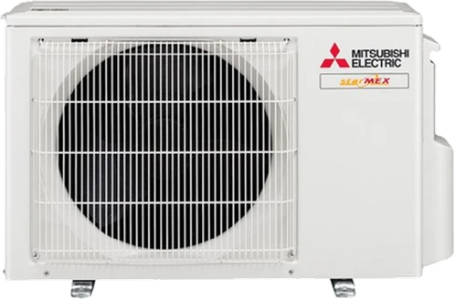

System 2
Up to 2 rooms · 5 Ticks
Free Upgrade To Premium Materials

Slide 3
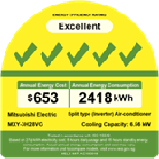
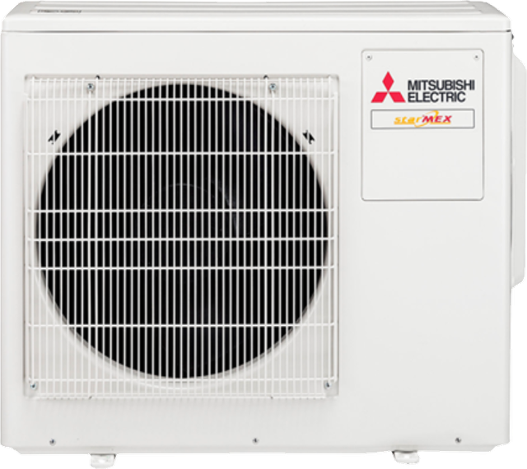
System 3
Up to 3 rooms · 5 Ticks
Free Upgrade To Premium Materials

