Slide 1

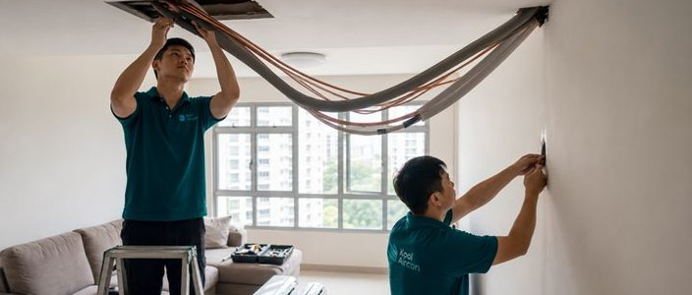
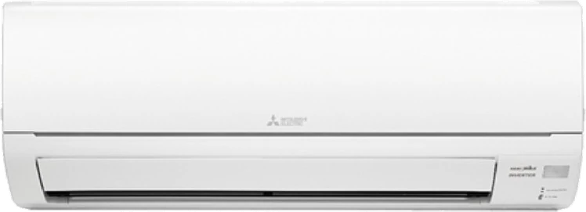
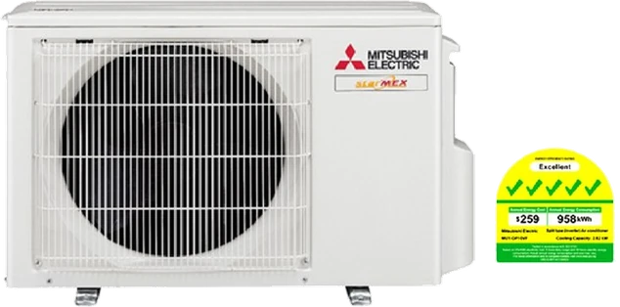

System 1
We only use high quality materials
✓
22g copper pipes
Single split · 1 room · 5 Ticks
✓
K-Flex Titan
✓
Keystone branded cables
Kool & Kleen Aircon

Slide 2
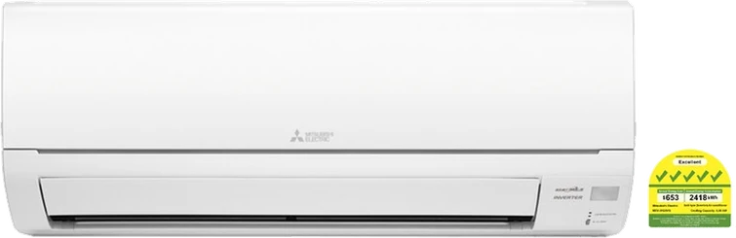
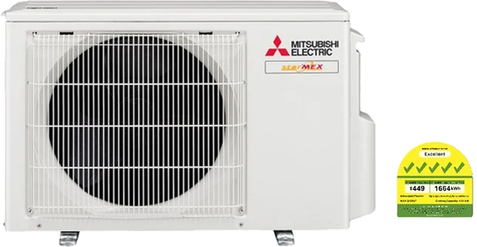
System 2
We only use high quality materials
✓
22g copper pipes
Up to 2 rooms · 5 Ticks
✓
K-Flex Titan
✓
Keystone branded cables
Kool & Kleen Aircon

Slide 3
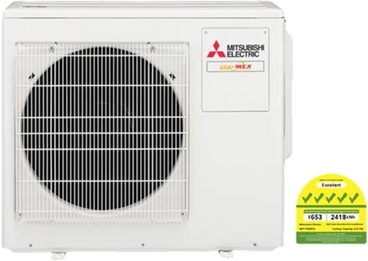
System 3
We only use high quality materials
✓
22g copper pipes
Up to 3 rooms · 5 Ticks
✓
K-Flex Titan
✓
Keystone branded cables
Kool & Kleen Aircon

Slide 4
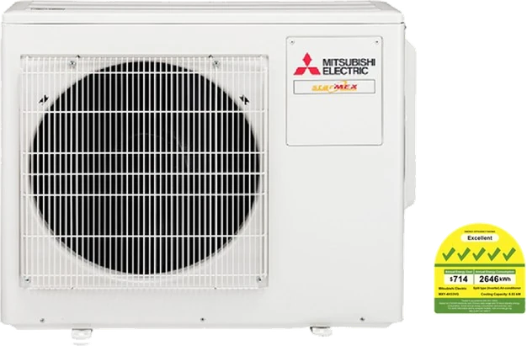
System 4
We only use high quality materials
✓
22g copper pipes
Up to 4 rooms · 5 Ticks
✓
K-Flex Titan
✓
Keystone branded cables
Kool & Kleen Aircon

