Slide 1


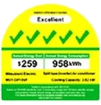
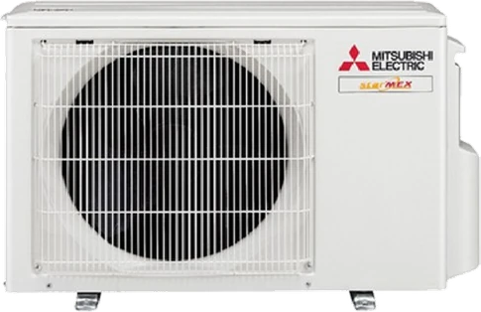
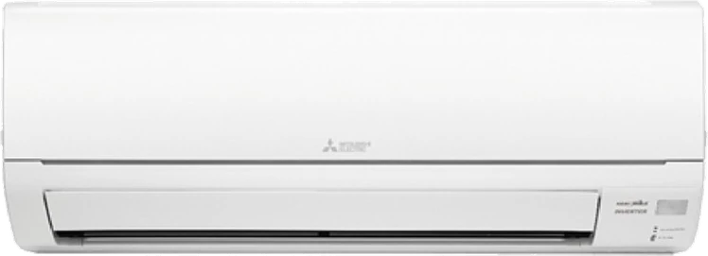

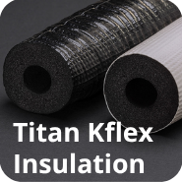

System 1
Single split · 1 room · 5 Ticks
Free Upgrade To Premium Materials

Slide 2
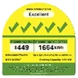
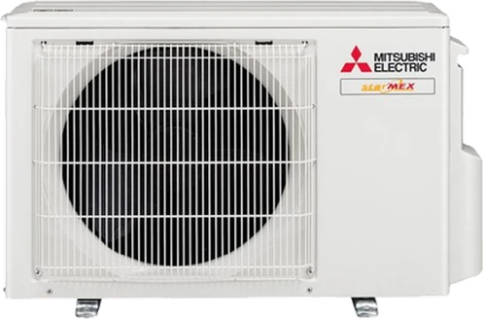
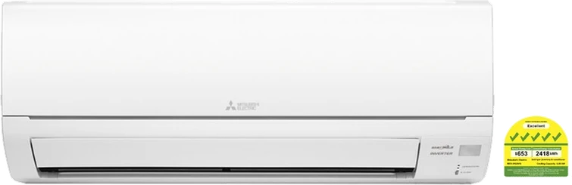
System 2
Up to 2 rooms · 5 Ticks
Free Upgrade To Premium Materials

Slide 3
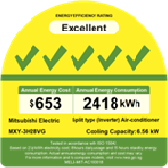
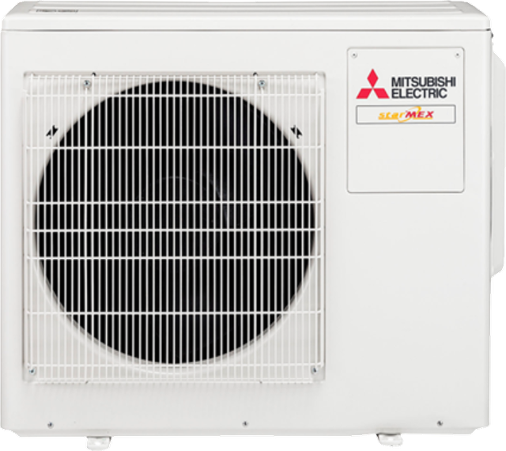
System 3
Up to 3 rooms · 5 Ticks
Free Upgrade To Premium Materials

Slide 4
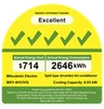
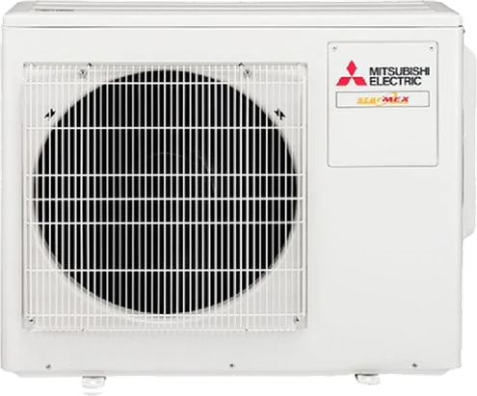
System 4
Up to 4 rooms · 5 Ticks
Free Upgrade To Premium Materials

Slide 5
System 1
5 Ticks · R32 Inverter

Slide 6
System 2
5 Ticks · R32 Inverter

Slide 7
System 3
5 Ticks · R32 Inverter

Slide 8
System 4
5 Ticks · R32 Inverter

Slide 9
Supply Only
Indoor and outdoor units delivered to your home in original manufacturer packaging.
Delivered in original packaging
Mainland Singapore delivery
Installation not included
Choose this if you already have an installer
Want us to install?
Select Installation Included instead

Slide 10
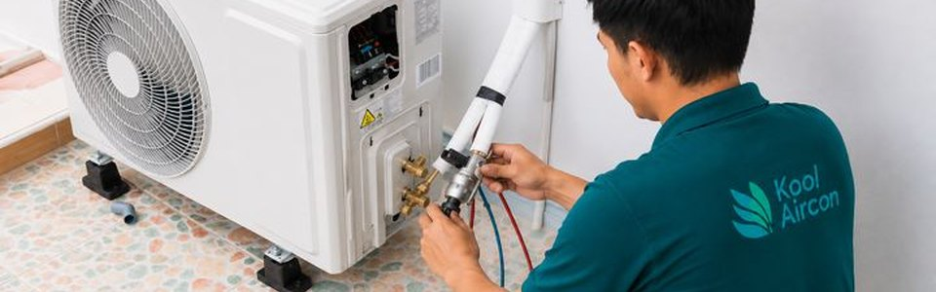
Installation Included
1
Site assessment: right capacity and placement for each room
2
Units installed and positioned, cored holes sealed
3
Insulated pipes and wiring, neatly trunked
4
Drainage set at the correct gradient
5
Full operational test before we leave
Covers pipe runs up to 15 m per unit.

Slide 11
We only use high quality materials
16mm drainage pipe
DNE PVC trunking
Grade 304 stainless brackets
Rust-resistant in Singapore's humidity

Slide 12
Starmex indoor sizes
Mix sizes to suit each room.
MODEL
CAPACITY
SIZE
MSXY-FP10VG
2.8 kW
9,000 BTU
MSXY-FP13VG
3.5 kW
12,000 BTU
MSXY-FP18VG
5.0 kW
18,000 BTU
MSXY-FP20VG
6.0 kW
20,000 BTU
MSXY-FP24VG
7.1 kW
24,000 BTU
Want a different combination? Ask us on Shopee Chat.

Slide 13
What may cost extra
Our price covers pipe runs up to 15 m per unit. The items below are identified at the site assessment and quoted before any work begins.
Pipe runs longer than 15 m per unit
New brackets
Powerpoints
Isolator switches
Replacing an old unit? Removal and disposal can be arranged in the same visit.

Slide 14
How to order
1
Choose your option
Supply Only or Installation Included, then check out
2
Message us on Shopee Chat
Send your postal code and preferred date
3
We confirm your date
Within 2 working days
For HDB installations, we manage the approval process where required.

