Slide 1
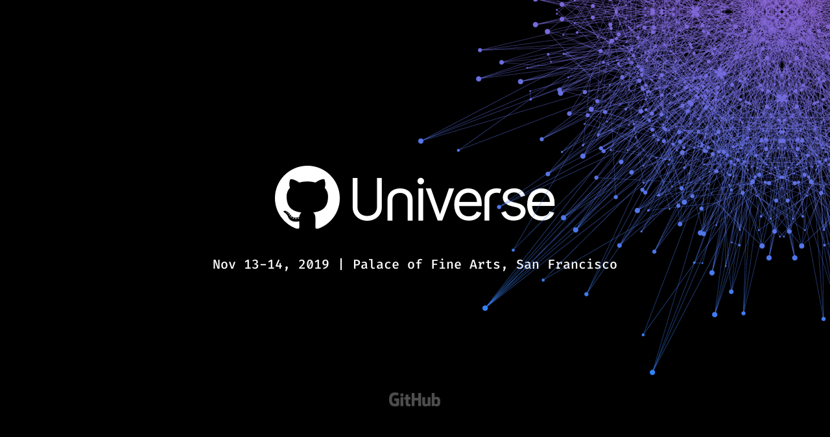

Slide 2

<What is GitHub?/>
>Provides hosting for software development version control
using Git
>37 million users
>100 million “repos”

Slide 3

<Open-Source Software Movement/>

Slide 4

<What is open-source software?/>
>Copyright holder grants users the rights to study, change,
and distribute the software to anyone and for any purpose
>Developed in a collaborative public manor

Slide 5
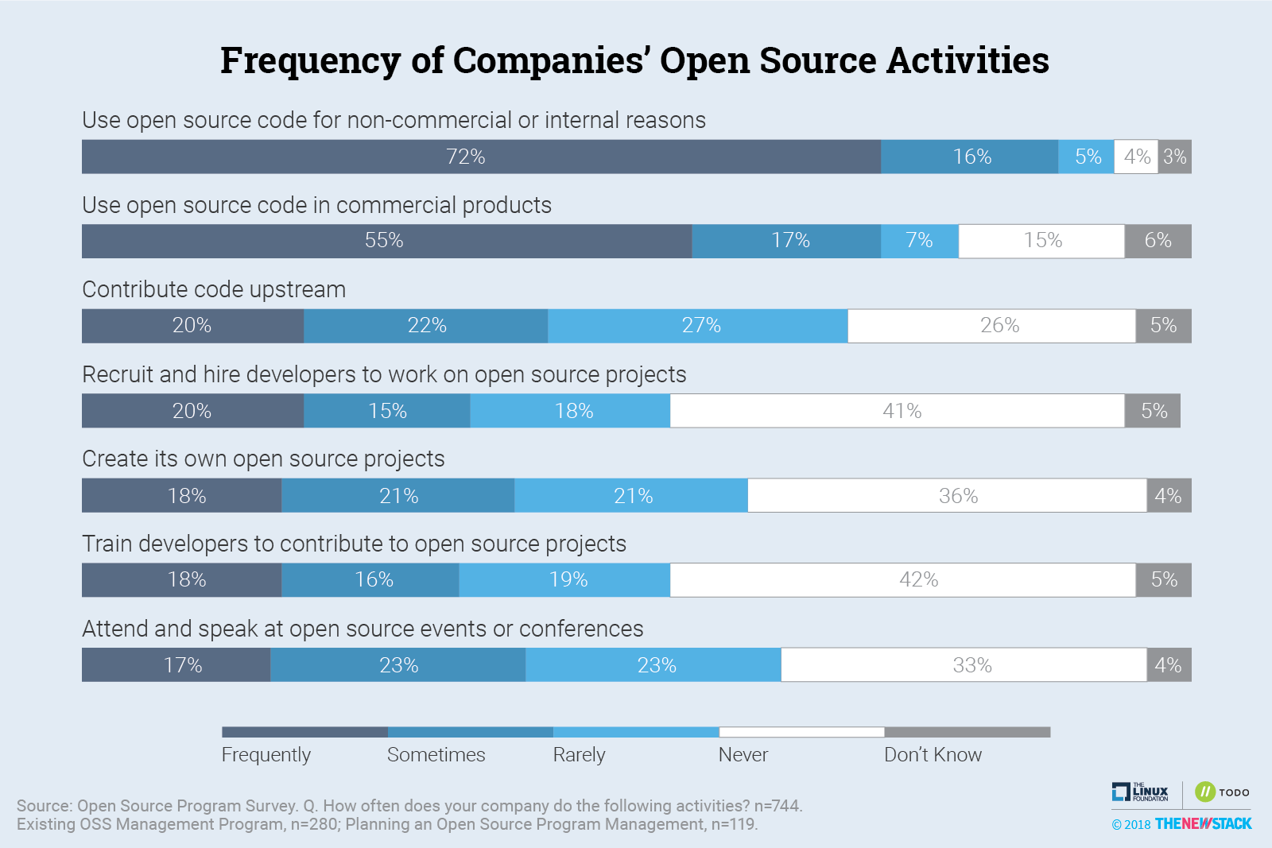
<How often is open-source software used?/>

Slide 6
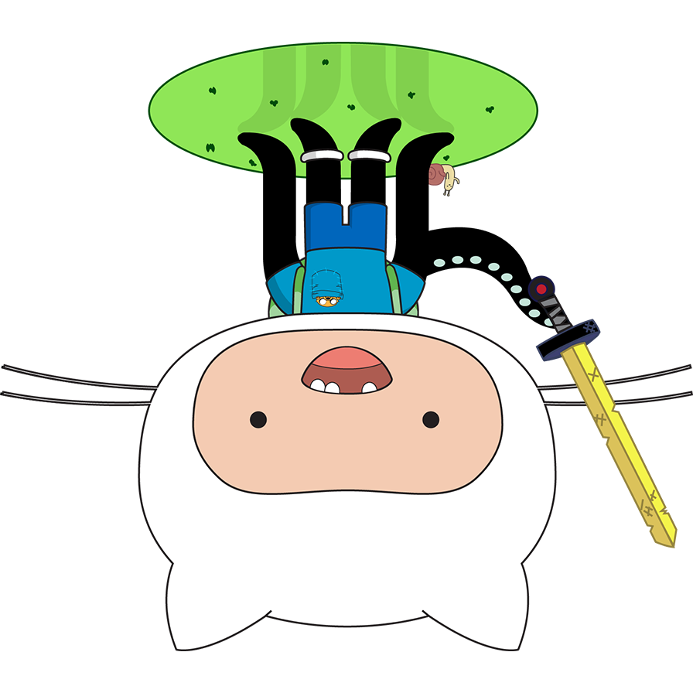
<Users of GitHub include/>
>The Apache Software Foundation
>Node.js
>npm package manager
>MySQL library
>Bootstrap

Slide 7


Slide 8

myUSF

Slide 9
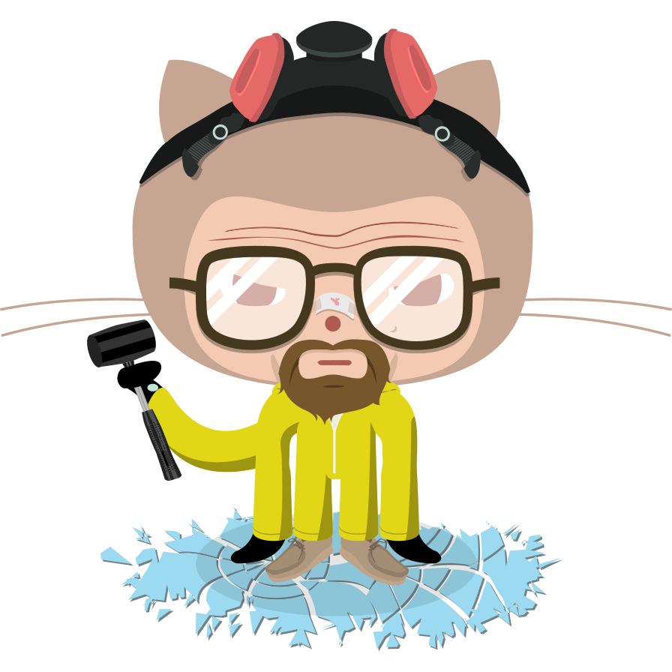
<What is GitHub Universe?/>
“Join a community connected by code and turn ideas
into innovations”

Slide 10
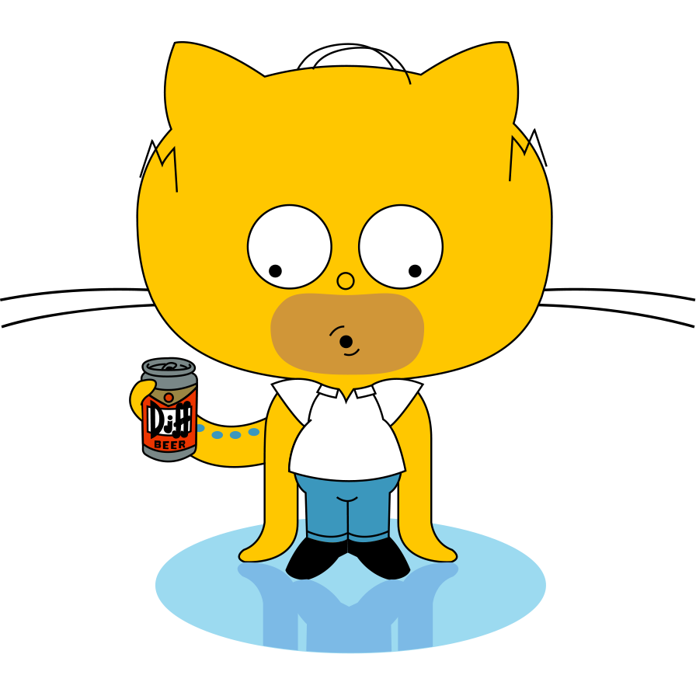
<Day 1 Workshops/>
>Integrate
>Automate

Slide 11

<Automate/>
“Learn how to use GitHub Actions to automate DevOps practices,
deployment, and more. Come away with key automation
concepts and open source tooling that save you time to focus
on what matters: your code.”

Slide 12
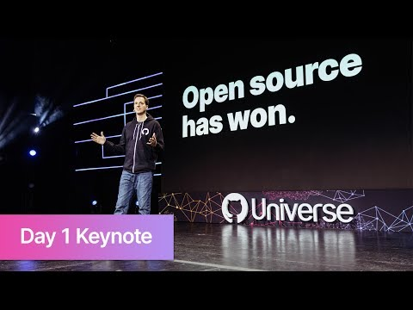
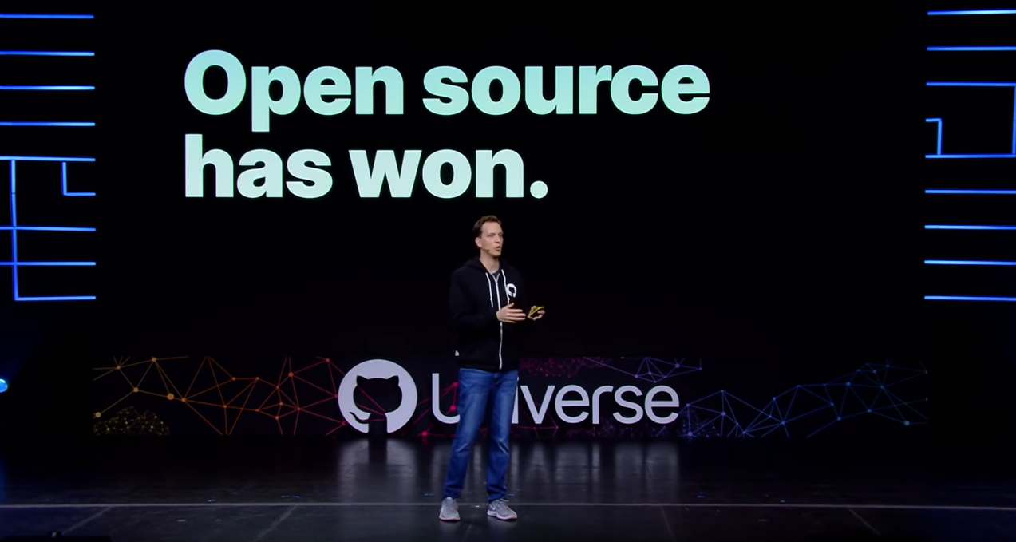
<Day 2 Sessions/>

Slide 13
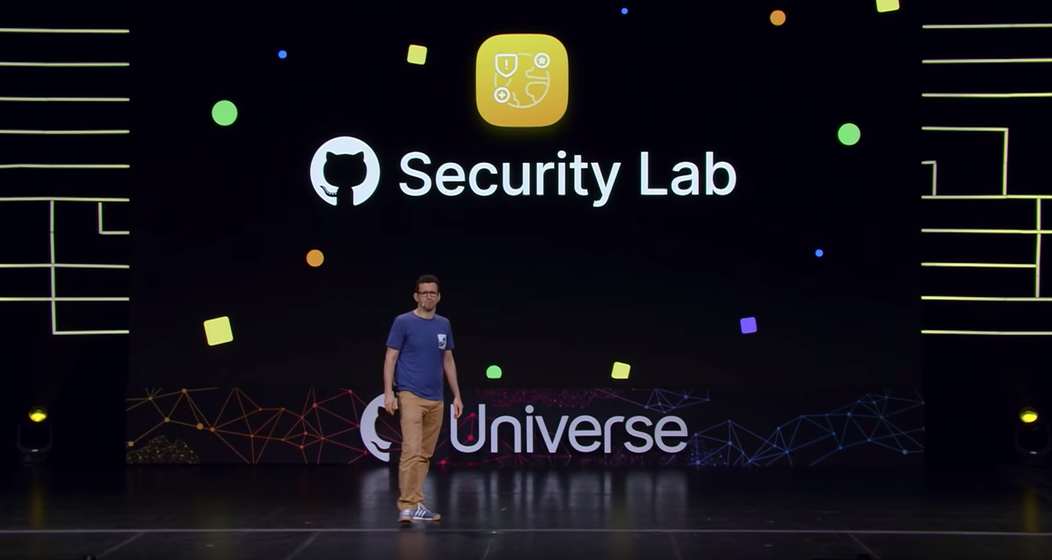
<Day 3 Sessions/>

Slide 14

Questions

